Slide 1

Booking Completion Prediction Model Comparison
Objective: Predict if a flight booking will be completed to improve conversion rates.
Dataset: 50,000 records from booking funnel, Severe class imbalance handled via SMOTE (Synthetic Minority Oversampling Technique), 13 features: demographics, behavior, and preferences.
Models Compared:
• Random Forest (Threshold=0.3): Accuracy=69%, Recall (Class 1) =72%, ROC AUC=0.76, Precision (Class 1) = 29%.
• LightGBM (Threshold=0.3): Accuracy=67%, Recall (Class 1) =74%, ROC AUC=0.75, Precision (Class 1) = 28%.
Recommendation: Deploy RF/LGBM with 0.3 threshold to increase booking recall.
Benefit: Higher recall helps re-engage users likely to convert with proactive outreach.

Slide 2
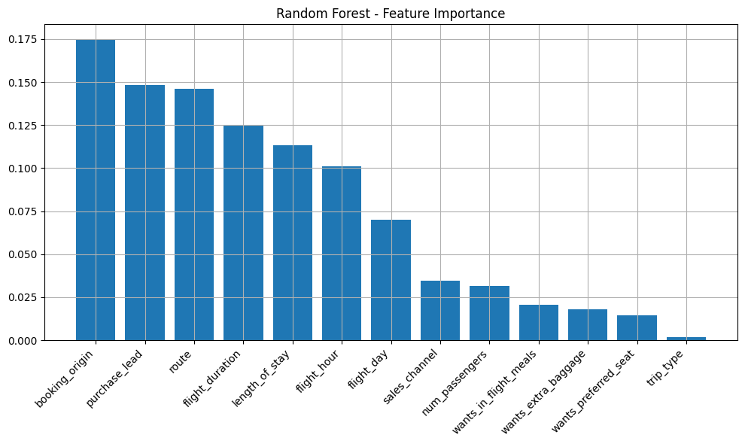
Feature Importance (Random Forest)
The most important variable in the model was booking_origin, indicating that the customer’s location had the highest influence on booking behavior.
Other significant features included purchase_lead, route, flight_duration, and length_of_stay, highlighting that flight-related and planning behavior play major roles in predicting bookings.
Customer preferences like wants_extra_baggage, wants_preferred_seat, and wants_in_flight_meals had relatively low importance in the model.

