Slide 1
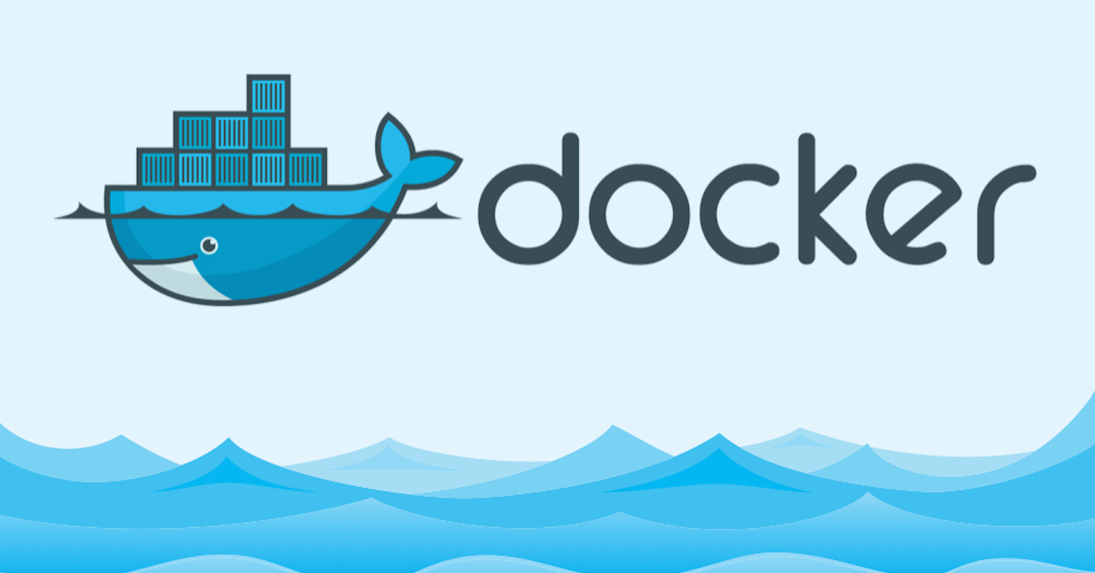
Docker by
ABDULLAH AHÇI

Slide 2

What is Docker?
Set of Platform as a Service (PaaS) products that use OS-level virtualization to deliver software in packages called containers
Helps developers build lightweight and portable software containers
Simplifies application development, testing, and deployment

Slide 3
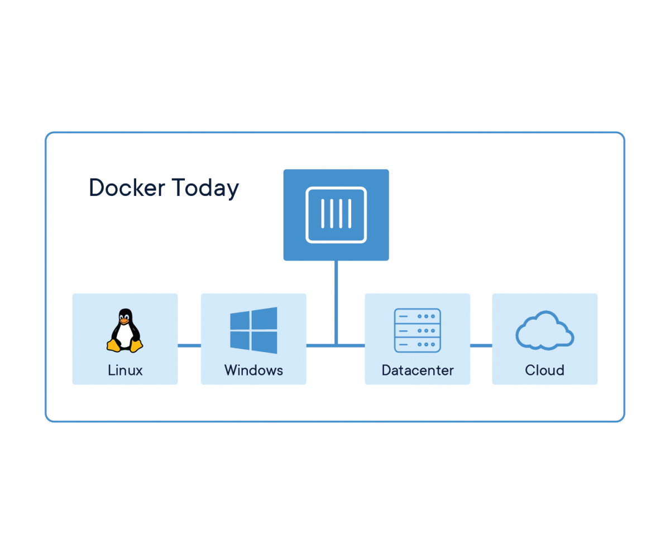
Docker Past to Present
Released as open-source in March 2013
Integration on Linux system on 2013, Windows Servers and Amazon Cloud on 2014
Main contributors to Docker: The Docker team, Cisco, Google, Huawei, IBM, Microsoft, and Red Hat.

Slide 4
What is Container?
A container is a standard unit of software that packages up code and all its dependencies, so the application runs quickly and reliably from one computing environment to another
Consists of an entire runtime environment: an application, plus all its dependencies, libraries and other binaries, and configuration files needed to run it, bundled into one package

Slide 5
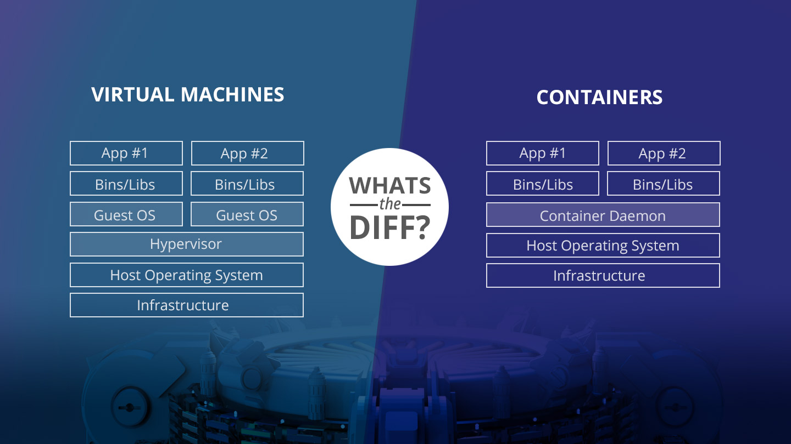
VM vs Container

Slide 6
VM vs Container
VMs | Containers
Heavyweight | Lightweight
Limited performance | Native performance
Each VM runs in its own OS | All containers share the host OS
Hardware level virtualization | OS virtualization
Startup time in minutes | Startup time in milliseconds
Allocates required memory | Requires less memory space
Fully isolated and hence more secure | Process-level isolation, possibly less secure

Slide 7
VM vs Container
VMs are a better choice for running apps that require all of the operating system’s resources and functionality when you need to run multiple applications on servers or have a wide variety of operating systems to manage.
Containers are a better choice when your biggest priority is maximizing the number of applications running on a minimal number of servers.

Slide 8
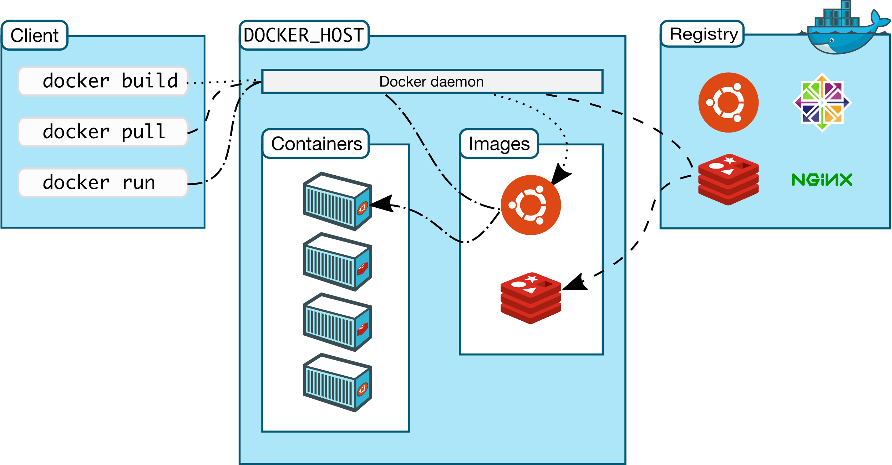
Docker Architecture

Slide 9
Docker Daemon and Client
The Docker daemon: The Docker daemon (dockerd) listens for Docker API requests and manages Docker objects such as images, containers, networks and volumes. A daemon can also communicate with other daemons to manage Docker services.
The Docker client: The Docker client (docker) is the primary way that many Docker users interact with Docker. When you use commands such as docker run, the client sends these commands to dockerd, which carries them out

Slide 10
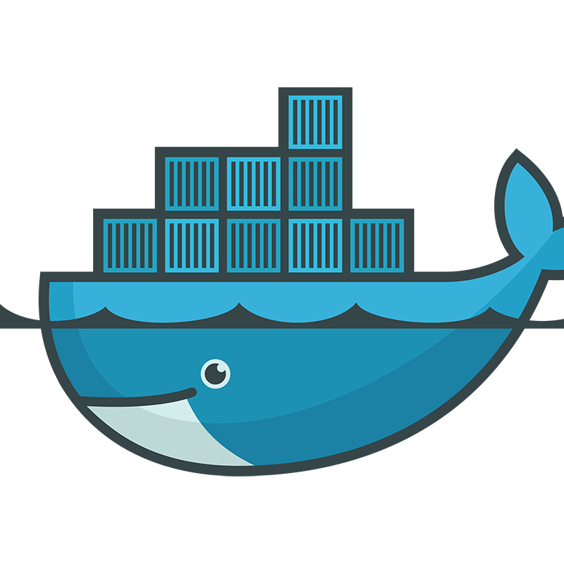
Docker registries
A Docker registry stores Docker images. Docker Hub is a public registry that anyone can use, and Docker is configured to look for images on Docker Hub by default
Private registries
Docker Hub, Azure Container Registry, Google Container Registry etc.

Slide 11
Docker Images
Read-only template with instructions for creating a Docker container
Mostly based on another image, with some additional customization
Consists of layers, stacked on top of each other
Layers can be shared between Images
Builded from Dockerfiles:
A text document that contains commands a user could call on the command line to assemble an image.

Slide 12
Image VS Container
Images are immutable
Image is an application to be run
Container is the instance of an image running as a process
Containers can be run multiple times with the same image

Slide 13
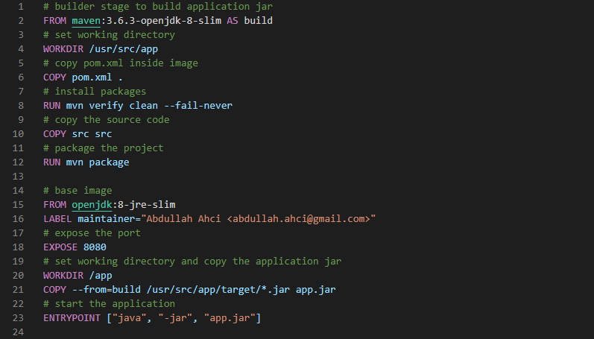
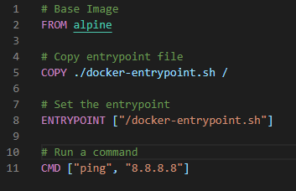
Dockerfile
FROM creates a layer from the ubuntu:18.04 Docker image.
COPY adds files from your Docker client’s current directory.
RUN builds your application with make.
CMD specifies what command to run within the container.
WORKDIR Sets the working directory for any instructions that follow it. (RUN, CMD, ENTRYPOINT)
ENTRYPOINT configures a container that will run as an executable.
EXPOSE informs Docker that the container listens on the specified network ports at runtime
ENV set an environment variable
VOLUME creates a mount point with the specified name

Slide 14
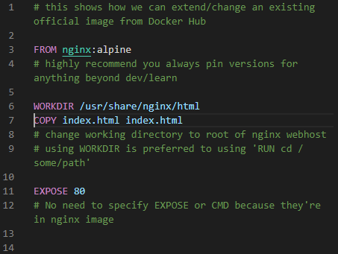
Building the Dockerfile
Keep it small
Each line is a layer
Use single line commands with «&&» and «;»
Add comments for readability
Use the base image tag carefully
Use .dockerignore file

Slide 15

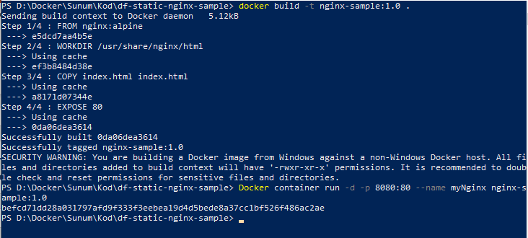
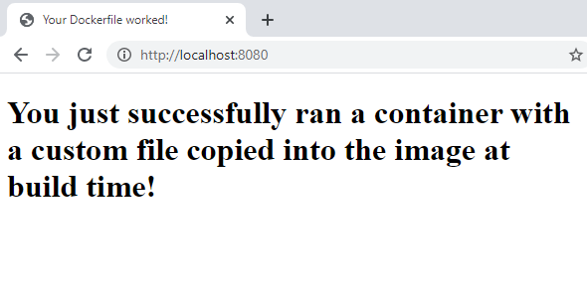
Building & Running Images

Slide 16
Docker Container
Runnable instance of a docker image
Isolated from other containers
OS kernel is shared between the containers
Multiple containers can be run in the same machine
Takes less space

Slide 17
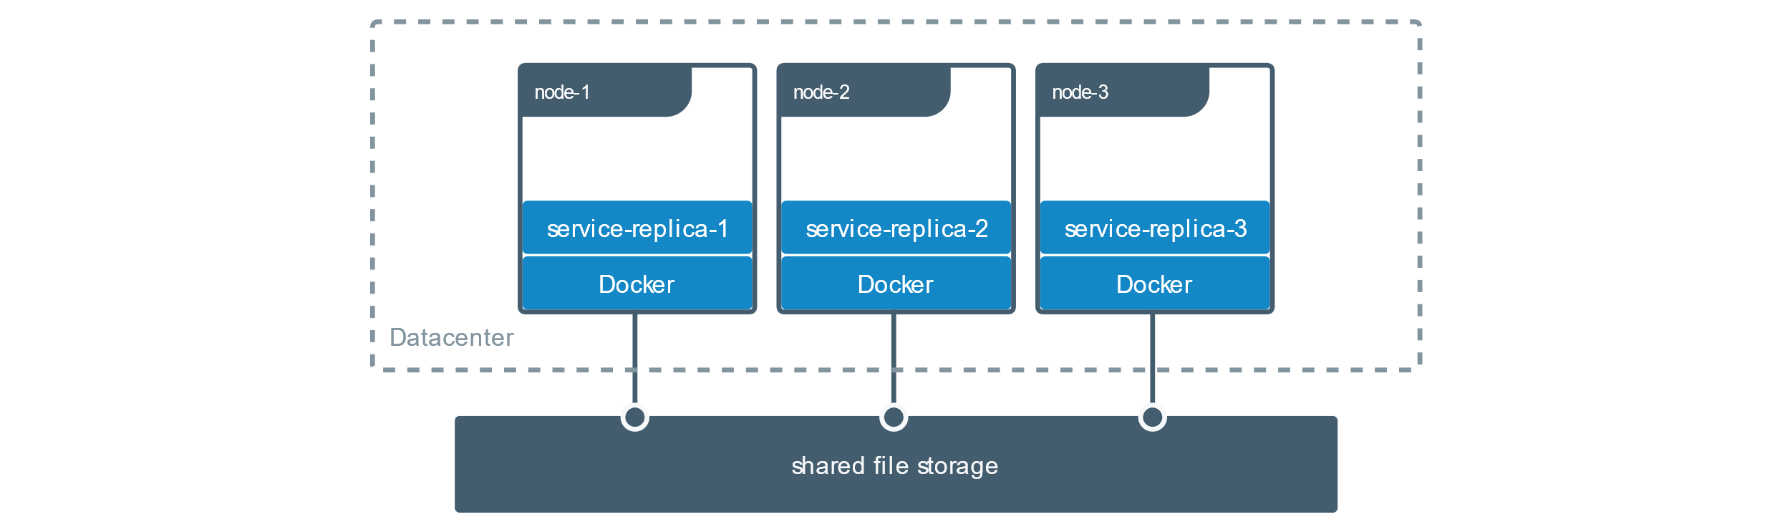
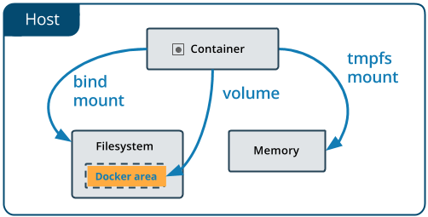
Persistant Data - Volumes
Bind Mount
Binds certain directory or file from the host inside the container
docker run -v /hostdir:/containerdir IMAGE_NAME
Named Volumes
Created and named manually
docker volume create mysql_data
Docker run -v mysql_data:/var/lib/mysql mysql
Volumes in dockerfiles
Created with -v and placed under volumes
Docker run -v /var/lib/mysql mysql

Slide 18
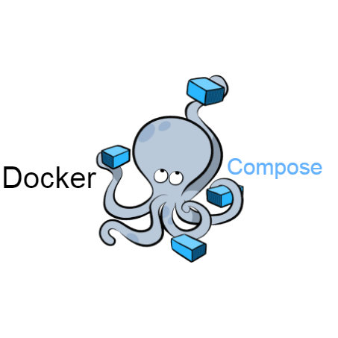
Docker Compose
Tool for defining and running multi-container Docker applications
Defined by docker-compose.yml
Creates, builds and runs all services, volumes etc. with a single command
Used for:
Start, stop, and rebuild services
View the status of running services
Stream the log output of running services
Run a one-off command on a service

Slide 19
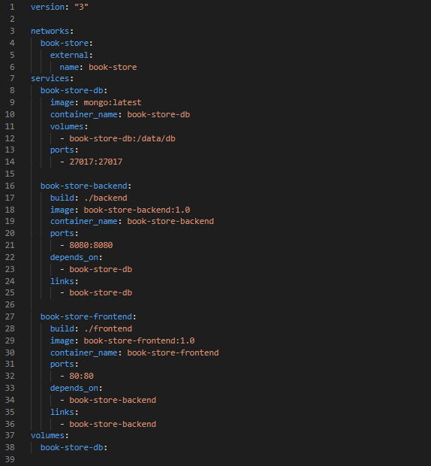
Docker-compose.yml

Slide 20
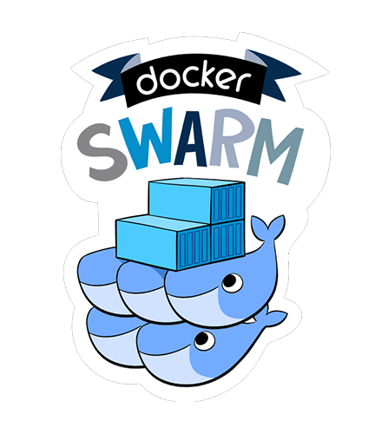
Docker Swarm
Container orchestrator, cluster manager
Scaling up and down
Embedded DNS
Load balancing
Rolling updates and rollbacks
Secure using TLS
Overlay network
Routing Mesh ( Load balance, Route)

