Slide 1
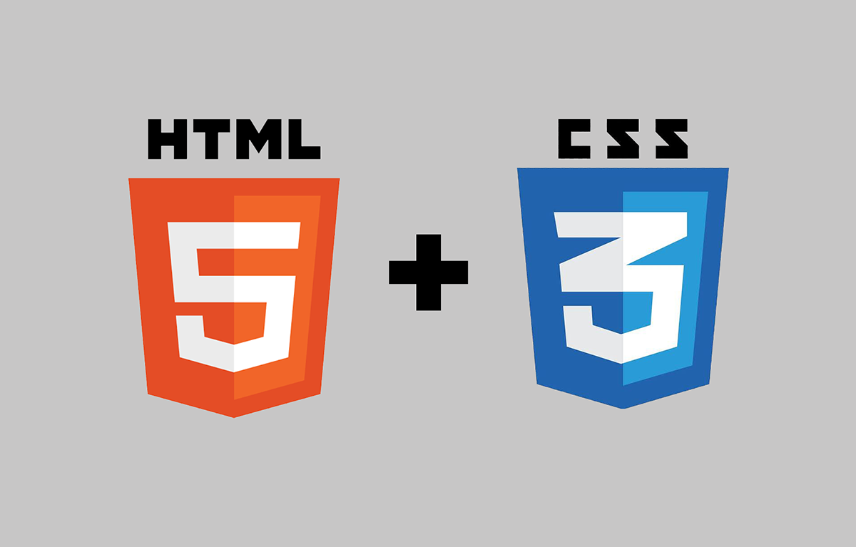

Slide 2
What is HTML
HyperText Markup Language
Describes the structure of a Web page
Interpreted by browsers and shown to the users
Starts with <!DOCTYPE html>
Consists of a series of elements that defined by a start tag, some content and an end tag

Slide 3
Main HTML Elements
<html> : Root tag
<head> : Container for metadata like title, scripts, styles, meta etc
<body> : Contains all the contents of the page
<script> : Can contain script statements or link to an external script file
<style> : Defines a style for the elements inside body tag
<link> : Mostly used to use link to external css files
<form> : To create a form to get user input
<h1> : Defines headings for the page
<div> : Defines a section or division in the page

Slide 4
Block vs Inline
Block level elements:
Starts on a new line
Takes the full width available
Can have margin on all sides
aside, div, footer, form, h1-h6, header, main, nav, p, table ul-ol-li…
Inline level elements:
Takes the necessary width and height, cannot be set
Can only have left and right margin
a, b, button, i, img, input, label, select, span

Slide 5
Attributes
Additional information on elements
Specified in start tag
Defined as a pair -> ‘name=value’
<a href="https://www.google.com">Google</a>
<img src="bg.png"/>
<p style="color: blue">A paragraph with blue color</p>
<link rel="stylesheet" type="text/css" href="main.css" />
<script src="main.js"></script>
<textarea name="descr" rows="4" cols="50"></textarea>

Slide 6
Semantic Elements
Semantics refers to the meaning of a piece of code
Gives meaning for both browsers and developers
<b> vs <strong>, <e> vs <em>
Other elements
<header>
<footer>
<aside>
<section>
<form>
<main>
<nav>
<summary>
<article>
…..

Slide 7

Media Elements
<audio controls> <source src="horse.ogg" type="audio/ogg"> <source src="horse.mp3" type="audio/mpeg"> Your browser does not support the audio element. </audio>
<video width="320" height="240" controls autoplay > <source src="movie.mp4" type="video/mp4"> <source src="movie.ogg" type="video/ogg"> Your browser does not support the video tag. </video>

Slide 8
HTML Status 1XX: Information
100 Continue
The server has received the request headers, and the client should proceed to send the request body
101 Switching Protocols
The requester has asked the server to switch protocols
103 Checkpoint
Used in the resumable requests proposal to resume aborted PUT or POST requests

Slide 9
HTML Status 2XX: Successful
200 OK
The request is OK (this is the standard response for successful HTTP requests)
201 Created
The request has been fulfilled, and a new resource is created
202 Accepted
The request has been accepted for processing, but the processing has not been completed
203 Non-Authoritative Information
The request has been successfully processed, but is returning information that may be from another source
204 No Content
The request has been successfully processed, but is not returning any content
205 Reset Content
The request has been successfully processed, but is not returning any content, and requires that the requester reset the document view
206 Partial Content
The server is delivering only part of the resource due to a range header sent by the client

Slide 10
HTML Status 3XX: Redirection
300 Multiple Choices
A link list. The user can select a link and go to that location. Maximum five addresses
301 Moved Permanently
The requested page has moved to a new URL
302 Found
The requested page has moved temporarily to a new URL
303 See Other
The requested page can be found under a different URL
304 Not Modified
Indicates the requested page has not been modified since last requested
306 Switch Proxy
No longer used
307 Temporary Redirect
The requested page has moved temporarily to a new URL
308 Resume Incomplete
Used in the resumable requests proposal to resume aborted PUT or POST requests

Slide 11
HTML Status 4XX: Client Error
400 Bad Request
The request cannot be fulfilled due to bad syntax
401 Unauthorized
The request was a legal request, but the server is refusing to respond to it. For use when authentication is possible but has failed or not yet been provided
402 Payment Required
Reserved for future use
403 Forbidden
The request was a legal request, but the server is refusing to respond to it
404 Not Found
The requested page could not be found but may be available again in the future
405 Method Not Allowed
A request was made of a page using a request method not supported by that page

Slide 12
HTML Status 4XX: Client Error 2
406 Not Acceptable
The server can only generate a response that is not accepted by the client
407 Proxy Authentication Required
The client must first authenticate itself with the proxy
408 Request Timeout
The server timed out waiting for the request
409 Conflict
The request could not be completed because of a conflict in the request
410 Gone
The requested page is no longer available
411 Length Required
The "Content-Length" is not defined. The server will not accept the request without it

Slide 13
HTML Status 4XX: Client Error 3
412 Precondition Failed
The precondition given in the request evaluated to false by the server
413 Request Entity Too Large
The server will not accept the request, because the request entity is too large
414 Request-URI Too Long
The server will not accept the request, because the URL is too long. Occurs when you convert a POST request to a GET request with a long query information
415 Unsupported Media Type
The server will not accept the request, because the media type is not supported
416 Requested Range Not Satisfiable
The client has asked for a portion of the file, but the server cannot supply that portion
417 Expectation Failed
The server cannot meet the requirements of the Expect request-header field

Slide 14
HTML Status 5XX: Server Error
500 Internal Server Error
A generic error message, given when no more specific message is suitable
501 Not Implemented
The server either does not recognize the request method, or it lacks the ability to fulfill the request
502 Bad Gateway
The server was acting as a gateway or proxy and received an invalid response from the upstream server
503 Service Unavailable
The server is currently unavailable (overloaded or down)
504 Gateway Timeout
The server was acting as a gateway or proxy and did not receive a timely response from the upstream server
505 HTTP Version Not Supported
The server does not support the HTTP protocol version used in the request
511 Network Authentication Required
The client needs to authenticate to gain network access

Slide 15
HTTP Methods
GET
Request data from a specified resource.
POST
Send data to a server to create/update a resource
Request repeatedly have side effects of creating the same resource multiple times
PUT
Send data to a server to create/update a resource.
Request multiple times will always produce the same result
HEAD
Identical to GET, but without the response body
Used for obtaining metainformation about the entity implied by the request
DELETE
To delete the specified resource.
OPTIONS
Requests permitted communication options for a given URL or server

Slide 16

What is CSS
Cascading Style Sheets
Describes how elements in the page will be displayed
Consists of a selector and a declaration block.
Can be stored in .css files
Multiple pages can be styled with one css file

Slide 17
Styling Elements
External
<link rel="stylesheet" type="text/css" href="main.css" />
Internal
<style> .inline-block { display: inline-block; width: 50%; height: 50px; } </style>
<div class="inline-block">
Inline
<div style="display:inline-block; width:50%;">

Slide 18
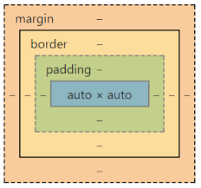
Box Model
Content - The content of the box, where text and images appear
Padding - Clears an area around the content. The padding is transparent
Border - A border that goes around the padding and content
Margin - Clears an area outside the border. The margin is transparent

Slide 19

Selectors
Simple Selectors
Combinator Selectors
Pseudo-class selectors
Pseudo-elements selectors
Attribute selectors

Slide 20
Simple Selectors
Element Selector
div { display: inline;}
Class selector
.nav { position: relative; }
ID selector
#main { float: left;}
Universel selector
* {font-familiy: sans-serif;}

Slide 21
Combinators
Space : descendant
> : direct child
+ : adjacent sibling
~ : general sibling
* : all

Slide 22

Pseudo-classes
:active
Selects the active link
:checked
Selects checked <input>
:disabled
Selects disabled <input>
:first-child
Selects elements that is the first child of its parent
:focus
Selects the <input> that has focus
:hover
Selects the element on mouse over
:last-child
Selects elements that is the last child of its parent
:not(selector)
Selects elements that is not "selector"
:nth-child(n)
Selects elements that is the n’th child of its parent
…
:visited
selects visited links
:nth-of-type(n)
Selects elements that is the n’th of the type

Slide 23
Pseudo-elements
::first-line
Selects the first line
::first-letter
Selects the first letter
::after
Insert something after the content
::marker
Selects the markers of list items
::selection
Selects the portion of an element that is selected
::before
Insert something before the content

Slide 24
Attribute selectors
Usages:
[attribute="value"] Selects directly
a[target="_blank"] { background-color: red; }
[attribute~="value"] Selects attribute that contains "value" as a word
[title~="main"] { border: 5px solid yellow; }
[attribute|="value"] Selects attribute that starts with "value-" (value with – at the end)
[class|="col"] { width: 100%; }
[attribute^="value"] Selects attribute that starts with "value"
[class^="big"] { font-size: 20px; }
[attribute$="value"] Selects attribute that ends with "value"
[class$="small"] { font-size: 12px; }
[attribute*="value"] Selects attribute that contains "value" anywhere
[class*="sm"] { font-size: 12px; }

Slide 25
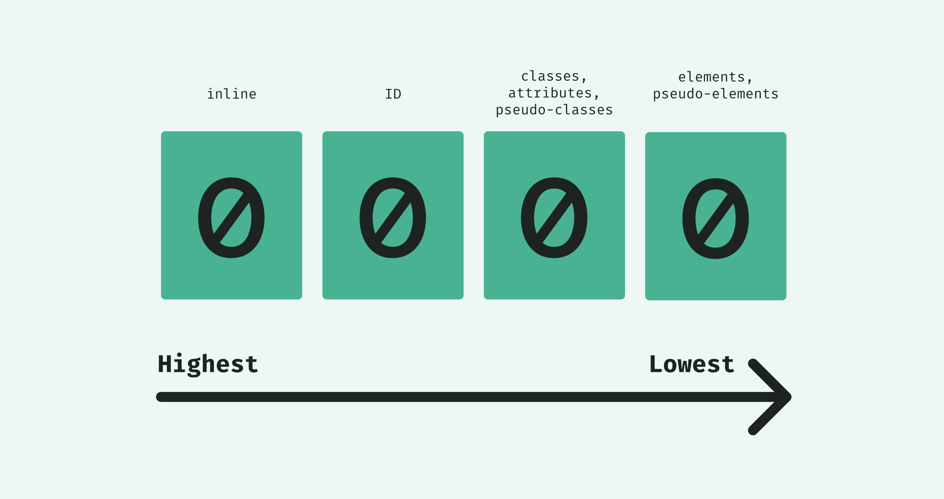
Specificity
Hierarchy of the style elements that is applied to the element
Most specific to less specific
Inline
ID
Classes, attributes and pseudo-classes
Elements and pseudo-elements

Slide 26
Units
Absolute:
cm centimeters
mm millimeters
in inches (1in = 96px = 2.54cm)
px * pixels (1px = 1/96th of 1in)
pt points (1pt = 1/72 of 1in)
pc picas (1pc = 12 pt)
Relative
em Relative to the font-size of the element (2em means 2 times the size of the current font)
ex Relative to the x-height of the current font (rarely used)
ch Relative to width of the "0" (zero)
rem Relative to font-size of the root element
vw Relative to 1% of the width of the viewport*
vh Relative to 1% of the height of the viewport*
vmin Relative to 1% of viewport's* smaller dimension
vmax Relative to 1% of viewport's* larger dimension
% Relative to the parent element

Slide 27
Position
Static : Default position
Relative : Relative to its normal position
Fixed : Relative to the viewport, not affected by scroll
Absolute : Relative to the nearest positioned ancestor
Sticky : Positioned based on the user's scroll position, toggles between relative and fixed

Slide 28
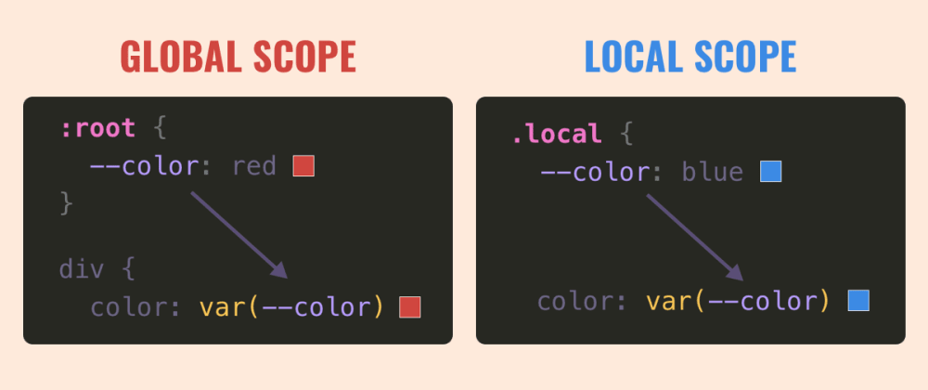
Variables
Defines variables to be used in the stylesheet
Defined with -- and used with var()
Easy to read,maintain and update

Slide 29
Functions
Can be used to make some calculation or process
Color functions : hsl(), hsla(), rgb(), rgba()
Gradient functions : linear-gradient(), radial-gradient() …
Calculation : calc(), min(), max(), clamp()
Attribute : attr()
Variable : var()
Image Url : url()
SVG path : path()
Transform : perspective(), translate(), rotate(), scale()…
Filter : brightness(), blur(), contrast(), grayscale()…

Slide 30
Media Queries
To modify your page depending on user’s device’s type, resoulution, width, height, etc
Specified using @media keyword
4 types:
all : All devices.
print : Print preview mode
screen : Screen of devices
speech : Speech synthesizers
Logical operators like AND, OR, NOT etc can be used
Usage:
@media screen and (min-width: 30em) and (orientation: landscape) { ... }
@media speech and (aspect-ratio: 11/5) { ... }

Slide 31
CSS Preprocessors
Lets you generate CSS from the preprocessor's own unique syntax
Nested selectors, inheritance, more readable, maintainable
Must be compiled to generate css file
SASS: Syntactically Awesome Style Sheets
$font-color: #fff
$bg-color: #00f
#box
color: $font-color
background: $bg-color
SCSS:Sassy CSS
$font-color: #fff;
$bg-color: #00f;
#box{
color: $font-color;
background: $bg-color;
}
LESS: Leaner Style Sheets
@font-color: #fff;
@bg-color: #00f
#box{
color: @font-color;
background: @bg-color;
}
Stylus
font-color = #fff;
bg-color = #00f;
#box {
color: font-color;
background: bg-color;
}

