Slide 1

SHADOW PROTOCOL
A Finite Automata-Based Stealth Game and Interactive Learning Environment
[STUDENT INPUT: team member names and registration numbers]
[STUDENT INPUT: course name and code · faculty name]
[STUDENT INPUT: institution, semester, date]
Theory of Computation project · Windows desktop application · v1.0.0
SHADOW PROTOCOL // THEORY OF COMPUTATION
01 / 13
Notes:
"Good [morning/afternoon]. Our project is Shadow Protocol, a Windows desktop application that is two things at once: a stealth game whose guards are controlled by finite automata, and a learning environment for DFAs and NFAs. In the next few minutes we will show the theory, how we turned it into the actual control logic of a game, and how we verified that the mathematics is correct."

Slide 2
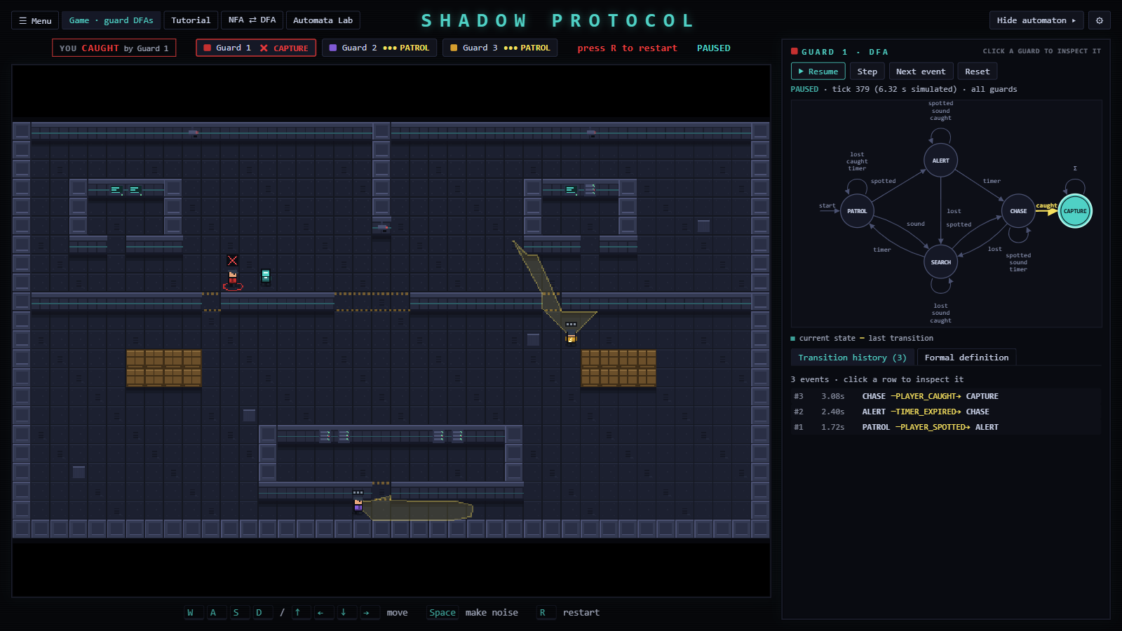
> PROBLEM STATEMENT ▌
Automata are taught on paper, disconnected from real systems
Static diagrams don't show computation step by step
Nondeterminism is often misread as randomness
Game AI hides its state machine in ad-hoc if statements: not stated, not validated, not visible
live: Guard 1's DFA while the game runs
SHADOW PROTOCOL // THEORY OF COMPUTATION
02 / 13
Notes:
"Students learn finite automata as abstract objects, but rarely see one actually running a system. When they do see state machines, for example in game AI, the machine is usually implicit, buried in conditional code. Our question was: can we build an application where a finite automaton is the real, inspectable control mechanism, and give learners tools to observe, build and convert automata, while guaranteeing that every operation is mathematically correct?"

Slide 3
> PROJECT OBJECTIVES ▌
Reusable, framework-independent automata engine: validation, DFA/NFA simulation, ε-closure, subset construction
Stealth game whose guards are controlled only by a validated DFA
Live visualiser with pause, step and reset
NFA ⇄ DFA comparison on the same input
Automata Lab: build, validate, simulate, convert, save
Interactive tutorial with challenges
Automated verification; offline Windows installer
SHADOW PROTOCOL // THEORY OF COMPUTATION
03 / 13
Notes:
"These were our objectives. The key design decision is the first one: a single engine that everything else uses, so the game, the visualiser, the Lab and the tutorial can never disagree about the mathematics. All objectives were met in version 1.0.0."

Slide 4
> TECHNOLOGIES USED ▌
Tauri 2 (Rust): native Windows window and installers; UI rendered by WebView2
React 19 + TypeScript: menus, visualiser, Lab, tutorial
Phaser 3.90: tilemap, Arcade physics, sprites, input
Vite 8: build · Vitest 5: 527 unit tests
No image or sound files: pixel art and sound effects are generated in code; works offline
Tauri 2 (Rust)
native window · installers · WebView2
React 19 + TypeScript
menus · visualiser · Lab · tutorial
Phaser 3.90
tilemap · Arcade physics · sprites · input
Automata engine
pure TypeScript · DFA / NFA · ε-closure · subset construction
Vite 8 build · Vitest 5: 527 unit tests
SHADOW PROTOCOL // THEORY OF COMPUTATION
04 / 13
Notes:
"Tauri gives us a small native Windows application: the installer is about 3.3 MB. React draws the user interface, Phaser runs the game, and Vitest runs our unit tests. Everything, including the pixel art and the sound effects, is generated in code, so the installed application needs no network connection."

Slide 5
> SYSTEM ARCHITECTURE ▌
Three layers, one direction: components → game → automata
Engine is pure TypeScript; a test fails if it imports anything outside itself
React ↔ Phaser only through GameBridge: immutable snapshots out, commands in
Fixed 1/60 s simulation ticks: pause = 0 ticks, step = 1 tick, so runs are reproducible
Tauri 2 shell (Rust) · WebView2 · bundled frontend
React 19 UI (src/components) · App.tsx: menu, tabs, settings
Live DFA visualiser
NFA ⇄ DFA comparison
Automata Lab
Tutorial
tutorial challenges load into the Lab
GameBridge
snapshots ↑ · commands ↓
comparison, Lab and tutorial
call the engine
Phaser 3.90 game (src/game) · fixed 1/60 s ticks
MainScene
SimulationClock
Player
+ controls
Guard × 3
perception · GuardBrain
BFS mover
GuardBrain wraps
Automata engine (src/automata) · pure TypeScript
validate
runDFA
runNFA
ε-closure
nfaToDfa
Automaton-
Runner
simplified from diagrams/01-system-architecture.mmd (full figure in the report)
SHADOW PROTOCOL // THEORY OF COMPUTATION
05 / 13
Notes:
"The engine at the bottom knows nothing about games or user interfaces, which is what allows it to be tested thoroughly and shared. The game and the UI never touch each other's objects. They exchange immutable snapshots and commands through a bridge. All game logic runs in fixed sixtieth-of-a-second ticks, which is what makes single-stepping meaningful: one step is exactly one tick of simulated time."

Slide 6
> DFA FUNDAMENTALS ▌
$M=\left(Q,Σ,δ,q_{0},F\right)$ with $δ:Q×Σ→Q$ (total and deterministic)
$\hat{δ}\left(q,ε\right)=q$, $\hat{δ}\left(q,wa\right)=δ\left(\hat{δ}\left(q,w\right),a\right)$; $L\left(M\right)=\left\{w ∣ \hat{δ}\left(q_{0},w\right)∈F\right\}$
In the engine: δ is an edge list; missing or duplicate (q, a) pairs are errors, never silently filled
Inputs are arrays of symbols, so PLAYER_SPOTTED is one symbol
δ | spotted | lost | sound | caught | timer
→PATROL | ALERT | PATROL | SEARCH | PATROL | PATROL
ALERT | ALERT | SEARCH | ALERT | ALERT | CHASE
CHASE | CHASE | SEARCH | CHASE | CAPTURE | CHASE
SEARCH | CHASE | SEARCH | SEARCH | SEARCH | PATROL
*CAPTURE | CAPTURE | CAPTURE | CAPTURE | CAPTURE | CAPTURE
Guard DFA δ : Q × Σ → Q, all 25 entries. Dimmed = self-loop (the event is ignored in that state). → start state, * accepting state.
spotted = PLAYER_SPOTTED · lost = PLAYER_LOST · sound = SOUND_HEARD · caught = PLAYER_CAUGHT · timer = TIMER_EXPIRED
SHADOW PROTOCOL // THEORY OF COMPUTATION
06 / 13
Notes:
"A DFA is a 5-tuple. Its transition function is total and deterministic: exactly one next state for every state and symbol. Our engine enforces this strictly. If a pair is missing or appears twice, the automaton is rejected with an explanation, never silently patched. Because our symbols are names like PLAYER_SPOTTED, an input string is an array of symbols rather than a text string."

Slide 7
> DFA-CONTROLLED GUARD BEHAVIOUR ▌
$Q$ = {PATROL, ALERT, CHASE, SEARCH, CAPTURE}; $q_{0}$ = PATROL; $F$ = {CAPTURE}
$Σ$ = {PLAYER_SPOTTED, PLAYER_LOST, SOUND_HEARD, PLAYER_CAUGHT, TIMER_EXPIRED}
Perception and timers → edge-triggered symbols (one per change, never per frame)
The DFA decides the state; movement, pathfinding and animation only carry it out
Three guards, three independent runners, one frozen definition
Acceptance ≠ behaviour: $L\left(M\right)$ = event histories ending in capture
Perception & timers
vision cone, hearing, capture check, timers
Edge-triggered symbol
e.g. PLAYER_SPOTTED (once per change)
DFA step
q′ = δ(q, symbol) · GuardBrain → AutomatonRunner
Behaviour
entry action + per-tick movement read guard.state
SHADOW PROTOCOL // THEORY OF COMPUTATION
07 / 13
Notes:
"Here is the guard's actual automaton: five states and five event symbols, with all 25 transitions defined. Continuous perception is turned into discrete events. Seeing the player produces PLAYER_SPOTTED once; losing sight for one and a half seconds produces PLAYER_LOST once. A typical capture is the string spotted, timer, caught: PATROL, ALERT, CHASE, CAPTURE.
An important subtlety: CAPTURE is the formal accepting state, so the language of this DFA is the set of event histories that end in a capture. A guard that is chasing is not 'rejecting' anything. The history just doesn't end in a capture yet."

Slide 8
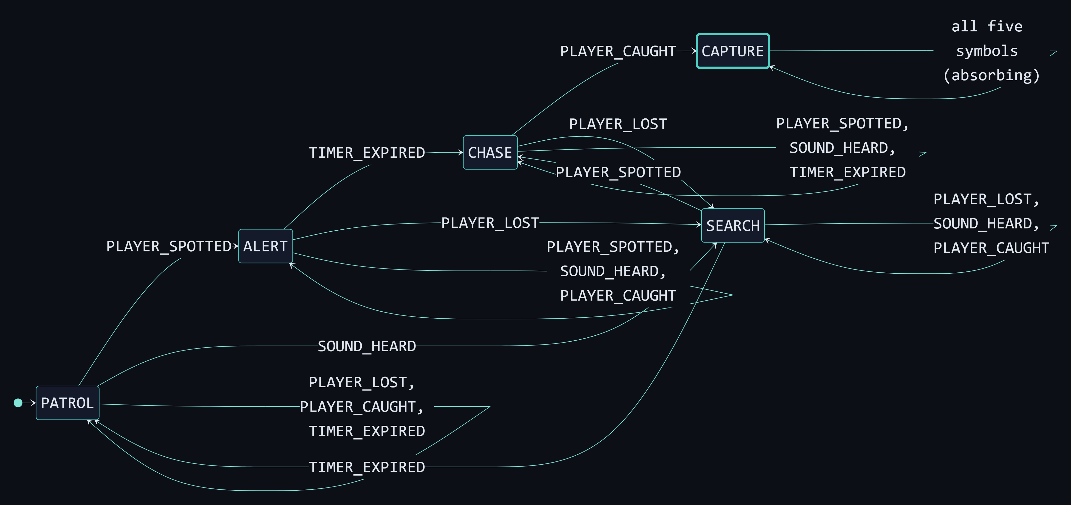
> GUARD DFA: ALL 25 TRANSITIONS ▌
q₀ = PATROL · F = {CAPTURE} (absorbing) · loops = events ignored in that state · source: diagrams/03-guard-dfa.mmd
SHADOW PROTOCOL // THEORY OF COMPUTATION
08 / 13
Notes:
Walk through the graph: the start state is PATROL. The typical capture path is PATROL → ALERT (spotted) → CHASE (timer) → CAPTURE (caught). Every state has an edge for every one of the five symbols; the loops are events that are ignored in that state. CAPTURE is absorbing and is the only accepting state. Full-page version: report Figure 13.1.

Slide 9
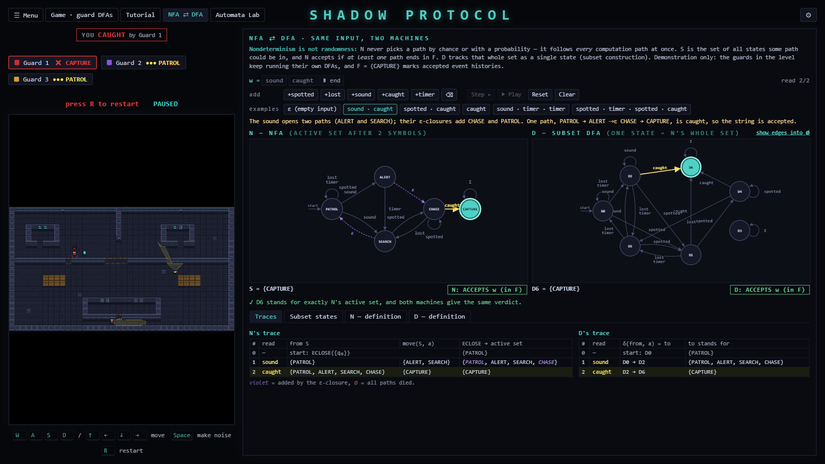
> NFA FUNDAMENTALS AND COMPARISON ▌
$δ:Q×\left(Σ∪\left\{ε\right\}\right)→𝒫\left(Q\right)$: zero, one or many next states
Simulate the active set: $\text{ECLOSE}\left(\bigcup_{p∈S}{δ\left(p,a\right)}\right)$; accept iff the set meets $F$
Not randomness: all paths are followed at once, deterministically
Same power as DFAs (Rabin–Scott), but up to exponentially smaller
Demonstration guard NFA: SOUND_HEARD → {ALERT, SEARCH}; ALERT →ε CHASE; SEARCH →ε PATROL
NFA ⇄ DFA mode after 'sound · caught': both accept
SHADOW PROTOCOL // THEORY OF COMPUTATION
09 / 13
Notes:
"An NFA may have several next states, or none, and may move on epsilon without reading input. We simulate it by tracking the set of all states some path could be in. This is the key point: nondeterminism is not randomness. Nothing is chosen by chance; every path is followed at once. In this screenshot, after 'sound', the NFA is in four states at once, because the epsilon-closure adds CHASE and PATROL. After 'caught', one path reaches CAPTURE, so the string is accepted, and the DFA on the right agrees."

Slide 10
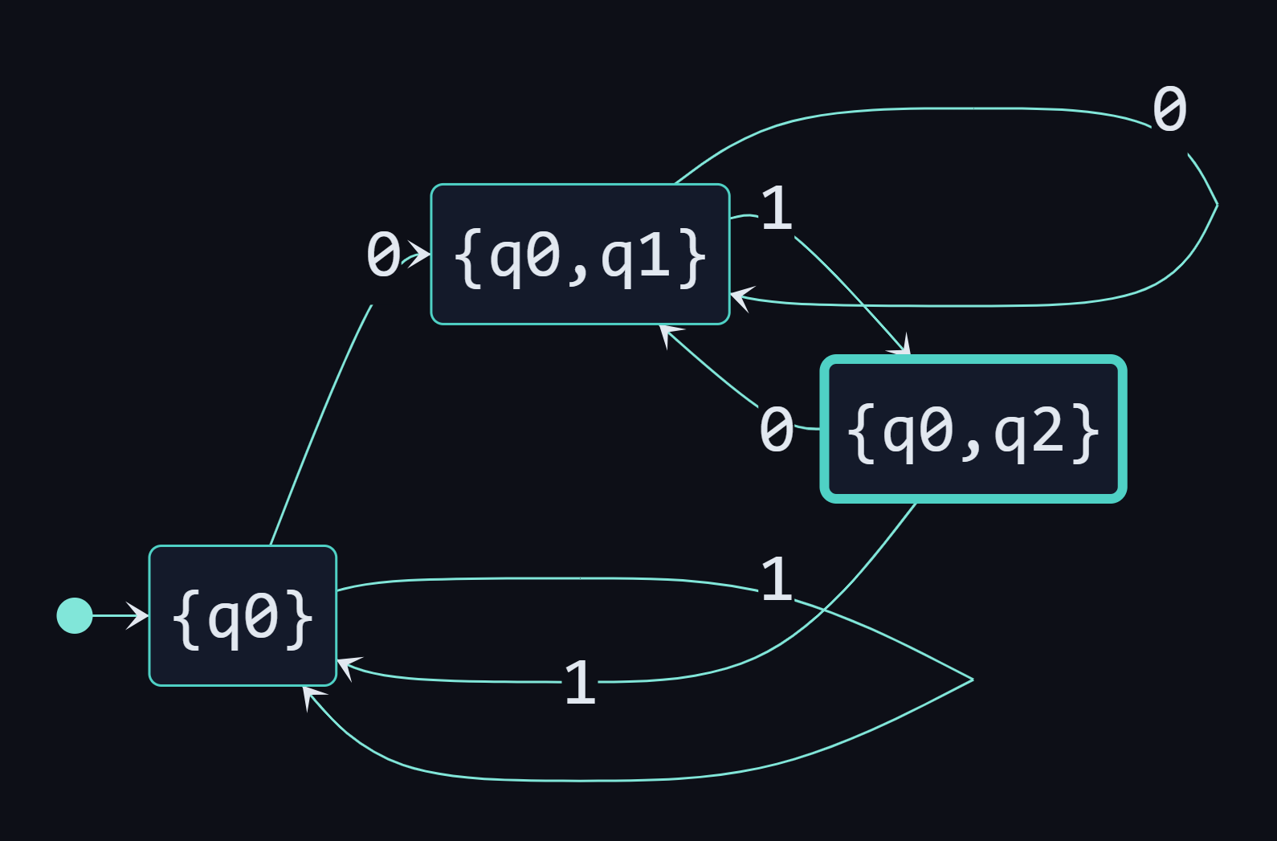
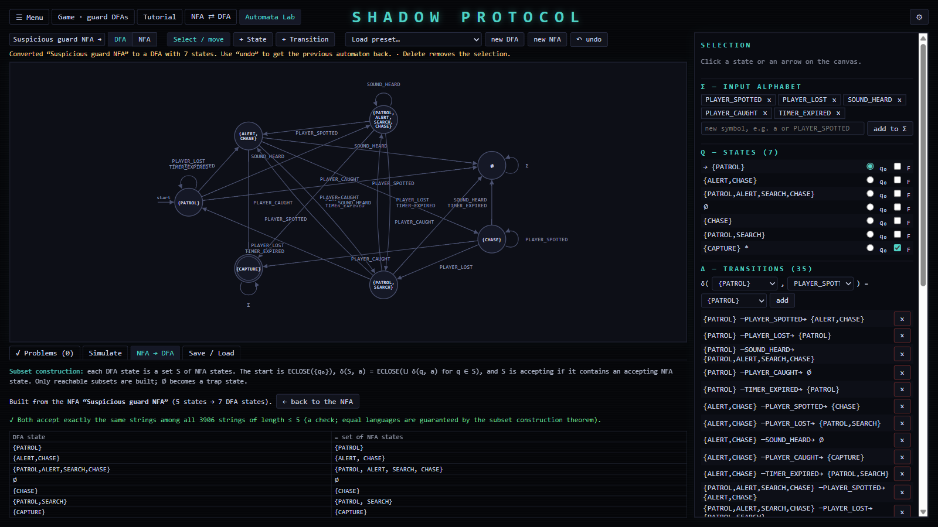
> NFA-TO-DFA CONVERSION ▌
Subset construction: $S_{0}=\text{ECLOSE}\left(q_{0}\right)$, $δ_{D}\left(S,a\right)=\text{ECLOSE}\left(\bigcup_{q∈S}{δ_{N}\left(q,a\right)}\right)$, $F_{D}=\left\{S ∣ S∩F_{N}≠∅\right\}$
Only reachable subsets, breadth-first worklist; ∅ becomes a trap state
"Ends in 01": 3 of 8 subsets · guard NFA: 7 of 32 · "3rd from end is 1": 4 → 8 (proven minimal)
Invariant checked live: DFA state = the NFA's active set
subset DFA of 'ends in 01': 3 states
Lab: guard NFA converted to 7 DFA states
SHADOW PROTOCOL // THEORY OF COMPUTATION
10 / 13
Notes:
"To convert an NFA into an equivalent DFA, each DFA state is a set of NFA states. We start from the epsilon-closure of the start state, and for each set and symbol we take all moves followed by the epsilon-closure. A set is accepting if it contains an accepting NFA state. We only build reachable subsets. For the guard NFA that is 7 of a possible 32. The classic 'third symbol from the end' example really does need all 8, and our tests prove that 8 is the minimum."

Slide 11
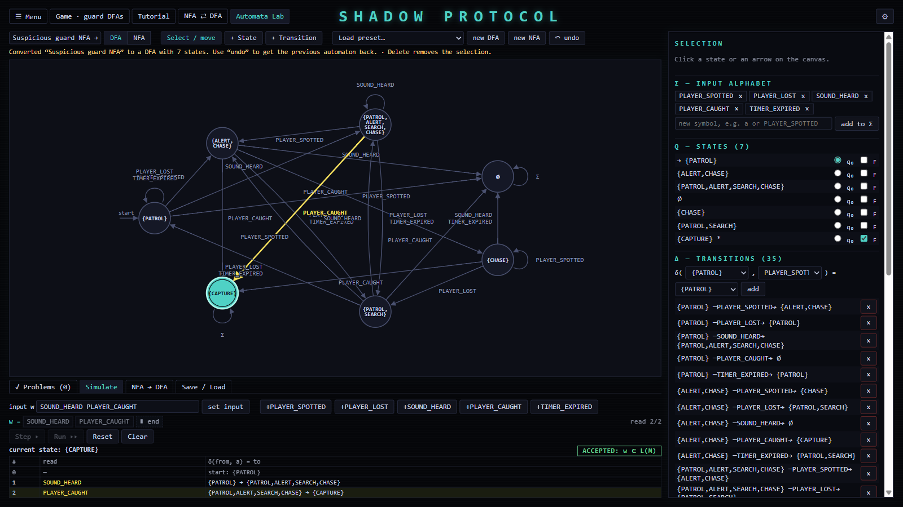
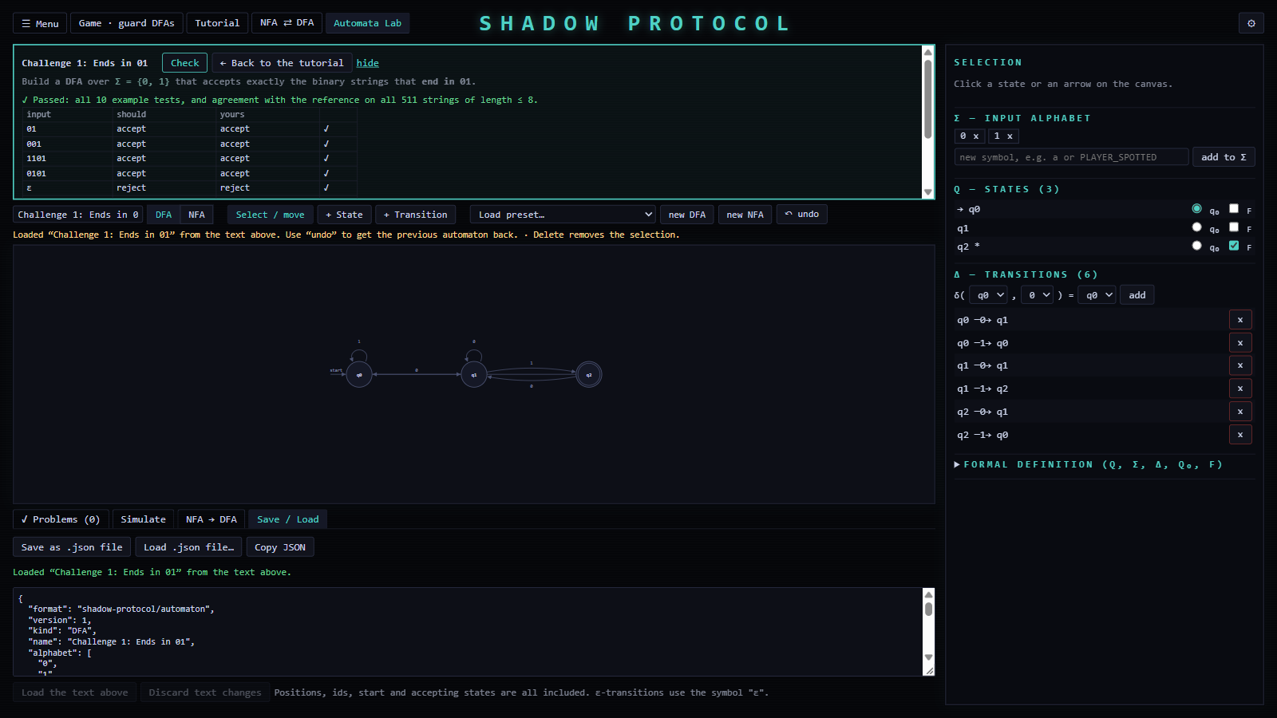
> INTERACTIVE AUTOMATA LAB ▌
Editor: states, Σ, transitions, q₀, F, DFA/NFA, ε-edges; drag and connect on the graph
Validation by the engine, with problems highlighted on the graph
Simulator: Step / Run, active state or set, trace, verdict
NFA → DFA conversion with an equivalence check
Nine presets · JSON save/load · undo
Tutorial: 7 modules, 18 pages; 4 challenges solved in the Lab
simulation: ACCEPTED · Challenge 1 passed
SHADOW PROTOCOL // THEORY OF COMPUTATION
11 / 13
Notes:
"The Lab is where students build their own automata. Every check is done by the same engine, and problems are highlighted on the graph. You can step through an input, convert an NFA into a DFA, and save your work as a file. The tutorial's challenges are solved here. They are checked by hand-picked tests and by comparing with a reference on every string up to length 8. We are careful to say that this is testing, not a proof."

Slide 12
> TESTING AND RESULTS ▌
527 unit tests, all passing: engine 132 · game logic 175 · UI logic 220
Randomised differential tests: 250 random ε-NFAs vs. an independent brute-force path search; subset DFA = active set on every string ≤ length 6
Tutorial claims re-checked by the engine; minimality proved by Myhill–Nerode
Scripted end-to-end checks of the running app; installed-app checks (16/16)
Type check clean · Rust clippy clean · NSIS and MSI installers built
Unit tests (Vitest) | passed
automata engine | 132
game logic | 175
UI logic | 220
total (41 files) | 527 / 527
Checks of the running app | passed
9 development suites | 324 / 324
production build | 13 / 13
installed application | 16 / 16
TypeScript type check clean · Rust clippy clean · NSIS + MSI installers built
SHADOW PROTOCOL // THEORY OF COMPUTATION
12 / 13
Notes:
"We tested at several levels. 527 unit tests run in Node. The most important are differential tests: 250 randomly generated NFAs with epsilon-cycles and dead ends, checked against a brute-force search we wrote independently of the engine, and against their own subset DFAs. We also re-check every example in the tutorial with the engine, so the teaching material can't drift from the implementation. Finally we scripted end-to-end checks of the running and the installed application. Testing also found real bugs, for example a crash specific to the Windows web view, which we fixed."

Slide 13
> CONCLUSION AND FUTURE SCOPE ▌
Automata are the real control mechanism, not an illustration
One engine for game, visualiser, comparison, Lab and tutorial
Clear distinction between acceptance and behaviour, and between testing and proof
Future: proof-producing equivalence (product construction), DFA minimisation, regular expressions ↔ NFAs, NFA-controlled guards, more levels
Thank you. Questions?
SHADOW PROTOCOL // THEORY OF COMPUTATION
13 / 13
Notes:
"To conclude: Shadow Protocol shows that the formal model and the working system can be the same thing. Every guard decision you saw is a transition of a validated DFA, and every operation in the Lab is computed by the same engine. For the future, the most interesting step is to replace our tested equivalence check with a proof. DFA equivalence is decidable, using the product construction. Thank you, and we're happy to take questions."
Anticipated questions (preparation):
Q: Why is CAPTURE the only accepting state?
A: $F$ defines the *language*: event histories ending in a capture. The other states are operational behaviour, not rejection.
Q: Is the NFA more powerful than the DFA?
A: No. They recognise the same class (regular languages); the NFA can be exponentially smaller.
Q: Does the guard choose randomly in the NFA?
A: No. The NFA is simulated deterministically by tracking all paths at once. And the gameplay guards use the DFA.
Q: How do you know the subset construction is correct?
A: The standard induction proof, plus tests: on every string up to length 6 for 250 random ε-NFAs, the DFA state equals the NFA's active set.
Q: Do the challenges prove that an answer is correct?
A: No. They test up to length 8 plus hand-picked cases. A proof would use the product construction (future work).
Q: What happens with ε-cycles?
A: ε-closure uses a visited set, so it terminates; this is tested.

