Slide 1

Final Presentation Report
Only for Course Teacher | Only for Course Teacher | Only for Course Teacher | Only for Course Teacher | Only for Course Teacher | Only for Course Teacher | Only for Course Teacher
 |  | Needs Improvement | Developing | Sufficient | Above Average | Total Mark
Allocate mark & Percentage | Allocate mark & Percentage | 25% | 50% | 75% | 100% | 15
Level of Understanding | 03
Analysis and Design | 04
Demonstration | 03
Delivery | 05
Total obtained mark | Total obtained mark | Total obtained mark | Total obtained mark | Total obtained mark | Total obtained mark
Comments
Total Mark

Slide 2





HEALTH CARE MANAGEMENT
SYSTEM
DEVELOPED BY:
GROUP 03
SEMESTER: SPRING 2025
COURSE TITLE: SOFTWARE DEVELOPMENT CAPSTONE PROJECT
COURSE CODE: SE 133
BATCH: 42
SECTION: G1

Slide 3







Group Member’s -
Tansina Afnan
ID:241-35-002
Israt Jahan Lubna
ID:241-35-202
Saima Hossain
ID:232-35-665
MD Sadman Shaid
ID:241-35-102
Abdullah Al Mukit
ID:241-35-121
Amdadul Hak
ID:241-35-025

Slide 4

PRESENTED TO-
Rashedul Hasan Hridoy
Lecturer
Department of Software Engineering
04
Faculty of Science & Information Technology
Daffodil International University

Slide 5
OVERVIEW
This project was initiated to make a Health Management System using the C programming language. The Functional requirements of this project
Included:
01
1.User Registration.
2.Doctor Appointment Scheduling.
3.Treatment Management.
4.Blood Bank Inventory.
5.Medcial Store Management
6.Billing/Payment System.
7.Exit

Slide 6


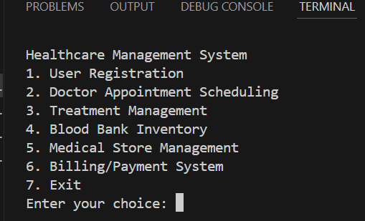
USER MANUAL
The first page includes-
Our Healthcare Management System efficiently handles User Registration, Doctor Appointment Scheduling, Treatment Management, Blood Bank Inventory, Medical Store Management, and Billing/Payment System. It streamlines hospital operations, reduces manual work, and enhances patient care.

Slide 7
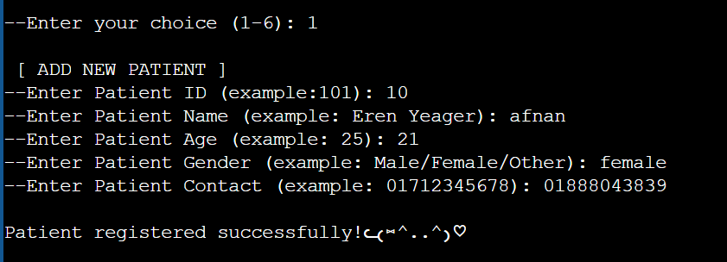
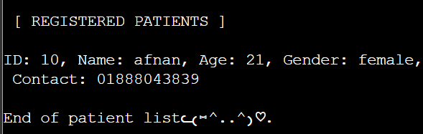
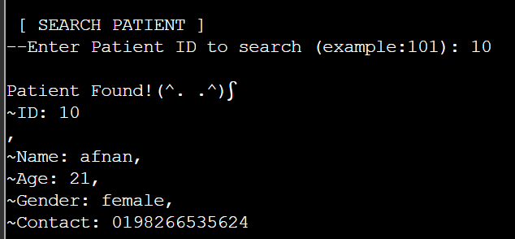
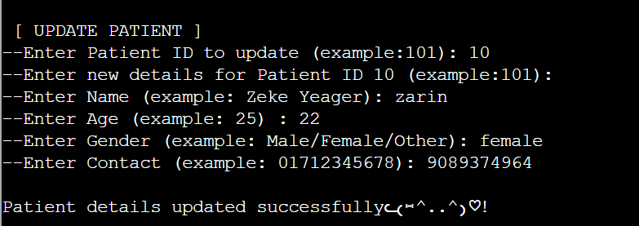
USER REGISTRATION
1. Add Patient
2. View Patients
3. Search Patient
4. Update Patient

Slide 8

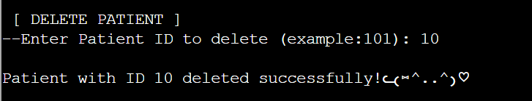
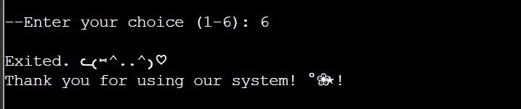
USER REGISTRATION
5. Delete Patient
6. Exit
This User registration system allows users to manage healthcare records through a file-based approach. It provides key functionalities including adding new patients with ID, name, age, gender, and contact details; viewing all registered patients; searching for specific patients by ID; updating existing records; and deleting patient entries. The program uses structures, file handling, and basic input/output in C, with all data securely stored in a text file (patients.txt) for future access.

Slide 9
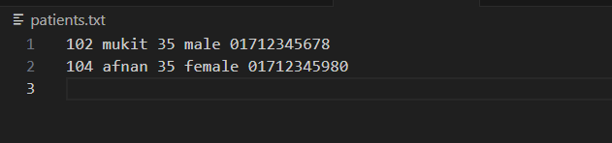
. TXT FILE
Additionally, we are able to add a database using C programming file handling. we are able to store the patients name on a file name’patient.txt’.

Slide 10
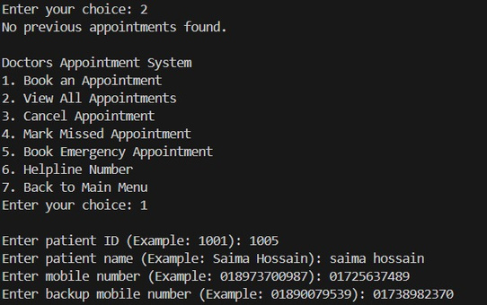
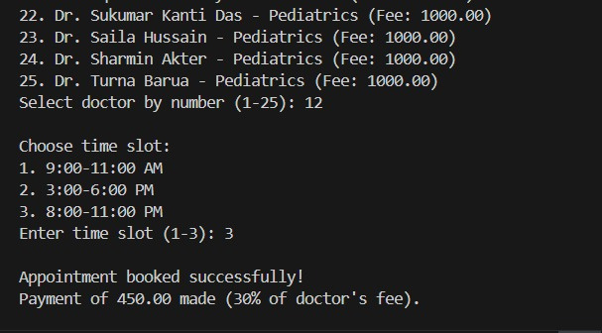
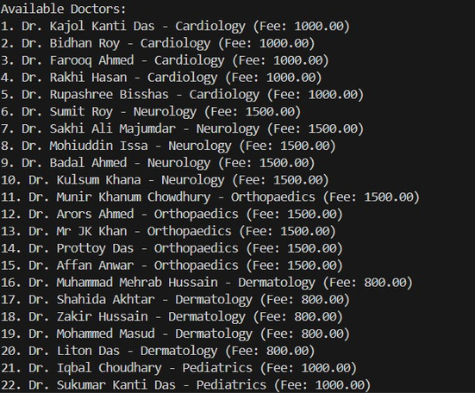
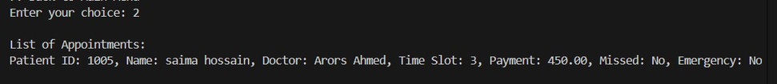
DOCTORS APPOINTMENT SYSTEM
Book an Appointment
View All Appointments

Slide 11
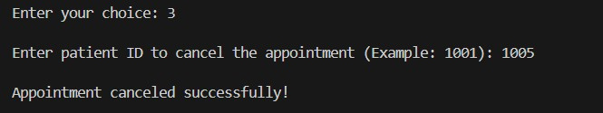
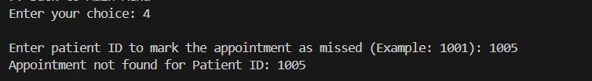
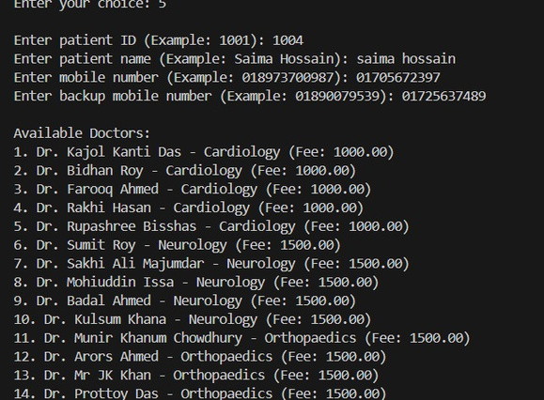
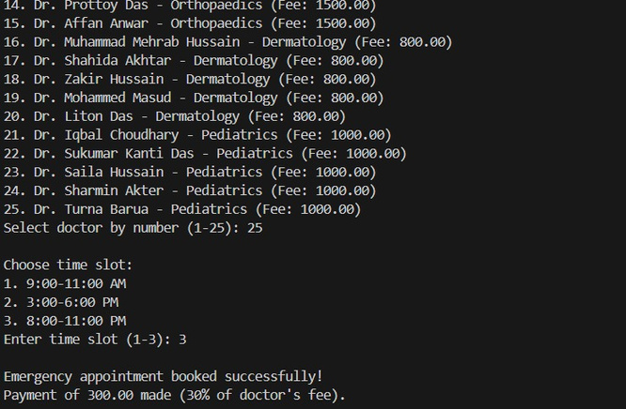


DOCTORS APPOINTMENT SYSTEM
Cancel Appointment
Mark Missed Appointment

Slide 12
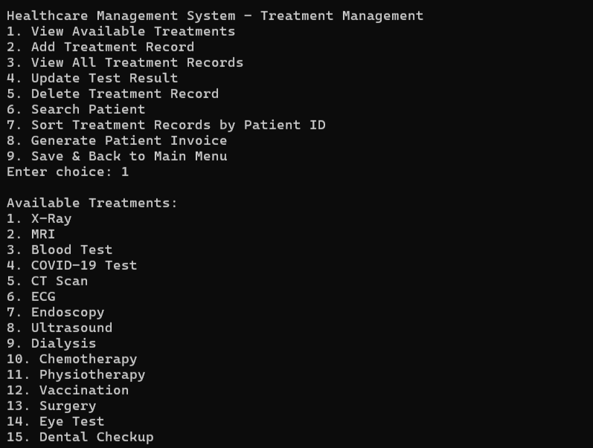
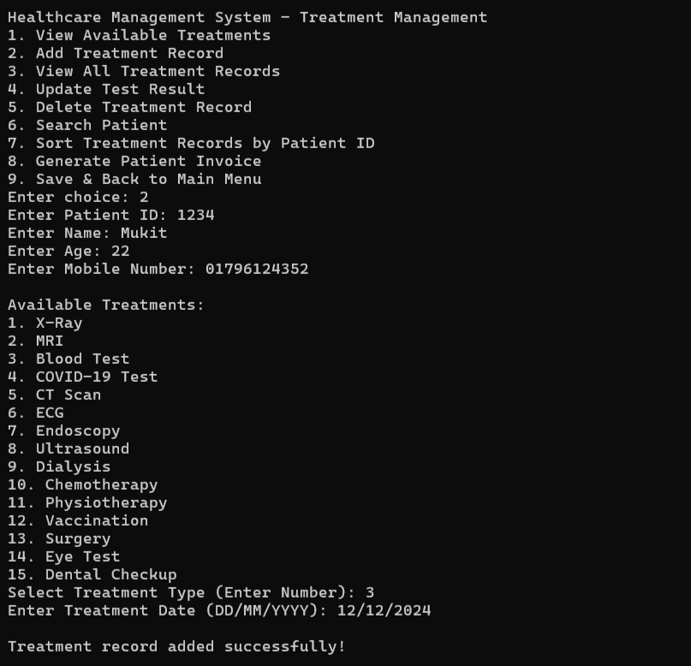
TREATMENT MANAGEMENT
1.View Available Treatments
2.Add Treatment Record

Slide 13
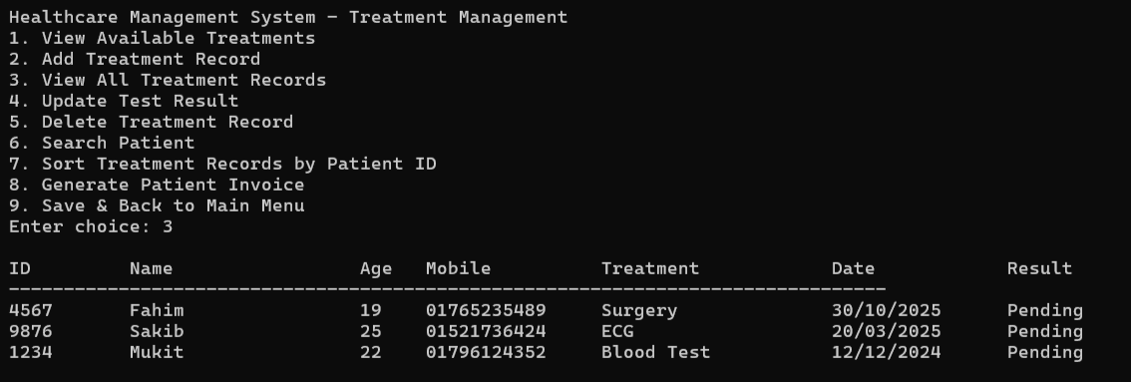
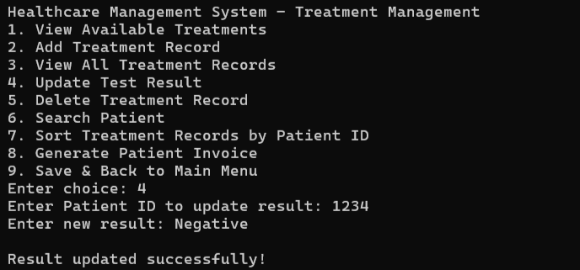
TREATMENT MANAGEMENT
3.View All Treatment Records
4.Update Test Result

Slide 14
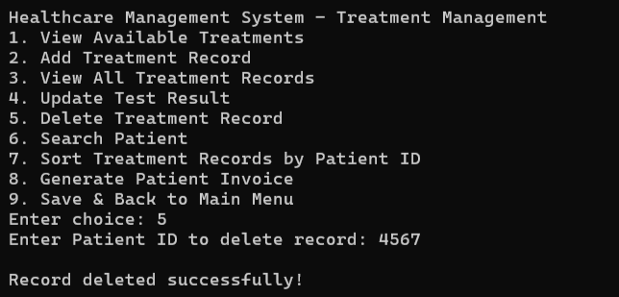
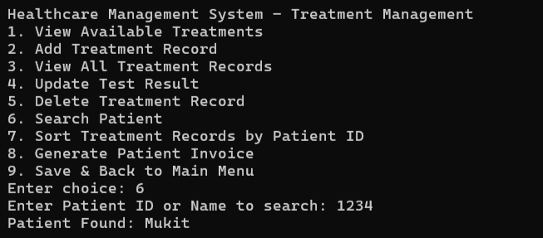
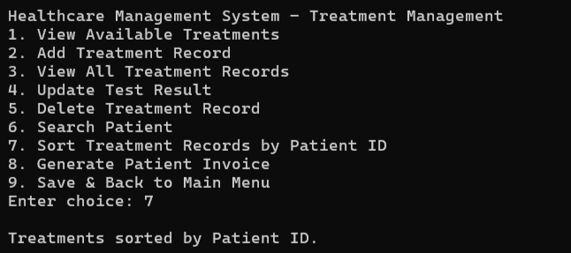
TREATMENT MANAGEMENT
5.Delete Treatment Record
6.Search Patient
7.Sort Treatment Records by Patient ID

Slide 15
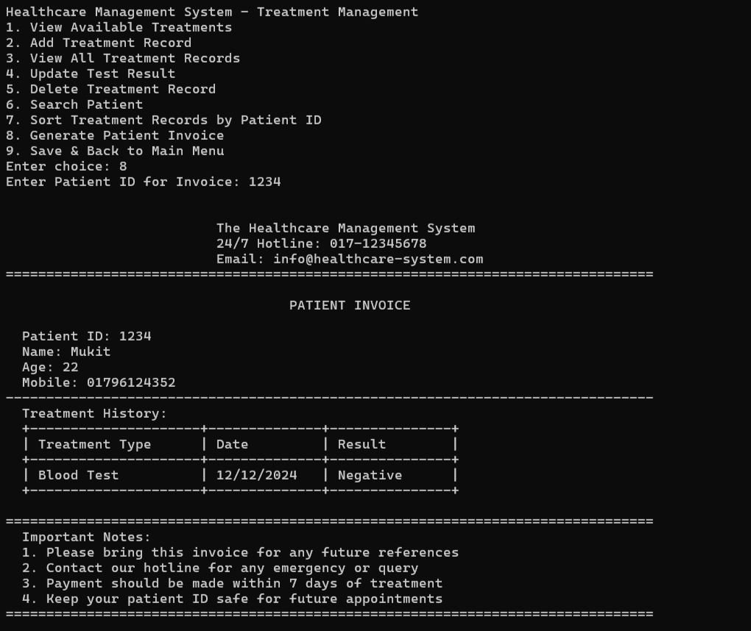
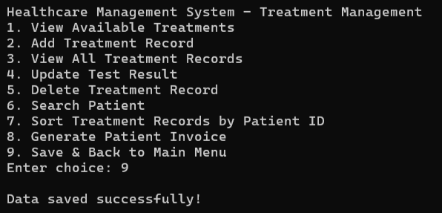
TREATMENT MANAGEMENT
8.Generate Patient Invoice
9.Save & Back to Main Menu

Slide 16
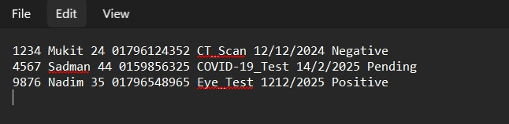
. TXT FILE
Additionally, we are able to add a database using C programming file handling. we are able to store the treatment name on a file name’treatment.txt’.

Slide 17
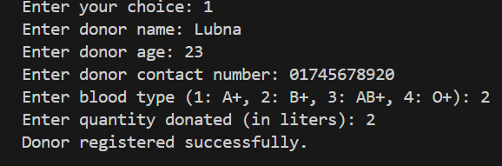
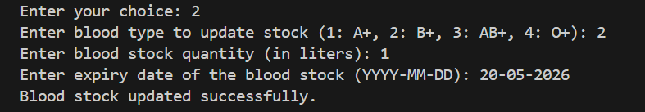
BLOOD BANK MANAGEMENT
Register Blood Donor
Update Blood Stock

Slide 18
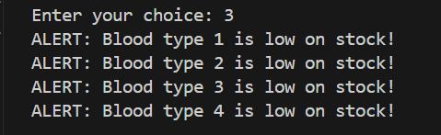
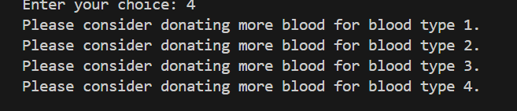
BLOOD BANK MANAGEMENT
Check Blood Stock
Ensure Sufficient Blood

Slide 19
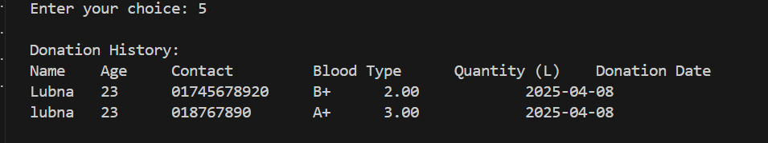
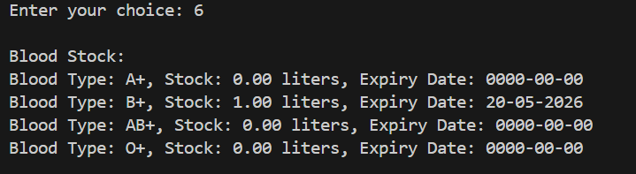
BLOOD BANK MANAGEMENT
View Donation History
View Blood Stock

Slide 20
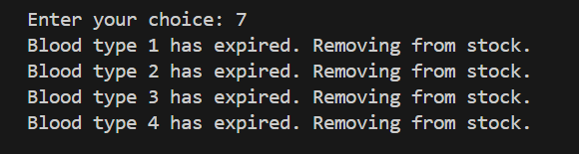

BLOOD BANK MANAGEMENT
Remove Expired Blood Stock
Back to Main Menu

Slide 21
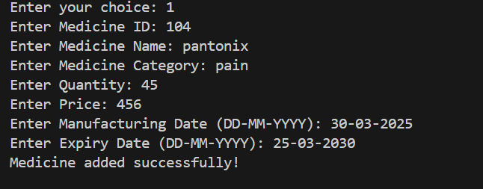
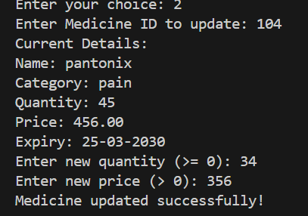
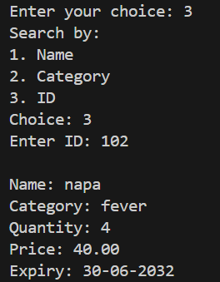
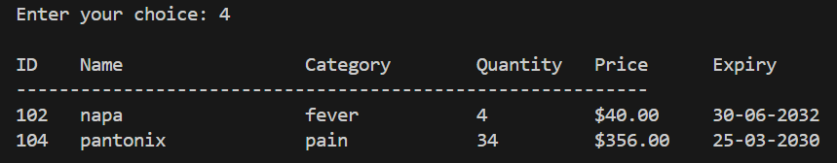
MEDICAL STORE MANAGEMENT
Update Medicine
Add Medicine
Search Medicine
Display Inventory

Slide 22

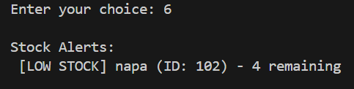
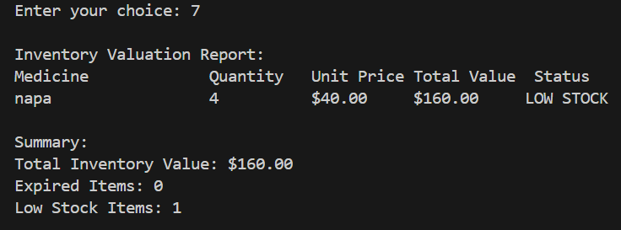

MEDICAL STORE MANAGEMENT
Delete Medicine
Stock Alerts
Generate Report
Back to Main Menu

Slide 23
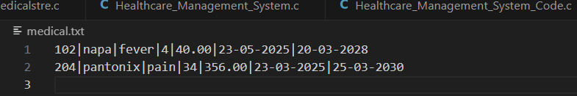
. TXT FILE
Additionally, we are able to add a database using C programming file handling. we are able to store the medicine name on a file name’medical.txt’.

Slide 24
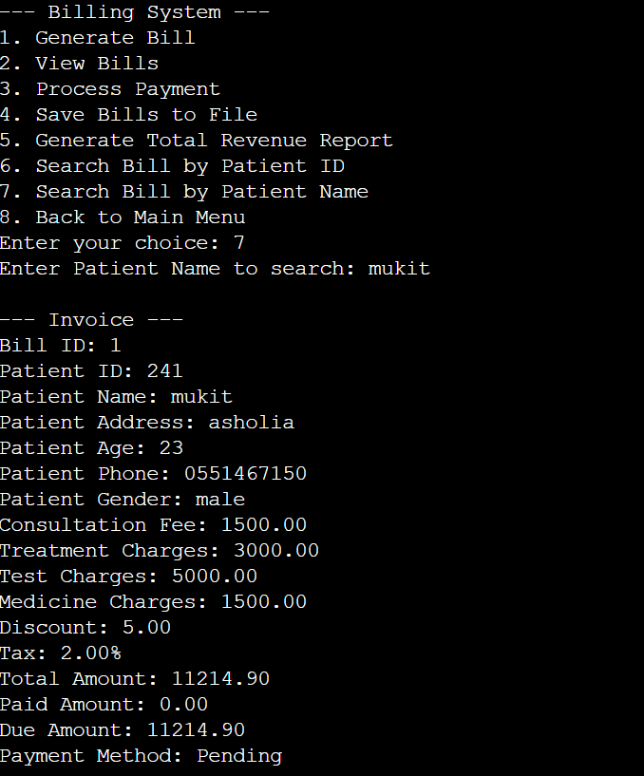
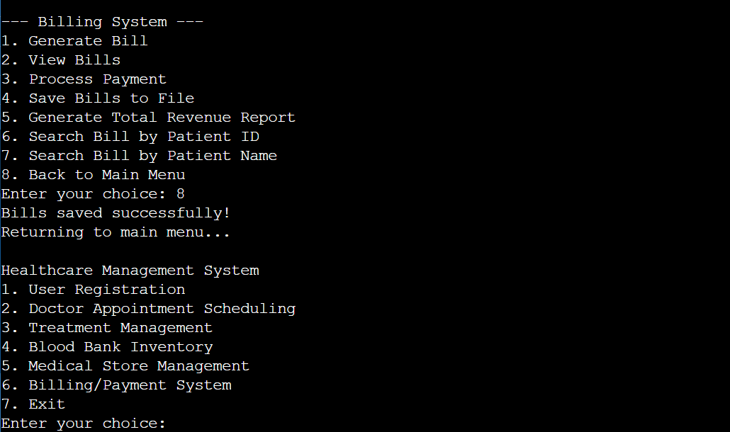
BILLING MANAGEMENT
2.Create a Bill
1.Enter the Billing Session

Slide 25
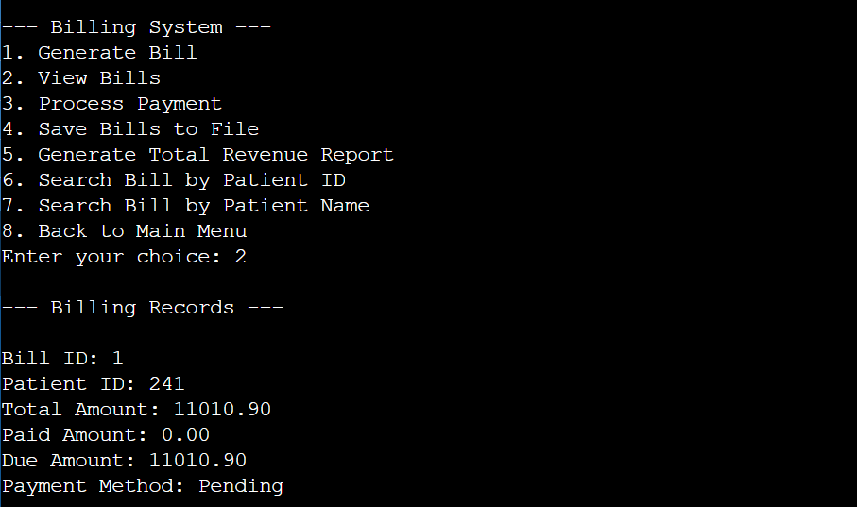
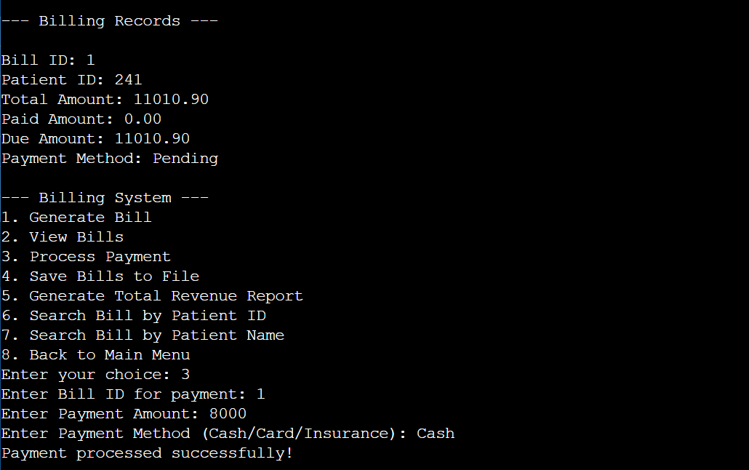
BILLING MANAGEMENT
3.View Bill Invoice
4.Make Payment

Slide 26
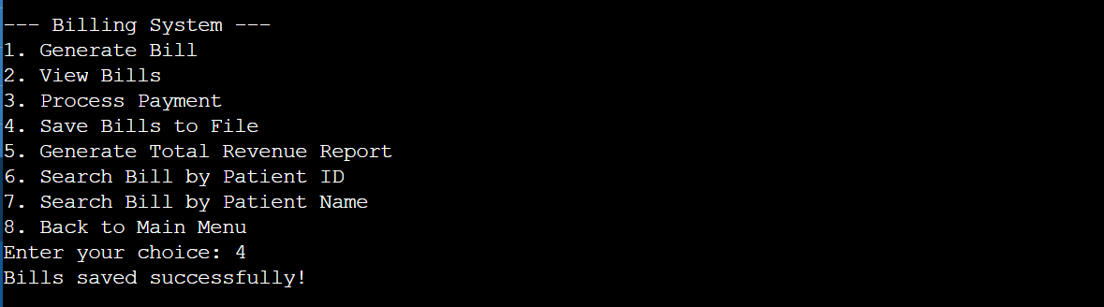
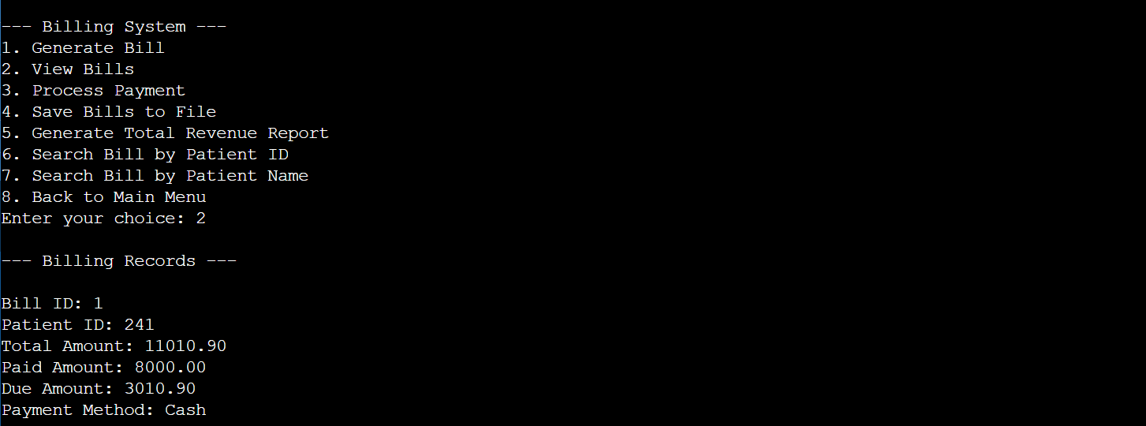
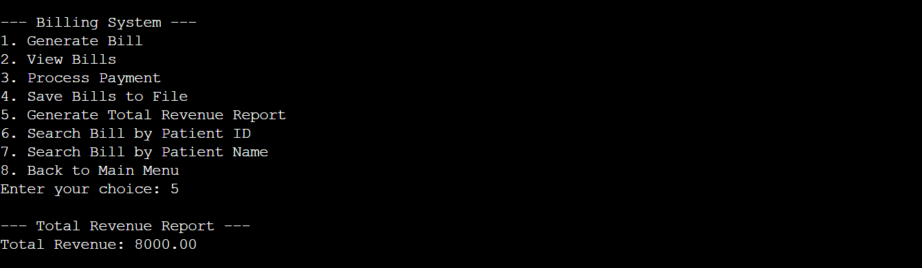
BILLING MANAGEMENT
6.Save the Bill
5.Bill record
7.Total Revenue

Slide 27
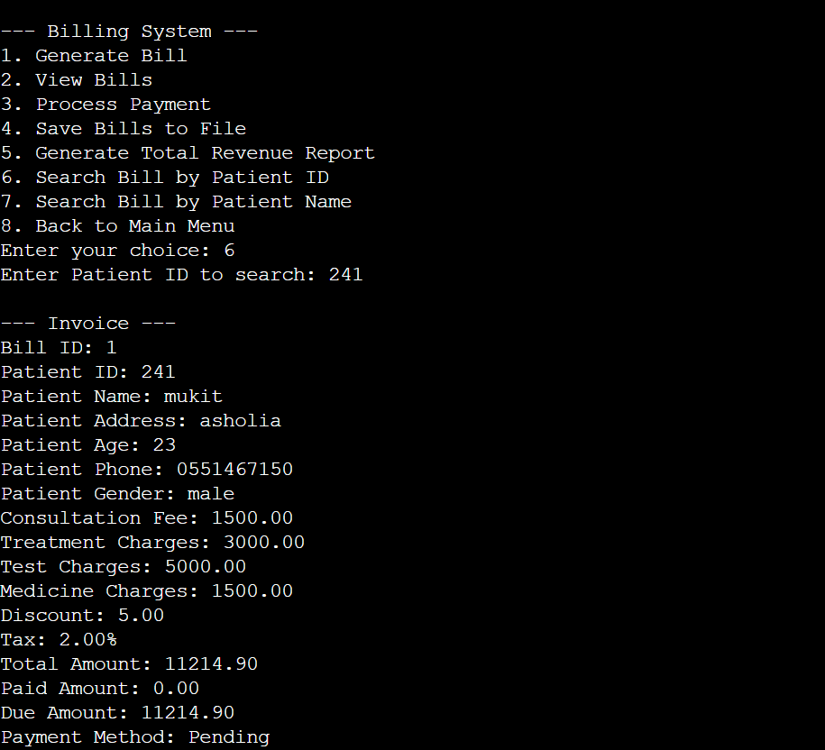
BILLING MANAGEMENT
8.Search by Name
9.Search by Id
10.Back to Main Manu

Slide 28
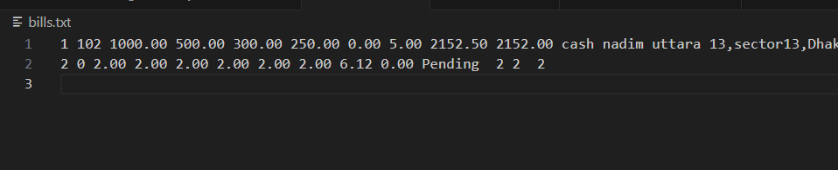
. TXT FILE
Additionally, we are able to add a database using C programming file handling. we are able to store the BILL&PAYMENT on a file name’bills.txt’ .

Slide 29

EXIT
A user can exit from the health care management system by clicking this function.

Slide 30
CONCLUSION
WE CAN SUCCESSFULLY IMPLEMENT ALL THE FUNCTIONAL REQUIREMENTS OF OUR PROJECT THAT WE WANT TO DO USING OUR HEALTHCARE MANAGEMENT SYSTEM.
ALSO WE ADD DATABASE OF OUR SYSTEM TO STORE ALL THE DATA WHICH USE IN OUR SYSTEM .INCLUDING THE DATA OF USER RESGISTRATION,DOCTOR’S APPOINTMENT SYSTEM,TREATMENT MANAGEMENT ,BLOOD BANK MANAGEMENT,MEDICAL STORE MANAGEMENT & BILLING/PAYMENT SYSTEM.

Slide 31
THANK YOU
PROJECT BY:
GROUP 3

