Slide 1

Course code: CSE 426
Course Title: Compiler Design Lab
Project Name: Mini Compiler Design
Submitted By:
Abdullah Al Musabbir
Reg No:22101039
Sec:A
Submitted To:
Md. Shafayatul Haque
Lecturer
Department od CSE, UAP

Slide 2
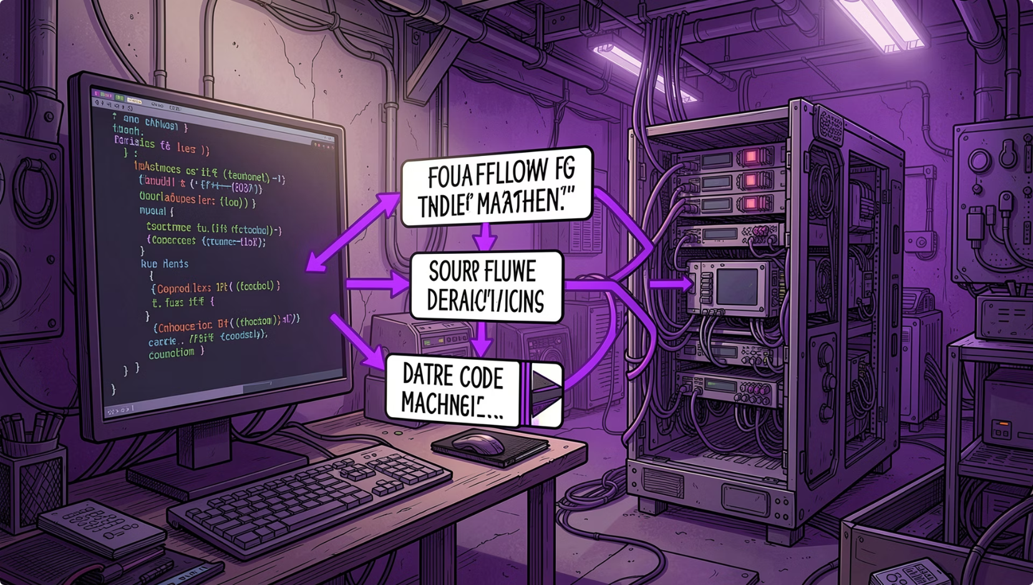
What is a Compiler?
Lexical Analysis
Tokenizes source text into meaningful symbols.
Syntax Analysis
Parses tokens into grammatical structure (AST).
Semantic Analysis
Checks types, scopes, and symbol consistency.
Code Generation
Produces intermediate code (TAC) for later optimization.

Slide 3
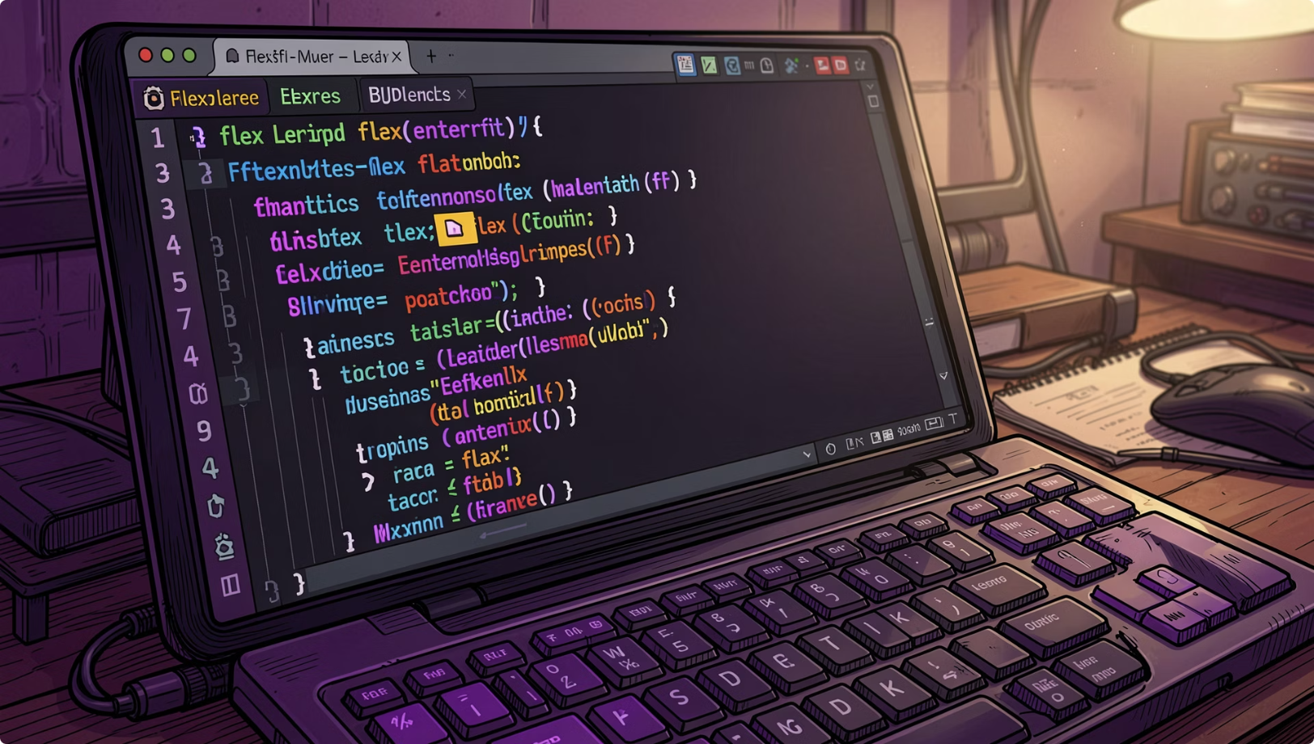
Problem Statement
Problem Statement
Understanding compiler design only through theory is difficult
Existing compilers are complex for beginners to analyze
Error detection and code translation processes are hard to visualize
Need for a simplified compiler to demonstrate complete compilation flow

Slide 4
Scope Statement
Scope Statement
Design and develop a mini compiler using C, Flex, and Bison
Perform lexical analysis and token generation
Implement syntax and semantic analysis
Create and manage symbol tables
Generate Abstract Syntax Tree (AST)
Produce Three-Address Code (TAC)
Apply code optimization techniques
Generate ARM assembly target code
Detect syntax and semantic errors with line numbers
Support basic programming constructs (variables, loops, conditions, expressions)

Slide 5
Project Objectives
Understand Compiler Design
Implement lexical analysis, parsing, symbol table, AST, TAC, and error detection.
Error Detection
Detect syntax and semantic errors with line numbers and warnings.

Slide 6
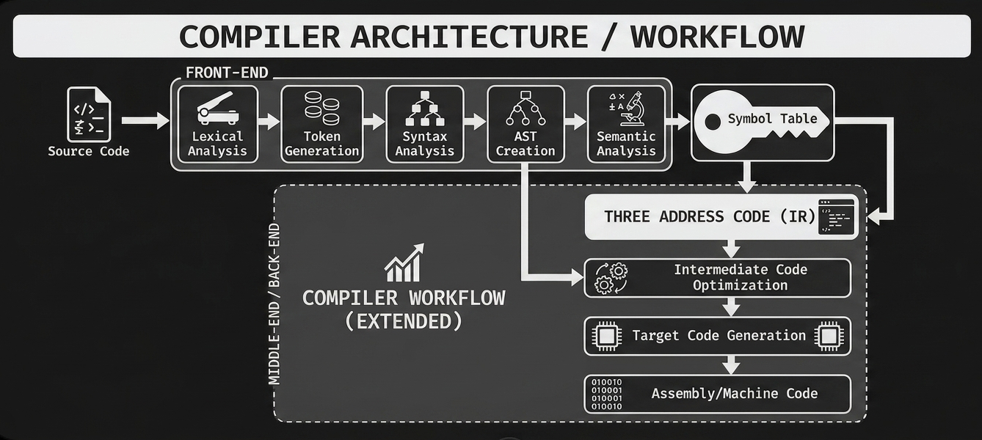

Slide 7
Technology & Project file
Tools
Flex
Bison
GCC
C
Key Files
Lexer.l
Parser.y
Compiler.h
Main.c
Test.c
Commands to compile and run
bison -d parser.y
flex lexer.l
gcc -w -o compiler lex.yy.c parser.tab.c main.c
./compiler

Slide 8
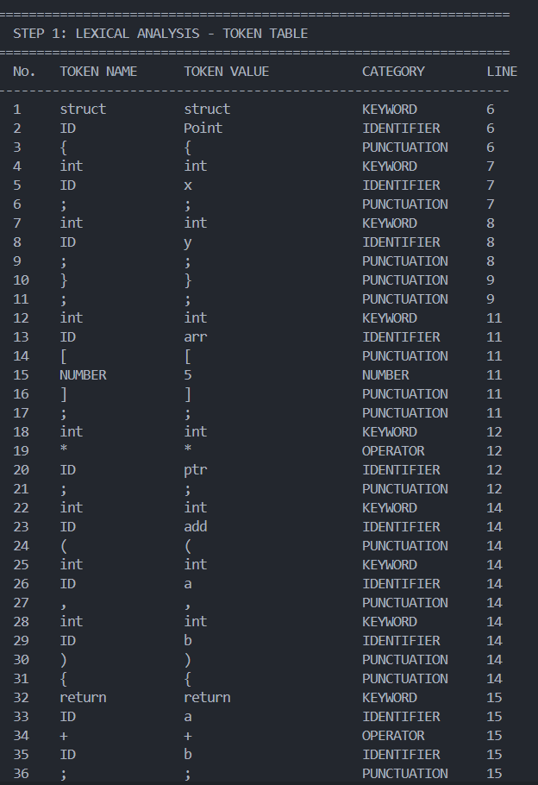
Output
Step 1 - Lexical Analysis (Tokenization)
● Tools used: Flex (Lex) and GCC ● Language used: C ● Data Structures: Token structure to recognize keywords (int, float, if, else, while, return), operators (+, -, , /, =, <, >, <=, >=, ==, !=), identifiers, numbers, and comments (single-line // and multi-line / */)

Slide 9
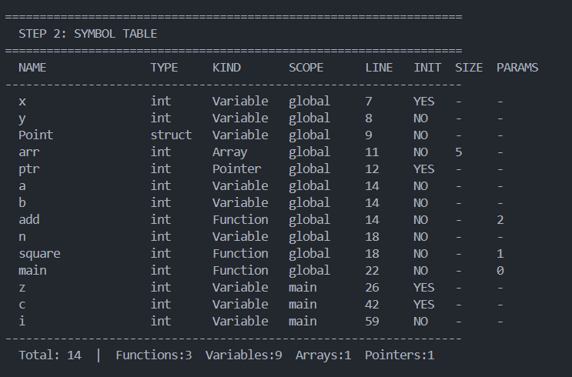
Output
Step 2 - Symbol Table Creation
● Tools used: Flex (Lex) and GCC ● Language used: C ● Data Structures: Symbol table (hash table or array) for variable tracking, type information struct, scope management stack for checking variable declarations, type compatibility, and semantic errors

Slide 10
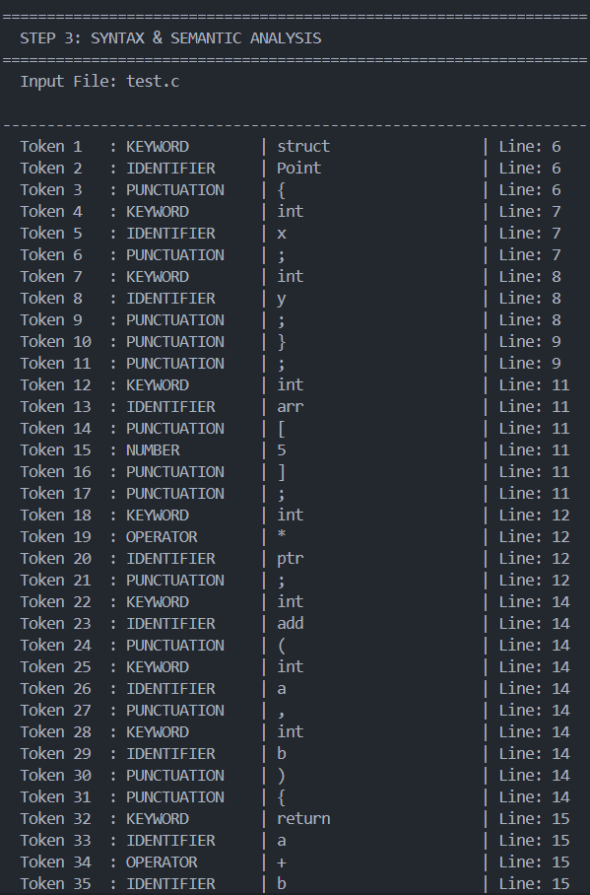
Output
Step 3 - Semantic/Syntax Analysis
● Tools used: Bison, Flex (Lex) and GCC ● Language used: C ● Data Structures: Symbol table (array-based) storing variable names, types, line numbers, and function flags; duplicate error tracking array to prevent repeated error messages ● Semantic, syntax Checks Performed

Slide 11
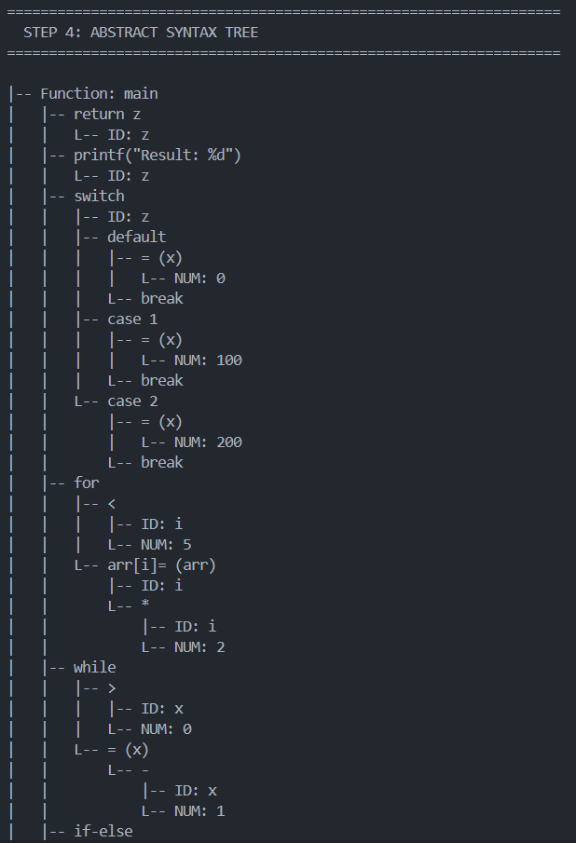
Output
Step 4 - Abstract Syntax Tree (AST) Generation
● Tools used: Bison, Flex (Lex) and GCC ● Language used: C ● Data Structures: AST node structure with node type, children pointers, expression trees for arithmetic operations, statement nodes for assignments and control flow

Slide 12
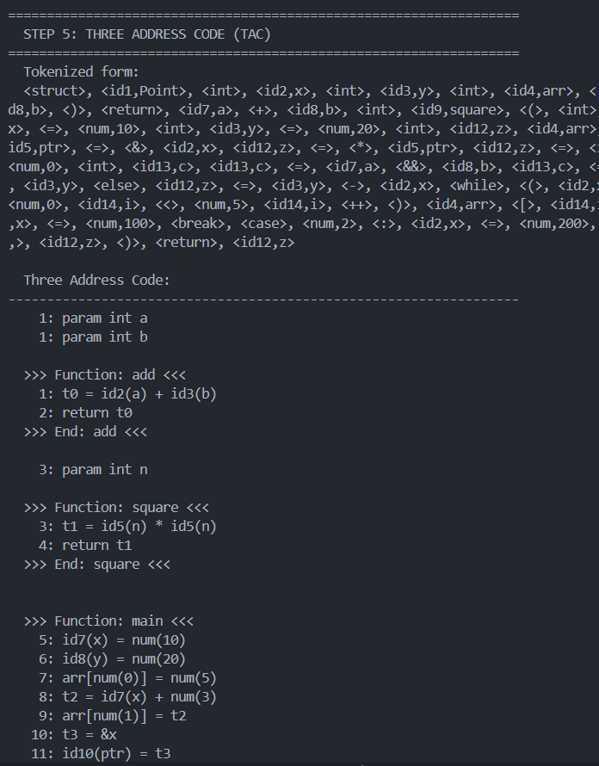
Output
Step 5 - Intermediate Code Generation (TAC)
● Tools used: Bison, Flex (Lex) and GCC ● Language used: C ● Data Structures: : Quadruple structure (op, arg1, arg2, result) for Three-Address Code, temporary variable counter, label generator for control flow (if-else, while loops), backpatching stack for label resolution

Slide 13
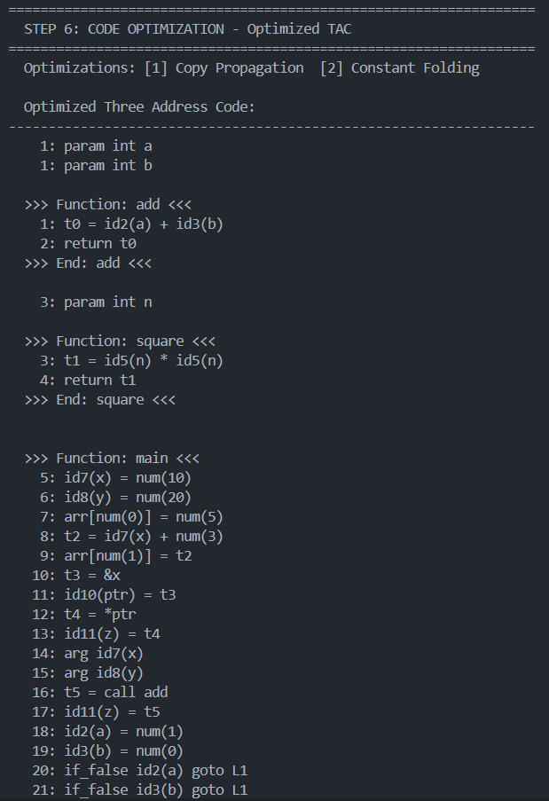
Output
Step 6 - Code Optimization
● Tools used: Bison, Flex (Lex) and GCC ● Language used: C ● Data Structures: : Variable information table for constant tracking, optimization flags (is_const, is_used, is_dead), TAC instruction array with dead code markers ● Optimization Techniques Implemented:
Constant Propagation
Constant Folding (multi-pass)
Dead Code Elimination
Unreachable Code Elimination

Slide 14
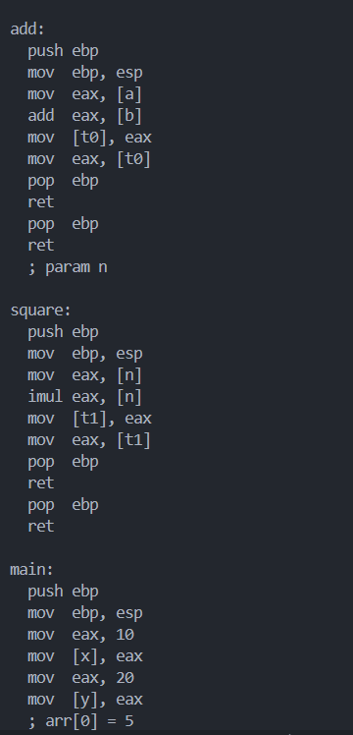
Output
Step 7 - Target Code Generation (ARM Assembly)
● Tools used: Bison, Flex (Lex) and GCC ● Language used: C ● Data Structures: : Register allocation table mapping variables to ARM registers (R0-R15), instruction templates for ARM assembly, label tracking for control flow translation ● Target Architecture: ARM (32-bit) ● Assembly Instructions Generated: MOV, ADD, SUB, MUL, SDIV, CMP, B (branch), conditional moves (MOVGE, MOVLT, etc.), SWI (system call)

Slide 15
Project Limitations
Supports only a simplified programming language
Limited data type support
Does not support advanced Object-Oriented Programming features
Limited optimization techniques implemented
Error recovery mechanism is basic
Supports only ARM 32-bit target code generation
No graphical user interface (GUI)
Handles only small to medium-sized programs
Does not include advanced compiler optimizations used in modern compilers
Multi-file program compilation is not supported

Slide 16
THANK YOU

