Slide 1
IMAM ABDULRAHMAN BIN FAISAL UNIVERSITY
College of Computer Science and Information Technology
CS 516 · Term Project
Smart Student Management
& Attendance System
A client–server application built twice — in Python and in C++
TEAM
Ahmed Mabkhot Al-Awlaqi · Abdulaziz Alghamdi · Abdullah Alsaedi
Submitted to
2220007240 · 2220003178 · 2220002306
Dr. Dhiaa

Slide 2
The Problem
CS516 · IAU
Why we built this
WHAT GOES WRONG TODAY
“
Most departments still juggle paper attendance sheets, Excel files, and the occasional WhatsApp group. Sheets get lost. Two instructors mark the same student twice. And at the end of the semester, somebody has to count rows manually.
📋
Lost sheets
Paper attendance can disappear before grades close.
🔁
Duplicates
Two instructors mark the same class twice.
— our starting point
⏳
Slow reports
End-of-semester totals are counted by hand.
📂
No backup
Excel files live on one laptop with no copies.

Slide 3
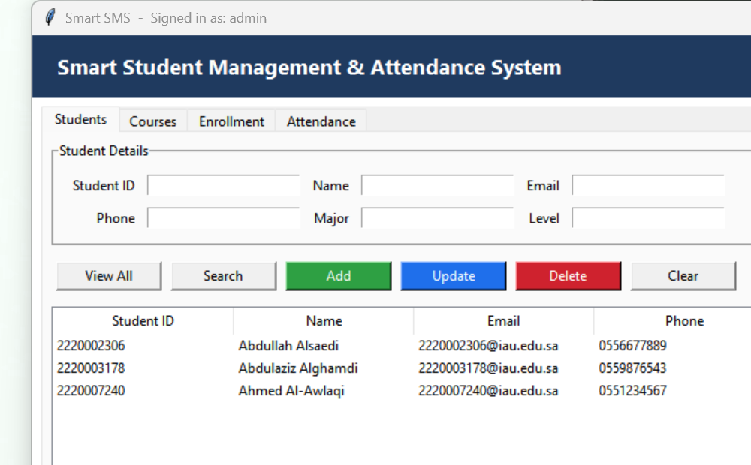
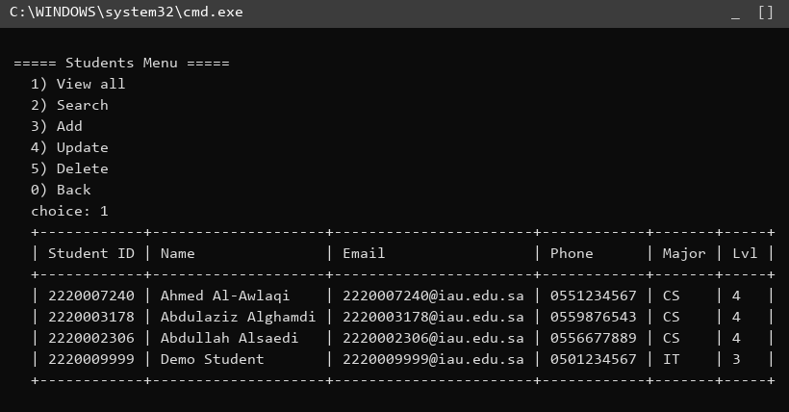
What We Built
CS516 · IAU
The same system, in two languages
One server holds the data. Two clients let you work with it.
PYTHON · Tkinter GUI + SQLite
C++ · OOP console + flat files
Both clients speak the same protocol — they could even share the server.

Slide 4

Features
CS516 · IAU
Everything Smart SMS does
WHAT INSTRUCTORS CARE ABOUT
🔐
Role-based Login
👤
Students CRUD
📚
Courses CRUD
Admin sees everything; instructor sees what they teach.
Add, update, delete, search — full lifecycle.
Same surface for courses with code as primary key.
📝
Enrollment
✅
Attendance
📊
Summary Reports
Per-semester enrollment with duplicate protection.
Mark Present/Absent, validated against enrollment.
Per-course present/absent counts in one click.
Per-course summary
Counts present vs absent for every student in a course. What used to take 10 minutes of counting now takes one click.

Slide 5
Architecture
CS516 · IAU
One server, two clients, one protocol
PYTHON CLIENT
C++ CLIENT
SERVER
🪟
💻
🖥️
Tkinter GUI
Console UI
JSON over TCP
Validation
ACTION|k=v over TCP
127.0.0.1 : 5055
Storage
127.0.0.1 : 5066
STORAGE · same data model, two engines
🐍 SQLite (mgmt via sqlite3)
⚙️ TAB-separated flat files
Parameterised SQL, JOINs, GROUP BY
One file per entity, std::vector in memory

Slide 6
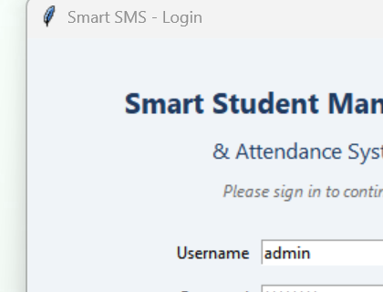
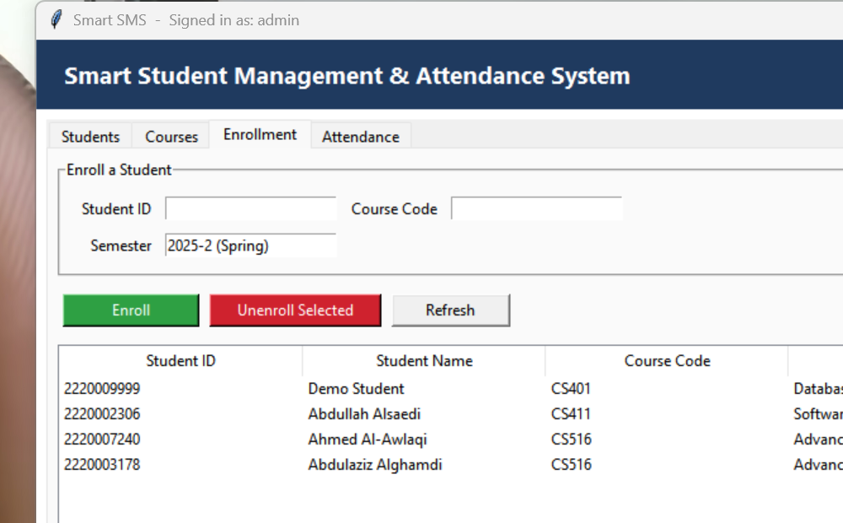
Python Implementation
CS516 · IAU
Tkinter GUI · SQLite · TCP server (multi-threaded)
1. Sign in
2. Enroll students
3. Track attendance
TECH STACK
WHY PYTHON SHINES HERE
tkinter
sqlite3
socket
threading
json
✓ Zero external dependencies — standard library only
✓ GUI built in ~600 lines of tkinter
✓ SQL handles GROUP BY for free
✓ Cross-platform from day one

Slide 7
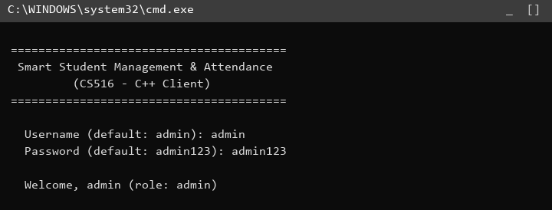
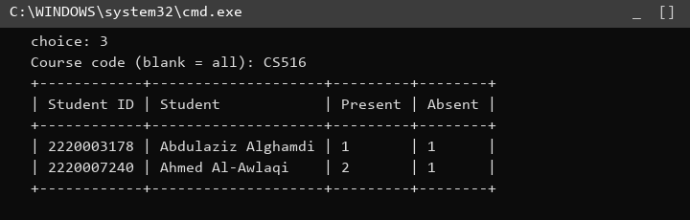
C++ Implementation
CS516 · IAU
OOP server · Winsock · static .exe — zero dependencies
1. Login
2. View students
3. Summary report
TECH STACK
WHY C++ SHINES HERE
C++17
Winsock2
std::thread
std::filesystem
MinGW g++ 14.2
✓ Single self-contained .exe (no DLLs needed)
✓ Clean OOP: one Repository class per entity
✓ Predictable memory via RAII — no GC pauses
✓ Static type checking catches bugs at compile time

Slide 8
Comparison — Part 1
CS516 · IAU
Syntax · Dependencies · Paradigm · Memory
Feature
🐍 Python
⚙️ C++
Syntax
Indented blocks, no braces.
Dynamic typing.
print("hi")
Braces and semicolons.
Static typing.
std::cout << "hi";
Dependencies
Standard library only.
tkinter, sqlite3, socket all bundled.
Requires C++17 compiler
+ ws2_32 (Winsock) on Windows.
Paradigm
Multi-paradigm: procedural,
OOP, and functional all welcome.
OOP + procedural primary;
generic programming via templates.
Memory
Automatic — reference counting
+ cyclic GC. Developer never frees.
Manual but rescued by RAII
(std::string, std::vector free in scope).

Slide 9
Comparison — Part 2
CS516 · IAU
Same function, two languages
Function: Add a Student (validation + persistence)
🐍 Python · server.py
⚙️ C++ · server.cpp
if not is_valid_id(p['student_id']):
return {'ok': False,
'error': 'Student ID must be 10 digits'}
conn.execute(
"INSERT INTO students(...) VALUES(?,?,?,?,?,?)",
(sid, name, email, phone, major, level))
conn.commit()
return {'ok': True}
if (!validId(sid))
return err("Student ID must be 10 digits");
auto e = students_.add(
{sid, name, email, phone, major, level});
if (!e.empty()) return err(e);
return ok();
// repository writes a TAB-separated row
// to data/students.txt
Function: Per-course Attendance Summary
🐍 Python · one SQL query
⚙️ C++ · manual aggregation
SELECT student_id, name,
SUM(status='Present') AS present_count,
SUM(status='Absent') AS absent_count
FROM attendance JOIN students USING(student_id)
WHERE course_code = ?
GROUP BY student_id;
map<string, pair<int,int>> counts;
for (auto& row : attendance_.all()) {
if (row[1] != code) continue;
if (row[3] == "Present") counts[row[0]].first++;
else counts[row[0]].second++;
}
Python wins on conciseness · C++ wins on transparency

Slide 10
Wrapping Up
THE VERDICT
Python was faster to write and the GUI looked polished with very little effort. C++ forced us to be explicit and produced a smaller, dependency-free binary, but every feature took noticeably longer to land. They are not in competition — they answer different questions.
2
17
21
34
LANGUAGES
SERVER ACTIONS
SCREENSHOTS
FILES IN REPO
Live Demo · Q & A
github.com/abdullahalsaedi2003-dotcom/adaved-programing-project
Thank you · Ahmed · Abdulaziz · Abdullah

