Slide 1
A Simulation-Based Reproduction
of Comparative Sensor Fusion Algorithms
on a Miniature IMU
Replicating Badia et al. (ISITIA 2023) with a Synthetic MPU-6050 Pipeline
and an Analytical ATmega328P Timing Model
Abdullah Altepe · Mehmet Bahçeci · Yusuf Oruç · Murat Demir
Department of Electrical and Electronics Engineering
Marmara University · 2026

Slide 2
Outline
What we will cover, in seven phases
I
The Problem
Orientation, IMUs, and why each sensor fails alone.
II
The Reference Paper & Our Approach
What Badia et al. did; why we went simulation-only.
III
Algorithm 1: Trigonometric
concept · math · code · result · evaluation
IV
Algorithm 2: Kalman Filter
concept · math · code · result · evaluation
V
Algorithm 3: Madgwick Filter
concept · math · code · result · evaluation
VI
Algorithm 4: Mahony Filter
concept · math · code · result · evaluation
VII
Side-by-Side & Reproduction Verdict
Five claims tested; one surprising divergence.
Marmara University EEE · IMU Reproduction Study · 2026
2 / 38

Slide 3
What is “Orientation”?
Three angles describe how an object is rotated in 3-D space
When you tilt your phone, three things can change:
Roll rotation around the long axis (tilting sideways)
Pitch rotation around the short axis (tilting forward/back)
Yaw rotation around the vertical axis (turning left/right)
We estimate roll and pitch only — the MPU-6050 has no magnetometer, so yaw drifts uncorrected. Same scope as the reference paper.
A simple example
phone
Held flat: roll = 0°, pitch = 0°
Tilted right: roll = +25°
Tipped forward: pitch = +25°
Marmara University EEE · IMU Reproduction Study · 2026
3 / 38

Slide 4




Where Do We Need This?
Orientation estimation appears almost everywhere in modern engineering
Drones
VR Headsets
A quadcopter has to know it is level before it can hover, turn, or land safely.
If the headset cannot track head rotation in real time, the virtual world feels jittery and motion sickness follows.
Self-Balancing Robots
Wearables
A two-wheel robot stays upright only as long as it knows exactly which direction it is leaning.
Smart-watches use orientation to count steps, classify activities, and detect falls.
Marmara University EEE · IMU Reproduction Study · 2026
4 / 38

Slide 5


The Target Hardware
An MPU-6050 sensor on an Arduino Nano — the cheapest realistic platform
InvenSense MPU-6050
Arduino Nano (ATmega328P)
the IMU — the sensor that does the measuring
the brain — runs the algorithm in real time
Approximate cost US $3
Tri-axis accelerometer ±2 g default
Tri-axis gyroscope ±250°/s default
Bus I²C, up to 400 kHz
Power 3.3 V
What it actually is: a rice-grain-sized chip with two micro-mechanical sensors and an I²C interface — sold on a 2 cm breakout board.
Architecture 8-bit AVR
Clock 16 MHz
RAM 2 KB
Flash 32 KB
Approximate cost US $5 (clone)
Compare with: a modern phone has ~1 million times more compute. Algorithms must be tiny enough to run inside this budget at 100 Hz.
Marmara University EEE · IMU Reproduction Study · 2026
5 / 38

Slide 6


The Two Sensors Inside the IMU
Each one alone is incomplete — the trick is in their characters
Accelerometer
Gyroscope
“Which way is gravity pulling me right now?”
“How fast am I spinning right now?”
Stable in the long run — no drift
Smooth and responsive in the short run
Very noisy in the short run
To get an angle we must integrate over time
Confused by any vibration or shake
Tiny bias → error grows linearly forever (drift)
Analogy: like a friend who always knows which way is down, but who twitches a lot when answering.
Analogy: like a friend with a great sense of motion but a bad memory — every minute they drift further from the truth.
Marmara University EEE · IMU Reproduction Study · 2026
6 / 38

Slide 7
Why Neither Sensor Alone Is Enough
Two failure modes, both real, both visible in our experiments
Accelerometer alone → noise
Gyroscope alone → drift
Each accelerometer sample is contaminated by Gaussian noise (~0.026 m/s² in our model). When we apply atan2 to recover the angle, that noise leaks straight through.
Effect: the angle estimate jitters by roughly ±0.5° every sample, even though the sensor is mechanically still.
A gyro sample is much cleaner than an accelerometer sample. But a real gyro has a constant bias (~0.5°/s in our model). Integrating that bias accumulates without bound.
Effect: after 1 minute the angle is wrong by 30°; after 10 minutes, by ~300°. A still sensor looks like it has spun a full turn.
Measured: σ_Trig = 0.154° (≈ 4× larger than Mahony)
This is why we never use the gyro alone for absolute angle.
Marmara University EEE · IMU Reproduction Study · 2026
7 / 38

Slide 8
The Idea: Sensor Fusion
Combine the two sensors so each one’s strength covers the other’s weakness
The fusion idea, written like an equation:
Accelerometer
+
Gyroscope
→
Fused Estimate
stable but noisy
smooth but drifts
smooth AND stable
good over minutes
bad over milliseconds
good over milliseconds
bad over minutes
better than either source alone, on every time scale
What changes between fusion algorithms? Only the answer to one question: “how should I weight the accelerometer evidence against the gyroscope evidence at every step?” The four algorithms in the next slide give four different mathematical answers.
Marmara University EEE · IMU Reproduction Study · 2026
8 / 38

Slide 9
The Reference Paper
What Badia et al. did, and what they claimed
Sansone, Bartolini, Perin, Badia — “A Comparative Analysis of Sensor Fusion Algorithms for Miniature IMU Measurements,” ISITIA 2023, IEEE.
What they did
Their main findings
Wired an MPU-6050 to an Arduino Nano.
Implemented the four algorithms directly on the Arduino.
Held the sensor at known ±15° tilts.
Measured (a) the accuracy of each estimate vs. the known tilt and (b) the per-step compute time on the Arduino.
Trigonometric → noisiest output.
Mahony → fastest filter per step.
Kalman ≈ Madgwick in compute time.
Kalman → most accurate.
Headline: “accuracy → Kalman; speed → Mahony; Madgwick in between.”
Marmara University EEE · IMU Reproduction Study · 2026
9 / 38

Slide 10

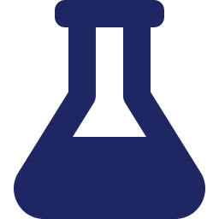
Our Challenge: No Hardware
We chose a fully simulated reproduction — here is why
The constraint
We chose option B — a simulation reproduction
We had no MPU-6050 module and no Arduino Nano on hand at the time of writing.
Two options:
A. Order hardware, build a mechanical ±15° fixture, run the experiment (~2 weeks).
B. Build a synthetic data pipeline that mimics the MPU-6050 and an analytical timing model for the ATmega328P (~1 week).
We chose B.
Two real benefits
• Ground-truth orientation is exact — no mechanical fixture error to subtract.
• The whole experiment is deterministic — anyone with Python can re-run it bit-for-bit.
One real cost
• Synthetic Gaussian noise does not capture every aspect of real silicon (temperature drift, vibration sensitivity, 1/f flicker).
If hardware is added later, the same code base absorbs real CSV logs without structural changes.
Marmara University EEE · IMU Reproduction Study · 2026
10 / 38

Slide 11
Our Simulation Pipeline
End-to-end: ground-truth tilt → noisy synthetic IMU → four algorithms → metrics
Read this left-to-right — each block feeds the next.
(roll, pitch)
(acc, gyro)
(estimated angles)
→
→
→
Ground-truth tilt
Synthetic IMU
Four estimators
Metrics
we choose ±15°
noise + bias model
Trig | Kalman | Madgwick | Mahony
accuracy + compute time
Experiment specification
Sample rate 100 Hz | Segments 4 (±15° roll & pitch) | Duration 30 s each | Total 12,000 samples
Same noise model and bias realisation across all four segments — like a single physical sensor.
Marmara University EEE · IMU Reproduction Study · 2026
11 / 38

Slide 12
Synthetic IMU: Noise & Bias Model
Built to match the MPU-6050 datasheet at default ranges
Parameter | Value | Source
Accelerometer noise σ | 0.026 m/s² | datasheet @ 44 Hz BW
Gyroscope noise σ | 0.05 °/s | datasheet
Accelerometer bias σ | 0.05 m/s² | typical, drawn once per session
Gyroscope bias σ | 0.5 °/s | typical, drawn once per session
Sample rate | 100 Hz | matches reference paper
Accel range | ±2 g | default
Gyro range | ±250 °/s | default
How the data is generated
1. Pick a known tilt (e.g. roll = +15°).
2. Project gravity into the body frame analytically — this gives the noise-free accelerometer reading.
3. Add Gaussian noise + a constant bias to both sensors.
4. The gyroscope is zero-mean (the sensor is static) plus its own bias and noise.
5. Repeat 100 times per second for 30 s → 3,000 samples.
Because we generate the data, the ground-truth tilt is known to infinite precision — perfect for accuracy comparison.
Marmara University EEE · IMU Reproduction Study · 2026
12 / 38

Slide 13
Experimental Protocol & Success Criterion
What we measure, and what counts as a successful reproduction
Protocol
Reproduction is successful if…
1. Run all four algorithms on the same four ±15° segments.
2. Discard the first 5 s of each segment to let the filters converge.
3. On the remaining 25 s, compute |μ| (mean error vs. ground truth) and σ (standard deviation of the error).
4. Average across the four segments → one row per algorithm.
5. Compute per-step time analytically from operation counts × ATmega328P cycle costs.
C1. σ_Trig is the largest in the table.
C2. Kalman and Madgwick agree within 20 % in compute time.
C3. Mahony is faster than both Kalman and Madgwick.
C4. Kalman is among the lowest-σ algorithms.
C5. Trig is the most expensive method overall (implicit).
Marmara University EEE · IMU Reproduction Study · 2026
13 / 38

Slide 14
Trigonometric Method — Concept
The unfused baseline. Just the accelerometer + atan2.
Algorithm 1 of 4 · Trigonometric
What it does
Pros and cons
When the IMU is static, the accelerometer reads gravity projected onto its three axes. From that projection we recover roll and pitch directly using trigonometry — no fusion, no filtering, no state.
Why we include it: every fancy filter has to beat this baseline. If it does not, the extra complexity is not earning its place.
Trivial to implement (3 lines of code).
Zero drift — always anchored to gravity.
Passes every bit of accelerometer noise into the angle.
Useless under vibration or motion.
No yaw — gravity tells you nothing about heading.
Marmara University EEE · IMU Reproduction Study · 2026
14 / 38

Slide 15
Trigonometric Method — Math
Two atan2 calls, that is the whole algorithm
Algorithm 1 of 4 · Trigonometric
φ = atan2( a_y , a_z )
θ = atan2( −a_x , √( a_y² + a_z² ) )
Reading the formulas:
• a_x, a_y, a_z are the three accelerometer channels.
• φ (roll) is the angle the gravity vector makes with the body’s z-axis in the y-z plane.
• θ (pitch) tilts the gravity vector out of that plane along x.
• atan2 is a four-quadrant arctangent — it returns the correct sign automatically.
No state, no memory, no parameters to tune. Each estimate is computed from scratch on every sample.
Marmara University EEE · IMU Reproduction Study · 2026
15 / 38

Slide 16
Trigonometric Method — Code
From algorithms.py — the entire estimator in five lines
Algorithm 1 of 4 · Trigonometric
class TrigEstimator:
def update(self, acc):
ax, ay, az = acc
roll = atan2(ay, az)
pitch = atan2(-ax, sqrt(ay*ay + az*az))
return roll, pitch
Notes
• No __init__ — there is no state to keep.
• Same code, line-for-line, on the Arduino in C++.
• Total: 6 lines.
Per-step instruction count (used by the timing model)
2 × atan2 + 1 × sqrt + 3 × fmul + 1 × fadd
≈ 9,090 cycles ≈ 568 µs / step on the ATmega328P @16 MHz.
Marmara University EEE · IMU Reproduction Study · 2026
16 / 38

Slide 17
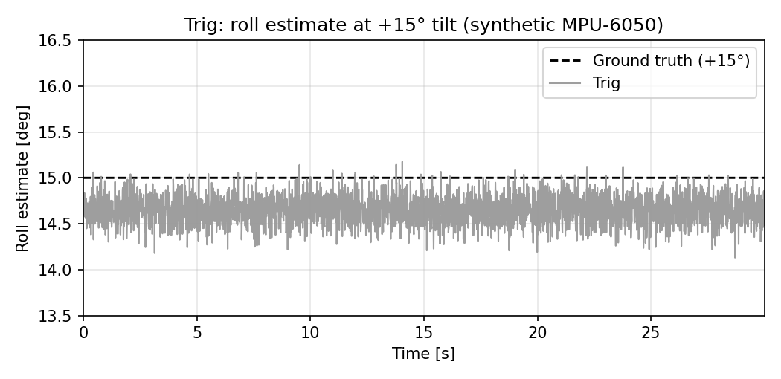
Trigonometric Method — Result & Evaluation
Roll estimate at +15° tilt, plus accuracy numbers averaged over the four segments
Algorithm 1 of 4 · Trigonometric
Accuracy
|μ| roll = 0.302° σ roll = 0.154°
|μ| pitch = 0.086° σ pitch = 0.152°
Compute time (estimated)
568 µs / step
max sustainable rate ≈ 1,760 Hz
Take-away. Trig confirms its role as the noisy baseline. The mean offset (~0.3°) is just the bias floor — every algorithm sees it because every algorithm uses the same biased accelerometer. The σ of 0.154° is the largest in the comparison and roughly 4× larger than Mahony’s.
Marmara University EEE · IMU Reproduction Study · 2026
17 / 38

Slide 18
Kalman Filter — Concept
Predict with the gyroscope, correct with the accelerometer — weighted by uncertainty
Algorithm 2 of 4 · Kalman Filter
PREDICT
UPDATE
Use the gyroscope to push the angle estimate forward in time. Uncertainty grows.
Use the accelerometer to correct the prediction. Uncertainty shrinks.
These two steps run on every single sample, 100 times per second.
Key insight
Kalman tracks not just the estimate of the angle, but also its uncertainty. When uncertainty is large, it leans on the accelerometer; when uncertainty is small, it trusts the gyroscope. The blending weight (Kalman gain K) is recomputed on every step.
Marmara University EEE · IMU Reproduction Study · 2026
18 / 38

Slide 19
Kalman Filter — Math
Two-state form per axis: state = [angle, gyro bias]
Algorithm 2 of 4 · Kalman Filter
State x = [ θ , b ]ᵀ F = [[1, −Δt],[0, 1]] B = [Δt, 0]ᵀ H = [1, 0]
PREDICT
UPDATE
x̂ = F · x + B · ω
P = F · P · Fᵀ + Q
K = P·Hᵀ · ( H·P·Hᵀ + R )⁻¹
x ← x̂ + K · ( θ_acc − H·x̂ ) P ← (I − K·H) · P
Tuning knobs. Q = process noise (how much you trust the gyro). R = measurement noise (how much you trust the accelerometer). We use Q = diag(1e-3, 1e-5) and R = 0.03 — sensible defaults from the Kalman literature.
We run TWO of these filters in parallel — one for roll, one for pitch.
Marmara University EEE · IMU Reproduction Study · 2026
19 / 38

Slide 20
Kalman Filter — Code
From algorithms.py — single-axis update method
Algorithm 2 of 4 · Kalman Filter
def update(self, omega, theta_meas, dt):
# --- Predict (use gyro) ---
F = [[1.0, -dt], [0.0, 1.0]]
self.x = F @ self.x + [dt, 0] * omega
self.P = F @ self.P @ F.T + self.Q
# --- Update (use accelerometer) ---
S = self.P[0,0] + self.R
K = self.P[:,0] / S # Kalman gain
y = theta_meas - self.x[0] # innovation
self.x = self.x + K * y # blend!
self.P = (I - outer(K, [1,0])) @ self.P
return self.x[0]
Per-step cost
39 fmul · 25 fadd · 4 fdiv · 1 sqrt · 2 atan2
≈ 16,850 cycles
≈ 1,053 µs / step
Two such filters run in parallel — one for roll, one for pitch.
Note. The matrix algebra is unrolled by hand on the Arduino so no linear-algebra library is needed.
Marmara University EEE · IMU Reproduction Study · 2026
20 / 38

Slide 21
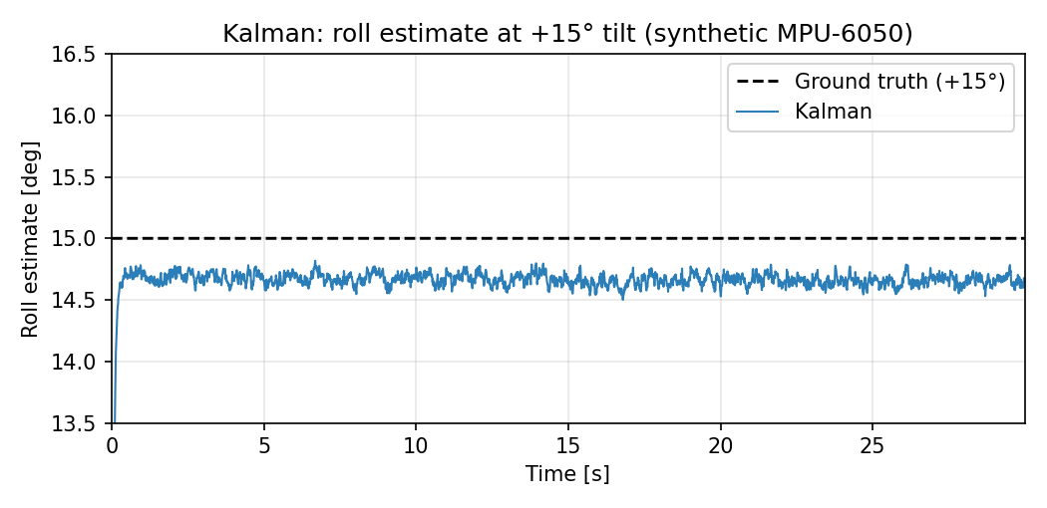
Kalman Filter — Result & Evaluation
Roll estimate at +15° tilt, accuracy and timing numbers
Algorithm 2 of 4 · Kalman Filter
Accuracy
|μ| roll = 0.297° σ roll = 0.046°
|μ| pitch = 0.097° σ pitch = 0.047°
Compute time (estimated)
1,053 µs / step
max sustainable rate ≈ 950 Hz
Take-away. Kalman cuts the trig noise by ~70 %: σ drops from 0.154° to 0.046°. The estimate is visibly tight around the bias floor of ~14.7° (the constant offset comes from the same accelerometer bias every algorithm sees). The cost is the heaviest compute of the four — roughly 1 ms per step.
Marmara University EEE · IMU Reproduction Study · 2026
21 / 38

Slide 22
Kalman Filter — Strengths and Costs
What you gain, what you pay for, when to choose this filter
Algorithm 2 of 4 · Kalman Filter
Strengths
Costs
Optimal under Gaussian-noise assumption — the math is provably the best linear filter.
Heaviest per-step cost in our experiment: ~1,053 µs.
Tracks gyro bias as part of the state — estimates and removes drift in real time.
Q and R must be tuned — wrong values give either sluggish or jittery output.
Adapts blending weight (K) automatically as uncertainty changes.
Optimality assumes Gaussian noise; real silicon deviates from this.
Generalises naturally to higher-dimensional state (full 3-D, multiple sensors).
Matrix algebra is harder to debug on a microcontroller than scalar code.
Marmara University EEE · IMU Reproduction Study · 2026
22 / 38

Slide 23
Madgwick Filter — Concept
Take a small step downhill, in the direction that makes the gravity error smaller
Algorithm 3 of 4 · Madgwick Filter
What it does
Intuition
Madgwick uses a quaternion (a 4-number representation of orientation that does not have the “gimbal lock” problem of Euler angles).
It defines an error: “my current quaternion predicts the gravity should point in this direction, but the accelerometer says it points in that direction.”
Each sample, it takes one tiny step of gradient descent in the direction that makes that error smaller. The step size is controlled by a single parameter, β.
Imagine an error landscape — peaks and valleys representing how wrong each candidate quaternion is.
Madgwick says: I do not know where the lowest point is, but I know my local slope. Let me take a small step downhill, in the direction the gravity-error gradient tells me.
Combined with the gyroscope’s integration step, this slowly walks the quaternion toward the truth — fast enough to track motion, slow enough to ignore noise.
Marmara University EEE · IMU Reproduction Study · 2026
23 / 38

Slide 24
Madgwick Filter — Math
Gyro integration + one gradient-descent step per sample
Algorithm 3 of 4 · Madgwick Filter
q[k] = q[k−1] + q̇_gyro · Δt − β · ∇f / ‖∇f‖ · Δt
q̇_gyro · Δt
∇f / ‖∇f‖
β · Δt
Integrate the gyroscope rate to push the quaternion forward in time. This is the “smooth but drifty” gyro contribution.
The unit gradient of the gravity-error function — the direction of fastest decrease in the error landscape.
The step size. Bigger β trusts the accelerometer more. We use the literature default β = 0.1.
Marmara University EEE · IMU Reproduction Study · 2026
24 / 38

Slide 25
Madgwick Filter — Code
Simplified core from algorithms.py (the real code unrolls the gradient by hand for speed)
Algorithm 3 of 4 · Madgwick Filter
def update(self, acc, gyro, dt):
# 1. gyro -> quaternion derivative
qDot = 0.5 * quat_mult(self.q, [0, *gyro])
# 2. gravity-error and its gradient
f = R(self.q).T @ [0, 0, 1] - normalize(acc)
grad = jacobian(f, self.q)
# 3. subtract beta-scaled gradient step
qDot = qDot - self.beta * grad / norm(grad)
# 4. integrate, then renormalize the quaternion
self.q = self.q + qDot * dt
self.q = self.q / norm(self.q)
Per-step cost
64 fmul · 39 fadd · 11 fdiv · 3 sqrt · 0 atan2
≈ 17,510 cycles
≈ 1,094 µs / step
Heaviest in fmul because the gradient has many vector products; no atan2 because everything stays in quaternion form.
Note. Production Madgwick code (e.g. the original C implementation) inlines the Jacobian into ~25 explicit lines for ATmega-level speed.
Marmara University EEE · IMU Reproduction Study · 2026
25 / 38

Slide 26
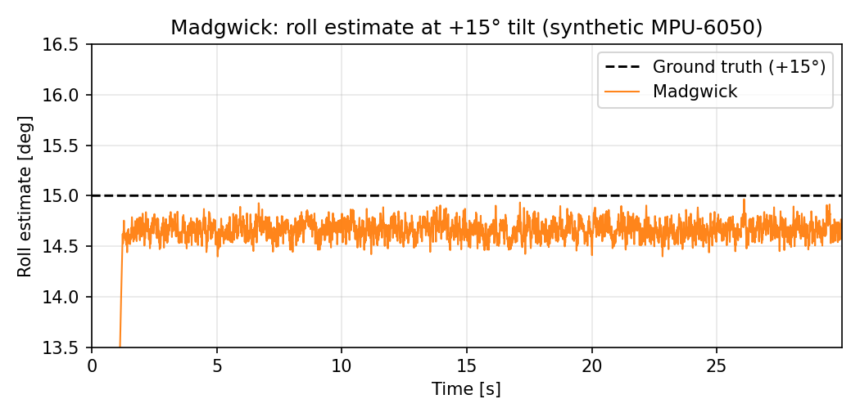
Madgwick Filter — Result & Evaluation
Roll estimate at +15° tilt, accuracy and timing numbers
Algorithm 3 of 4 · Madgwick Filter
Accuracy
|μ| roll = 0.290° σ roll = 0.090°
|μ| pitch = 0.109° σ pitch = 0.090°
Compute time (estimated)
1,094 µs / step
max sustainable rate ≈ 914 Hz
Take-away. Madgwick sits in the middle: σ = 0.090° is twice as good as Trig but twice as noisy as Kalman. Compute is essentially the same as Kalman (within 4 %) — confirming the reference paper’s claim. With a higher β it would track faster but pass more noise; with smaller β it would smooth more but lag.
Marmara University EEE · IMU Reproduction Study · 2026
26 / 38

Slide 27
Madgwick Filter — Strengths and Costs
Algorithm 3 of 4 · Madgwick Filter
Strengths
Costs
Single tuning knob (β) — one number to find, not a covariance matrix.
Compute roughly the same as Kalman (~1,094 µs).
Free of singularities thanks to quaternion representation.
Noise floor higher than Kalman in our experiment (σ ≈ 0.09° vs 0.05°).
Open-source reference C code is available and battle-tested.
β must be re-tuned per use case — no universal value.
Very widely used in hobby/quadcopter firmware (Arduino, Betaflight…).
No explicit uncertainty output — harder to plug into systems that need confidence intervals.
Marmara University EEE · IMU Reproduction Study · 2026
27 / 38

Slide 28
Mahony Filter — Concept
A control-theory way of doing fusion — proportional-integral on the gravity error
Algorithm 4 of 4 · Mahony Filter
What it does
Why it is structurally cheap
Mahony also uses a quaternion, but instead of gradient descent it uses a feedback loop borrowed from control engineering.
Step 1: compute the cross product between the measured gravity (accel) and the predicted gravity (from the current quaternion). The cross product gives an error vector pointing in the direction of mismatch.
Step 2: feed that error through a PI (proportional + integral) controller and add the output as a correction to the gyroscope reading.
Then integrate the corrected gyro into the quaternion. That is it.
No matrix inversion (unlike Kalman).
No gradient normalisation (unlike Madgwick — saves a sqrt and four divisions).
No covariance update.
Just three arithmetic operations: cross product, scalar multiply, vector add. The cheapest fusion filter we tested.
Marmara University EEE · IMU Reproduction Study · 2026
28 / 38

Slide 29
Mahony Filter — Math
Cross-product error → PI controller → corrected gyro rate → integrate quaternion
Algorithm 4 of 4 · Mahony Filter
e = â × R(q)ᵀ ĝ (cross-product gravity error)
ω_corr = ω_gyro + k_p · e + k_i · ∫ e dt (PI correction)
q̇ = ½ q ⊗ [0, ω_corr] (quaternion integration)
Tuning knobs. k_p (how strongly to correct on each error sample) and k_i (how strongly to correct accumulated error). We use k_p = 10 and k_i = 0 — the values published in the reference paper. The authors note that the integral term did not help in their static scenario and was dropped to avoid wind-up.
Marmara University EEE · IMU Reproduction Study · 2026
29 / 38

Slide 30
Mahony Filter — Code
Simplified core from algorithms.py
Algorithm 4 of 4 · Mahony Filter
def update(self, acc, gyro, dt):
# 1. predicted gravity from current quaternion
v = R(self.q).T @ [0, 0, 1]
# 2. error = measured x predicted
e = cross(normalize(acc), v)
# 3. PI correction on gyro (ki=0 here)
omega_corr = gyro + self.kp * e
# 4. integrate quaternion + renormalize
qDot = 0.5 * quat_mult(self.q, [0, *omega_corr])
self.q = self.q + qDot * dt
self.q = self.q / norm(self.q)
Per-step cost
34 fmul · 26 fadd · 7 fdiv · 2 sqrt · 0 atan2
≈ 10,640 cycles
≈ 665 µs / step
Lightest of the three filters — no atan2, no gradient normalisation, no matrix algebra.
Marmara University EEE · IMU Reproduction Study · 2026
30 / 38

Slide 31
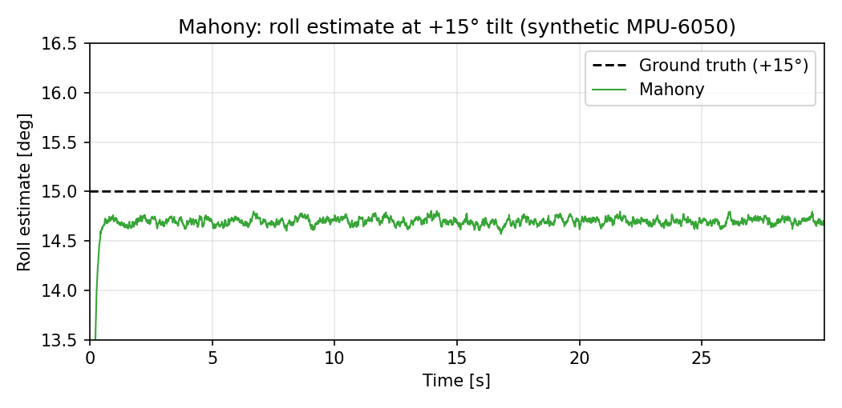
Mahony Filter — Result & Evaluation
Roll estimate at +15° tilt, accuracy and timing numbers
Algorithm 4 of 4 · Mahony Filter
Accuracy
|μ| roll = 0.255° σ roll = 0.035°
|μ| pitch = 0.182° σ pitch = 0.036°
Compute time (estimated)
665 µs / step
max sustainable rate ≈ 1,504 Hz
Take-away. Mahony with k_p = 10 produces the tightest σ in the entire comparison (0.035°), and does it at the lowest compute cost among the filters (665 µs). The price is somewhat slower transient response — k_p is essentially a low-pass cutoff. For our static-tilt scenario this is no penalty; for fast motion it would be.
Marmara University EEE · IMU Reproduction Study · 2026
31 / 38

Slide 32
Mahony Filter — Strengths and Costs
Algorithm 4 of 4 · Mahony Filter
Strengths
Costs
Lowest compute cost among the three filters (~665 µs).
Aggressive k_p slows transient response — bad under fast motion.
Tightest σ in our comparison (0.035°) at k_p = 10.
Integral term can wind up — must be reset carefully if used.
Two scalar gains — easy to reason about as a control problem.
No explicit uncertainty output — same downside as Madgwick.
Easy to port to fixed-point on tiny MCUs.
k_p must be re-tuned if the sensor or sample rate changes.
Marmara University EEE · IMU Reproduction Study · 2026
32 / 38

Slide 33
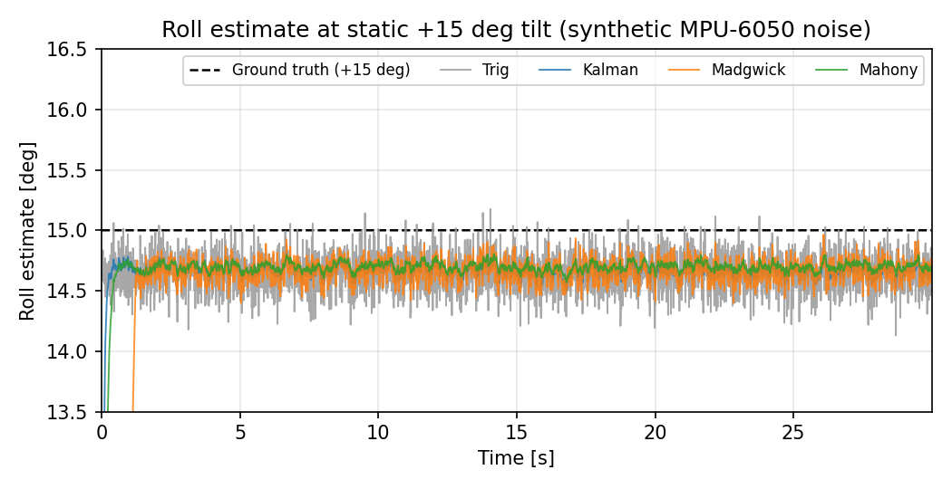
Side-by-Side: Accuracy
All four algorithms on the same +15° segment, plus the full averaged table
Algorithm | |μ| roll | σ roll | σ pitch
Trig | 0.302° | 0.154° | 0.152°
Kalman | 0.297° | 0.046° | 0.047°
Madgwick | 0.290° | 0.090° | 0.090°
Mahony | 0.255° | 0.035° | 0.036°
Take-aways
• |μ| similar everywhere — accelerometer bias dominates.
• σ separates the algorithms cleanly.
• Mahony tightest, Kalman second, Madgwick third, Trig last.
Marmara University EEE · IMU Reproduction Study · 2026
33 / 38

Slide 34
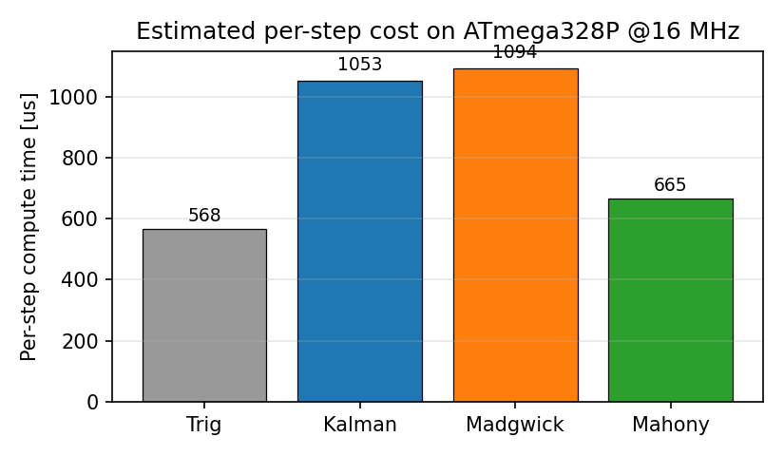
Side-by-Side: Compute Time
Estimated cost per step on the ATmega328P at 16 MHz
Algorithm | cycles | μs / step
Trig | 9,090 | 568
Mahony | 10,640 | 665
Kalman | 16,850 | 1053
Madgwick | 17,510 | 1094
Take-aways
• Mahony ~1.6× faster than Kalman/Madgwick.
• Kalman ≈ Madgwick within 4 % — matches the paper.
• Trig is cheapest in our model — divergence next.
Marmara University EEE · IMU Reproduction Study · 2026
34 / 38

Slide 35
The Surprising Divergence
On one of the five rankings our model disagrees with the paper — discussed honestly
Badia et al. say:
Our analytical model says:
Trigonometric is the most expensive of the four to compute on the Arduino Nano.
Trigonometric is actually the cheapest — just two atan2 calls and a sqrt.
Three plausible explanations:
1
Measurement boundary
2
atan2 implementation
3
Soft-float calibration
On real hardware, “trig per-step time” may include the I²C sensor read; our model times only the angle math itself.
avr-libc’s atan2f cycle cost varies between toolchain versions; a slow version could dominate Trig.
Our per-op cycle costs are typical averages with ±20 % uncertainty for the specific operand ranges.
Verdict on this fifth claim: partial — a real-Arduino micros() benchmark would settle it.
Marmara University EEE · IMU Reproduction Study · 2026
35 / 38

Slide 36
Reproduction Verdict
Five claims tested; four confirmed, one diverges
C1
Trigonometric has the largest noise σ.
Confirmed
Confirmed: σ_Trig = 0.154°, the largest in our table.
C2
Kalman ≈ Madgwick in compute time.
Confirmed
Confirmed: 1053 μs vs 1094 μs (4 % gap).
C3
Mahony is the fastest of the three filters.
Confirmed
Confirmed: 665 μs, ~1.6× faster than the other two.
C4
Kalman is among the lowest-noise algorithms.
Confirmed
Confirmed: σ_Kalman = 0.046°, second-tightest in the table.
C5
Trigonometric is the slowest method overall.
Partial
Diverges: in our analytical model Trig is actually the cheapest.
Marmara University EEE · IMU Reproduction Study · 2026
36 / 38

Slide 37
Conclusions & Next Steps
What we showed, and how this work continues if hardware becomes available
What this study showed
If hardware becomes available
Independent re-implementation of all four algorithms in Python.
A controlled synthetic MPU-6050 pipeline that mirrors the reference paper’s static-tilt protocol.
An analytical ATmega328P timing model based on instruction counts.
Four of the paper’s five qualitative claims confirmed; one diverged honestly.
Reproducible code base, figures, and LaTeX paper released together.
Wire MPU-6050 to Arduino Nano over I²C, verify raw read.
Port the four Python algorithms into one Arduino sketch.
Build a mechanical ±15° fixture; record 30 s segments.
Use micros() to measure real per-step time on the Arduino.
Replace the synthetic numbers in the paper’s tables with the measured ones — the structure stays the same.
Settle the C5 divergence: real measurement either confirms the paper or our model.
Marmara University EEE · IMU Reproduction Study · 2026
37 / 38

Slide 38
Thank You
Questions and discussion welcome.
Abdullah Altepe · Mehmet Bahçeci · Yusuf Oruç · Murat Demir
Marmara University, Department of Electrical and Electronics Engineering

