Slide 1
Super Store Analysis
Presented by Abdullah Atiq Ur Rehman

Slide 2
Superstore Dataset
USA superstore dataset containing order history.
Duration January 2014 - December 2017
Covers orders placed by 793 customers
Pool of 49 states in the USA (One state not included is Alaska)
Link to Dataset: Superstore Dataset

Slide 3
Superstore Dataset
Data Source: Kaggle
Rows: About 10,000 rows
Columns: 21 columns
Major Columns: Order ID, Order Date, Ship Date, Ship Modes, Customer ID, Customer Name, Segments, Cities, States, Postal Codes, Regions, Product ID, Category, Sub-Category, Unit Price, Quantity, Discount and Profit

Slide 4
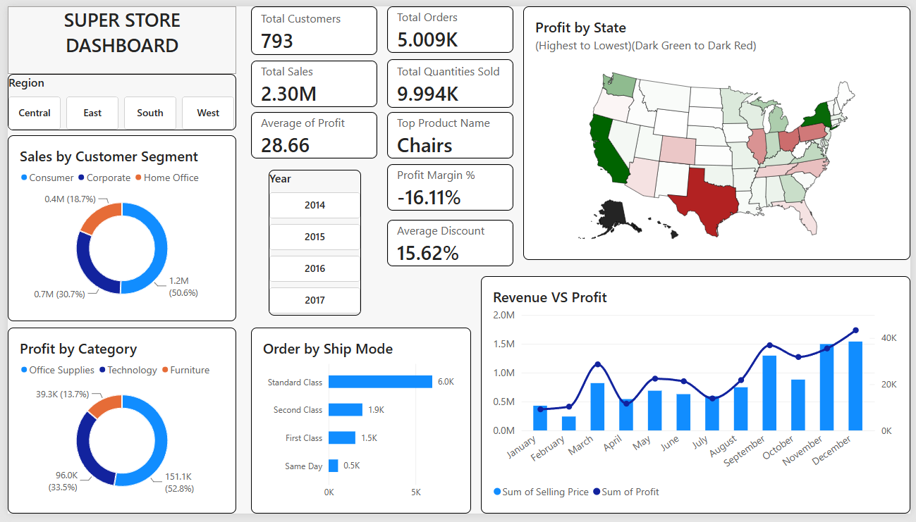

Slide 5
Business problems:-
Q) Heavy Discounts destroy profitability
Q) Furniture is barely profitable
Q) Tables are losing money
Q) Some states are destroying profits

Slide 6
Q) Heavy Discounts destroy profitability
Finding:-
So What:-
Revenue is rising, but Profit margins are being severely suppressed by specific product categories and states.
The company is paying the customer to buy products at more than 20% discount
Recommendation:-
Limit discount rate to 20%
Require approval for a discount above 20 %

Slide 7
Q) Furniture is barely profitable
Finding:-
So What:-
Furniture contributes 32% of sales and only 6% of total profit
A huge amount of effort and inventory is generated, with almost no return.
Recommendation:-
Re-pricing furniture
Reduce discounts

Slide 8
Q) Tables are losing money
Finding:-
So What:-
Tables are the single biggest
profit leak
Even if sales increase, losses may
increase too.
Recommendation:-
Bundle with profitable products
Increase pricing

Slide 9
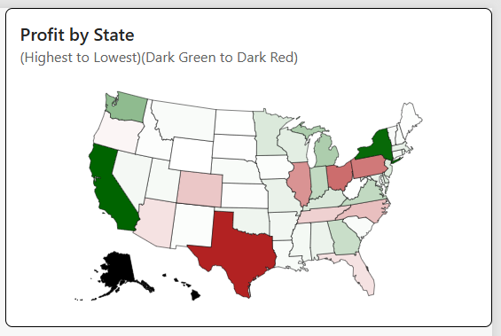
Q) Some states are destroying profits
Finding:- (Top 3 states) (States have profit less than 0)
Texas has a profit of -$25.7K
Ohio has a profit of -$16.9K
Pennsylvania has a profit of -$15.6K
So What:-
These states are consuming
profits generated elsewhere.
Recommendation:-
Review regional pricing

Slide 10
Regional Performance
Insight:-
The West region is the strongest contributor to profit
Investigation needed on central performance because the revenue to profit is relatively lower than others.

Slide 11
Hidden Risk
19.4 % of orders are Loss-Making
Nearly 1 in 5 orders lose money
Recommendation:-
Build an alert for orders with a discount above the threshold
Build an alert for an order with negative margins

Slide 12
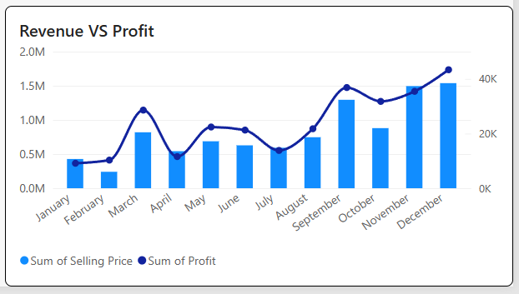
Useful Finding:-
Revenue generated in each month of the year 2014 – 2017.
Feb is the month with the least sales, which is $240.8K, and the least profit is $10.2K
Dec is the month with the highest sales, which is $1.54M, and the highest profit is $43.3K because of festivals like Thanksgiving, Christmas and New Year

Slide 13
Conclusion
The company does not have a sales problem- rather, it has a profitability management issue. Revenue is strong at $2.3M, but profit has worsened due to excessive discounting, underperforming states, and regional performance. So, by implementing the recommendations mentioned earlier, the realistic target would be a 10 to 20% profit improvement.
I would recommend the executive to monitor:-
Total Sales (Focus on Revenue)
Profit Margin % (Focus on Profit)
Profit by Region (Focus on Profit)
Sales by Segment (Focus on Customer)
Discount %
Average Profit

