Slide 1
BANK MARKETING CAMPAIGN
Scipy

Slide 2
OUTLINE
Dataset & Case
Scenario
Business problem dan goals
EDA
Modelling
Simulation
Conclusion

Slide 3
Dataset & Case
Dataset used was bank marketing campaign dataset from Kaggle (https://www.kaggle.com/volodymyrgavrysh/bank-marketing-campaigns-dataset)
Features Description
Bank client data:
Age (numerical continuous)
Job : type of job (categorical: "admin.","blue-collar","entrepreneur",...,"unknown")
Marital : marital status (categorical: "divorced","married","single","unknown")
Education : (categorical: "illiterate",...,"university.degree","unknown")
Default: has credit in default? (categorical: "no","yes","unknown")
Housing: has housing loan? (categorical: "no","yes","unknown")
Loan: has personal loan? (categorical: "no","yes","unknown")

Slide 4
Dataset & Case
Related with the last contact of the current campaign:
Contact: contact communication type (categorical: "cellular","telephone")
Month: last contact month of year (categorical: "jan", …, "nov", "dec")
Dayofweek: last contact day of the week (categorical: "mon","tue",...)
Duration: last contact duration, in seconds (numeric).
Important note: this attribute highly affects the output target (e.g., if duration=0 then y="no"). , Can not get this feature before the campaign
Other attributes:
Campaign: number of contacts performed during this campaign and for this client (numeric, includes last contact)
Important note: Can not get this feature before the campaign
Pdays: number of days that passed by after the client was last contacted from a previous campaign (numeric; 999 means client was not previously contacted)
Previous: number of contacts performed before this campaign and for this client (numeric)
Poutcome: outcome of the previous marketing campaign (categorical: "failure","nonexistent","success")

Slide 5
Dataset & Case
Social and economic context attributes
- Emp.var.rate: employment variation rate - quarterly indicator (numeric)
- Cons.price.idx: consumer price index - monthly indicator (changes in the price level of a weighted average market basket of consumer goods and services purchased by households, affect inflation (numeric))
- Cons.conf.idx: consumer confidence index - monthly indicator (degree of consumers optimism are expressing through their activities of savings and spending. affect consumer behavior (numeric))
- Euribor3m: euribor 3 month rate - daily indicator (Euribor (euro interbank offered rate) (numeric))
- Nr.employed: number of employees - quarterly indicator (Number of employed persons for a quarter (numeric))
Output variable (desired target):
- y - has the client subscribed a term deposit? (binary: "yes","no")

Slide 6
Scenario
We are data scientist team working at XYZ Bank in Portugal
The business development team came to us and told us that they needed improvement on marketing campaign result because the result was not good enough compared to the cost
They are asking if we can propose solutions to either reduce the cost or increase the income generated or both
They gave us customer dataset used at the recent campaign which consist of the bank’s customer data

Slide 7
TIM DATA SCIENCE
PERLU DIBUAT MODEL
Model untuk prediksi calon customer untuk program marketing selanjutnya
Terima report dari tim marketing
Dari report tersebut didaptkan masih gagal (88% tdk beli deposito)
Evaluasi
Tambahan :
Concern tim marketing di cost campaign
[PENTING] model digunakan sebelum melakukan campaign/program marketing
Kolom di dataset model yang dipakai adalah KOLOM YG BISA DIDAPATKAN Sebelum melakukan Campaign
!! INGAT !!
Calon customer yang di approach adalah nasabah bank tersebut

Slide 8
Analisis dilakukan di waktu jeda antar program
Mengacu pada jumlah minimal rekening nasabah premium
Gas masukin ke list calon customer
Model
Proba YA > 0.6
Data baru
!! INGAT !!
patokan di 500 jt rupiah/ 30,000 euro
Rekening >= patokan (SABI)
Rekening < Patokan (tidak sabi)
Sabi
0.6 >=Proba Ya >= 0.3
Lihat isi rekeningnya sabi ga
Tidak Sabi
Proba Ya < 0.3
JANGAN masukin ke list calon customer

Slide 9
Business Problems and Goals
Business Problems
Subscribe rate from the dataset is low (11.27%)
Cost expended was too big for the income generated
Need a way to filtering the potential bank customer or not to buy a deposit

Slide 10
Business Problems and Goals
Business Goals
Predict Potential Bank Customer that will buy deposit or not with Machine Learning Method
Give Cost Reduction Simulation after and before using Machine Learning

Slide 11
EDA (EXPLANATORY DATA ANALYSIS)
UNIVARIATE
MULTIVARIATE

Slide 12
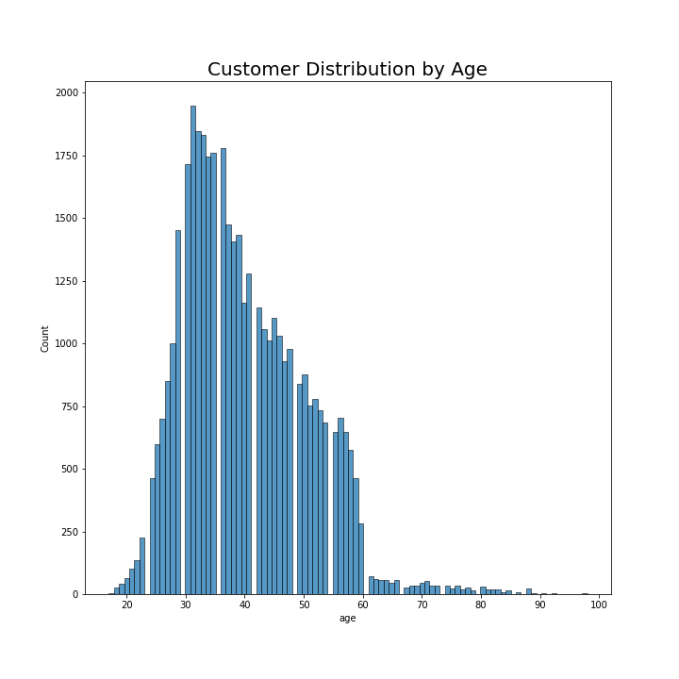
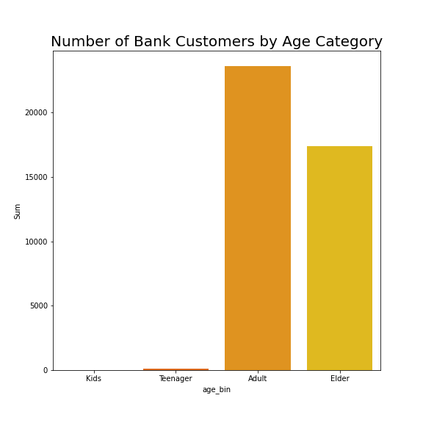
EDA - Univariate
Most customers were 25 to 60 years old
There is little to none customers in kids and teenager group

Slide 13
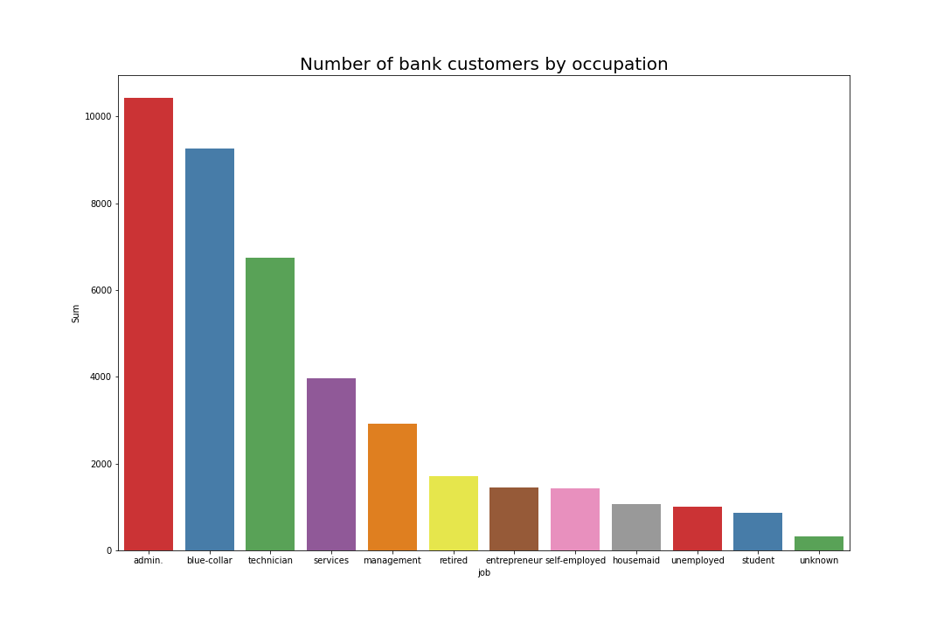
EDA – Univariate (2)
Most customers are working as admin, blue-collar, and technician

Slide 14
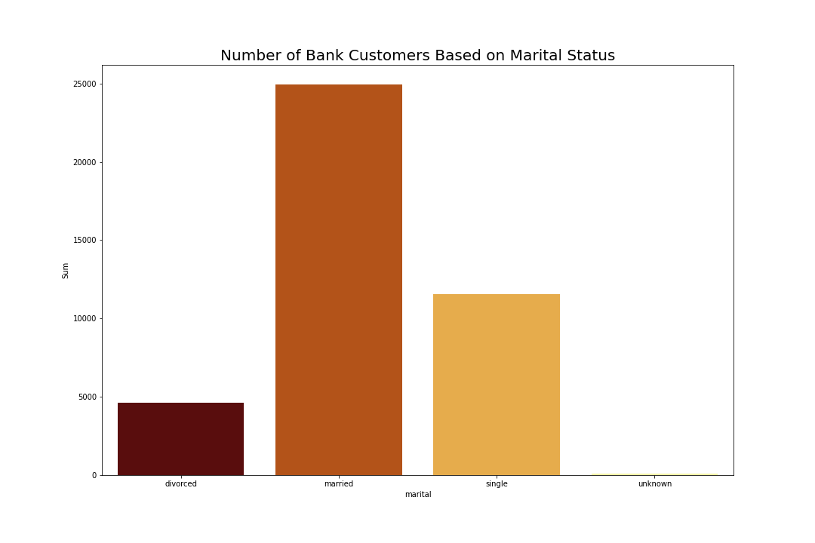
EDA – Univariate (3)
Most customers are married

Slide 15
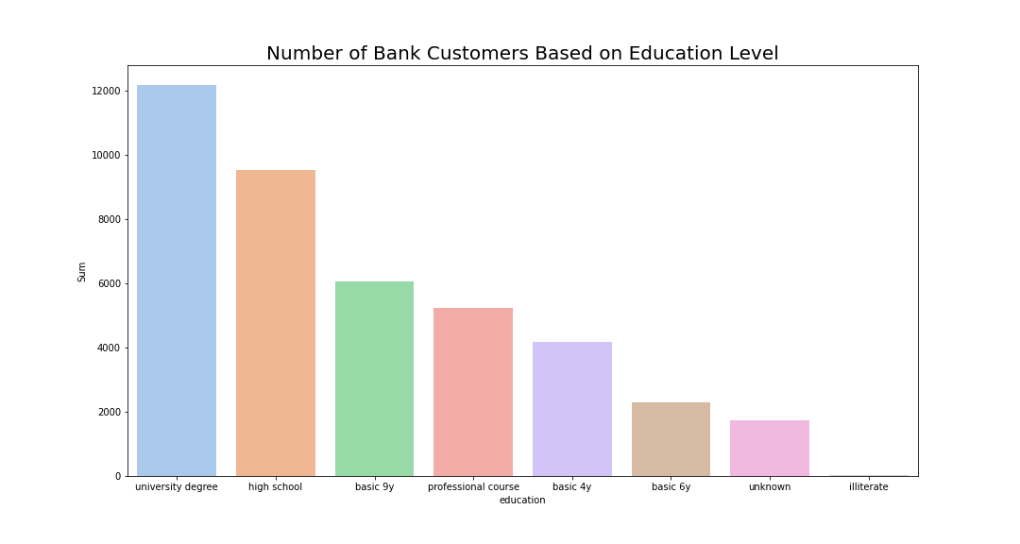
EDA – Univariate (4)
Most customers have university degree and high school education

Slide 16
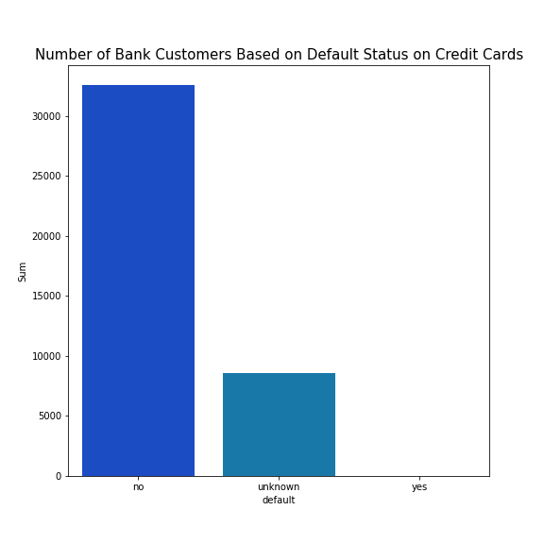
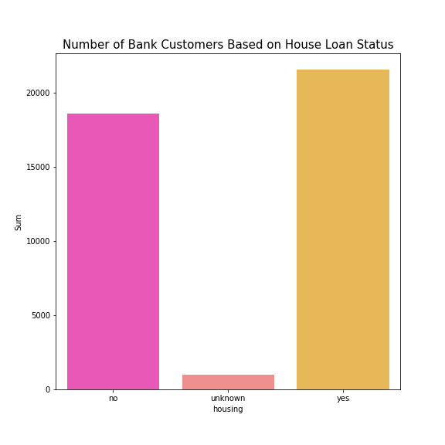
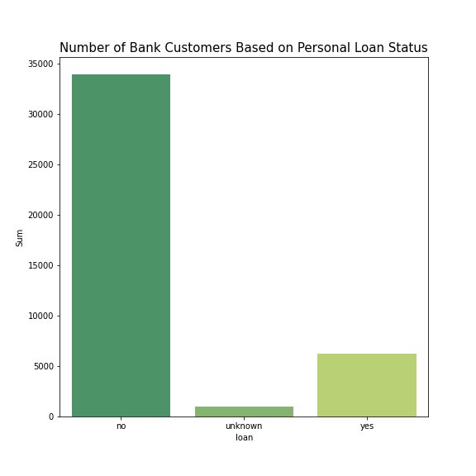
EDA – Univariate (5)
Most customers are not credit card default and has no personal loan
More than half of the customers have housing loan

Slide 17
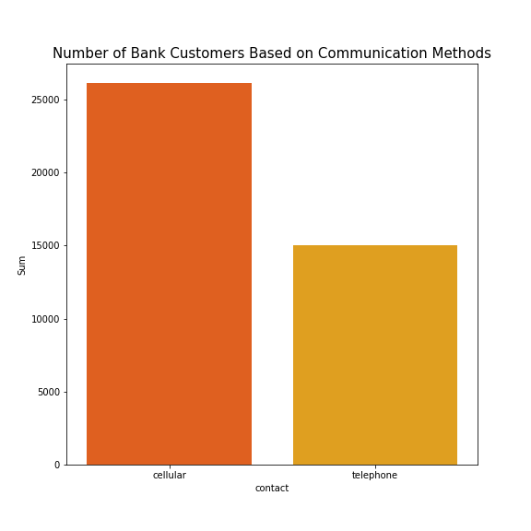
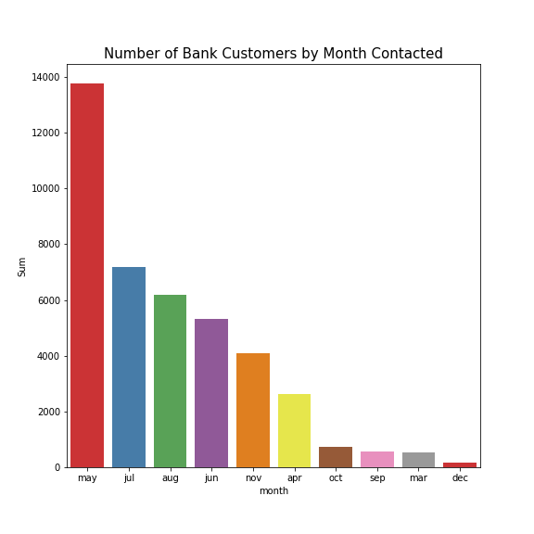
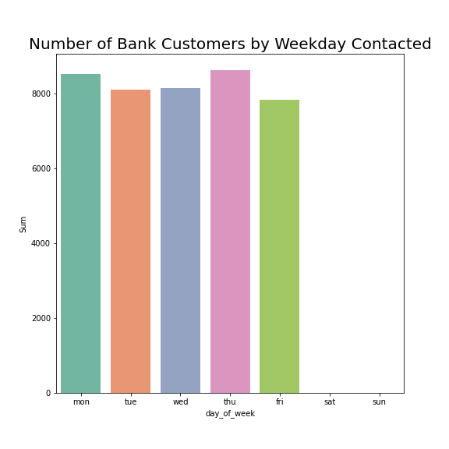
EDA – Univariate (6)
Most customers were contacted through their mobile phone
Most customers were contacted in May and all of them were contacted at weekdays

Slide 18
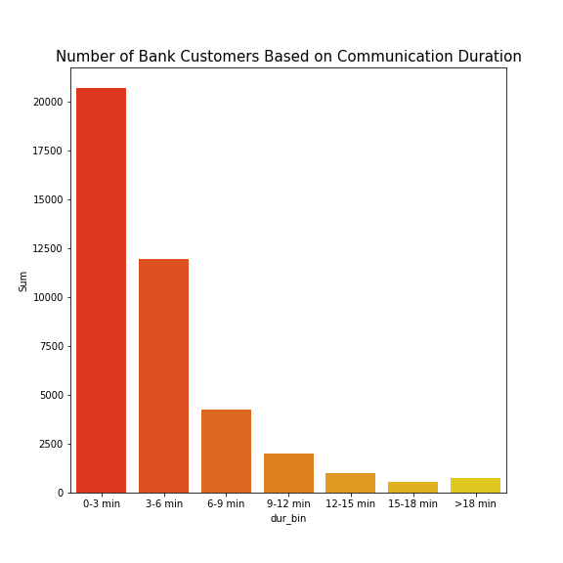
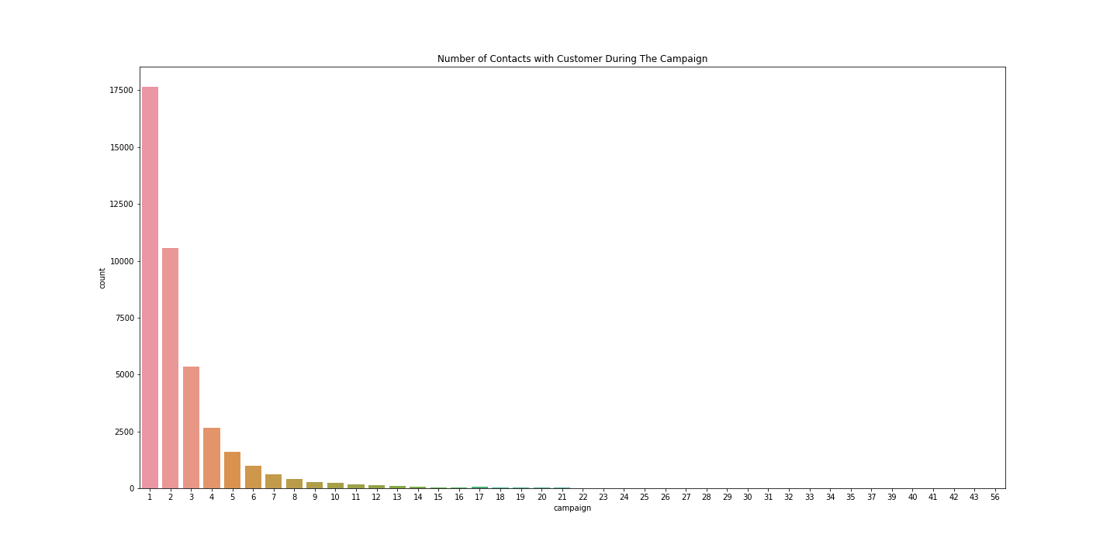
EDA – Univariate (6)
Most call durations are 0-3 mins and 3-6 mins
Most customers only contacted between 1 to 3 times during the campaign

Slide 19
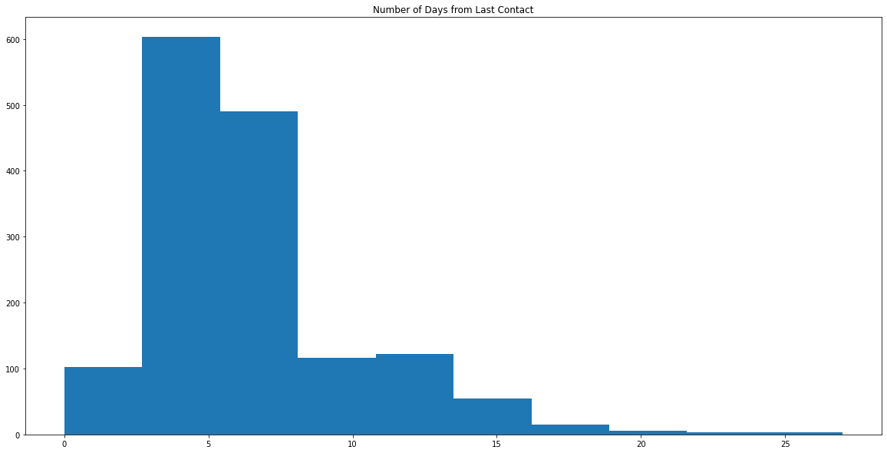
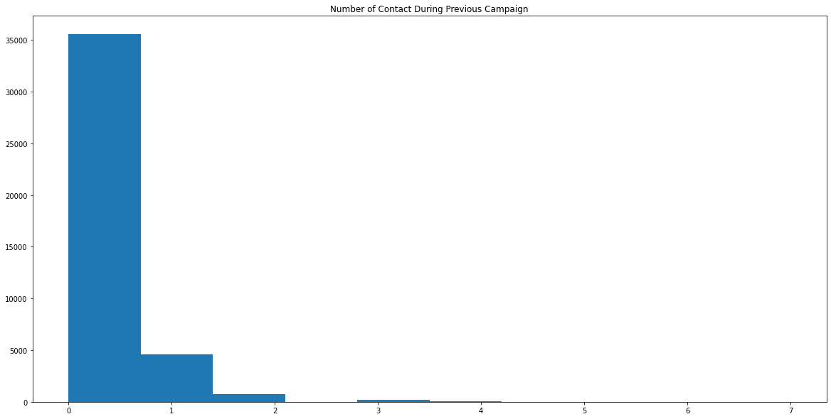
EDA – Univariate (7)
Most call customers are contacted again in 10 days
Most customers only contacted between 1 to 2 times during the previous campaign

Slide 20
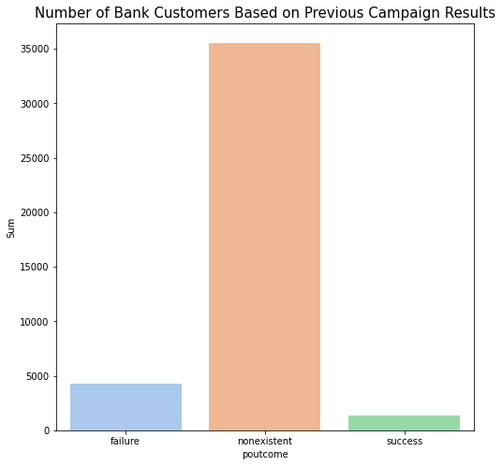
EDA – Univariate (8)
Most customers were not included in previous campaign and have nonexistent results

Slide 21
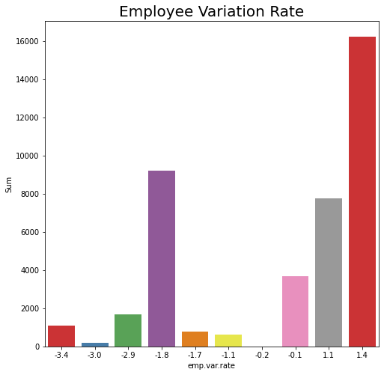
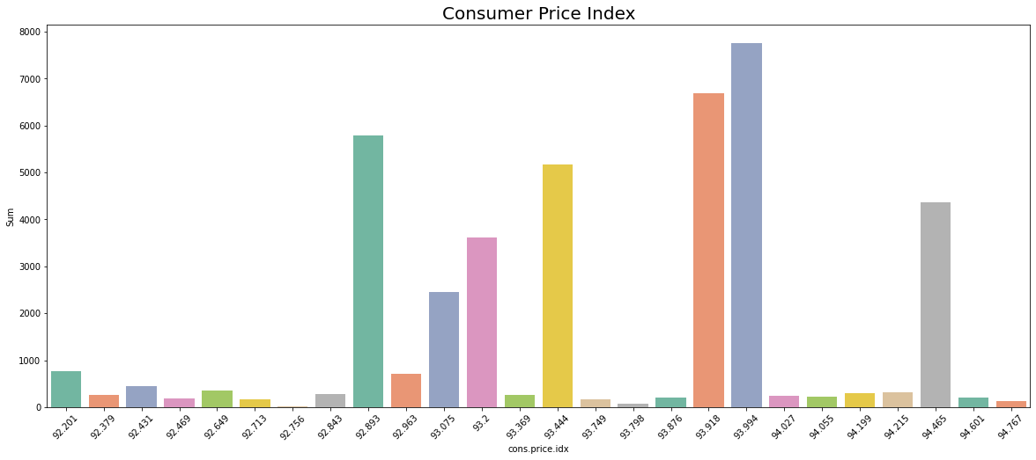
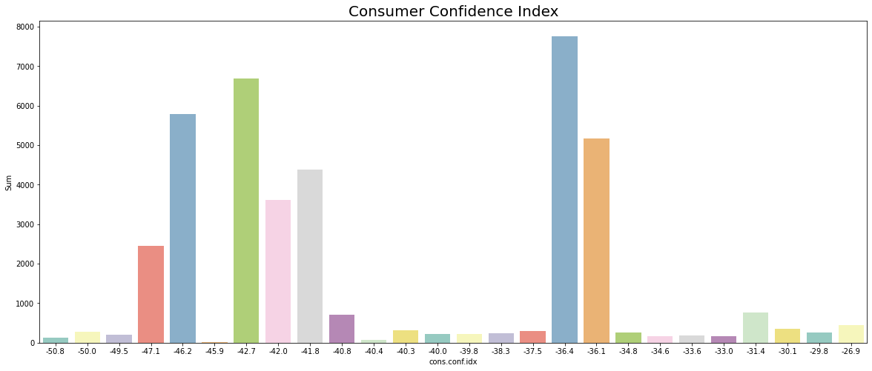
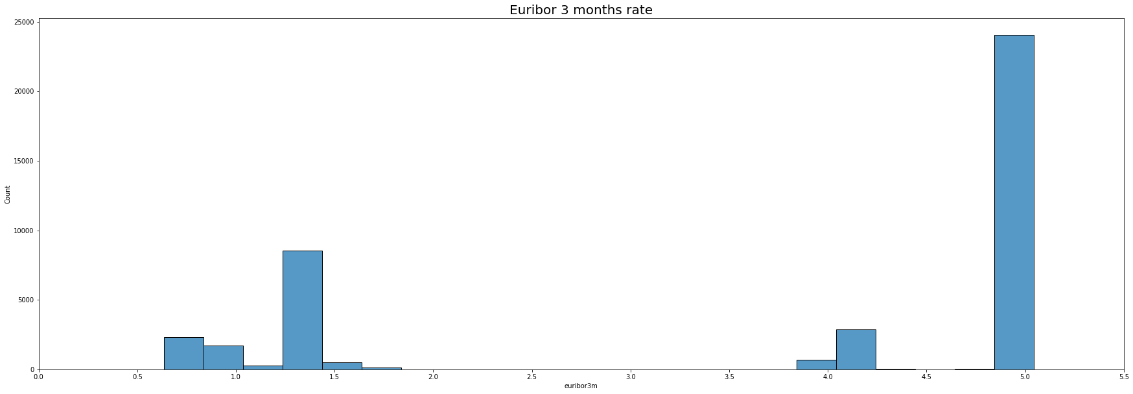
EDA – Univariate (9)

Slide 22
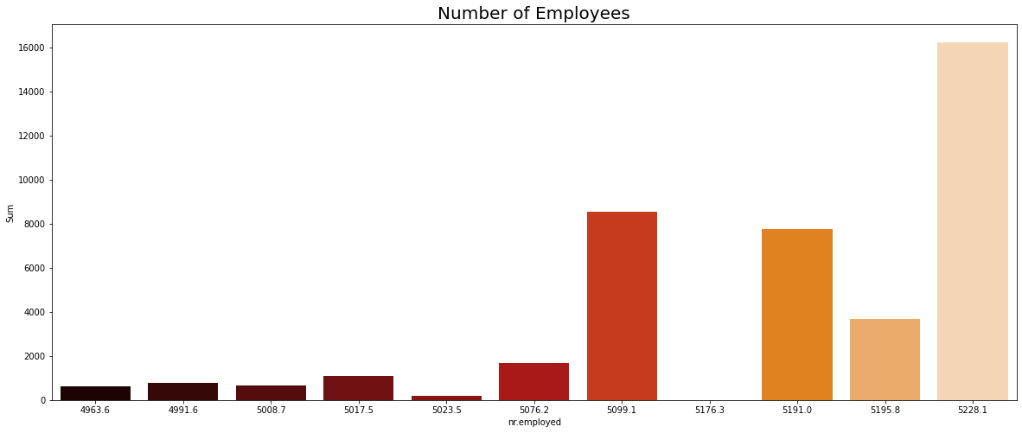
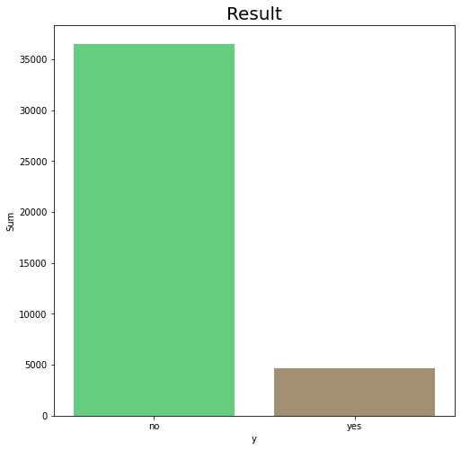
EDA – Univariate (10)
Most call customers were contacted when number of employees were high
Most didn’t subscribe to term deposit offered

Slide 23
MODELLING

Slide 24
Overview
The model used before running the campaign
Use Features/column that can be obtained before the campaign
Data Preparation
Drop Columns ‘duration’ & ‘campaign’
Check Null values
Change the values in target column (‘y’) into numerical value

Slide 25

Data Imbalance Check
0 ➔ No
1 ➔ Yes

Slide 26
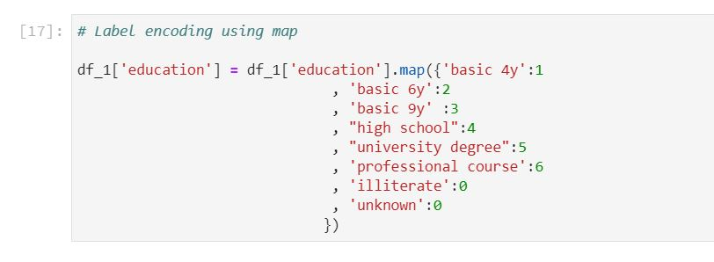
Label Encoding
Only Education Column

Slide 27
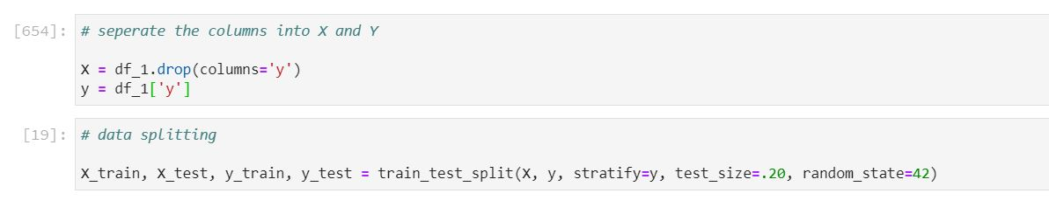
Splitting Data
Split the data into X (all features except ‘y’) and y (target column)
Split the X and y into train and test data each with ratio 80%:20%

Slide 28
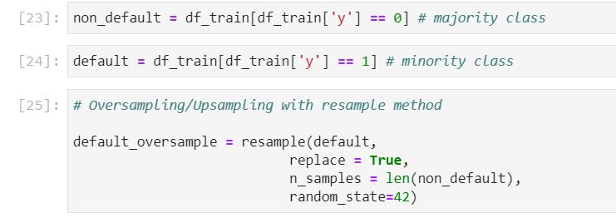
Data Oversampling
To solve the data imbalance problem
Random Over sampling
ONLY for the train data

Slide 29
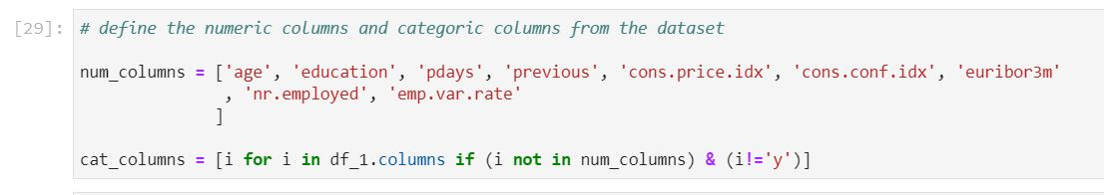
Pipeline
Separate the Numerical Columns and Categorical Columns

Slide 30
Pipeline
Pipeline
Features engineering
Robust Scaling
Encoding
One Hot Encoding
Numerical Columns
Categorical Columns

Slide 31
Model
Logistic Regression
Random Forest
SVM
XGB
KNN
Decision Tree

Slide 32
Evaluation Matrix
PRECISION is more important because
Predict 1 (buy deposit) but in actual 0 (not buying) have more risk and wasting more cost
Increase
Precision
Decrease
False Positive

Slide 33
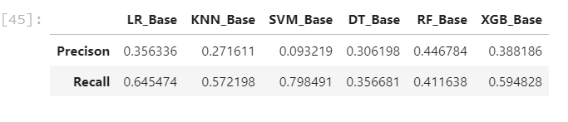
Evaluation Matrix
Base Model

Slide 34
Hyperparameter Tuning
4 Potential Model :
Logistic Regression
Random Forest
Decision Tree
XGBoost

Slide 35
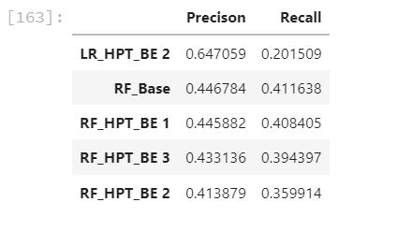
Hyperparameter Tuning
5 Model that have the highest precision
In conclusion we use Logistic Regression 2nd Hyperparameter tuning

Slide 36
Suggestion
We need to add costumer account balance feature that have greater impact to the model because before someone decide to take/buy a deposit, they surely gonna check their account balance first to see if they have enough money or not

Slide 37
Probability
We predict the probability to buy a deposit (after using the model) for every bank customer
We categorize the probability into 3 groups (‘< 0.3’, ‘0.3 – 0.6’ & ‘> 0.6’)

Slide 38
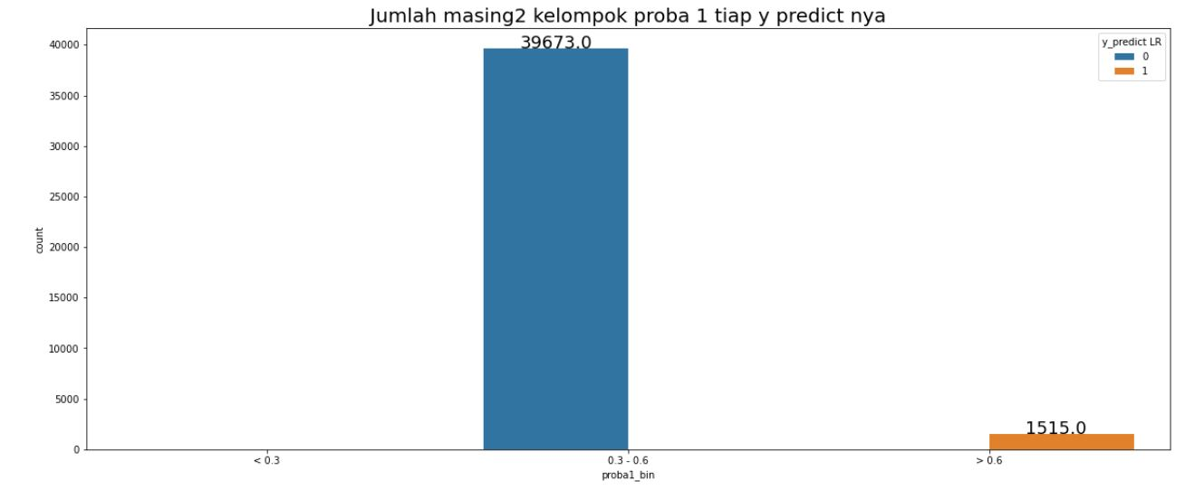
Probability
All 0 predict ➔ 0.3 – 0.6 proba 1
All 1 predict ➔ > 0.6 proba 1

Slide 39
SIMULATION

Slide 40
Approach
Duration Approach
Use sum of the duration directly

Slide 41
Assumption
Cost driven by two main things : Call Charges per Minutes, Salary
The campaign duration is can be adjust
Call charges: 0.3 euro per minutes
Salary : 1600 euro/person/month
4 hours/240 minutes of call (effective time) that can handled by 1 employee per day
Notes:
Call charges : https://www.lonelyplanet.com/portugal/narratives/practical-information/directory/telephone#:~:text=Local%2C%20Regional%20%26%20National%20Calls&text=Local%20calls%20cost%20around%20%E2%82%AC,from%20anywhere%20in%20the%20country.
Salary : http://www.salaryexplorer.com/salary-survey.php?loc=174&loctype=1&job=12702&jobtype=3

Slide 42
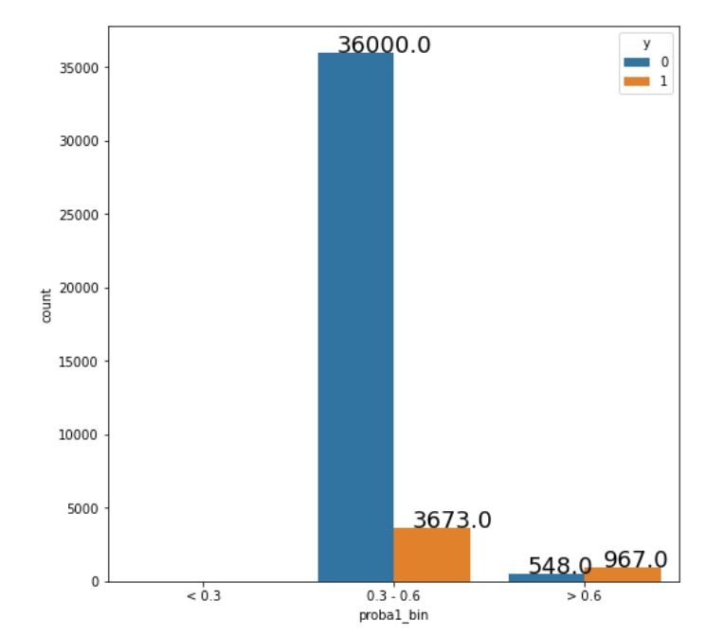
Assumption
we assume for people that have bank account more than 30,000 Euro (from total people that have probability to buy a deposit between 0.3 & 0.6) is people that buy the deposit in actual (‘y’ = 1) which is in this case there are 3673
Notes:
Call charges : https://www.lonelyplanet.com/portugal/narratives/practical-information/directory/telephone#:~:text=Local%2C%20Regional%20%26%20National%20Calls&text=Local%20calls%20cost%20around%20%E2%82%AC,from%20anywhere%20in%20the%20country.
Salary : http://www.salaryexplorer.com/salary-survey.php?loc=174&loctype=1&job=12702&jobtype=3

Slide 43
Before using the model
 |  | Price | Quantity | Frequency | Total (all months) (euro)
BEFORE | Call Charges | 0.3 euro/minutes | 1 | 177304 minutes (in 10 months) | 53191.215
 | Salary | 1600 euro/month/emp | 4 emp | 10 months | 64000.000
 | TOTAL |  |  |  | 117191.215
AFTER | Call Charges | 0.3 euro/minutes | 1 | 44977 minutes (in 10 months) | 13493.094
 | Salary | 1600 euro/month/emp | 3 emp | 3 months | 14400.000
 | TOTAL |  |  |  | 27893.094
SAVING |  |  |  |  | 89298.121
Cost reduced 76.2 %
Notes:
Call charges : https://www.lonelyplanet.com/portugal/narratives/practical-information/directory/telephone#:~:text=Local%2C%20Regional%20%26%20National%20Calls&text=Local%20calls%20cost%20around%20%E2%82%AC,from%20anywhere%20in%20the%20country.
Salary : http://www.salaryexplorer.com/salary-survey.php?loc=174&loctype=1&job=12702&jobtype=3

Slide 44
Conclusion
Menjawab Business Goalss

