Slide 1
BANK MARKETING CAMPAIGN
Scipy

Slide 2
Urutan PPT
Tunjukin data set & casenya
Skenario
Business problem dan goals
EDA
Modelling
Simulasi
Conclusion

Slide 3
Dataset & Case
Dataset used was bank marketing campaign dataset from Kaggle (https://www.kaggle.com/volodymyrgavrysh/bank-marketing-campaigns-dataset)
Features Description
Bank client data:
Age (numerical continuous)
Job : type of job (categorical: "admin.","blue-collar","entrepreneur",...,"unknown")
Marital : marital status (categorical: "divorced","married","single","unknown")
Education : (categorical: "illiterate",...,"university.degree","unknown")
Default: has credit in default? (categorical: "no","yes","unknown")
Housing: has housing loan? (categorical: "no","yes","unknown")
Loan: has personal loan? (categorical: "no","yes","unknown")

Slide 4
Dataset & Case
Related with the last contact of the current campaign:
Contact: contact communication type (categorical: "cellular","telephone")
Month: last contact month of year (categorical: "jan", …, "nov", "dec")
Dayofweek: last contact day of the week (categorical: "mon","tue",...)
Duration: last contact duration, in seconds (numeric).
Important note: this attribute highly affects the output target (e.g., if duration=0 then y="no"). , Can not get this feature before the campaign
Other attributes:
Campaign: number of contacts performed during this campaign and for this client (numeric, includes last contact)
Important note: Can not get this feature before the campaign
Pdays: number of days that passed by after the client was last contacted from a previous campaign (numeric; 999 means client was not previously contacted)
Previous: number of contacts performed before this campaign and for this client (numeric)
Poutcome: outcome of the previous marketing campaign (categorical: "failure","nonexistent","success")

Slide 5
Dataset & Case
Social and economic context attributes
- Emp.var.rate: employment variation rate - quarterly indicator (numeric)
- Cons.price.idx: consumer price index - monthly indicator (changes in the price level of a weighted average market basket of consumer goods and services purchased by households, affect inflation (numeric))
- Cons.conf.idx: consumer confidence index - monthly indicator (degree of consumers optimism are expressing through their activities of savings and spending. affect consumer behavior (numeric))
- Euribor3m: euribor 3 month rate - daily indicator (Euribor (euro interbank offered rate) (numeric))
- Nr.employed: number of employees - quarterly indicator (Number of employed persons for a quarter (numeric))
Output variable (desired target):
- y - has the client subscribed a term deposit? (binary: "yes","no")

Slide 6
Scenario
We are data scientist team working at XYZ Bank in Portugal
The business development team came to us and told us that they needed improvement on marketing campaign result because the result was not good enough compared to the cost
They are asking if we can propose solutions to either reduce the cost or increase the income generated or both
They gave us customer dataset used at the recent campaign which consist of the bank’s customer data

Slide 7
Business Problems and Goals
Subscribe rate from the dataset is low (11.27%)
Cost expended was too big for the income generated
Dibutuhkan cara agar supaya bisa memfilter nasabah yang berpotensi dan yang tidak
GOALS
Memprediksi nasabah bank yang mungkin akan mengambil dposit atau tidak untk campaign berikutnya berdasrkan model dari yang sudah terjadi dengan menggunakan Machine Learning
Memberikan simulasi penurunan cost jika menggunakan Machine learningggggg

Slide 8
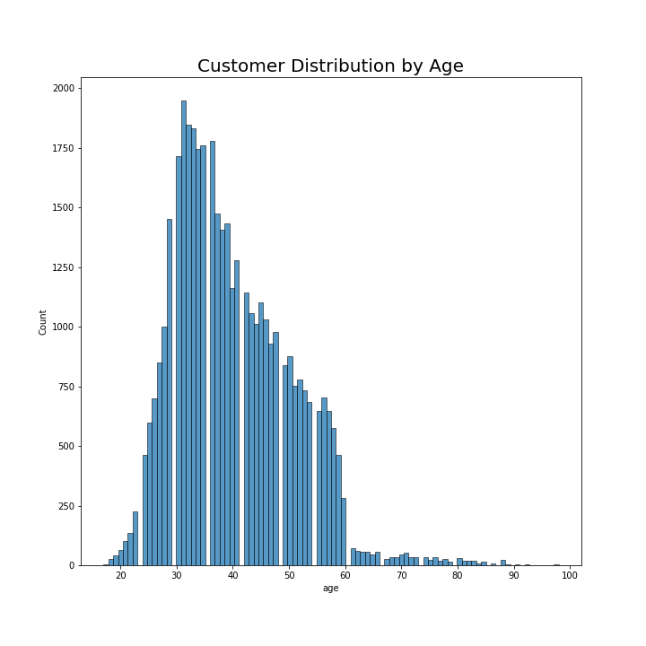
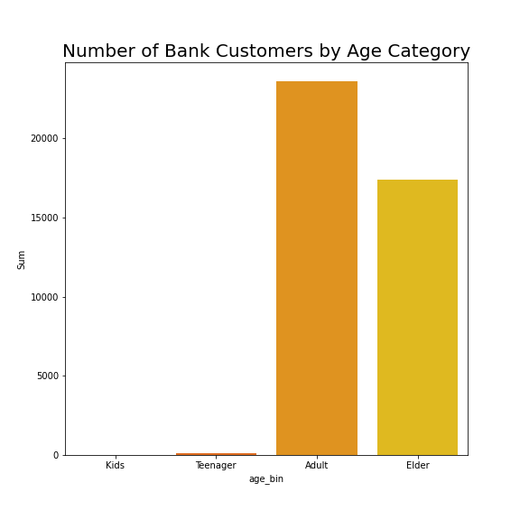
EDA - Univariate
Most customers were 25 to 60 years old
There is little to none customers in kids and teenager group

Slide 9
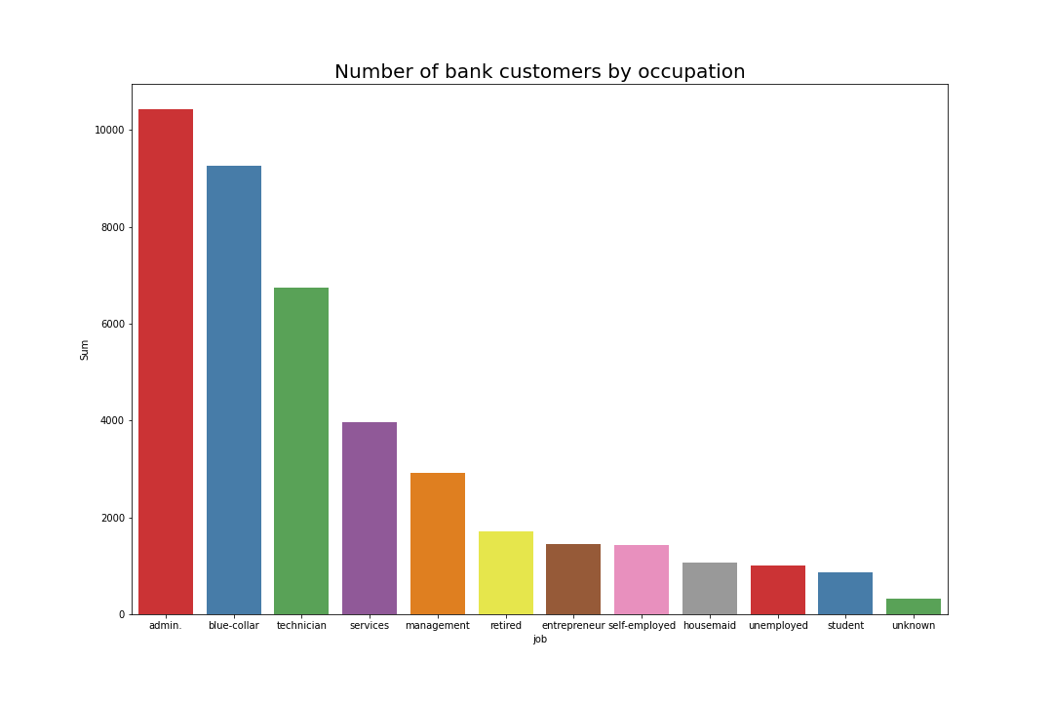
EDA – Univariate (2)
Most customers are working as admin, blue-collar, and technician

Slide 10
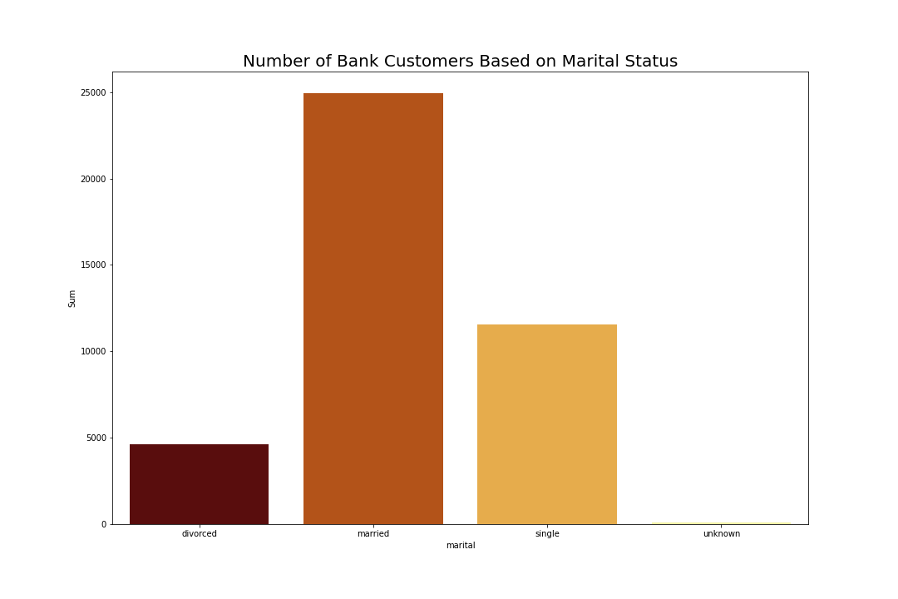
EDA – Univariate (3)
Most customers are married

Slide 11
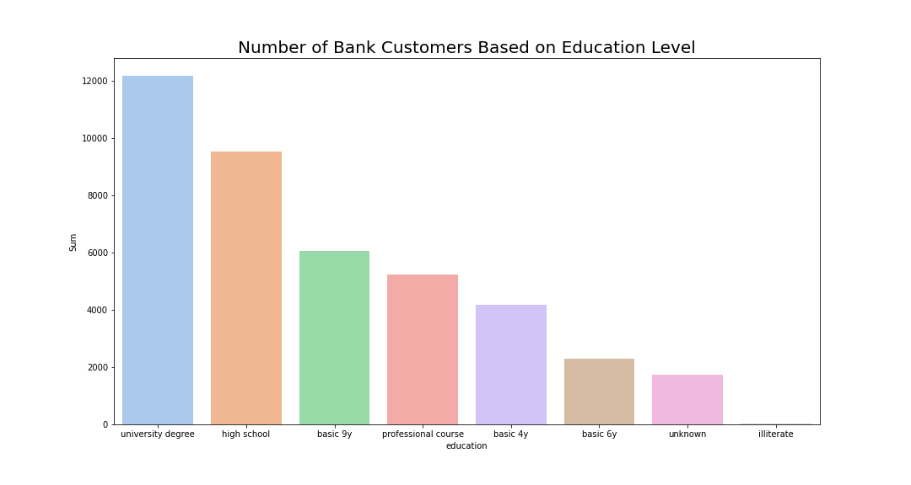
EDA – Univariate (4)
Most customers have university degree and high school education

Slide 12
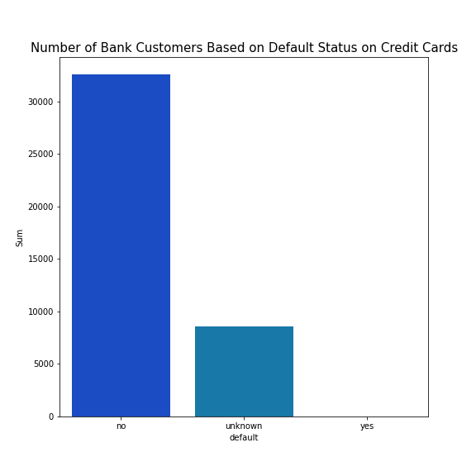
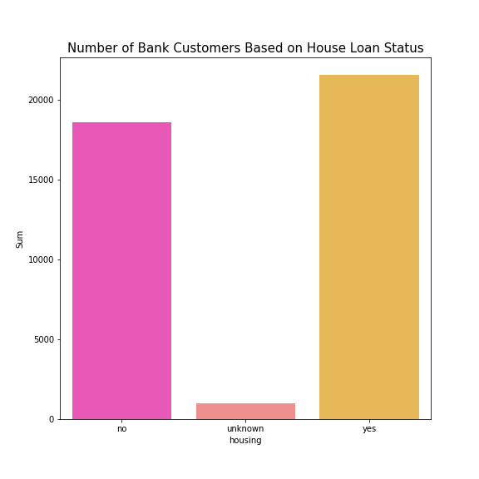
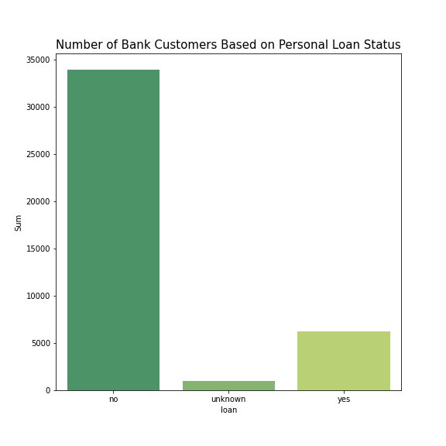
EDA – Univariate (5)
Most customers are not credit card default and has no personal loan
More than half of the customers have housing loan

Slide 13
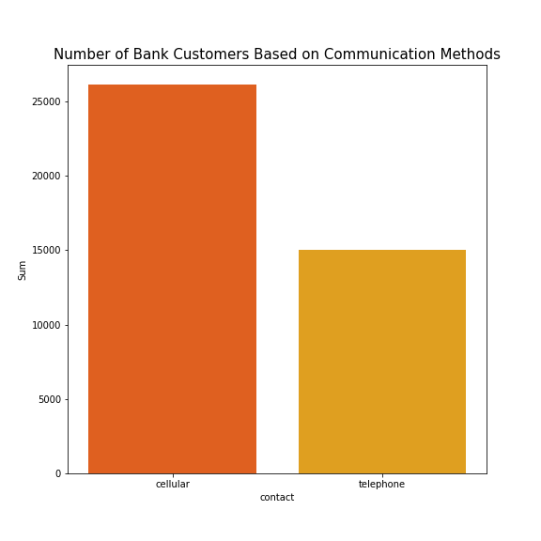
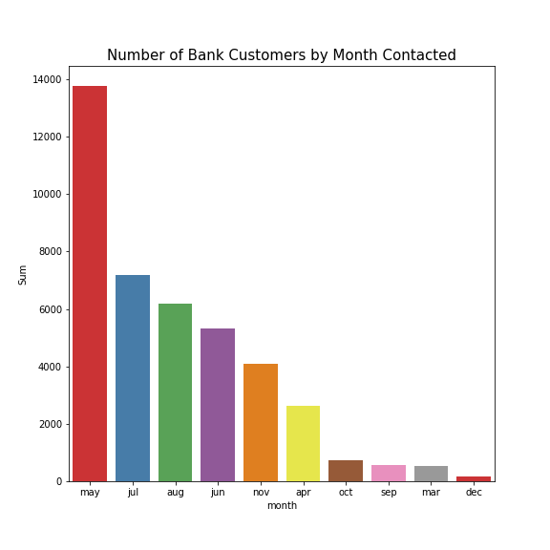
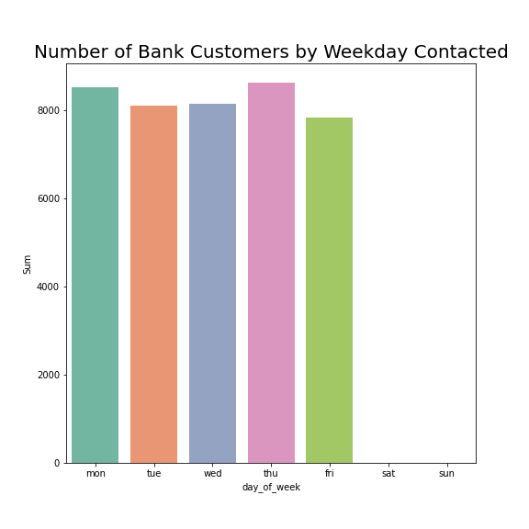
EDA – Univariate (6)
Most customers were contacted through their mobile phone
Most customers were contacted in May and all of them were contacted at weekdays

Slide 14
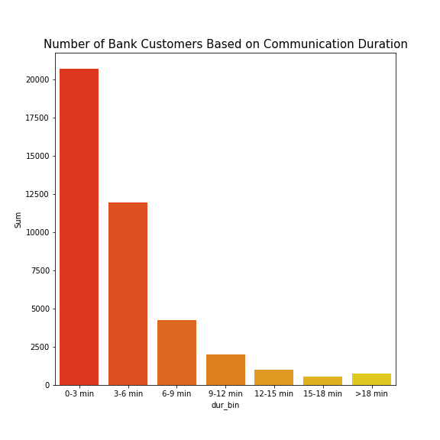
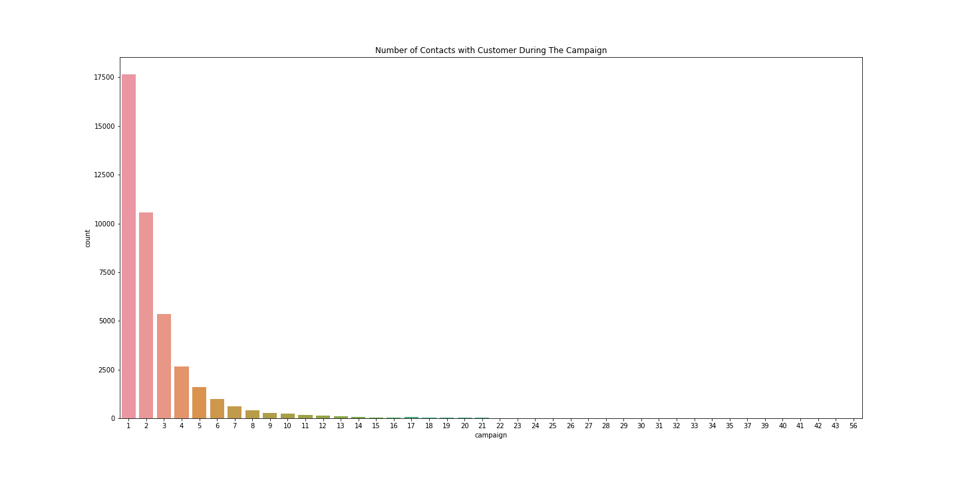
EDA – Univariate (6)
Most call durations are 0-3 mins and 3-6 mins
Most customers only contacted between 1 to 3 times during the campaign

Slide 15
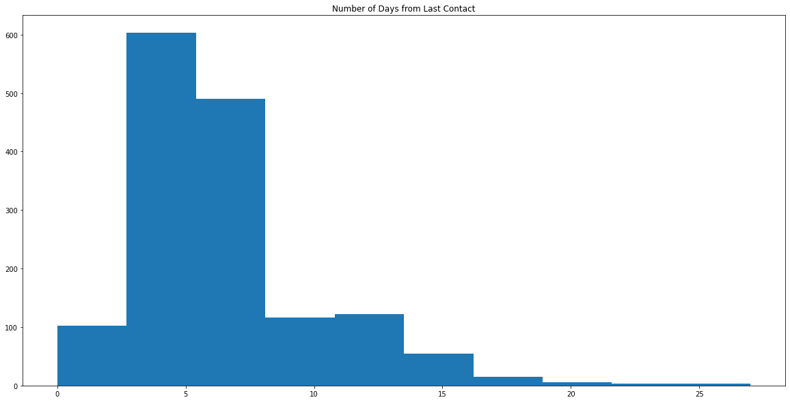
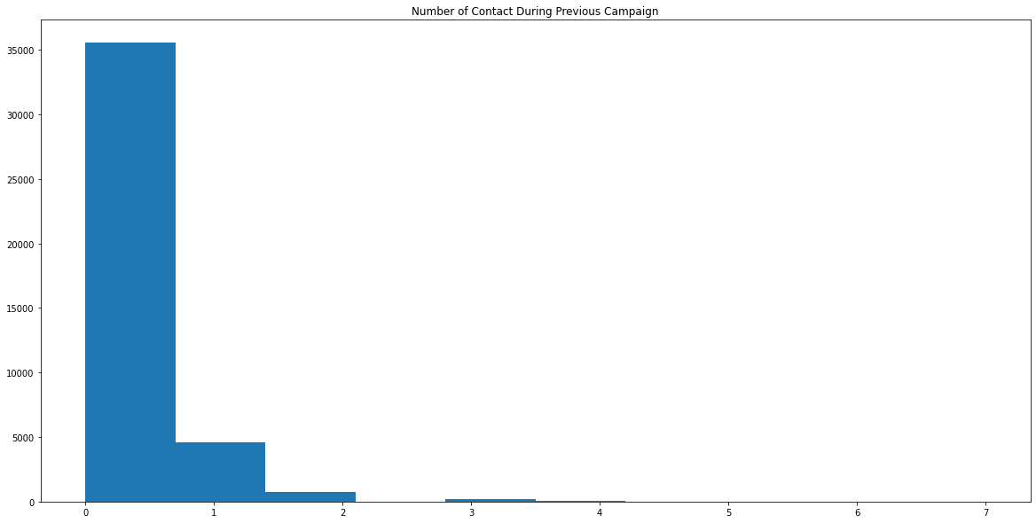
EDA – Univariate (7)
Most call customers are contacted again in 10 days
Most customers only contacted between 1 to 2 times during the previous campaign

Slide 16
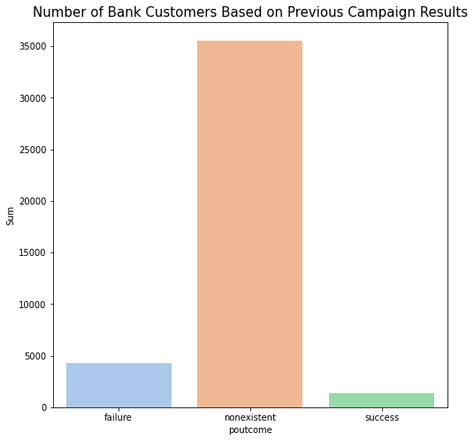
EDA – Univariate (8)
Most customers were not included in previous campaign and have nonexistent results

Slide 17
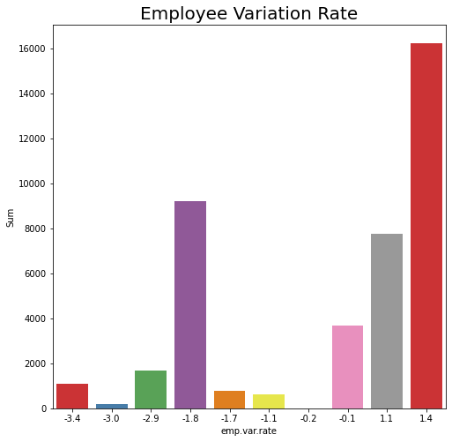
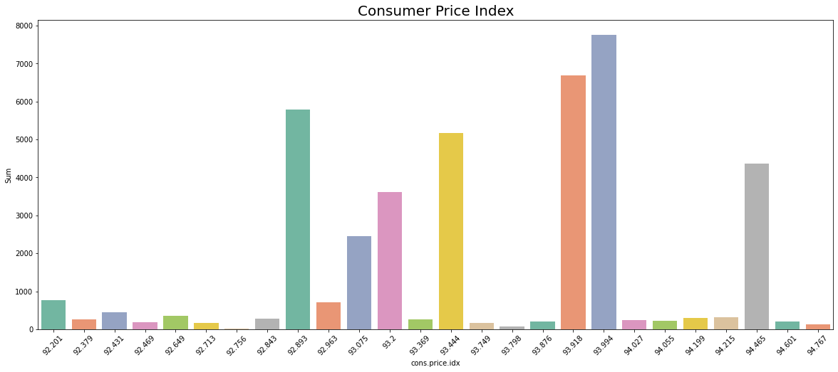
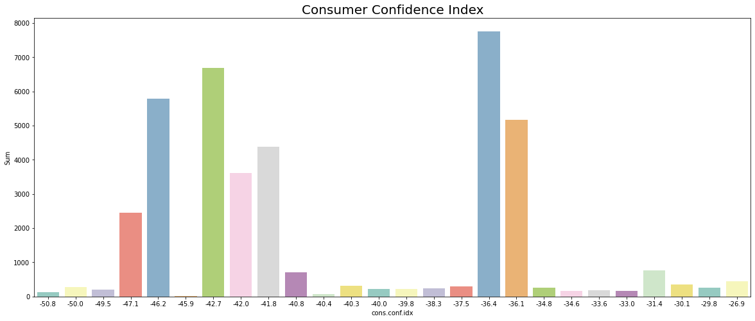
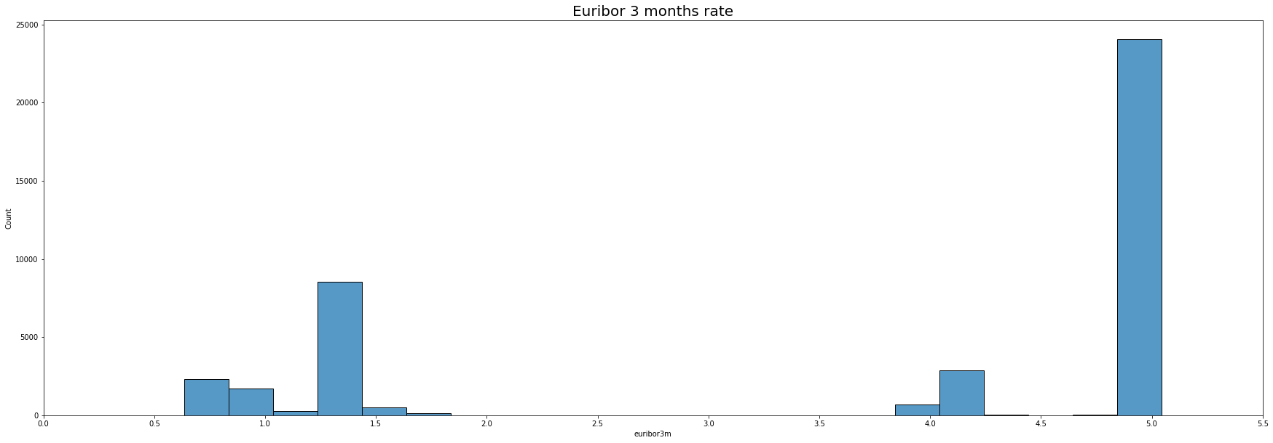
EDA – Univariate (9)

Slide 18
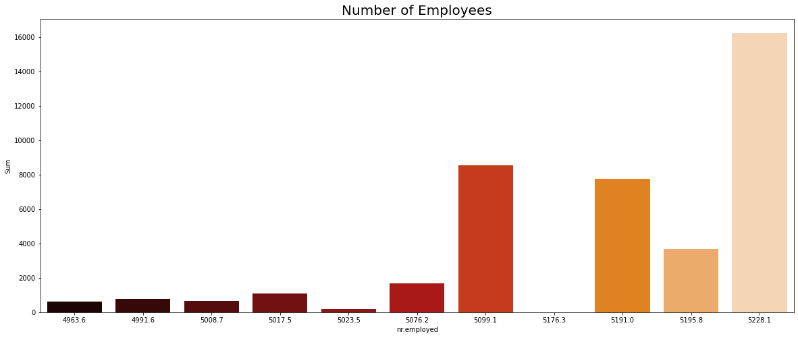
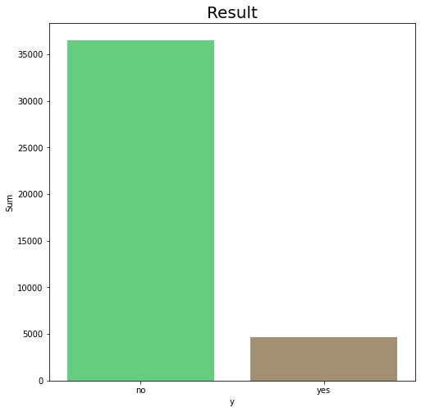
EDA – Univariate (10)
Most call customers were contacted when number of employees were high
Most didn’t subscribe to term deposit offered

Slide 19
Modelling
Tunjukkan table Perbandingan precision
Pk model apa aja
Kesimpulan
Grafik predict proba

Slide 20
Simulasi
Tunjukkan asumsi yang dipakai
Perhitungan
Kesimpulan (cost berkurang brp)

Slide 21
Conclusion
Menjawab Business Goalss

