Slide 1
BANK MARKETING CAMPAIGN
Scipy

Slide 2
OUTLINE
Dataset & Case
Scenario
Business problem and goals
EDA
Modelling
Simulation
Conclusion

Slide 3
Dataset & Case
Dataset used was bank marketing campaign dataset from Kaggle (https://www.kaggle.com/volodymyrgavrysh/bank-marketing-campaigns-dataset)
Features Description
Bank client data:
Age (numerical continuous)
Job : type of job (categorical: "admin.","blue-collar","entrepreneur",...,"unknown")
Marital : marital status (categorical: "divorced","married","single","unknown")
Education : (categorical: "illiterate",...,"university.degree","unknown")
Default: has credit in default? (categorical: "no","yes","unknown")
Housing: has housing loan? (categorical: "no","yes","unknown")
Loan: has personal loan? (categorical: "no","yes","unknown")

Slide 4
Dataset & Case
Related with the last contact of the current campaign:
Contact: contact communication type (categorical: "cellular","telephone")
Month: last contact month of year (categorical: "jan", …, "nov", "dec")
Dayofweek: last contact day of the week (categorical: "mon","tue",...)
Duration: last contact duration, in seconds (numeric).
Important note: this attribute highly affects the output target (e.g., if duration=0 then y="no"). , Can not get this feature before the campaign
Other attributes:
Campaign: number of contacts performed during this campaign and for this client (numeric, includes last contact)
Important note: Can not get this feature before the campaign
Pdays: number of days that passed by after the client was last contacted from a previous campaign (numeric; 999 means client was not previously contacted)
Previous: number of contacts performed before this campaign and for this client (numeric)
Poutcome: outcome of the previous marketing campaign (categorical: "failure","nonexistent","success")

Slide 5
Dataset & Case
Social and economic context attributes
- Emp.var.rate: employment variation rate - quarterly indicator (numeric)
- Cons.price.idx: consumer price index - monthly indicator (changes in the price level of a weighted average market basket of consumer goods and services purchased by households, affect inflation (numeric))
- Cons.conf.idx: consumer confidence index - monthly indicator (degree of consumers optimism are expressing through their activities of savings and spending. affect consumer behavior (numeric))
- Euribor3m: euribor 3 month rate - daily indicator (Euribor (euro interbank offered rate) (numeric))
- Nr.employed: number of employees - quarterly indicator (Number of employed persons for a quarter (numeric))
Output variable (desired target):
- y - has the client subscribed a term deposit? (binary: "yes","no")

Slide 6
Scenario
We are data scientist team working at XYZ Bank in Portugal
The business development team came to us and told us that they needed improvement on marketing campaign result because the result was not good enough compared to the cost
They are asking if we can propose solutions to either reduce the cost or increase the income generated or both
They gave us customer dataset used at the recent campaign which consist of the bank’s customer data

Slide 7
Business Problems and Goals
Business Problems
Subscribe rate from the dataset is low (11.27%)
Cost expended was too big for the income generated
Need a way to filtering the potential bank customer or not to buy a deposit

Slide 8
Business Problems and Goals
Business Goals
Predict Potential Bank Customer that will buy deposit or not with Machine Learning Method
Give Cost Reduction Simulation after and before using Machine Learning

Slide 9
Road map

Slide 10
TIM DATA SCIENCE
PERLU DIBUAT MODEL
Model untuk prediksi calon customer untuk program marketing selanjutnya
Terima report dari tim marketing
Dari report tersebut didaptkan masih gagal (88% tdk beli deposito)
Evaluasi
Tambahan :
Concern tim marketing di cost campaign
[PENTING] model digunakan sebelum melakukan campaign/program marketing
Kolom di dataset model yang dipakai adalah KOLOM YG BISA DIDAPATKAN Sebelum melakukan Campaign
!! INGAT !!
Calon customer yang di approach adalah nasabah bank tersebut

Slide 11
Flow chart
Analisis dilakukan di waktu jeda antar program
Predict Ya
Gas masukin ke list calon customer
Model
Data baru
Predict Tidak
JANGAN masukin ke list calon customer

Slide 12
EDA (EXPLANATORY DATA ANALYSIS)
UNIVARIATE
MULTIVARIATE

Slide 13
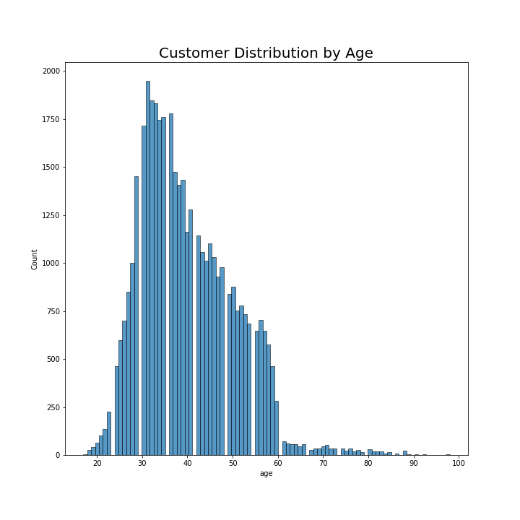
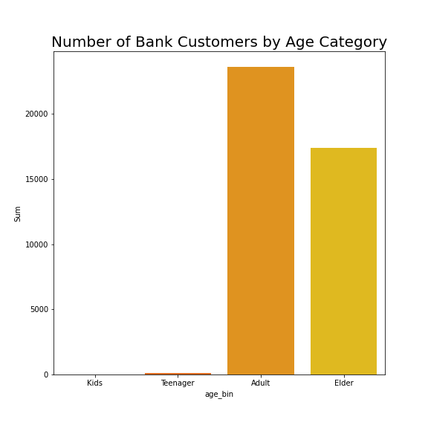
EDA - Univariate
Most customers were 25 to 60 years old
There is little to none customers in kids and teenager group

Slide 14
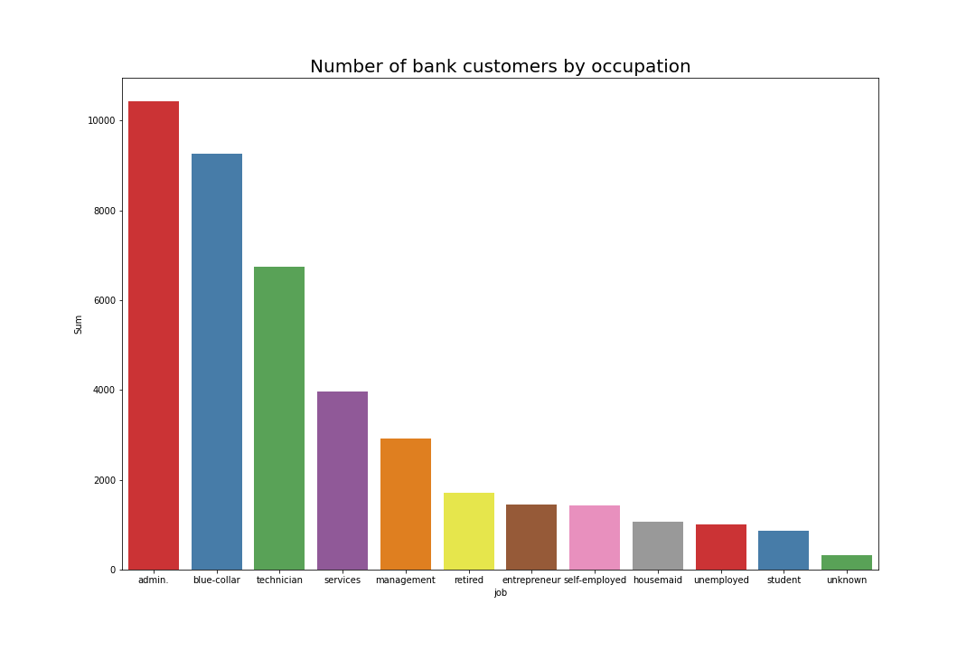
EDA – Univariate (2)
Most customers are working as admin, blue-collar, and technician

Slide 15
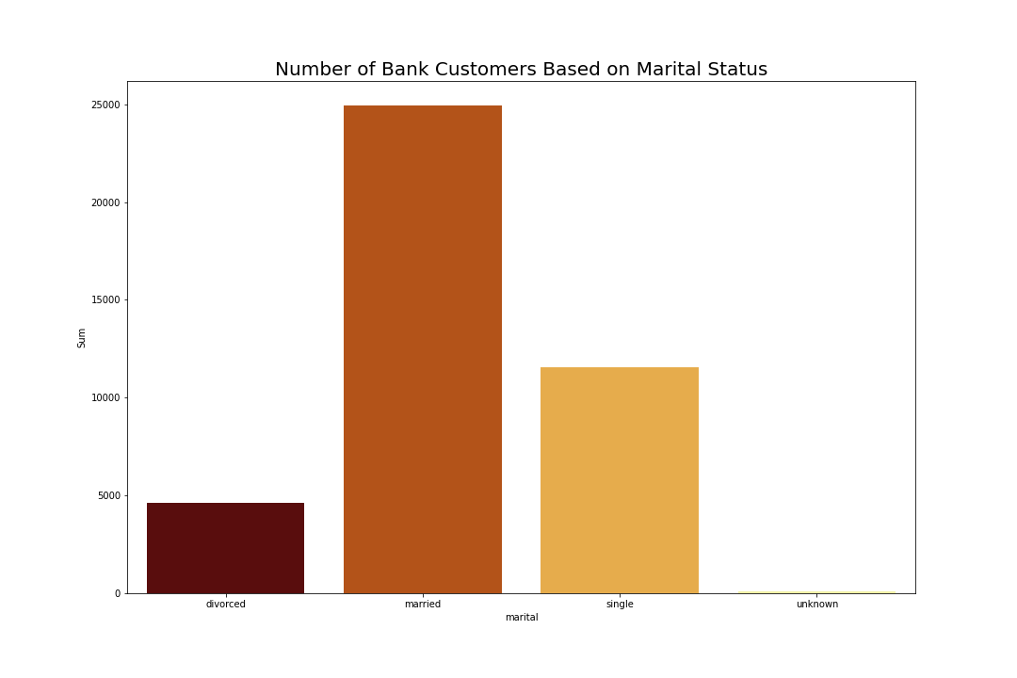
EDA – Univariate (3)
Most customers are married

Slide 16
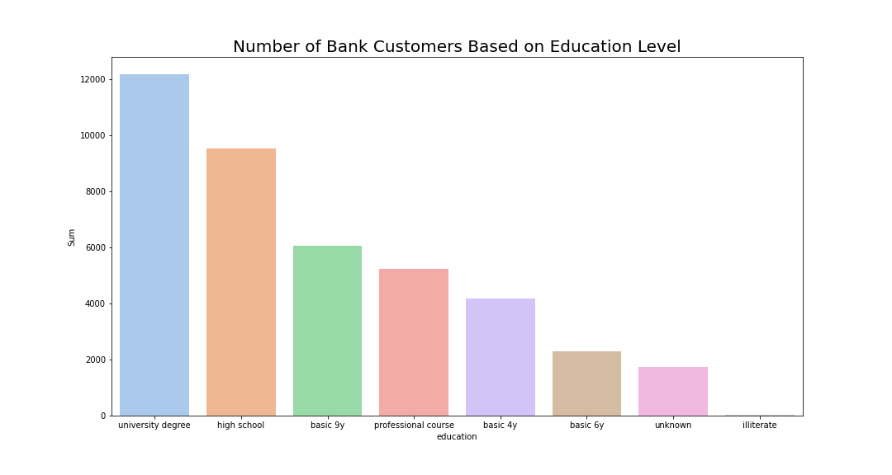
EDA – Univariate (4)
Most customers have university degree and high school education

Slide 17
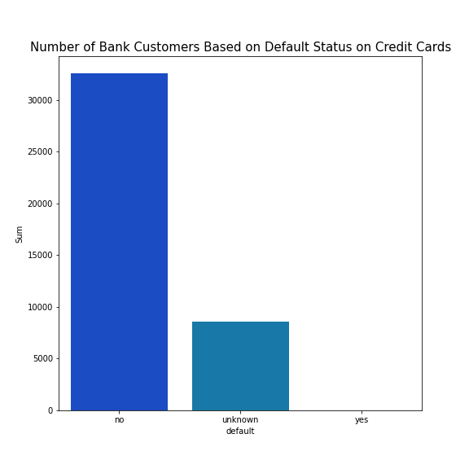
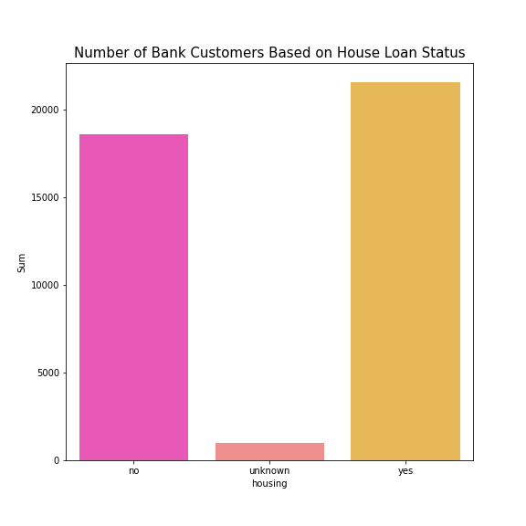
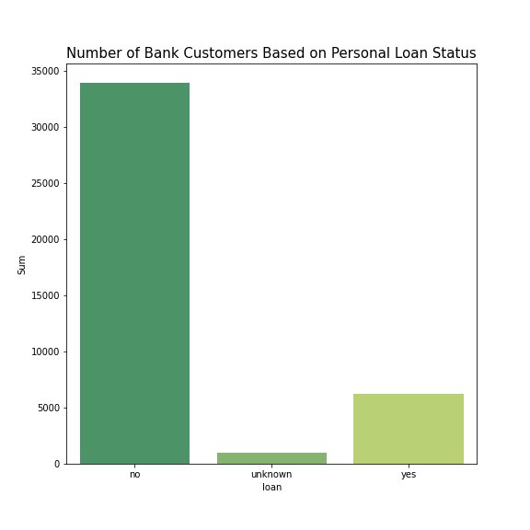
EDA – Univariate (5)
Most customers are not credit card default and has no personal loan
More than half of the customers have housing loan

Slide 18
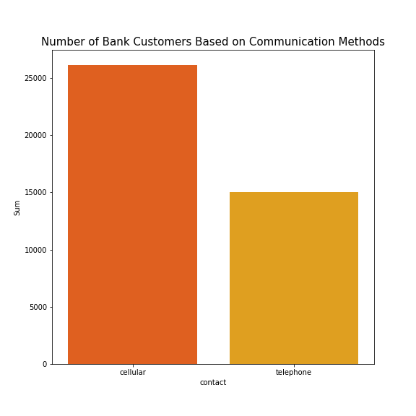
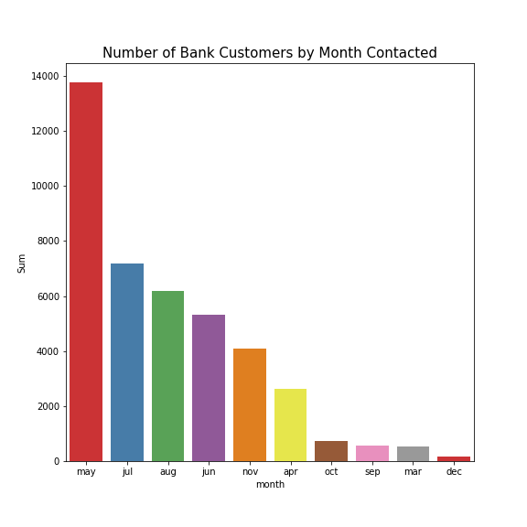
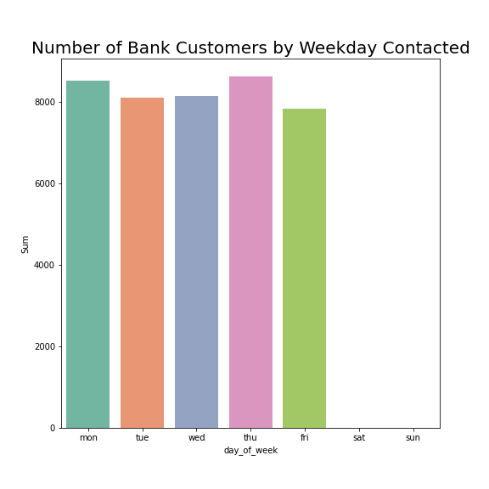
EDA – Univariate (6)
Most customers were contacted through their mobile phone
Most customers were contacted in May and all of them were contacted at weekdays

Slide 19
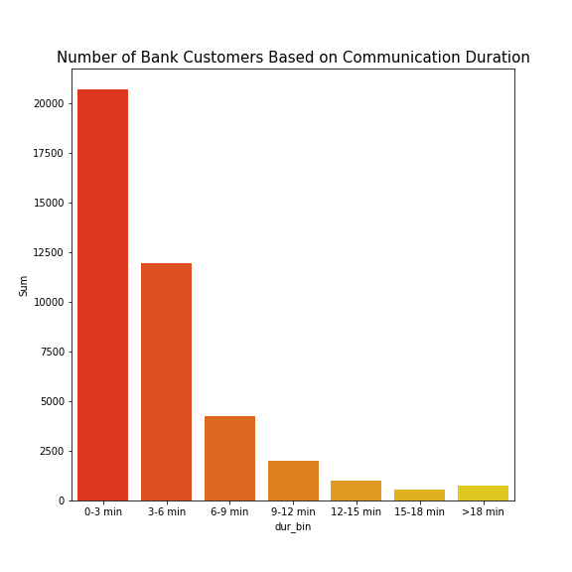
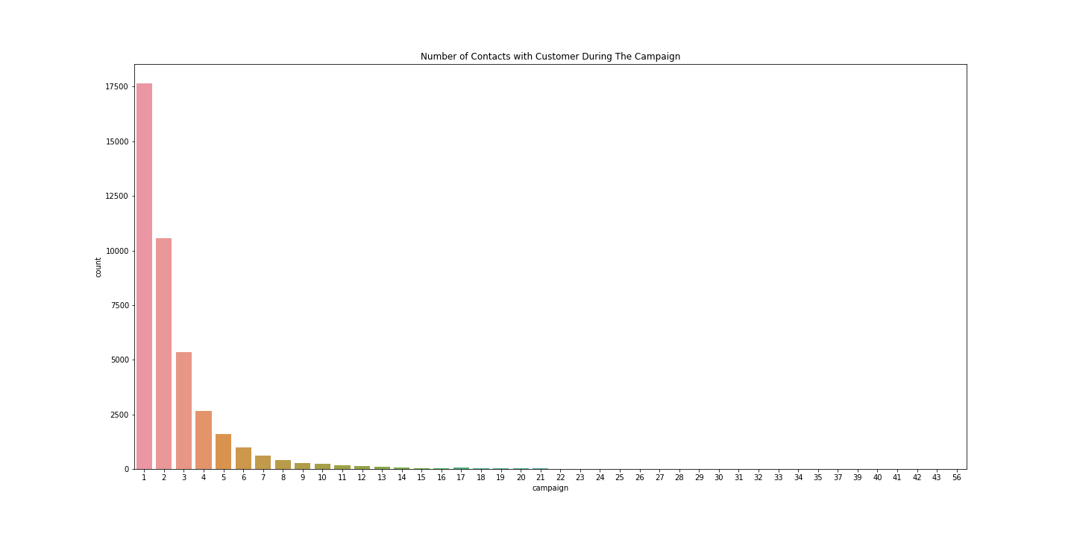
EDA – Univariate (6)
Most call durations are 0-3 mins and 3-6 mins
Most customers only contacted between 1 to 3 times during the campaign

Slide 20
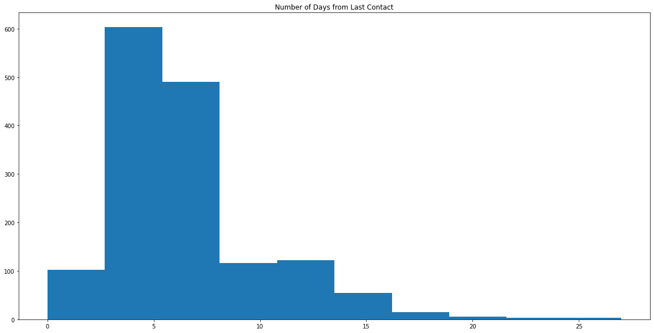
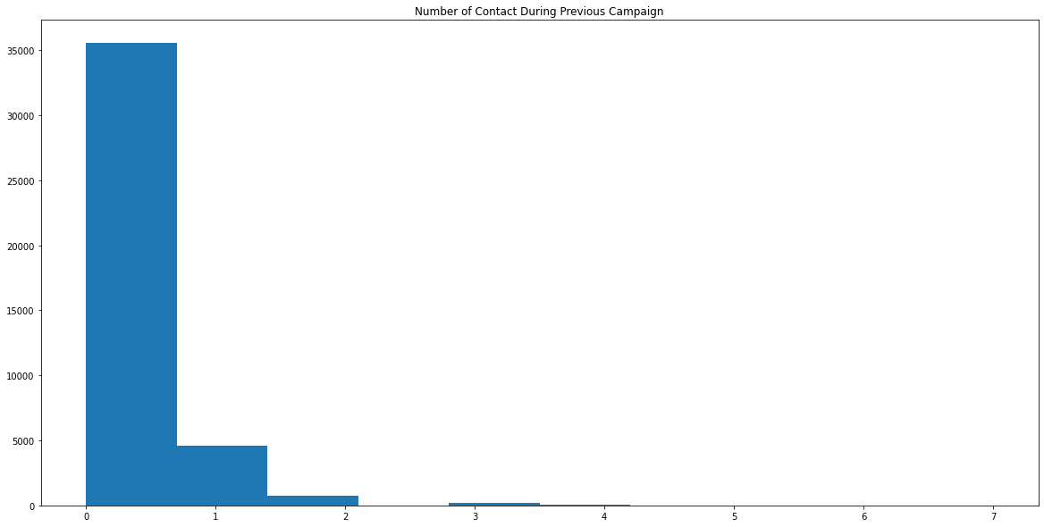
EDA – Univariate (7)
Most call customers are contacted again in 10 days
Most customers only contacted between 1 to 2 times during the previous campaign

Slide 21
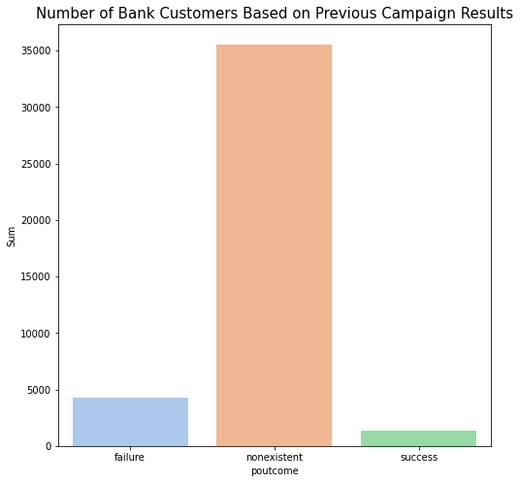
EDA – Univariate (8)
Most customers were not included in previous campaign and have nonexistent results

Slide 22
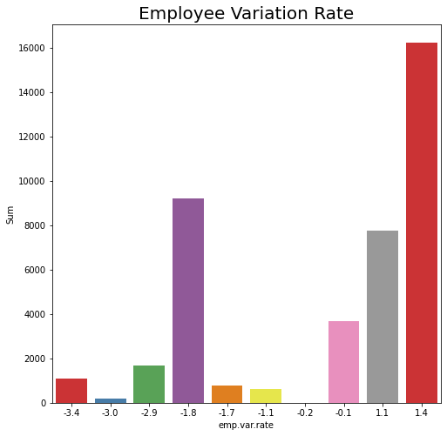
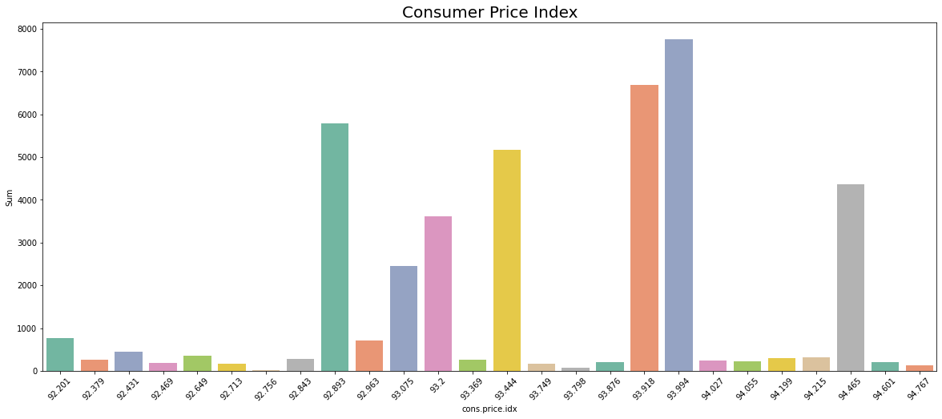
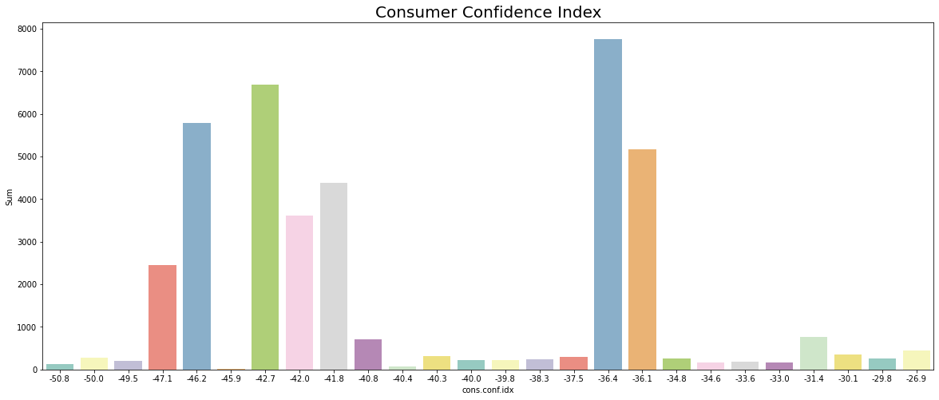
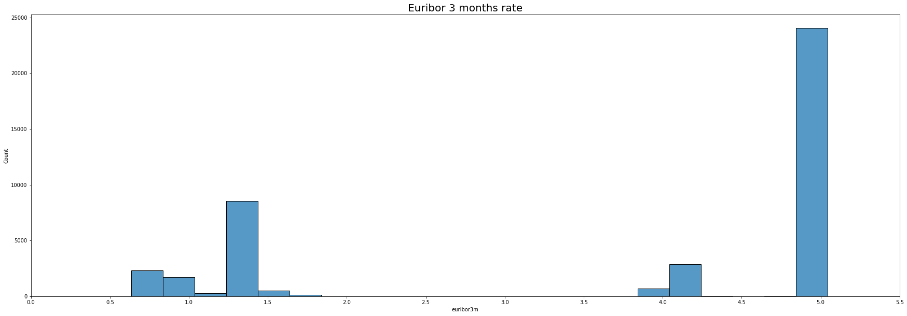
EDA – Univariate (9)

Slide 23
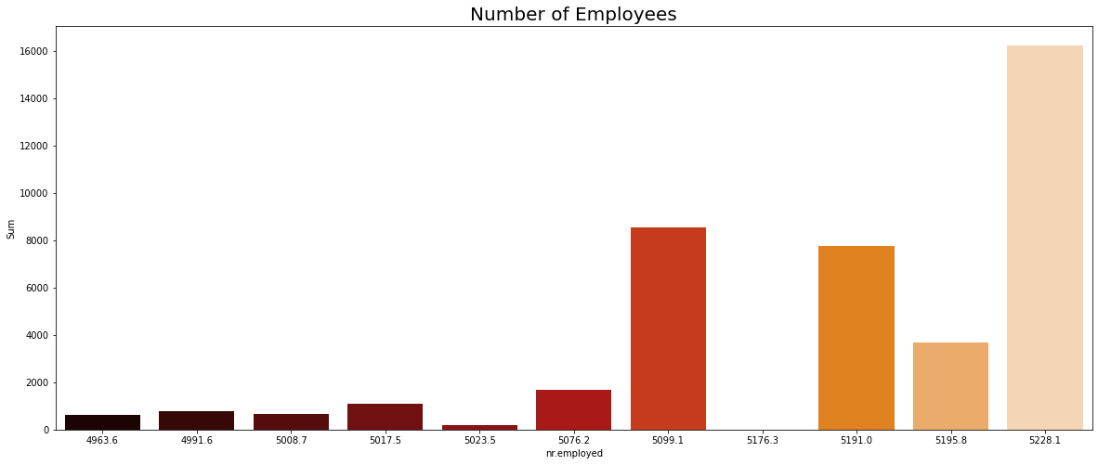
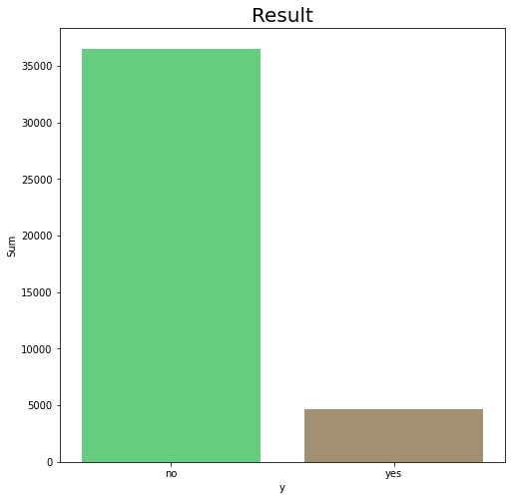
EDA – Univariate (10)
Most call customers were contacted when number of employees were high
Most didn’t subscribe to term deposit offered

Slide 24
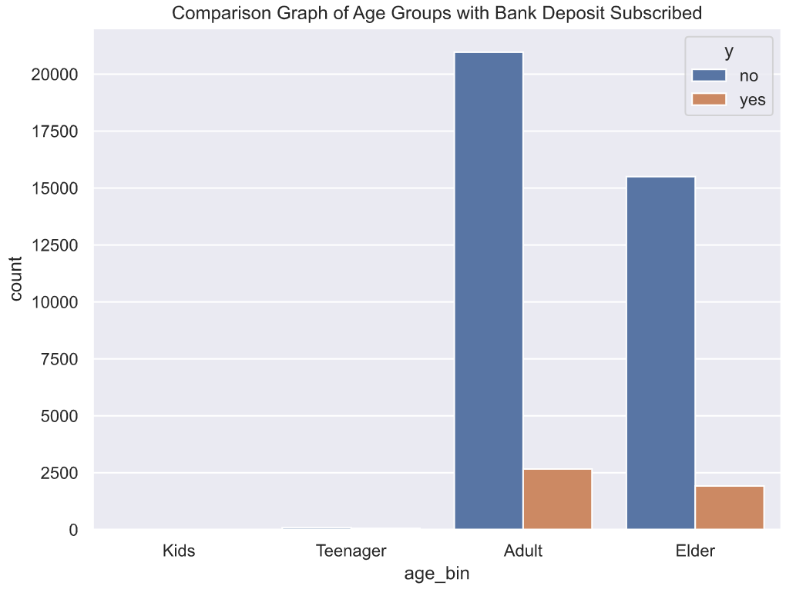
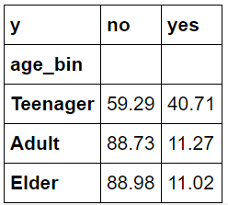
EDA – Multivariate Analysis age and subscribed deposit
The adult group dominates deposit subscribed in banks

Slide 25
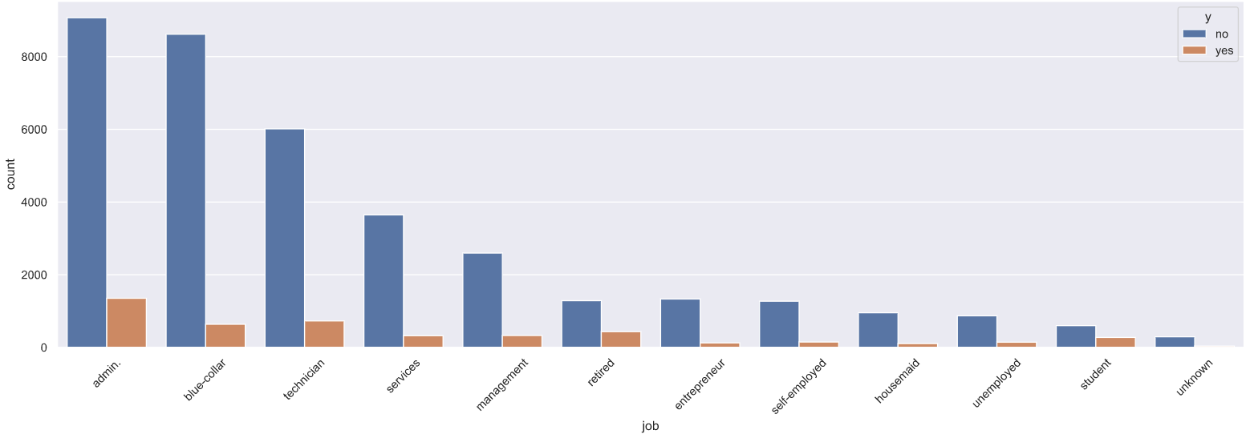
EDA – Multivariate Analysis (2) job and subscribed deposit
job | no | yes | job | no | yes | job | no | yes | job | no | yes
Student | 68.57 | 31.43 | Admin | 87.03 | 12.97 | Technician | 89.17 | 10.83 | Entrepreneur | 91.48 | 8.52
Retired | 74.77 | 25.23 | Management | 88.78 | 11.22 | Self-employed | 89.51 | 10.49 | Services | 91.86 | 8.14
Unemployed | 85.80 | 14.20 | Unknown | 88.79 | 11.21 | Housemaid | 90.00 | 10.00 | Blue-collar | 93.11 | 6.89
The admin job-group dominates deposit subscribed in banks by quantity
The student job-group has highest subscribe percentage

Slide 26
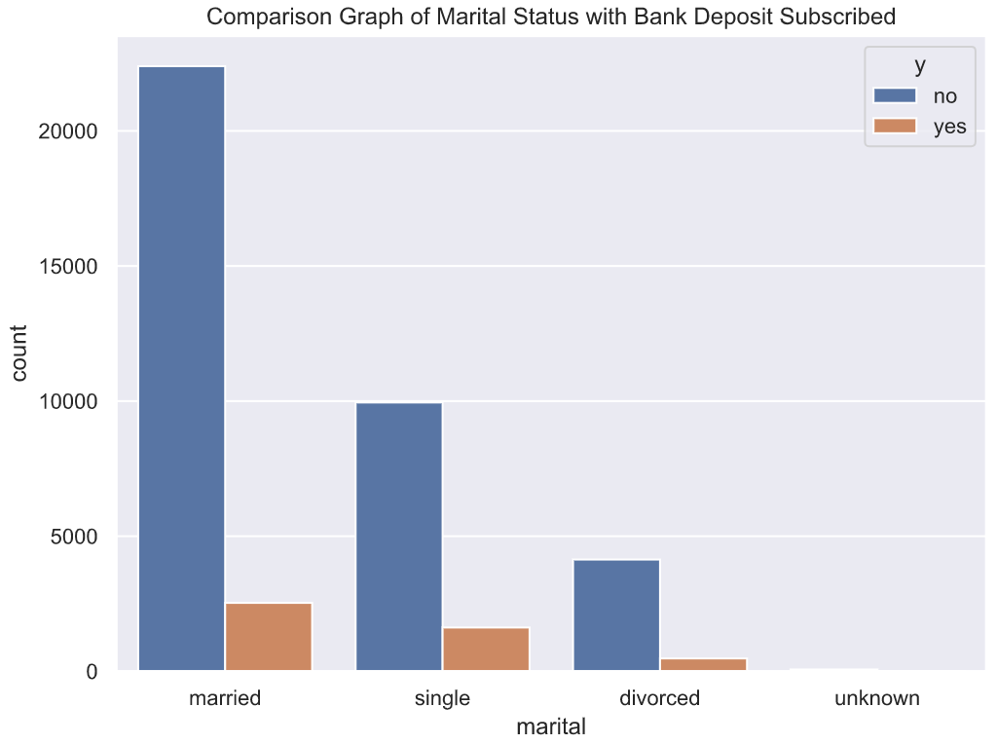
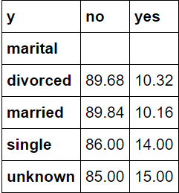
EDA – Multivariate Analysis (3) marital and subscribed deposit
The marital status as married dominates deposit subscribed in banks
Unknown marital status has the highest subscribe percentage

Slide 27
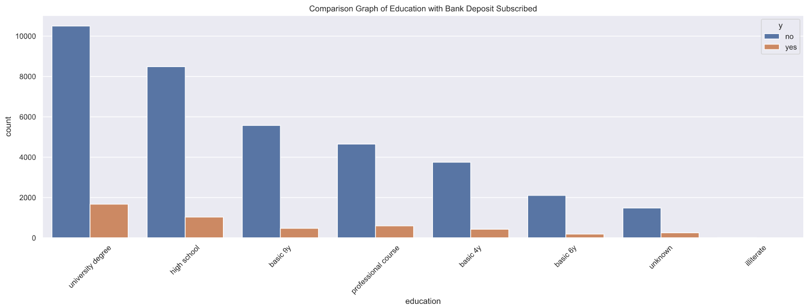
EDA – Multivariate Analysis (4) education and deposit subscribed
Education | No | yes | education | no | yes | education | no | yes | education | no | yes
Basic 4 year | 89.75 | 10.25 | Basic 9 year | 92.18 | 7.82 | Illiterate | 77.78 | 22.22 | University degree | 86.28 | 13.72
Basic 6 year | 91.80 | 8.20 | High school | 89.16 | 10.84 | Professional course | 88.65 | 11.35 | unknown | 85.50 | 14.50
The education level as university degree dominates deposit subscribed in banks
Illiterate has the highest subscribe percentage but has the smallest quantity

Slide 28
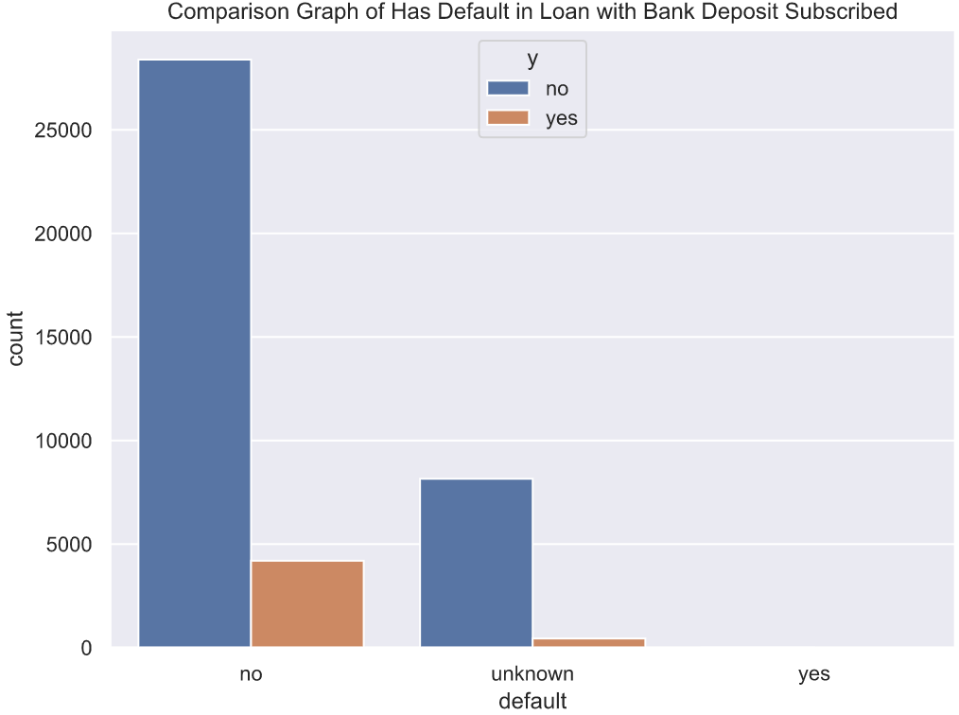
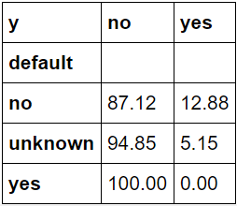
EDA – Multivariate Analysis (5) has default in loan and deposit subscribed
Group which has no default loan dominates deposit subscribed in banks by quantity and percentage

Slide 29
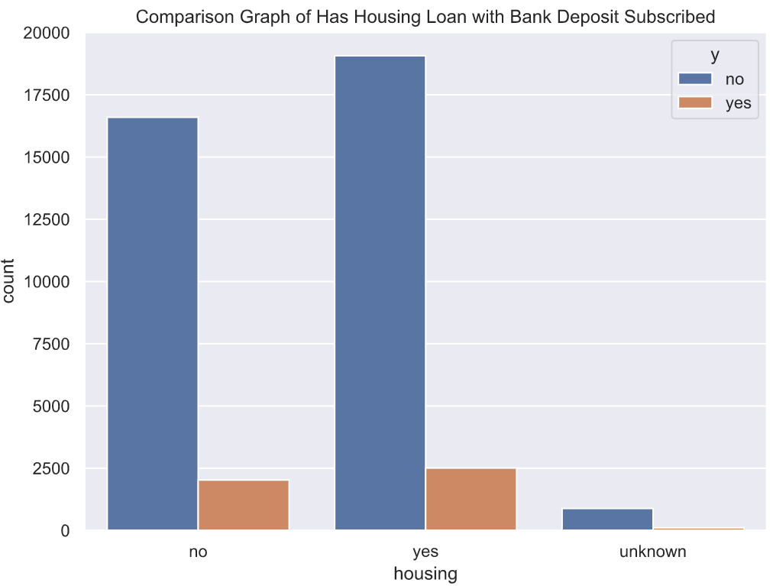
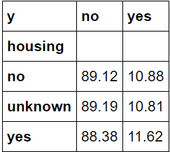
EDA – Multivariate Analysis (6) has housing loan and deposit subscribed
Group of clients which has housing loan dominates deposit subscribed in banks by quantity and percentage

Slide 30
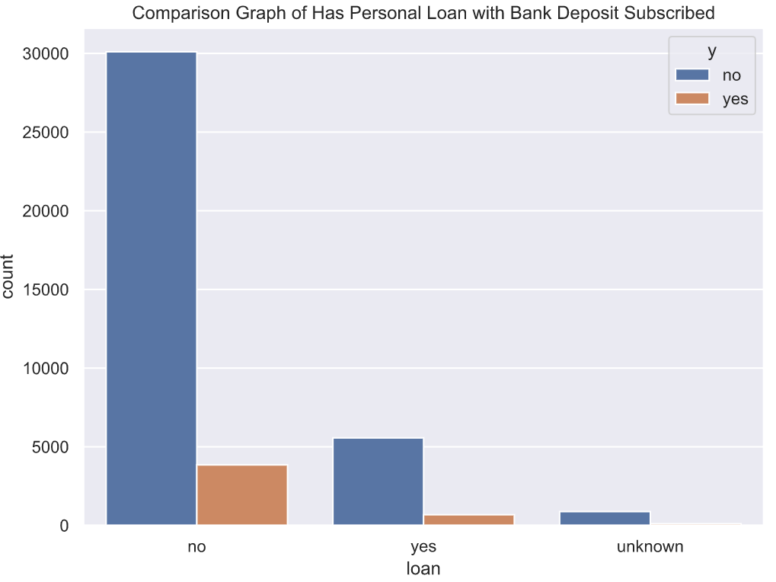
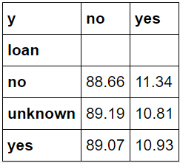
EDA – Multivariate Analysis (7) has personal loan and deposit subscribed
Group which has no personal loan dominates deposit subscribed in banks by quantity and percentage

Slide 31
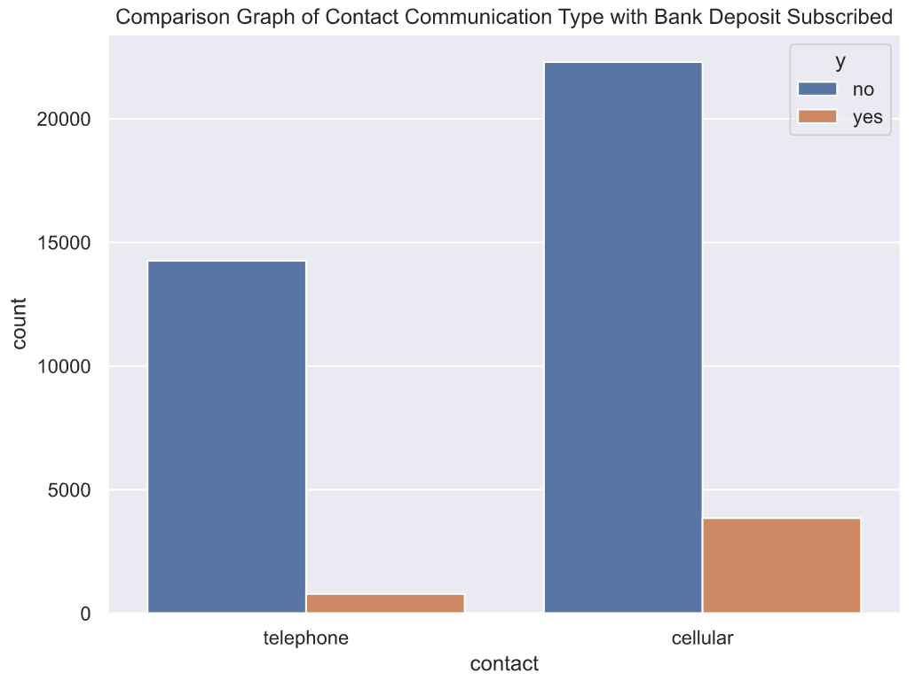
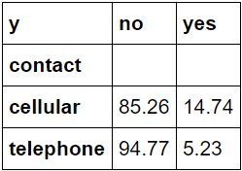
EDA – Multivariate Analysis (8) communication type and deposit subscribed
Group which contacted by cellular dominates deposit subscribed in banks by quantity and percentage

Slide 32
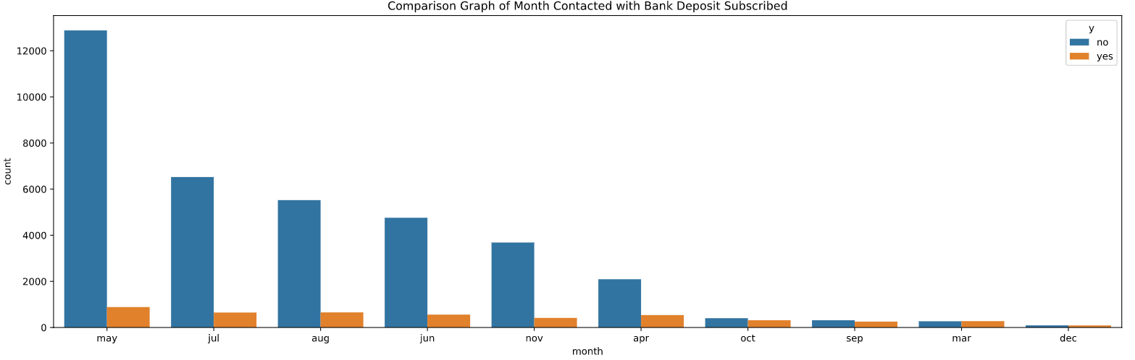
EDA – Multivariate Analysis (9) last month contacted and deposit subscribed
month | no | yes | month | no | yes | month | no | yes | month | no | yes | month | no | yes
Mar | 49.45 | 50.55 | May | 93.57 | 6.43 | Jul | 90.95 | 9.05 | Sep | 55.09 | 44.91 | Nov | 89.86 | 10.14
Apr | 79.52 | 20.48 | Jun | 89.49 | 10.51 | Aug | 89.40 | 10.60 | Oct | 56.13 | 43.87 | Dec | 51.10 | 48.90
Most customer was contacted in May and even though May has the lowest subscribe percentage, the quantity of deposit is the highest
Mar has the highest subscribe percentage but is the second lowest by quantity

Slide 33
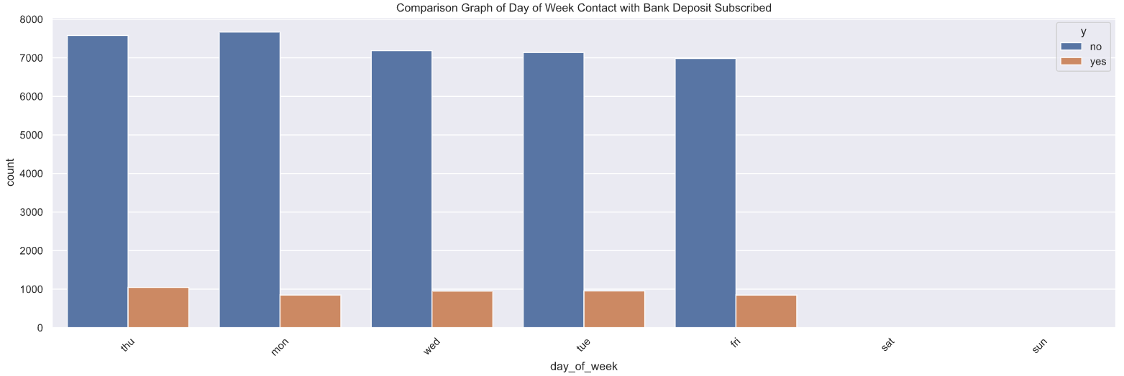
EDA – Multivariate Analysis (10) last day of week contacted and deposit subscribed
Day of week | no | yes | Day of week | no | yes | Day of week | no | yes | Day of week | no | yes | Day of week | no | yes
mon | 90.05 | 9.95 | tue | 88.22 | 11.78 | wed | 88.33 | 11.67 | thu | 87.88 | 12.12 | fri | 89.19 | 10.81
Last day of week communication between client and campaign team was dominated in Thursday

Slide 34
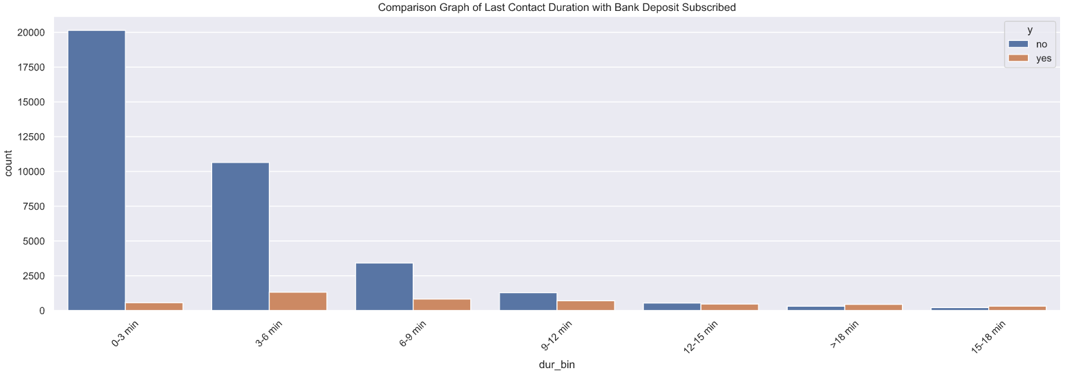
EDA – Multivariate Analysis (11) duration contacted and deposit subscribed
Duration | no | yes | Duration | no | yes | Duration | no | yes | Day of week | no | yes
0 – 3 minutes | 97.28 | 2.72 | 6 – 9 minutes | 80.52 | 19.48 | 12 – 15 minutes | 53.57 | 46.43 | > 18 min | 41.11 | 58.89
3 – 6 minutes | 88.98 | 11.02 | 9 – 12 minutes | 64.58 | 35.42 | 15 – 18 minutes | 40.04 | 59.96
Last duration calls between bank customers and campaign by range 3 - 6 minutes has the highest deposit quantity
There is a trend that shows the longer the duration, the greater the chance for the customer to deposit

Slide 35
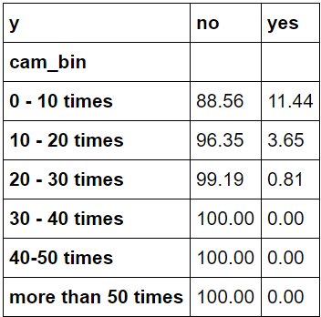
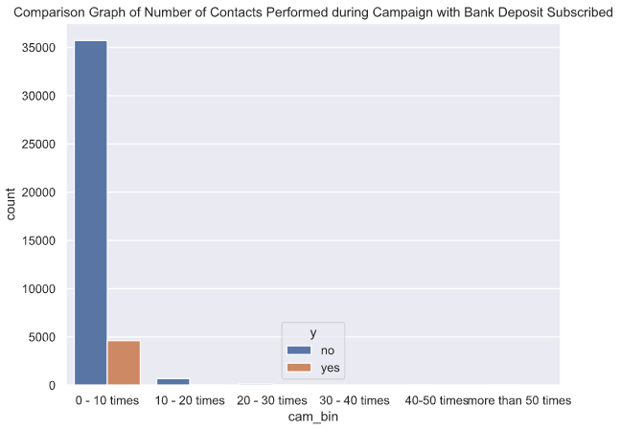
EDA – Multivariate Analysis (12) campaign and deposit subscribed
Number of calls between bank customers and campaign team was dominated by range 0 - 10 times
If the customer already contacted more that 10 times, the probabilty of deposit become slim to none

Slide 36
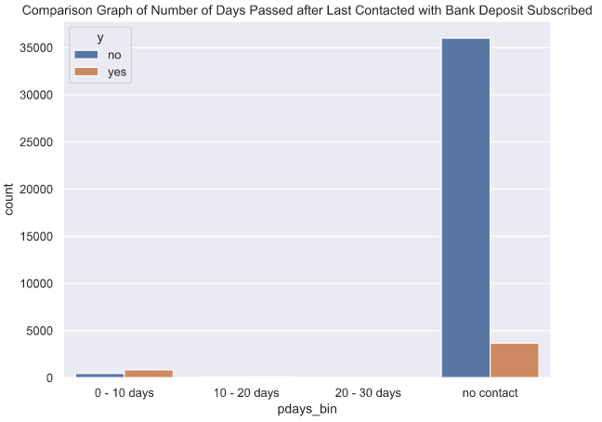
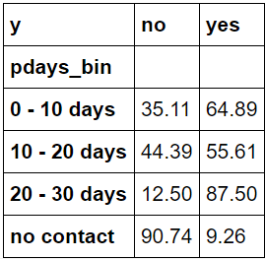
EDA – Multivariate Analysis (13) previous days and deposit subscribed
Clients who choose to subscribe deposits are dominated by who were not contacted from the previous campaign
If the customer has been contacted in the previous campaign, there is higher chance that they will deposit

Slide 37
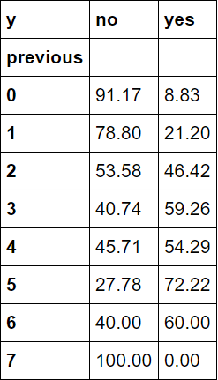
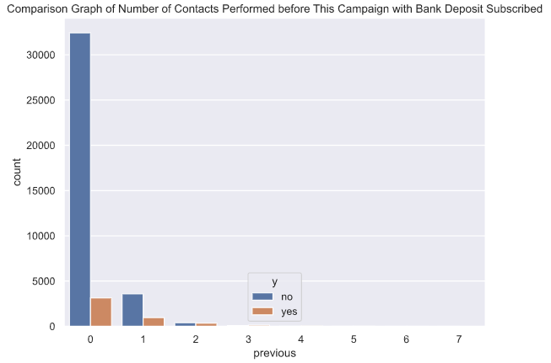
EDA – Multivariate Analysis (14) number of previous contact and deposit subscribed
Clients who choose to subscribe deposits are dominated by clients who were not contacted from the previous campaign
If the customer was contacted between 2 - 7 times in the previous campaign, there is higher chance that they will subscribe

Slide 38
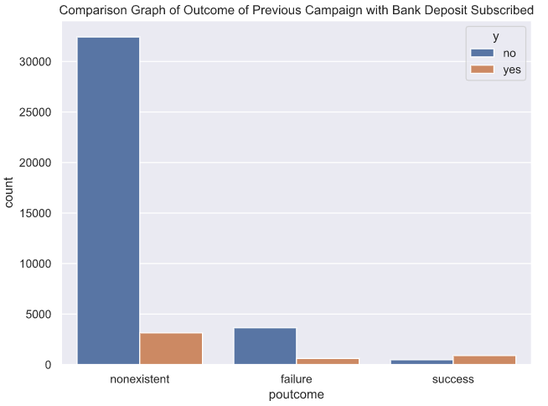
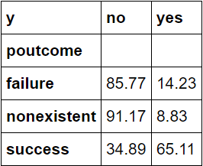
EDA – Multivariate Analysis (15) previous outcome and deposit subscribed
Clients who choose to subscribe deposits are dominated by clients whose previous outcome of campaign were nonexistent
Customer who subscribe at the previous campaign highest subscribe percentage in the current campaign

Slide 39
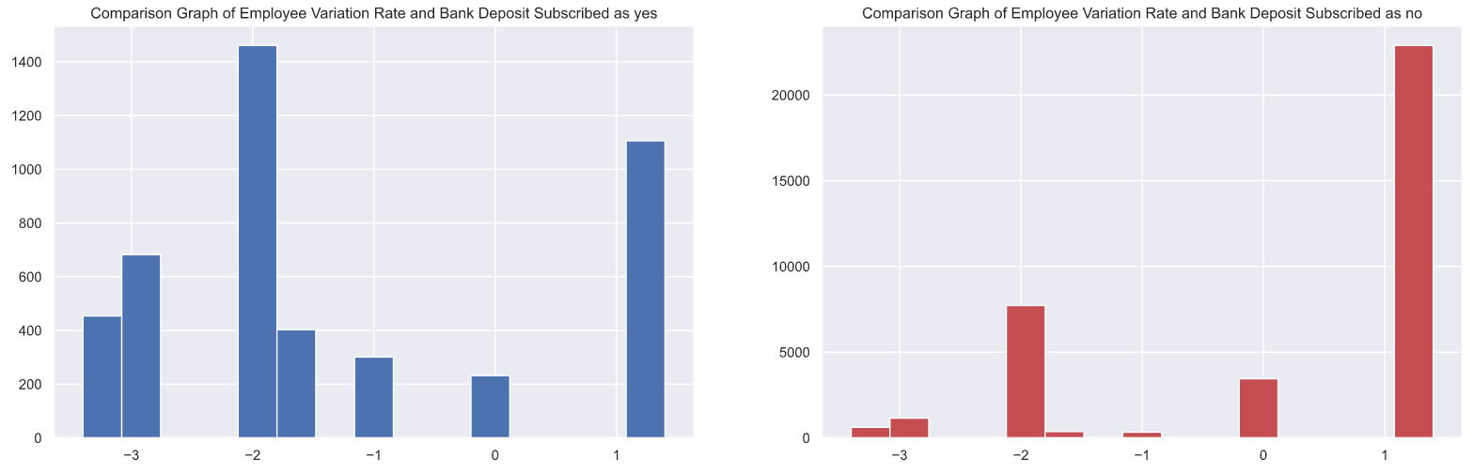
EDA – Multivariate Analysis (16) employee variation rate and deposit subscribed
Emp var rate | no | yes | Emp var rate | no | yes | Emp var rate | no | yes | Emp var rate | no | yes | Emp var rate | no | yes
-3.4 | 56.71 | 42.39 | -2.9 | 64.28 | 35.72 | -1.7 | 47.87 | 52.13 | -0.2 | 90.00 | 10.00 | 1.1 | 96.91 | 3.09
-3.0 | 48.48 | 51.16 | -1.8 | 84.09 | 15.91 | -1.1 | 52.60 | 47.40 | -0.1 | 93.70 | 6.30 | 1.4 | 94.67 | 5.33
Clients who choose to subscribe deposits are dominated by clients whose employee variation rate as -1.8
There is a trend that shows if the employee variation rate become better (less negative or more positive), the subscribe percentage become lower

Slide 40
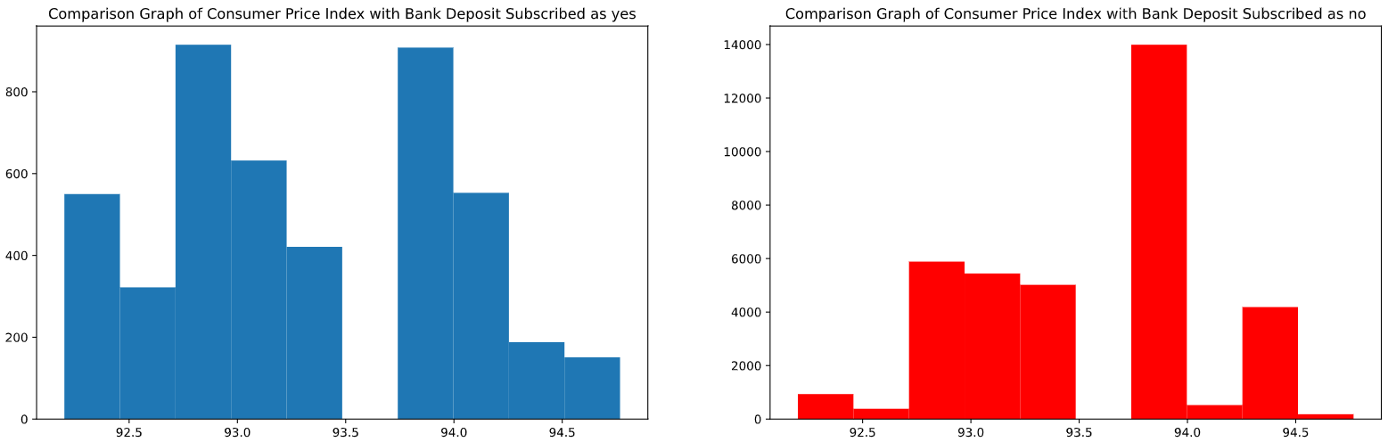
EDA – Multivariate Analysis (17) consumer price index and deposit subscribed
Cons price idx | no | yes | Cons price idx | no | yes | Cons price idx | no | yes | Cons price idx | no | yes | Cons price idx | no | yes | Cons price idx | no | yes
92.201 | 65.71 | 34.29 | 92.713 | 48.84 | 51.16 | 93.075 | 82.02 | 17.98 | 93.798 | 37.31 | 62.69 | 94.055 | 53.28 | 46.27 | 94.767 | 54.69 | 45.31
92.379 | 60.30 | 39.70 | 92.756 | 90.00 | 10.00 | 93.200 | 94.75 | 5.25 | 93.876 | 42.45 | 57.55 | 94.199 | 50.50 | 49.50
92.431 | 59.73 | 40.27 | 92.843 | 55.32 | 44.68 | 93.369 | 43.18 | 56.82 | 93.918 | 93.91 | 6.09 | 94.215 | 43.41 | 56.59
92.469 | 62.92 | 37.08 | 92.893 | 90.96 | 9.04 | 93.444 | 94.76 | 5.24 | 93.994 | 96.91 | 6.09 | 94.465 | 95.70 | 4.30
92.649 | 52.94 | 47.06 | 92.963 | 63.08 | 36.92 | 93.749 | 44.25 | 55.75 | 94.027 | 48.50 | 51.50 | 94.601 | 54.41 | 45.59
Client who choose to subscribe are dominated by clients whose consumer price index was 92.893

Slide 41
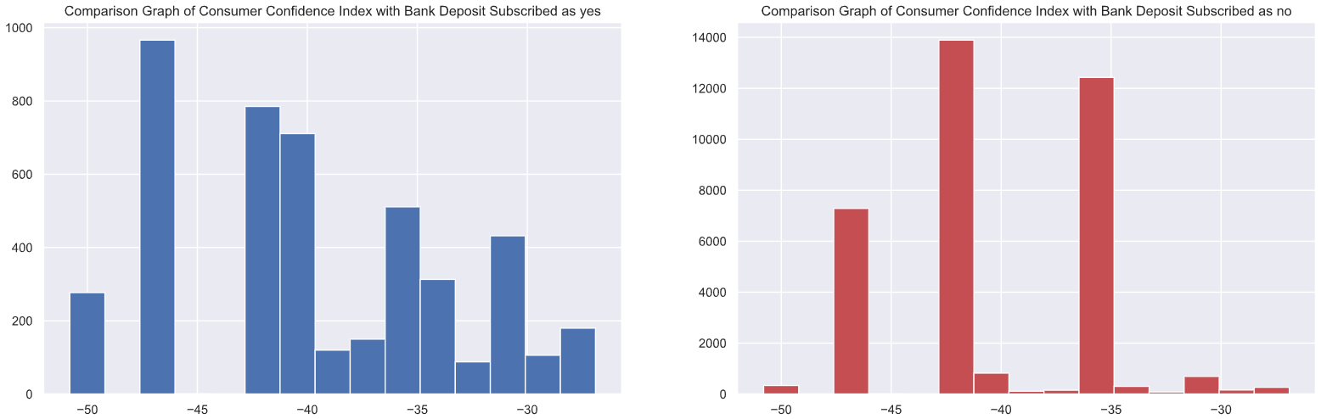
EDA – Multivariate Analysis (18) consumer confidence index and deposit subscribed
Cons conf idx | no | yes | Cons conf idx | no | yes | Cons conf idx | no | yes | Cons conf idx | no | yes | Cons conf idx | no | yes | Cons conf idx | no | yes
-50.8 | 54.69 | 54.31 | -45.9 | 90.00 | 10.00 | -40.4 | 37.31 | 62.69 | -37.5 | 50.50 | 49.50 | -33.6 | 62.92 | 37.08 | -26.9 | 59.73 | 40.27
-50.0 | 55.32 | 44.68 | -42.7 | 93.91 | 6.09 | -40.3 | 43.41 | 56.59 | -36.4 | 96.91 | 3.09 | -33.0 | 48.84 | 51.16
-49.5 | 54.41 | 45.59 | -42.0 | 94.75 | 5.25 | -40.0 | 42.45 | 57.55 | -36.1 | 94.76 | 5.24 | -31.4 | 65.71 | 34.29
-47.1 | 82.02 | 17.98 | -41.8 | 95.70 | 4.03 | -39.8 | 53.28 | 46.72 | -34.8 | 43.18 | 56.82 | -30.1 | 52.94 | 47.06
-46.2 | 90.96 | 9.04 | -40.8 | 63.08 | 36.92 | -38.3 | 48.50 | 51.50 | -34.6 | 44.25 | 55.75 | -29.8 | 60.30 | 39.70
Clients who choose to subscribe deposits are dominated by clients whose consumer confidence index as -46.2

Slide 42


EDA – Multivariate Analysis (19) Euribor 3 months rate and deposit subscribed
Clients who choose to subscribe deposits are dominated by clients whose euribor 3 months rate in range 0 - 1 by quantity
If euribor become higher then subscribe percentage become lower

Slide 43

EDA – Multivariate Analysis (20) number of employee and deposit subscribed
Nr employed | no | yes | Nr employed | no | yes | Nr employed | no | yes | Nr employed | no | yes
4963.6 | 52.60 | 47.40 | 5017.5 | 57.61 | 42.39 | 5099.1 | 87.20 | 12.80 | 5195.8 | 93.70 | 6.30
4991.6 | 47.87 | 52.13 | 5023.5 | 48.84 | 51.16 | 5176.3 | 90.00 | 10.00 | 5228.1 | 94.67 | 5.33
5008.7 | 43.23 | 56.77 | 5076.2 | 64.28 | 35.72 | 5191.0 | 96.91 | 3.09
Last day of week communication between client and campaign team was dominated in Thursday

Slide 44
MODELLING

Slide 45
Overview
The model used before running the campaign
Use Features/column that can be obtained before the campaign
Data Preparation
Drop Columns ‘duration’ & ‘campaign’
Check Null values
Change the values in target column (‘y’) into numerical value

Slide 46

Data Imbalance Check
0 ➔ No
1 ➔ Yes

Slide 47

Label Encoding
Only Education Column

Slide 48

Splitting Data
Split the data into X (all features except ‘y’) and y (target column)
Split the X and y into train and test data each with ratio 80%:20%

Slide 49

Data Oversampling
To solve the data imbalance problem
Random Over sampling
ONLY for the train data

Slide 50

Pipeline
Separate the Numerical Columns and Categorical Columns

Slide 51
Pipeline
Pipeline
Features engineering
Robust Scaling
Encoding
One Hot Encoding
Numerical Columns
Categorical Columns

Slide 52
Model
Logistic Regression
Random Forest
SVM
XGB
KNN
Decision Tree

Slide 53
Evaluation Matrix
PRECISION is more important because
Predict 1 (buy deposit) but in actual 0 (not buying) have more risk and wasting more cost
Increase
Precision
Decrease
False Positive

Slide 54

Evaluation Matrix
Base Model

Slide 55
Hyperparameter Tuning
4 Potential Model :
Logistic Regression
Random Forest
Decision Tree
XGBoost

Slide 56

Hyperparameter Tuning
5 Model that have the highest precision
In conclusion we use Logistic Regression 2nd Hyperparameter tuning

Slide 57

Confusion Metrix
False Positive : 102
False Negative : 741

Slide 58
Suggestion
We need to add costumer account balance feature that have greater impact to the model because before someone decide to take/buy a deposit, they surely will check their account balance first to see if they have enough money or not

Slide 59


Prediction
Using all data
Confusion Metrix
False Positive : 548
False Negative : 3673

Slide 60

Prediction
False Positive : 548
False Negative : 3673
High False negative → prediction 0 (no) but in actual 1 (yes) → Causing High lose of potential customer
SOLUTION
Predict Probability

Slide 61
Analisis dilakukan di waktu jeda antar program
Mengacu pada jumlah minimal rekening nasabah premium
Gas masukin ke list calon customer
Model
Proba YA > 0.6
Data baru
!! INGAT !!
patokan di 500 jt rupiah/ 30,000 euro
Rekening >= patokan (SABI)
Rekening < Patokan (tidak sabi)
Sabi
0.6 >=Proba Ya >= 0.3
Lihat isi rekeningnya sabi ga
Tidak Sabi
Proba Ya < 0.3
JANGAN masukin ke list calon customer

Slide 62
Probability
We predict the probability to buy a deposit (after using the model) for every bank customer
We categorize the probability into 3 groups (‘< 0.3’, ‘0.3 – 0.6’ & ‘> 0.6’)

Slide 63

All 0 result in .predict ➔ 0.3 – 0.6 .predict_proba (for 1) ➔ all FN’s and TN’s costumer account balance should be checked.
All 1 result in .predict ➔ > 0.6 .predict_proba (for 1)

Slide 64
SIMULATION

Slide 65
Approach
Duration Approach
Use sum of the duration directly

Slide 66
Assumption
Cost driven by two main things : Call Charges per Minutes, Salary
The campaign duration is can be adjust
Call charges: 0.3 euro per minutes
Salary : 1600 euro/person/month
4 hours/240 minutes of call (effective time) that can handled by 1 employee per day
Notes:
Call charges : https://www.lonelyplanet.com/portugal/narratives/practical-information/directory/telephone#:~:text=Local%2C%20Regional%20%26%20National%20Calls&text=Local%20calls%20cost%20around%20%E2%82%AC,from%20anywhere%20in%20the%20country.
Salary : http://www.salaryexplorer.com/salary-survey.php?loc=174&loctype=1&job=12702&jobtype=3

Slide 67

Assumption
we assume for people that have bank account more than 30,000 Euro (from total people that have probability to buy a deposit between 0.3 & 0.6) is people that buy the deposit in actual (‘y’ = 1)[The false negative] which is in this case there are 3673
Notes:
Call charges : https://www.lonelyplanet.com/portugal/narratives/practical-information/directory/telephone#:~:text=Local%2C%20Regional%20%26%20National%20Calls&text=Local%20calls%20cost%20around%20%E2%82%AC,from%20anywhere%20in%20the%20country.
Salary : http://www.salaryexplorer.com/salary-survey.php?loc=174&loctype=1&job=12702&jobtype=3

Slide 68
Before & After using the model
 |  | Price | Quantity | Frequency | Total (all months) (euro)
BEFORE | Call Charges | 0.3 euro/minutes | 1 | 177304 minutes (in 10 months) | 53191.215
 | Salary | 1600 euro/month/emp | 4 emp | 10 months | 64000.000
 | TOTAL |  |  |  | 117191.215
AFTER | Call Charges | 0.3 euro/minutes | 1 | 44977 minutes (in 10 months) | 13493.094
 | Salary | 1600 euro/month/emp | 3 emp | 3 months | 14400.000
 | TOTAL |  |  |  | 27893.094
SAVING |  |  |  |  | 89298.121
Cost reduced 76.2 %
Notes:
Call charges : https://www.lonelyplanet.com/portugal/narratives/practical-information/directory/telephone#:~:text=Local%2C%20Regional%20%26%20National%20Calls&text=Local%20calls%20cost%20around%20%E2%82%AC,from%20anywhere%20in%20the%20country.
Salary : http://www.salaryexplorer.com/salary-survey.php?loc=174&loctype=1&job=12702&jobtype=3

Slide 69
Conclusion
Based on our model (Logistic Regression), we got 1515 People want to buy (y predict=1) and 39673 People don’t want to buy (y predict = 0). If we look on the probability of wanting to buy (y predict proba 1) for every person, with threshold 0,3 and 0,6 there are 0 People that have the probability < 0.3, 39673 People 0.3 – 0.6 and 1515 People > 0.6.
After we use the model, estimation of cost reduction up to 76.2 %

Slide 70
THANKS

