Slide 1



Amazon_Dashboard
View in Power BI
Last data refresh:
01/04/2024 01:32:26 UTC
Downloaded at:
02/04/2024 21:43:41 UTC

Slide 2
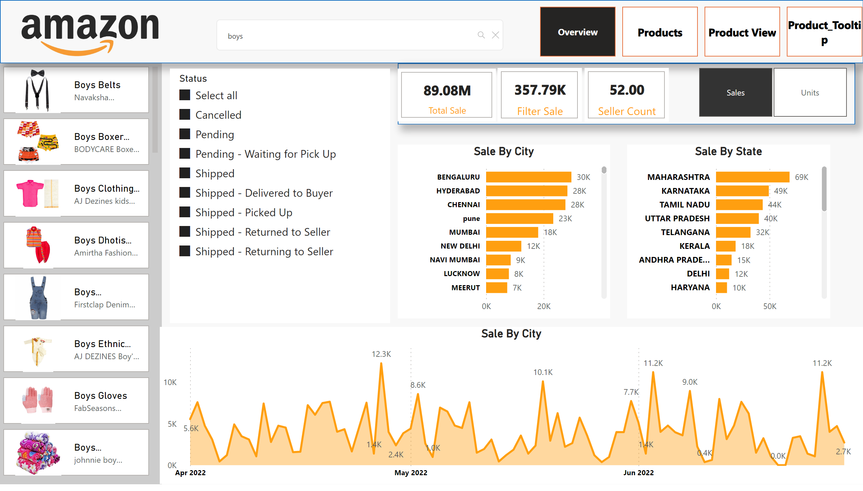
Overview
Notes:
pageNavigator
No alt text provided
image
No alt text provided
shape
No alt text provided
advancedSlicerVisual
No alt text provided
advancedSlicerVisual
No alt text provided
cardVisual
No alt text provided
cardVisual
No alt text provided
cardVisual
No alt text provided
Sale By City
No alt text provided
Sale By State
No alt text provided
Sale By City
No alt text provided
shape
No alt text provided
slicer
No alt text provided
slicer
No alt text provided
textSearchSlicerF85E2E78BE4A4D7D9F99ED75B5D71C85
No alt text provided

Slide 3
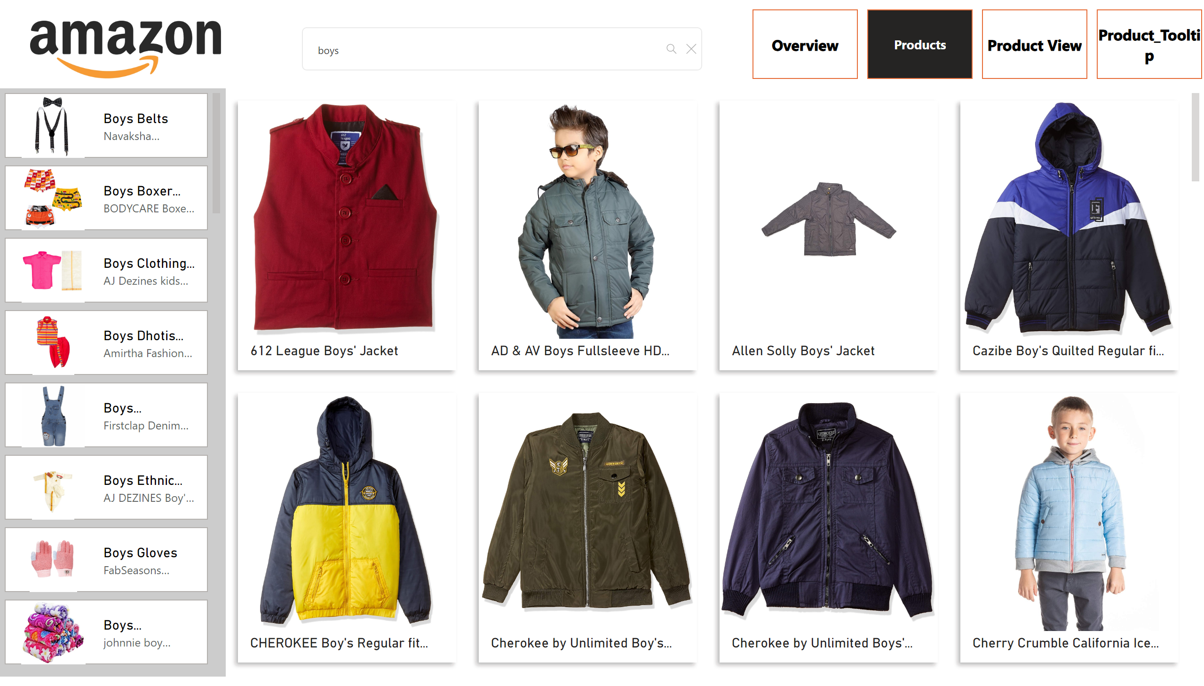
Products
Notes:
pageNavigator
No alt text provided
textSearchSlicerF85E2E78BE4A4D7D9F99ED75B5D71C85
No alt text provided
image
No alt text provided
advancedSlicerVisual
No alt text provided
advancedSlicerVisual
No alt text provided

Slide 4
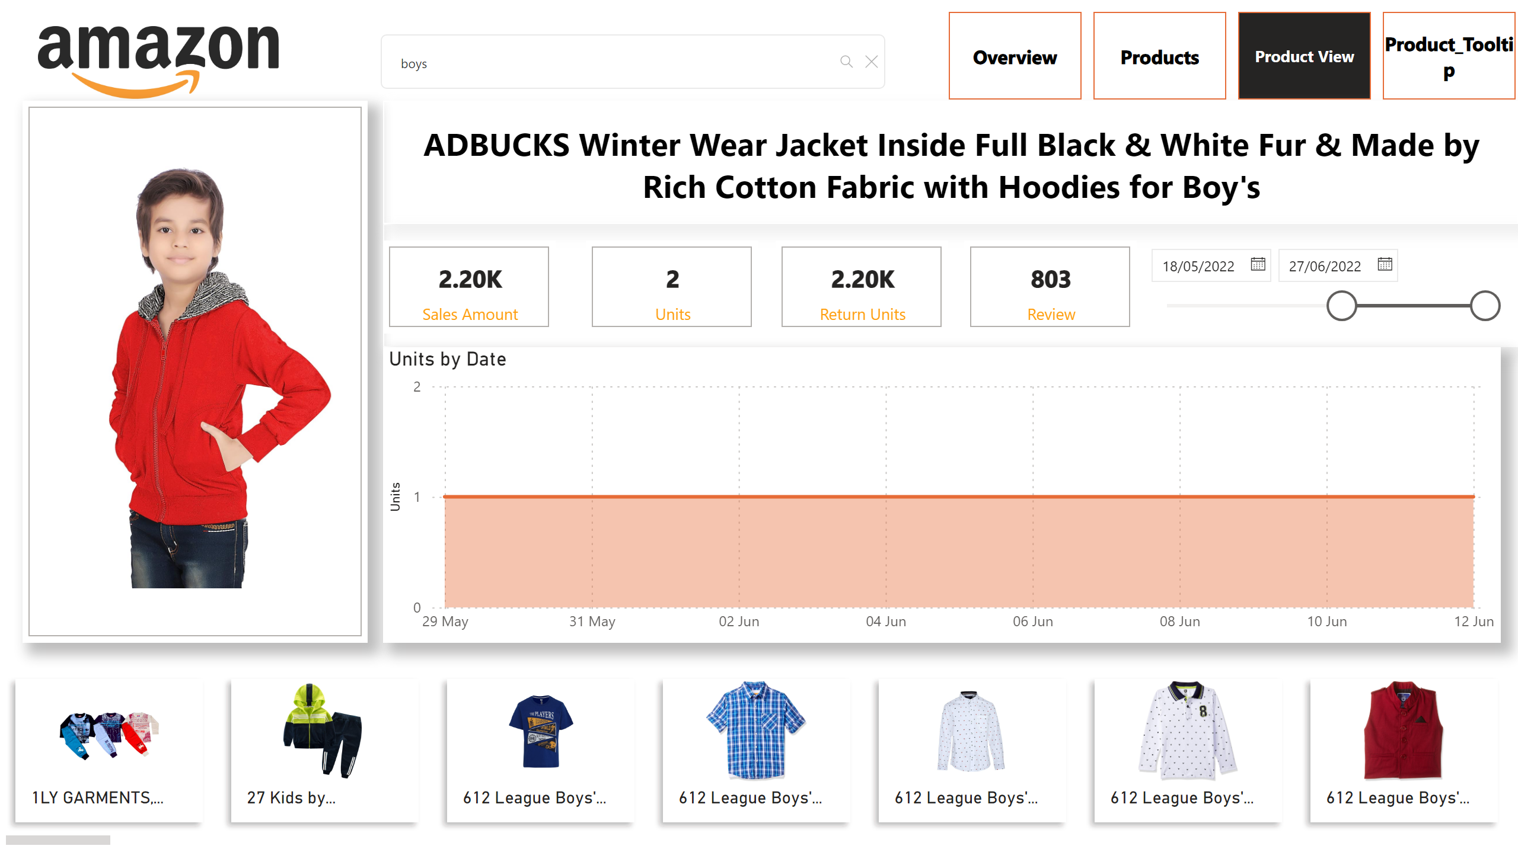
Product View
Notes:
pageNavigator
No alt text provided
textSearchSlicerF85E2E78BE4A4D7D9F99ED75B5D71C85
No alt text provided
image
No alt text provided
advancedSlicerVisual
No alt text provided
cardVisual
No alt text provided
shape
No alt text provided
shape
No alt text provided
cardVisual
No alt text provided
cardVisual
No alt text provided
cardVisual
No alt text provided
cardVisual
No alt text provided
slicer
No alt text provided
areaChart
No alt text provided

