Slide 1



Healthcare_Analytics
View in Power BI
Last data refresh:
02/04/2024 21:40:37 UTC
Downloaded at:
02/04/2024 21:47:02 UTC

Slide 2
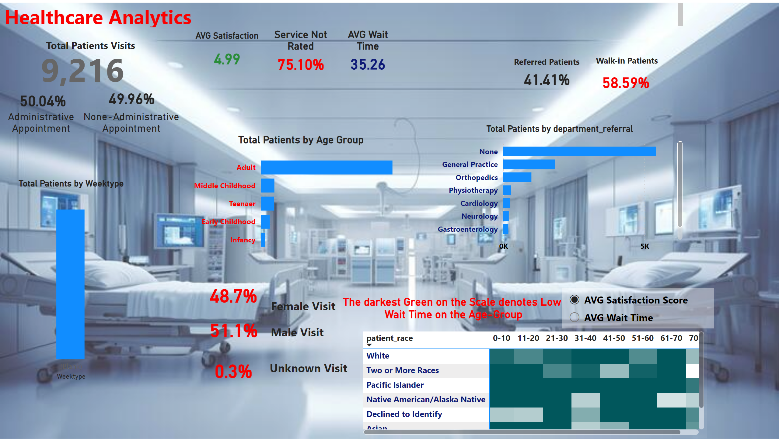
Page 1
Notes:
card
No alt text provided
card
No alt text provided
card
No alt text provided
pivotTable
No alt text provided
slicer
No alt text provided
clusteredBarChart
No alt text provided
clusteredBarChart
No alt text provided
card
No alt text provided
textbox
No alt text provided
textbox
No alt text provided
AVG Satisfaction
No alt text provided
Service Not Rated
No alt text provided
AVG Wait Time
No alt text provided
card
No alt text provided
card
No alt text provided
textbox
No alt text provided
textbox
No alt text provided
clusteredColumnChart
No alt text provided
card
No alt text provided
card
No alt text provided
card
No alt text provided
textbox
No alt text provided
textbox
No alt text provided
textbox
No alt text provided
textbox
No alt text provided
textbox
No alt text provided

