Slide 1



Zomato_Netwrok_Analysis
View in Power BI
Last data refresh:
17/04/2024 23:09:51 UTC
Downloaded at:
18/04/2024 00:04:03 UTC

Slide 2

Index
Notes:
actionButton
No alt text provided

Slide 3
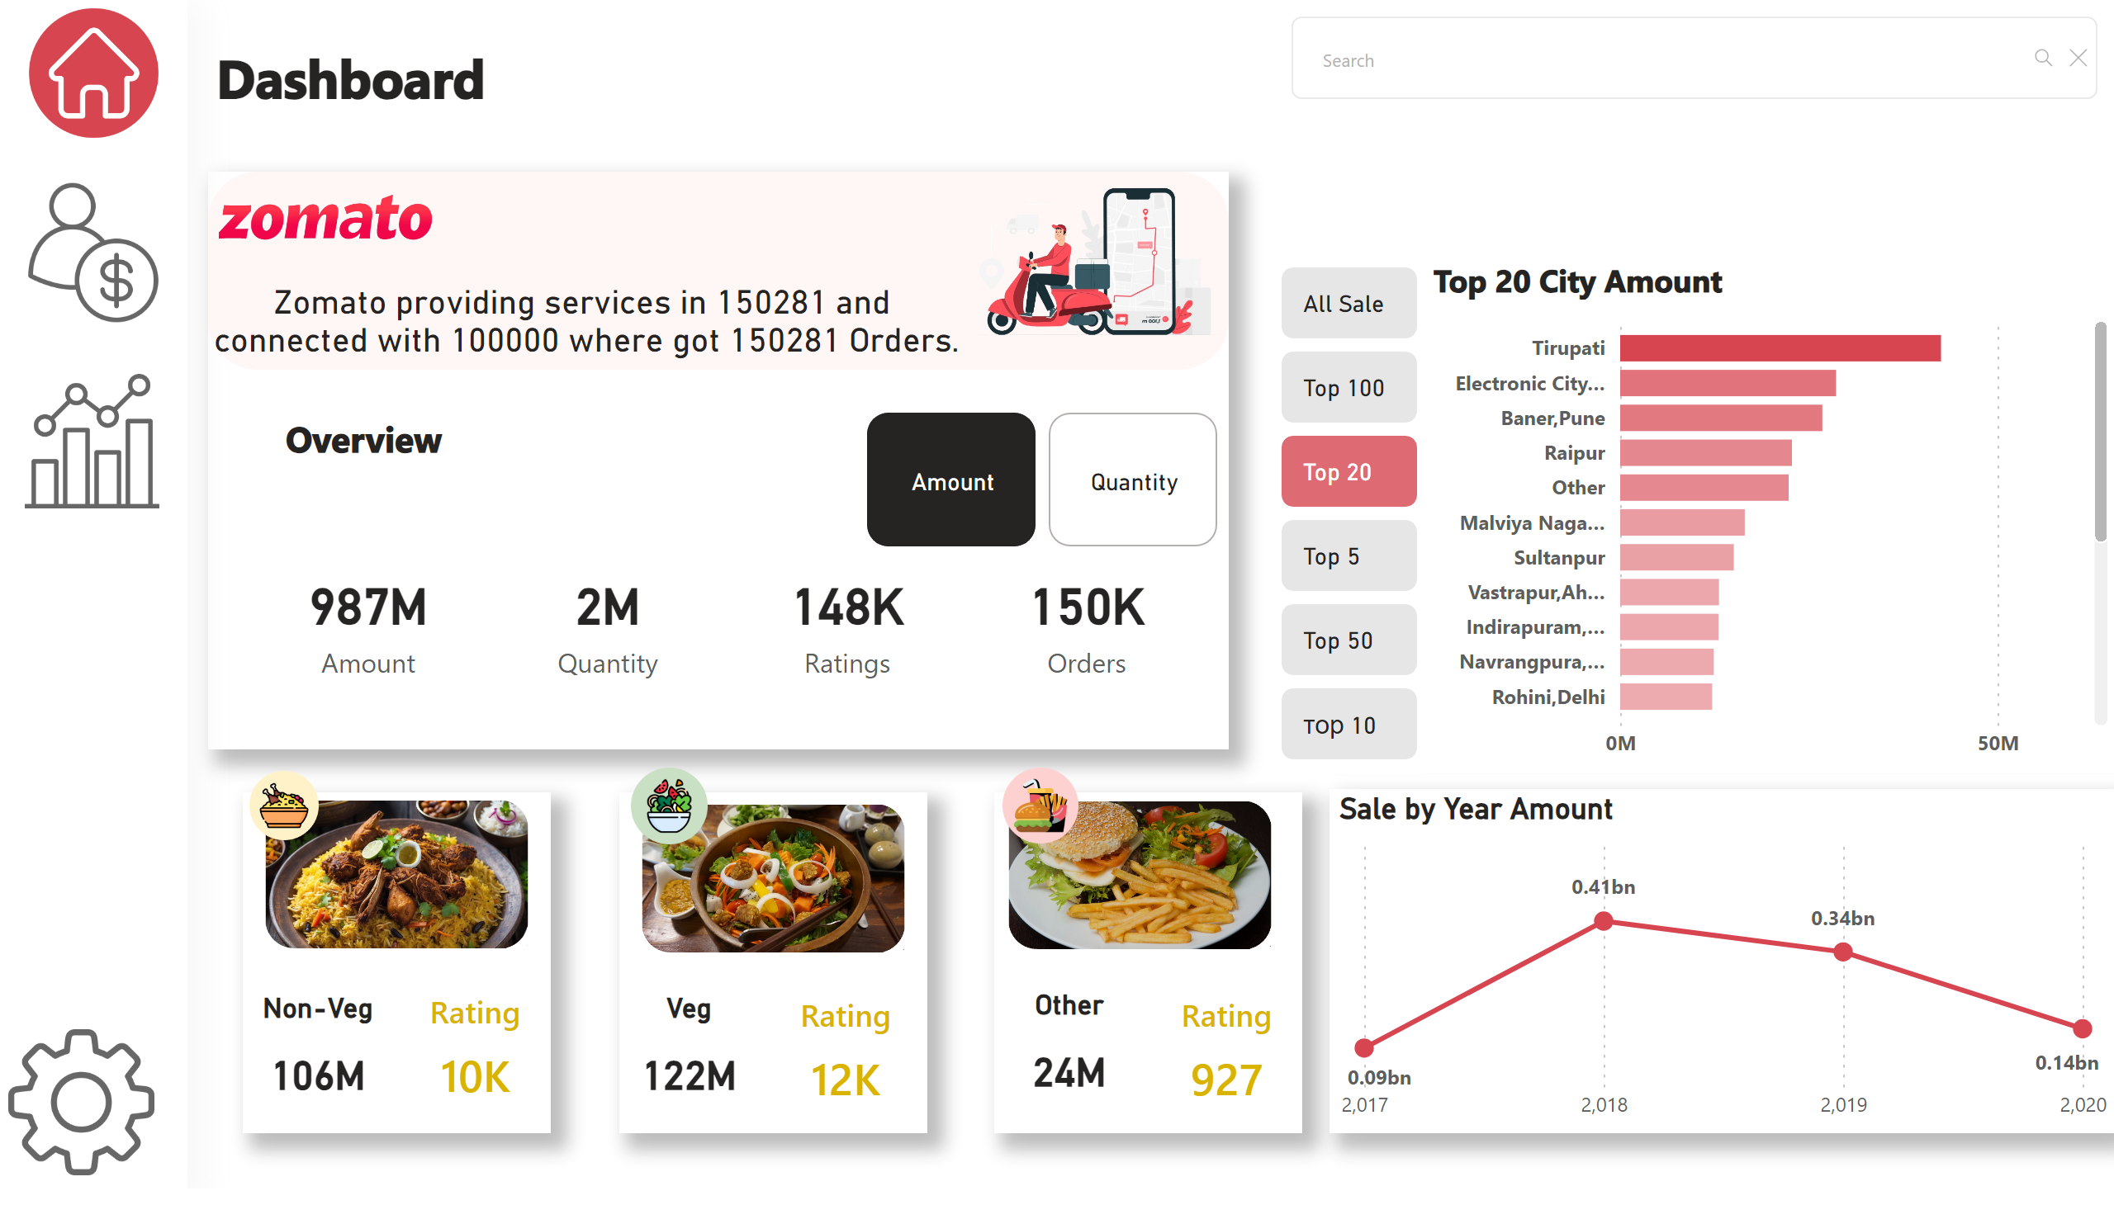
Overview
Notes:
advancedSlicerVisual
No alt text provided
Top 20 City Amount
No alt text provided
advancedSlicerVisual
No alt text provided
Sale by Year Amount
No alt text provided
card
No alt text provided
card
No alt text provided
card
No alt text provided
Non-Veg
No alt text provided
Veg
No alt text provided
Other
No alt text provided
Rating
No alt text provided
Rating
No alt text provided
Rating
No alt text provided
card
No alt text provided
shape
No alt text provided
shape
No alt text provided
shape
No alt text provided
shape
No alt text provided
shape
No alt text provided
image
No alt text provided
image
No alt text provided
image
No alt text provided
image
No alt text provided
image
No alt text provided
image
No alt text provided
textbox
No alt text provided
image
No alt text provided
image
No alt text provided
image
No alt text provided
image
No alt text provided
shape
No alt text provided
image
No alt text provided
image
No alt text provided
textbox
No alt text provided
textSearchSlicerF85E2E78BE4A4D7D9F99ED75B5D71C85
No alt text provided
card
No alt text provided
shape
No alt text provided

Slide 4
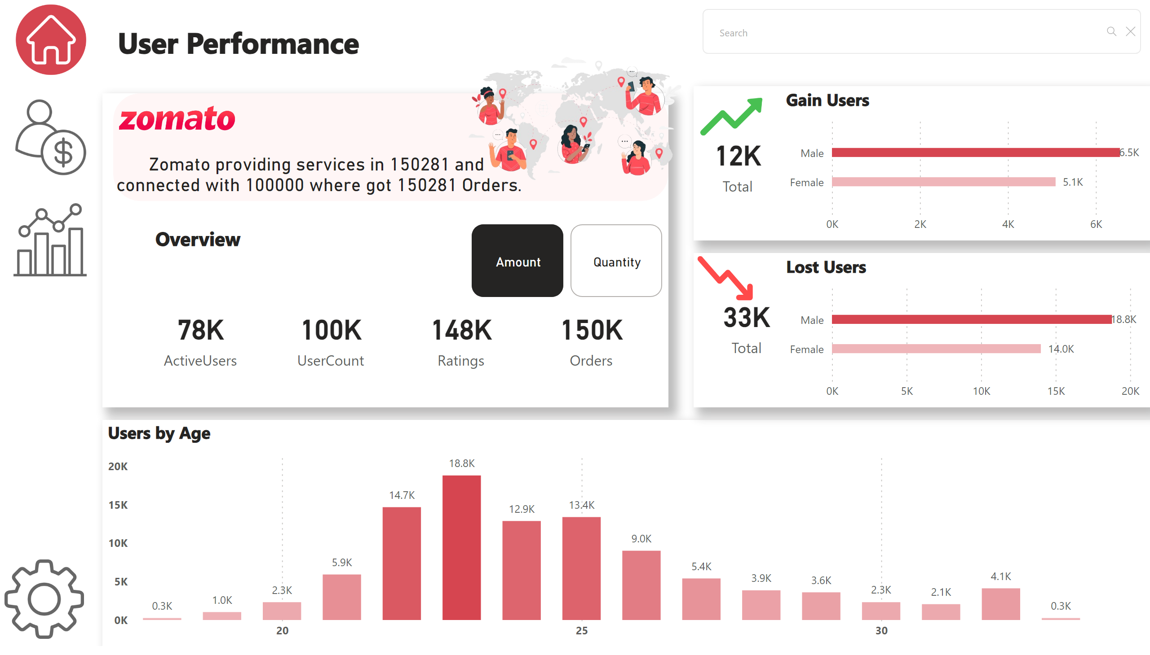
User Performance
Notes:
advancedSlicerVisual
No alt text provided
card
No alt text provided
card
No alt text provided
card
No alt text provided
card
No alt text provided
shape
No alt text provided
textbox
No alt text provided
image
No alt text provided
image
No alt text provided
image
No alt text provided
image
No alt text provided
shape
No alt text provided
image
No alt text provided
textbox
No alt text provided
textSearchSlicerF85E2E78BE4A4D7D9F99ED75B5D71C85
No alt text provided
card
No alt text provided
clusteredColumnChart
No alt text provided
shape
No alt text provided
shape
No alt text provided
Gain Users
No alt text provided
Lost Users
No alt text provided
card
No alt text provided
card
No alt text provided
image
No alt text provided
image
No alt text provided
image
No alt text provided

Slide 5
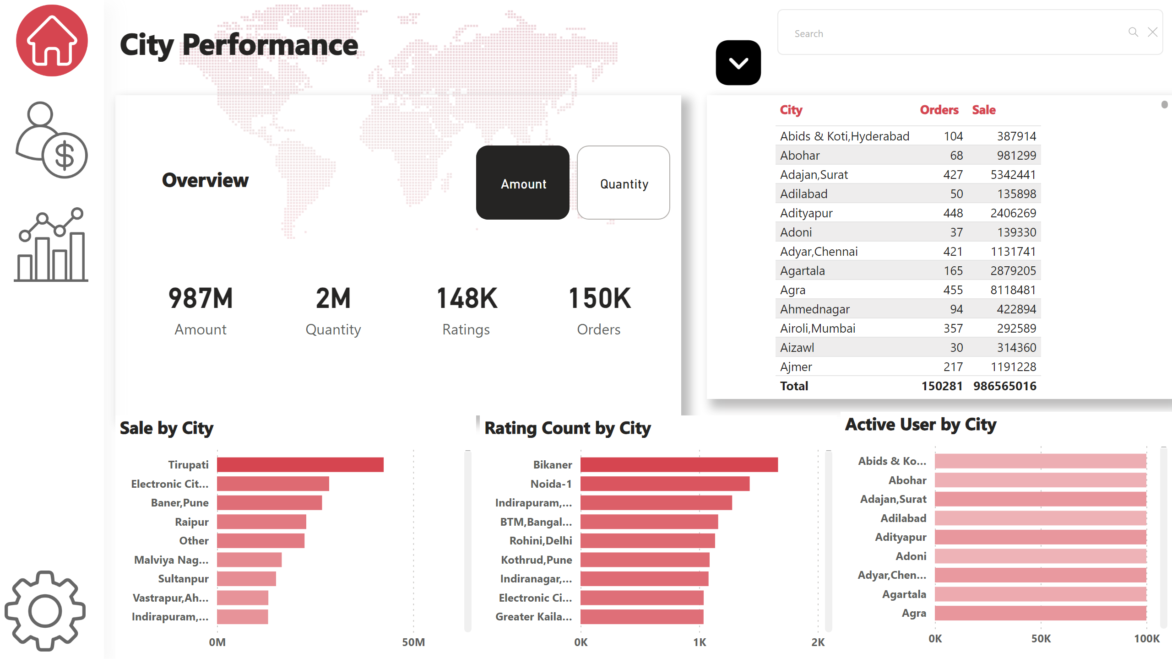
City Performance
Notes:
advancedSlicerVisual
No alt text provided
card
No alt text provided
card
No alt text provided
card
No alt text provided
card
No alt text provided
shape
No alt text provided
shape
No alt text provided
textbox
No alt text provided
image
No alt text provided
image
No alt text provided
image
No alt text provided
image
No alt text provided
textbox
No alt text provided
textSearchSlicerF85E2E78BE4A4D7D9F99ED75B5D71C85
No alt text provided
shape
No alt text provided
image
No alt text provided
Sale by City
No alt text provided
Rating Count by City
No alt text provided
Active User by City
No alt text provided
tableEx
No alt text provided
image
No alt text provided
slicer
No alt text provided
slicer
No alt text provided
image
No alt text provided
slicer
No alt text provided
shape
No alt text provided

