Slide 1
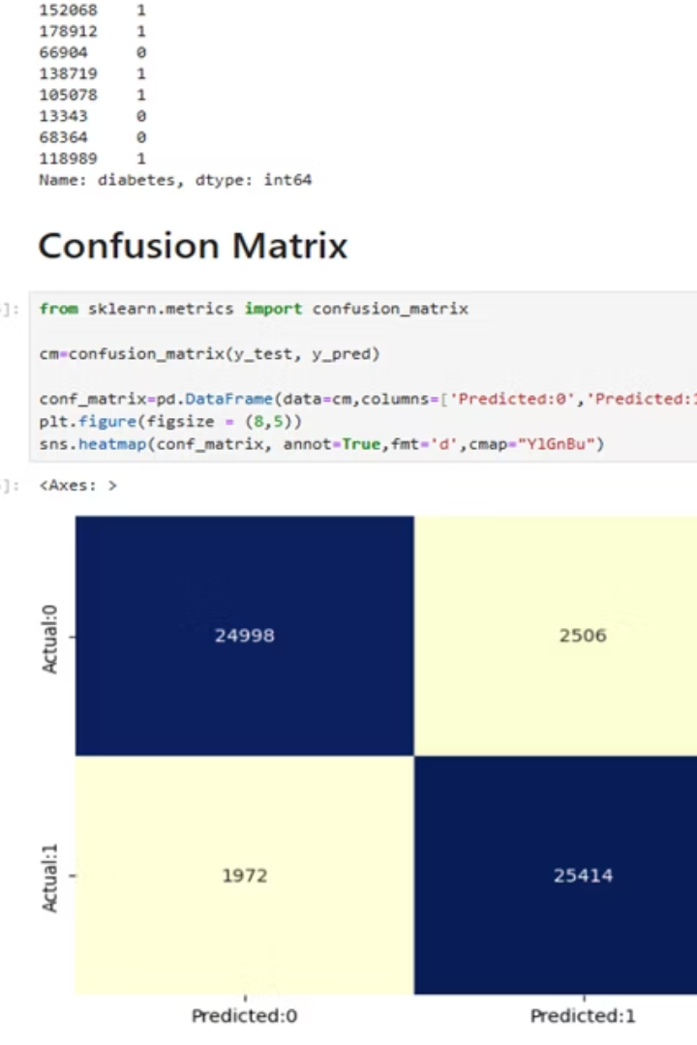

Diabetes Prediction Using Classification
by Abdullah Azhar
Leveraging machine learning for early diabetes detection, this project developed a classification model to predict diabetes based on key health indicators. This model aims to assist healthcare professionals in proactive patient management.

Slide 2
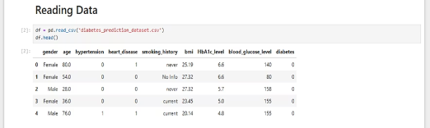
Model Overview & Key Features
Developed a robust classification model.
Key Features
Age
Predicts diabetes risk.
Glucose Level
BMI
Hypertension
Smoking History

Slide 3
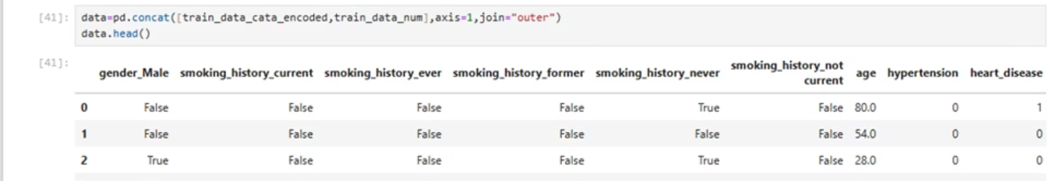



Data Preprocessing Pipeline
Label Encoding
Converted categorical features into numerical format.
Handling Missing Data
Addressed missing values to ensure data integrity.
Feature Scaling
Normalized numerical features for optimal algorithm performance.

Slide 4
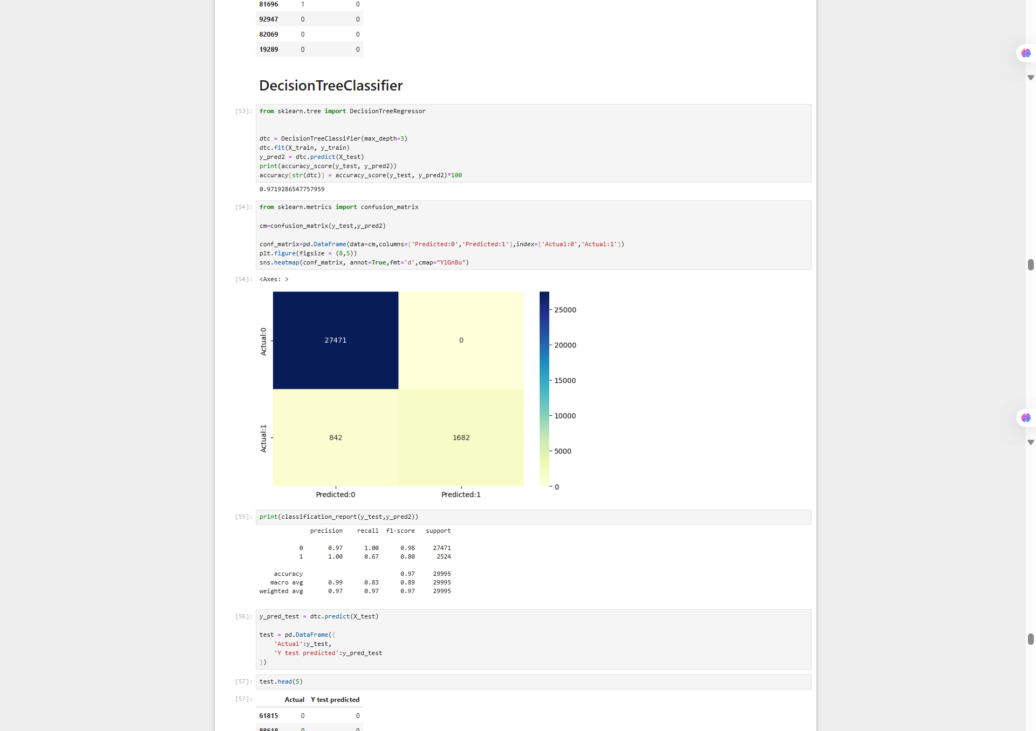
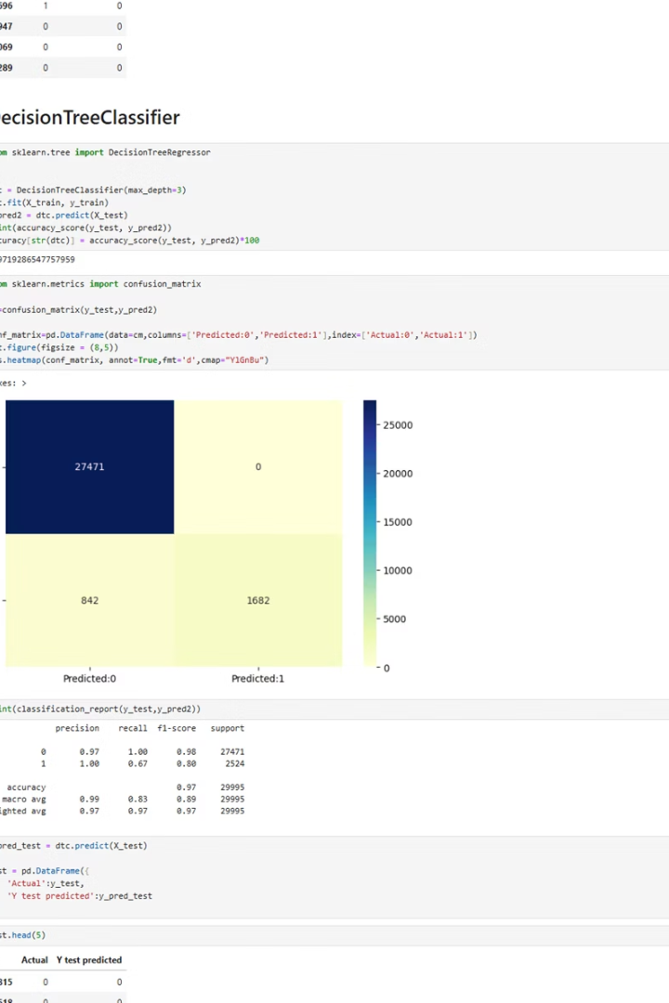
Classification Algorithms Utilized
Logistic Regression
A linear model for binary classification, known for interpretability.
Decision Tree
A non-linear model that partitions data into decision nodes, capable of capturing complex relationships.

Slide 5
Model Performance Metrics
Accuracy: Approximately 0.84
Precision: Focus on true positive predictions (0.97)
Recall: Emphasis on identifying all actual positives
F1-Score: Harmonic mean of precision and recall
These metrics provide a comprehensive view of the model's predictive capabilities, especially crucial in healthcare where both false positives and false negatives carry significant implications.

Slide 6
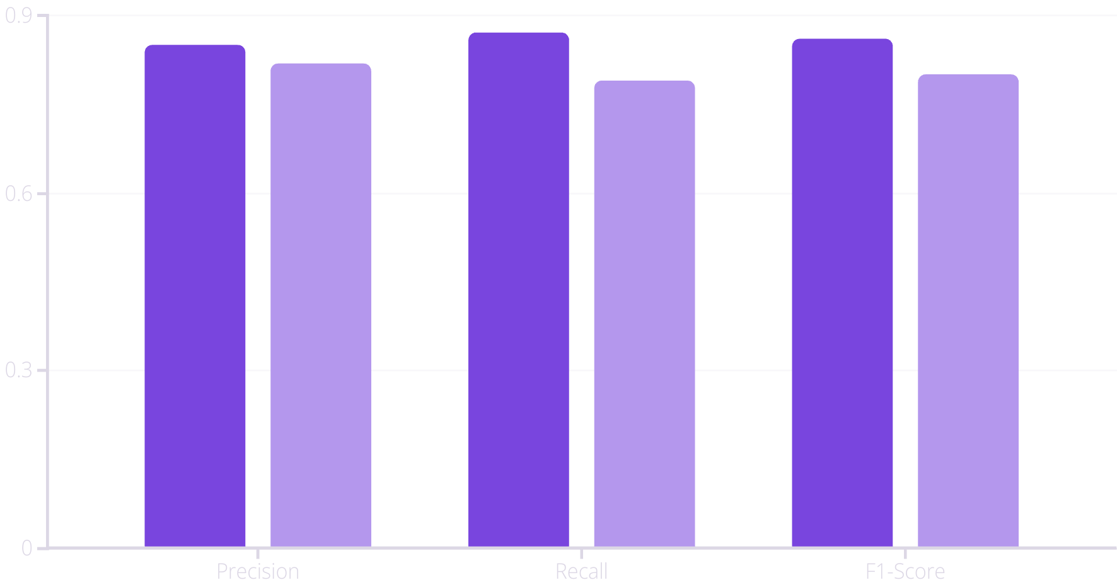
Evaluation: Classification Report
The classification report provides a detailed breakdown of precision, recall, and F1-score for each class (diabetic/non-diabetic).
Non-Diabetic
Diabetic

Slide 7
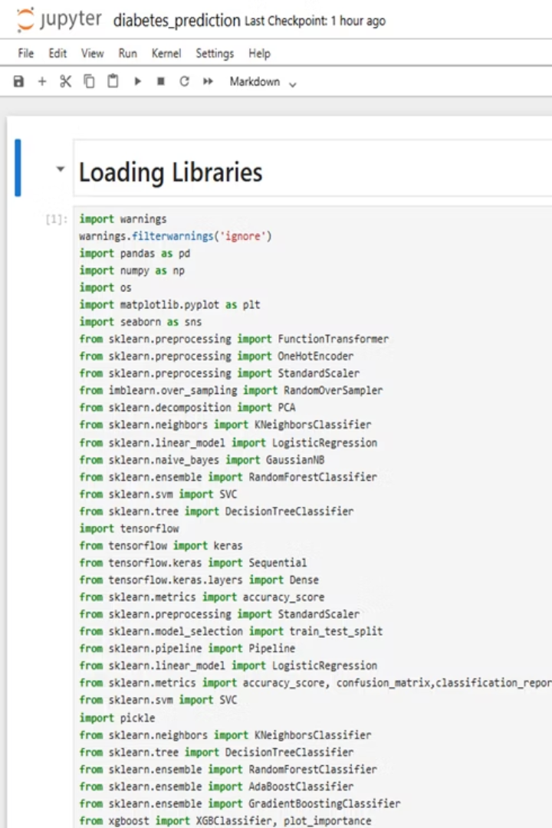




Tools and Technologies
Python
Pandas
Scikit-learn
Core programming language.
Data manipulation and analysis.
Machine learning library.
Seaborn
Statistical data visualization.

Slide 8
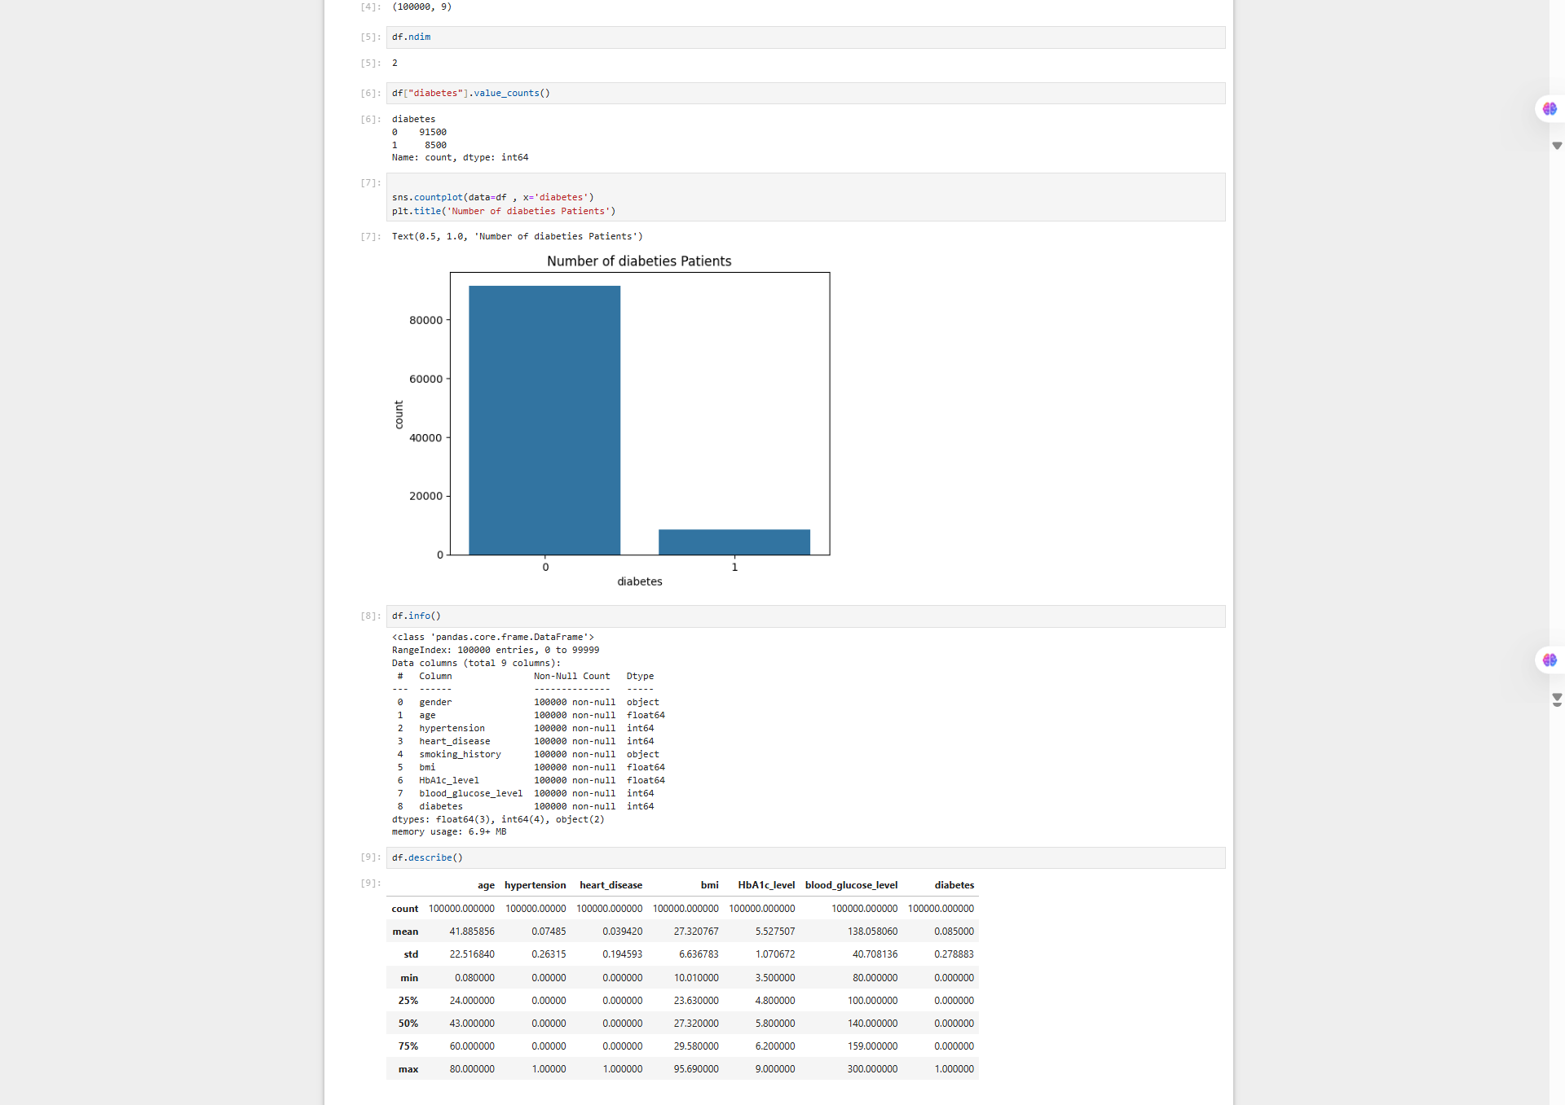
The Importance of Early Detection
1.5M
37.3M
New Diabetes Cases
Americans with Diabetes
Diagnosed annually in the US.
Significant public health challenge.
8.5%
Adult Population Affected
Based on 2021 statistics.
Early detection through predictive models can significantly improve patient outcomes and reduce long-term complications associated with diabetes.

Slide 9



Future Directions & Impact
This model serves as a foundation for advanced predictive analytics in healthcare. Future work will explore integrating more diverse datasets and real-time monitoring capabilities.
Research Expansion
Explore new data sources.
Clinical Integration
Pilot studies with healthcare providers.
Patient Empowerment
Tools for personal health management.

Slide 10

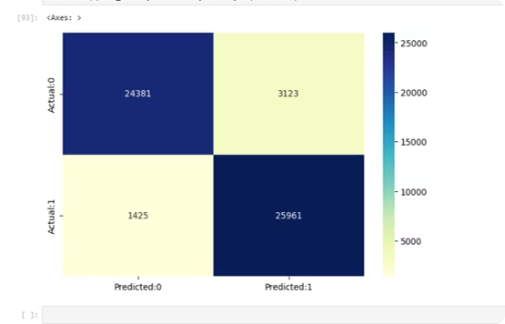



Key Takeaways & Next Steps
Our classification model effectively predicts diabetes using readily available features. This project highlights the immense potential of machine learning in preventive healthcare.
Model Validation
Scalability
Confirmed effectiveness in diabetes prediction.
Adaptable for larger datasets.
Collaboration
Opportunities with medical professionals.

