Slide 1
Insomnia101
</>
Test APIs like a PRO!
github.com/abdullahazharkhan

Slide 2


DON’T BE LIKE HIM!
Instead test APIs with INSOMNIA in dev.
Richard Stockton, CEO OceanGate

Slide 3

Tech Stack Used for the Demonstration
</>
> expressjs - for server
> mongo db - database
Software: InsomniaREST [insomnia.rest]
github.com/abdullahazharkhan

Slide 4

We Have All the Code Written.
</>
@
/abdullahazharkhan/Insomnia-101
github.com/abdullahazharkhan

Slide 5
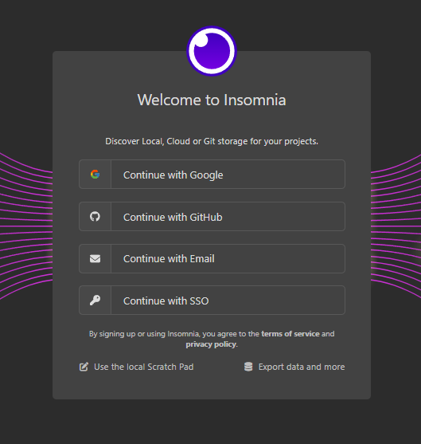
github.com/abdullahazharkhan

Slide 6
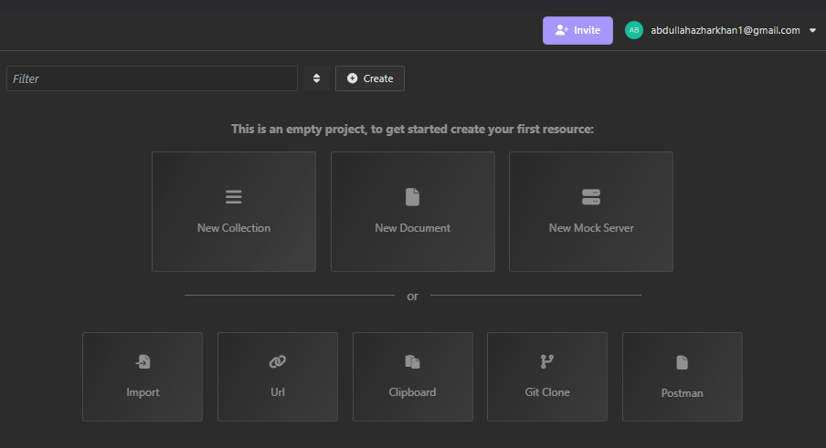
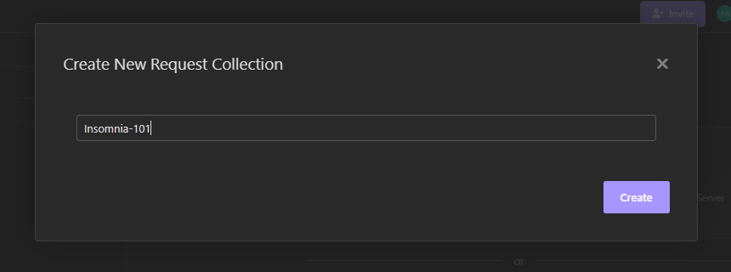
Create a Collection
github.com/abdullahazharkhan

Slide 7
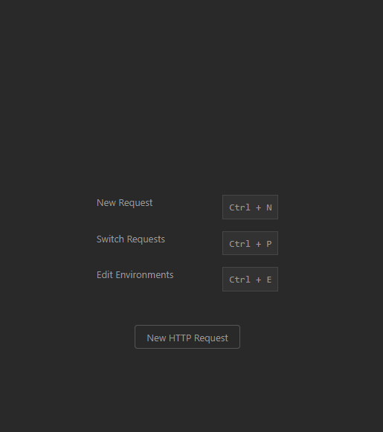
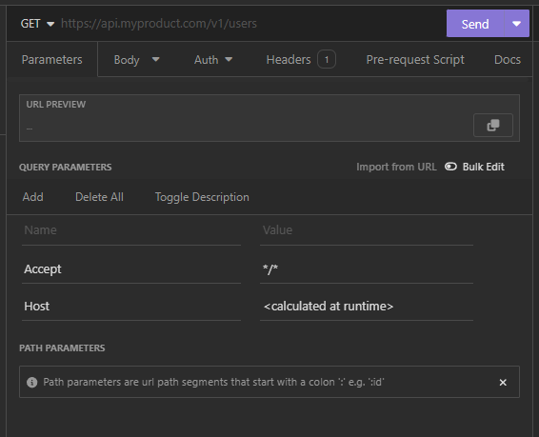
Create an HTTP Request
github.com/abdullahazharkhan

Slide 8
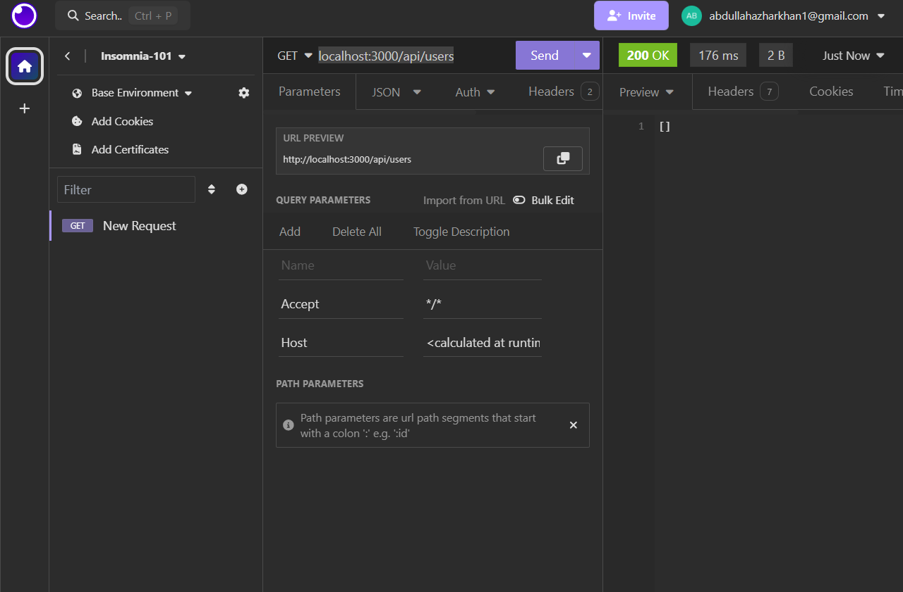
GET Request
(gets all the data)
github.com/abdullahazharkhan

Slide 9
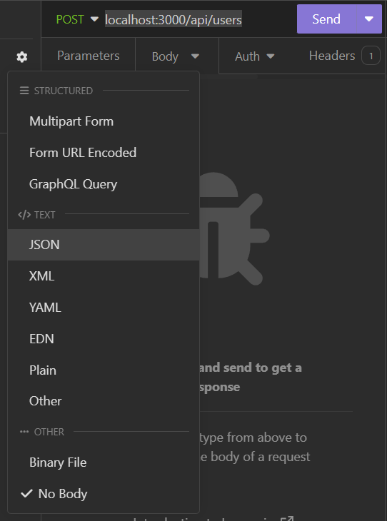
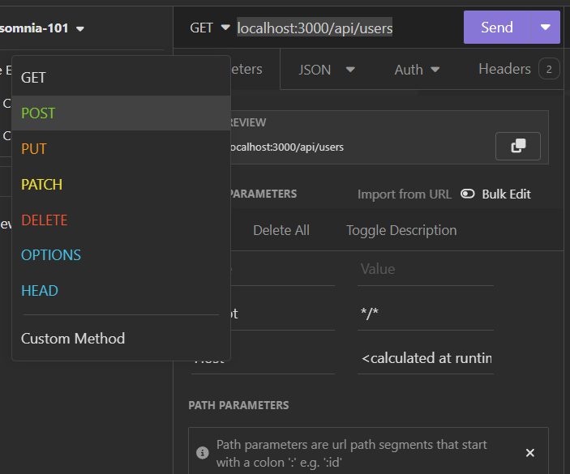
POST Request
(posts the data to database)
github.com/abdullahazharkhan

Slide 10
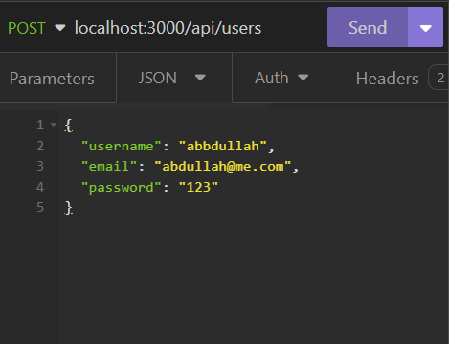


Adding data to database
github.com/abdullahazharkhan

Slide 11
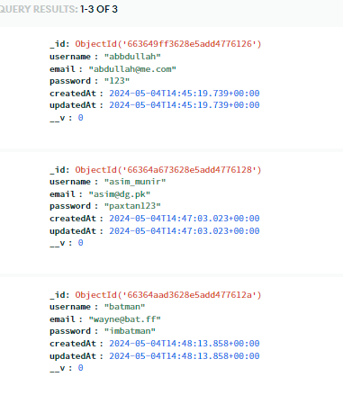
Our Table:
github.com/abdullahazharkhan

Slide 12
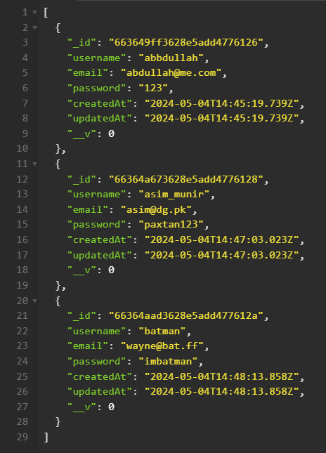
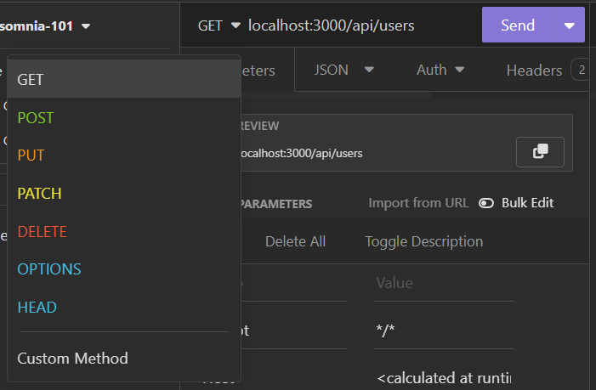
GET Request
Getting data in Insomnia
github.com/abdullahazharkhan

Slide 13
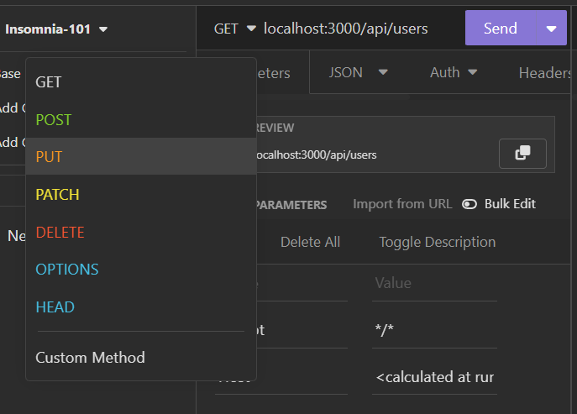
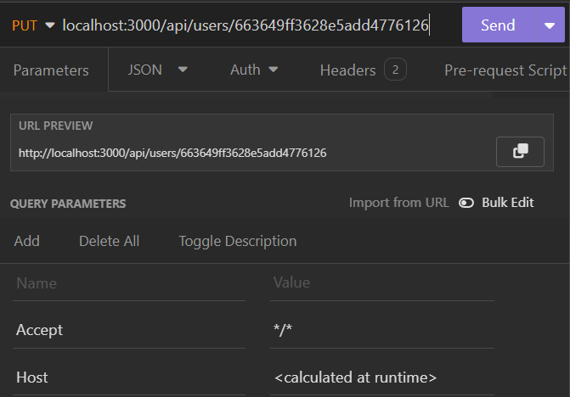
PUT Request
(updates the data of given ID)
github.com/abdullahazharkhan

Slide 14
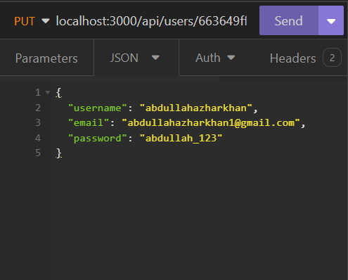
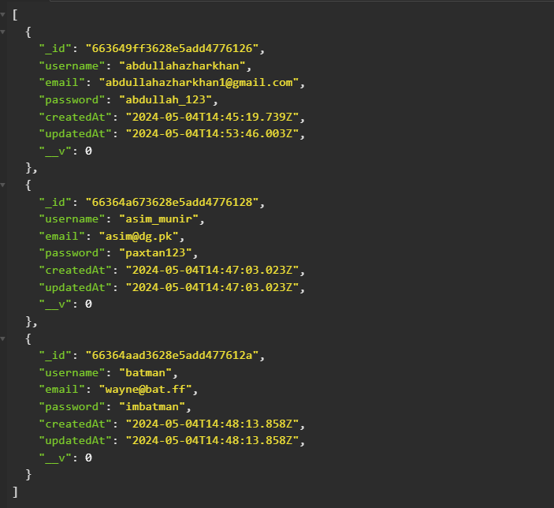
Data updated
github.com/abdullahazharkhan

Slide 15
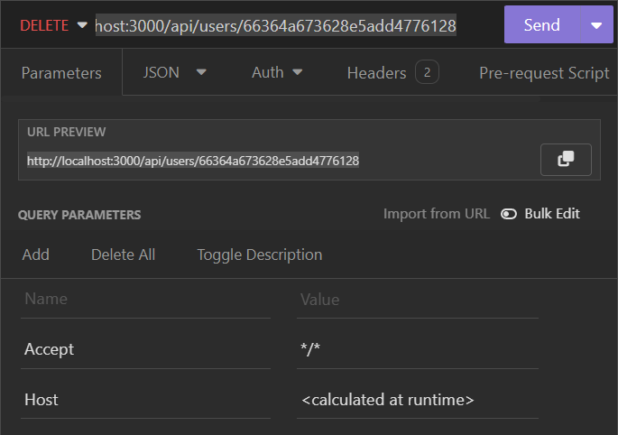
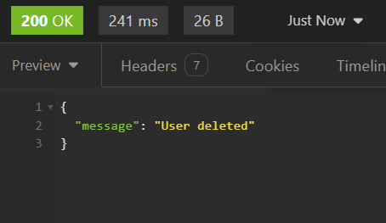
DELETE Request
(deletes the data)
github.com/abdullahazharkhan

Slide 16
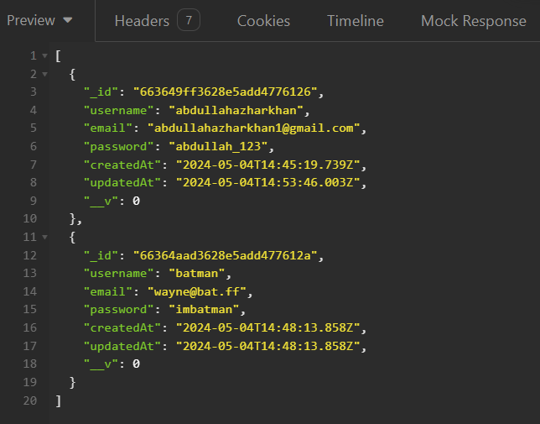
Our Final Table:
github.com/abdullahazharkhan

Slide 17
I Hope it Went Well.
</>
Slides & Code will be made available at
/abdullahazharkhan/Insomnia-101
github.com/abdullahazharkhan

