Slide 1
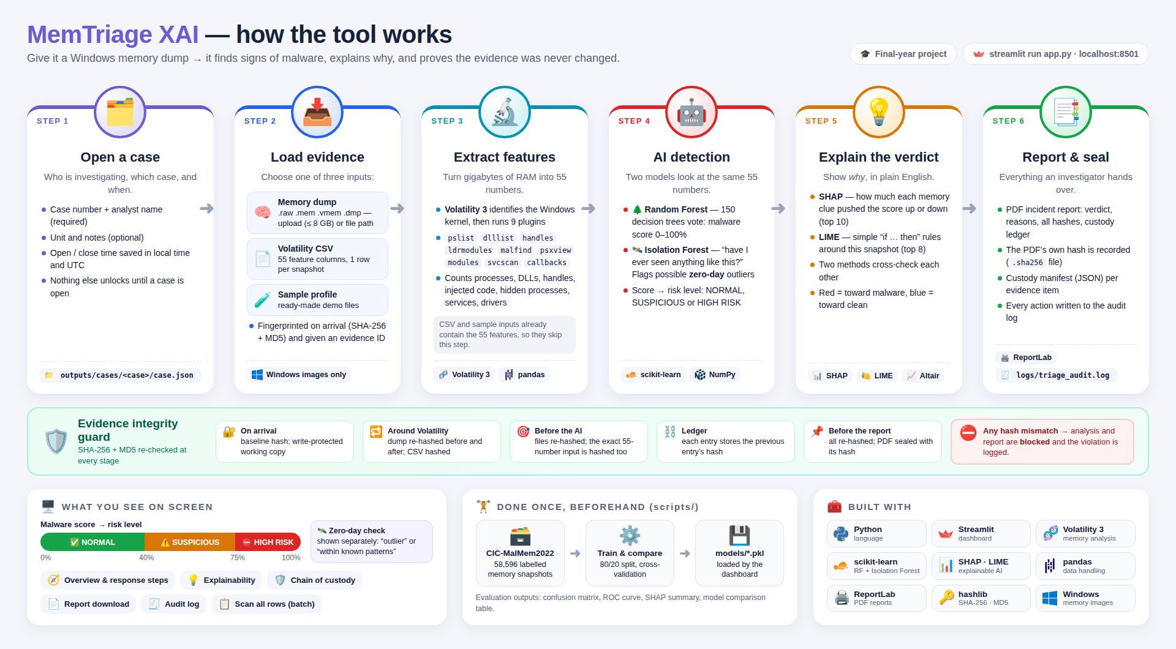
How the tool works — the big picture
Notes:
This picture shows the whole tool. Give it a copy of a computer's memory, and it finds signs of malware, explains why, and proves the evidence was never changed. It works in six steps, left to right. The green band underneath shows that the evidence is checked at every step. I will go through the steps on the next two slides.

Slide 2







Steps 1–3: getting the evidence ready
1. Open a case
2. Load evidence
3. Extract clues
Record who is investigating, which case, and when. Nothing works until a case is open.
Give a memory file (or a ready-made CSV). It gets a digital fingerprint the moment it arrives.
Turn gigabytes of memory into 55 simple numbers, e.g. hidden programs or injected code.
TOOL
TOOL
TOOL
Streamlit
hashlib
Volatility 3
pandas
Notes:
Steps 1 to 3 prepare the evidence. First the investigator opens a case, so we know who did the work and when. Then they load the memory file, and the tool takes its digital fingerprint immediately. Then Volatility 3, a standard forensic tool, reads the memory and counts 55 clues, such as hidden programs and injected code.

Slide 3







Steps 4–6: deciding, explaining, reporting
4. AI detection
5. Explain why
6. Report & seal
Many small decision trees vote: malware score 0–100%. A second model flags things never seen before.
Show which clues pushed the score up or down, in plain English. Red = towards malware.
A PDF report with the result, the reasons and all fingerprints, sealed with its own fingerprint.
TOOL
TOOL
TOOL
scikit-learn
SHAP
LIME
ReportLab
Notes:
Steps 4 to 6 give the answer. The AI, a Random Forest, works like many small decision trees voting, and gives a malware score. A second model warns about anything it has never seen before. Then SHAP and LIME explain which clues caused the result. Finally, the tool writes a PDF report and seals it with its own fingerprint.

Slide 4
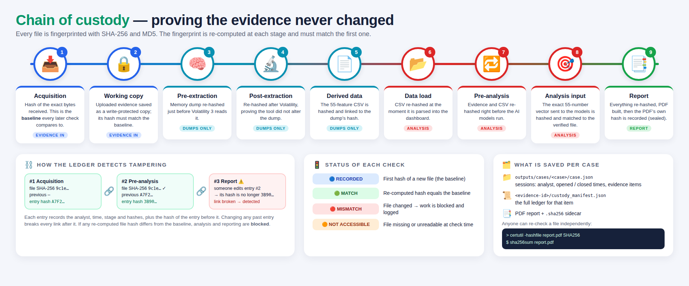



Proving the evidence never changed
Every file gets a digital fingerprint (hash)
It is re-checked at 9 points along the way
If it ever changes, the tool stops and logs it
Notes:
In forensics we must prove the evidence was not changed. Every file gets a digital fingerprint called a hash. If even one tiny part of the file changes, the fingerprint changes completely. The tool re-checks the fingerprint at nine points, from the moment the file arrives to the final report. Each record also stores the fingerprint of the record before it, so nobody can quietly edit the history. If anything does not match, the tool stops.

Slide 5

Tools used — in simple terms
Python
Streamlit
Volatility 3
scikit-learn
The programming language the tool is written in
Makes the web page the investigator uses
Reads the memory file and counts the clues
Builds the AI that decides clean or infected
SHAP · LIME
pandas · NumPy
ReportLab
hashlib
Explain why the AI made its decision
Handle the tables of numbers
Creates the PDF report
Makes the digital fingerprints (SHA-256, MD5)
Notes:
These are the tools behind the system, in simple terms. Python is the language. Streamlit makes the web page. Volatility 3 reads the memory file. scikit-learn builds the AI. SHAP and LIME explain the AI's decision. pandas and NumPy handle the numbers. ReportLab creates the PDF. And hashlib makes the digital fingerprints. All of them are free and open source.

