Slide 1

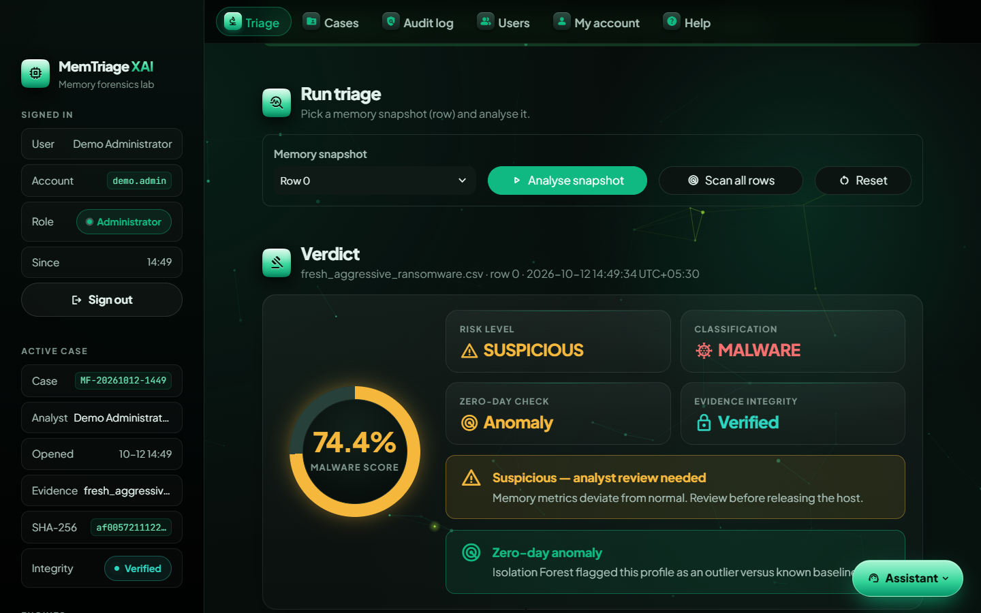
MemTriage XAI
Memory forensics lab
Explainable AI-Based Memory Forensic Triage System for Detecting Fileless Malware
Detect · Explain · Prove the evidence was never altered
The working tool: verdict view
Abdullah Azwar · COBSCEHNS24.2P-017
BSc (Hons) in Ethical Hacking & Network Security
Supervisor: Mr. Chathura Suduwella
Notes:
Good morning. My project is MemTriage XAI, an explainable AI-based memory forensic triage system for detecting fileless malware. It detects malicious Windows memory snapshots, explains every verdict in plain English, and proves the evidence was never altered, from acquisition to the sealed PDF report. On the right is the verdict screen of the working tool.

Slide 2




















Top-level system architecture
EVIDENCE IN
Sign-in & roles
auth.py · admin, analyst
Streamlit dashboard app.py
RESULTS OUT
Memory dump
Triage
Cases
Help
Audit
Users
Risk verdict
.raw .mem .vmem .dmp
score · risk tier · zero-day flag
Volatility CSV
Intake checks
Feature extraction
Feature gate
Detection
Explainable AI
Explanations
55 feature columns
input_validation.py · size, type, signature
Volatility 3 · 9 plugins → 55 features
55 features valid? else block
Random Forest + Isolation Forest · pinned model hashes
SHAP + LIME · plain English
top reasons, plain English
Sample profile
Sealed PDF report
Integrity & custody ledger
evidence_integrity.py · SHA-256 + MD5 at every stage · HMAC-linked ledger · mismatch blocks analysis
Audit log
audit_log.py · HMAC-chained, every action
built-in demo files
provenance + custody ledger
Evidence origin
Offline assistant
models/
outputs/cases/
keys/ · logs/
device · custodian · tool hash
explains the result
RF · IF · model_hashes.json
case.json · custody manifests · reports
HMAC key · accounts · audit log
Notes:
This is the top-level architecture. On the left, evidence comes in as a memory dump, a Volatility CSV or a demo sample, together with where it came from and the hash from the acquisition tool. Every user signs in with a role, administrator or analyst, and works in the Streamlit dashboard with its Triage, Cases, Help, Audit log and Users pages. Evidence then flows through five steps: intake checks on the file, feature extraction with Volatility 3, a feature gate that blocks invalid input, detection with a Random Forest and an Isolation Forest using hash-pinned models, and explanation with SHAP and LIME. Underneath, the integrity layer re-hashes the evidence at every stage in an HMAC-linked custody ledger and blocks analysis on any mismatch, and every action goes to an HMAC-chained audit log. Models, case records, keys and logs are stored at the bottom. The outputs are the risk verdict, plain-English explanations, a sealed PDF report and an offline assistant that explains the result.

Slide 3

Thank you
MemTriage XAI
Memory forensics lab
Questions are welcome
Abdullah Azwar · COBSCEHNS24.2P-017
Explainable AI-Based Memory Forensic Triage System
Notes:
Thank you for listening. I am happy to answer any questions, and I can show a live demonstration of the tool.

