Slide 1

Explainable AI-Based Memory Forensic Triage System
Methodology · Final-year viva
Abdullah Azwar · COBSCEHNS24.2P-017
BSc in Ethical Hacking & Network Security
Supervisor: Mr. Chathura Suduwella
Notes:
Good morning. My project is an explainable AI-based memory forensic triage system. In this presentation I will focus on the methodology: how I built it, phase by phase, and how I validated it.

Slide 2



Problem and aim
Hidden in RAM
AIM
Fileless and memory-resident malware leaves little or no trace on disk.
A triage tool that flags malicious memory, explains why, and keeps the evidence forensically sound.
Manual analysis is slow
Investigators read thousands of lines of Volatility output by hand.
Classify memory snapshots as benign or malicious
Explain every verdict with SHAP and LIME
Accept raw memory dumps, not only CSVs
Prove the evidence is never modified
Flag possible zero-day behaviour
AI is a black box
A “malicious” score without reasons is not usable as forensic evidence.
Notes:
The problem has three parts. Fileless malware lives in RAM. Manual memory analysis is slow. And plain AI detectors are black boxes, which is not acceptable in forensics, where every conclusion must be justified. So my aim was a triage tool that detects, explains, and protects the evidence. These five objectives map directly onto the phases I will show next.

Slide 3







Methodology at a glance: seven phases
1
2
3
4
5
6
7
Data
Feature extraction
Model training
Detection
Explainability
Forensic soundness
System & testing
CIC-MalMem2022 dataset
Volatility 3 → 55 features
RF vs LR, cross-validation
Risk tiers + zero-day check
SHAP + LIME
Hashing + custody ledger
Dashboard, report, tests
Research approach: applied and experimental. Each phase produces an artefact (dataset, extractor, trained models, explanations, custody ledger, tool) that the next phase builds on, and every result is measured on held-out data.
Notes:
This is the whole methodology on one slide. Seven phases, left to right. First the data, then turning memory dumps into features, then training and choosing a model, then detection with risk levels and a zero-day check, then explainability, then forensic soundness, and finally building and testing the system. I will now go through each phase.

Slide 4
Phase 1 — Data: CIC-MalMem2022
PHASE 1
58,596
memory snapshots
55
numeric features
50 / 50
benign / malware
3
malware categories
Preprocessing: label → benign 0 / malware 1 · drop the Category column (prevents label leakage) · stratified 80/20 split, fixed seed 42 for reproducibility.
Notes:
I used CIC-MalMem2022 from the Canadian Institute for Cybersecurity. It has 58,596 Windows memory snapshots, half benign and half malware: ransomware, spyware and trojans, including obfuscated samples. Each snapshot was processed with Volatility and reduced to 55 numbers. The chart shows which plugins contribute most of those features. I removed the Category column so the model cannot cheat, and split the data 80/20 with stratification.

Slide 5



Phase 2 — From a memory dump to 55 numbers
PHASE 2
Memory dump
windows.info
9 Volatility plugins
55-feature CSV
.raw .mem .vmem .dmp
upload or file path
identify the Windows
kernel and symbols
run in parallel
same columns as
the training data
pslist
dlllist
handles
ldrmodules
malfind
psxview
modules
svcscan
callbacks
What they measure: processes, DLLs, handles, injected code, hidden processes, services and kernel drivers.
Approximations: 3 features differ slightly because Volatility 3 lacks some checks used to build the dataset (psxview views, de-duplicated services, malfind.protection).
Notes:
To work on real evidence, the tool must turn a raw memory dump into the same 55 numbers the model was trained on. My extractor first runs windows.info to identify the kernel, then nine Volatility 3 plugins in parallel, and converts their output into the 55 features. Three features are approximations because Volatility 3 does not have every check used to build the original dataset; I document this as a limitation.

Slide 6
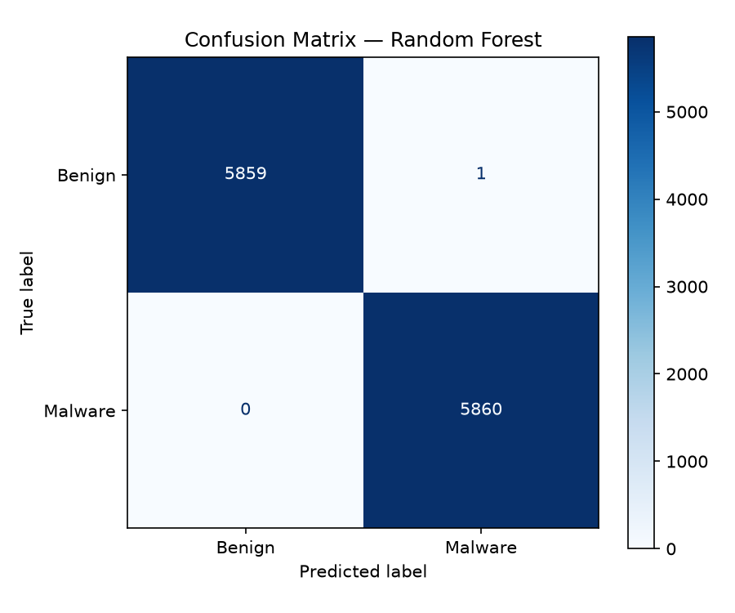
Phase 3 — Training and choosing the model
PHASE 3
1
Two candidates: Logistic Regression (baseline) and Random Forest
2
Stratified 80/20 train–test split
3
3-fold cross-validation on the training set
4
Keep the model with the highest test ROC-AUC
Model | Accuracy | Recall | F1 | ROC-AUC
Random Forest ✔ | 99.99% | 100% | 99.99% | 1.000
Logistic Regression | 99.87% | 99.90% | 99.87% | 0.9999
1 error
in 11,720 test snapshots — one benign flagged as malware, no malware missed.
Deployed Random Forest: 150 trees, max depth 12, min 4 samples per leaf.
Notes:
I compared a simple Logistic Regression baseline with a Random Forest. I used a stratified 80/20 split, plus 3-fold cross-validation to check the result is stable and not a lucky split. Random Forest won on every metric: on 11,720 unseen snapshots it made one mistake and missed no malware. I limited tree depth and leaf size to reduce overfitting. I will come back to why these numbers are optimistic in the limitations.

Slide 7

Phase 4 — Detection: two models, three risk levels
PHASE 4
Random Forest (supervised)
Isolation Forest (unsupervised)
150 decision trees vote on the 55 features.
Asks “have I seen anything like this before?”
Output: probability of malware, 0–100%
Output: outlier → possible zero-day alert
Malware probability → risk level
NORMAL
below 40%
SUSPICIOUS
40% to 75%
HIGH RISK
75% and above
Routine review
Analyst investigates
Isolate host, escalate
The zero-day flag is shown next to the verdict, not merged into it, so “benign but unusual” cases stay visible.
Notes:
Detection uses two models. The Random Forest gives a malware probability. Because a supervised model only knows what it was trained on, I added an Isolation Forest, an unsupervised model that flags snapshots unlike anything in the training data, as a possible zero-day. The probability is mapped to three risk levels so the analyst knows what to look at first.

Slide 8
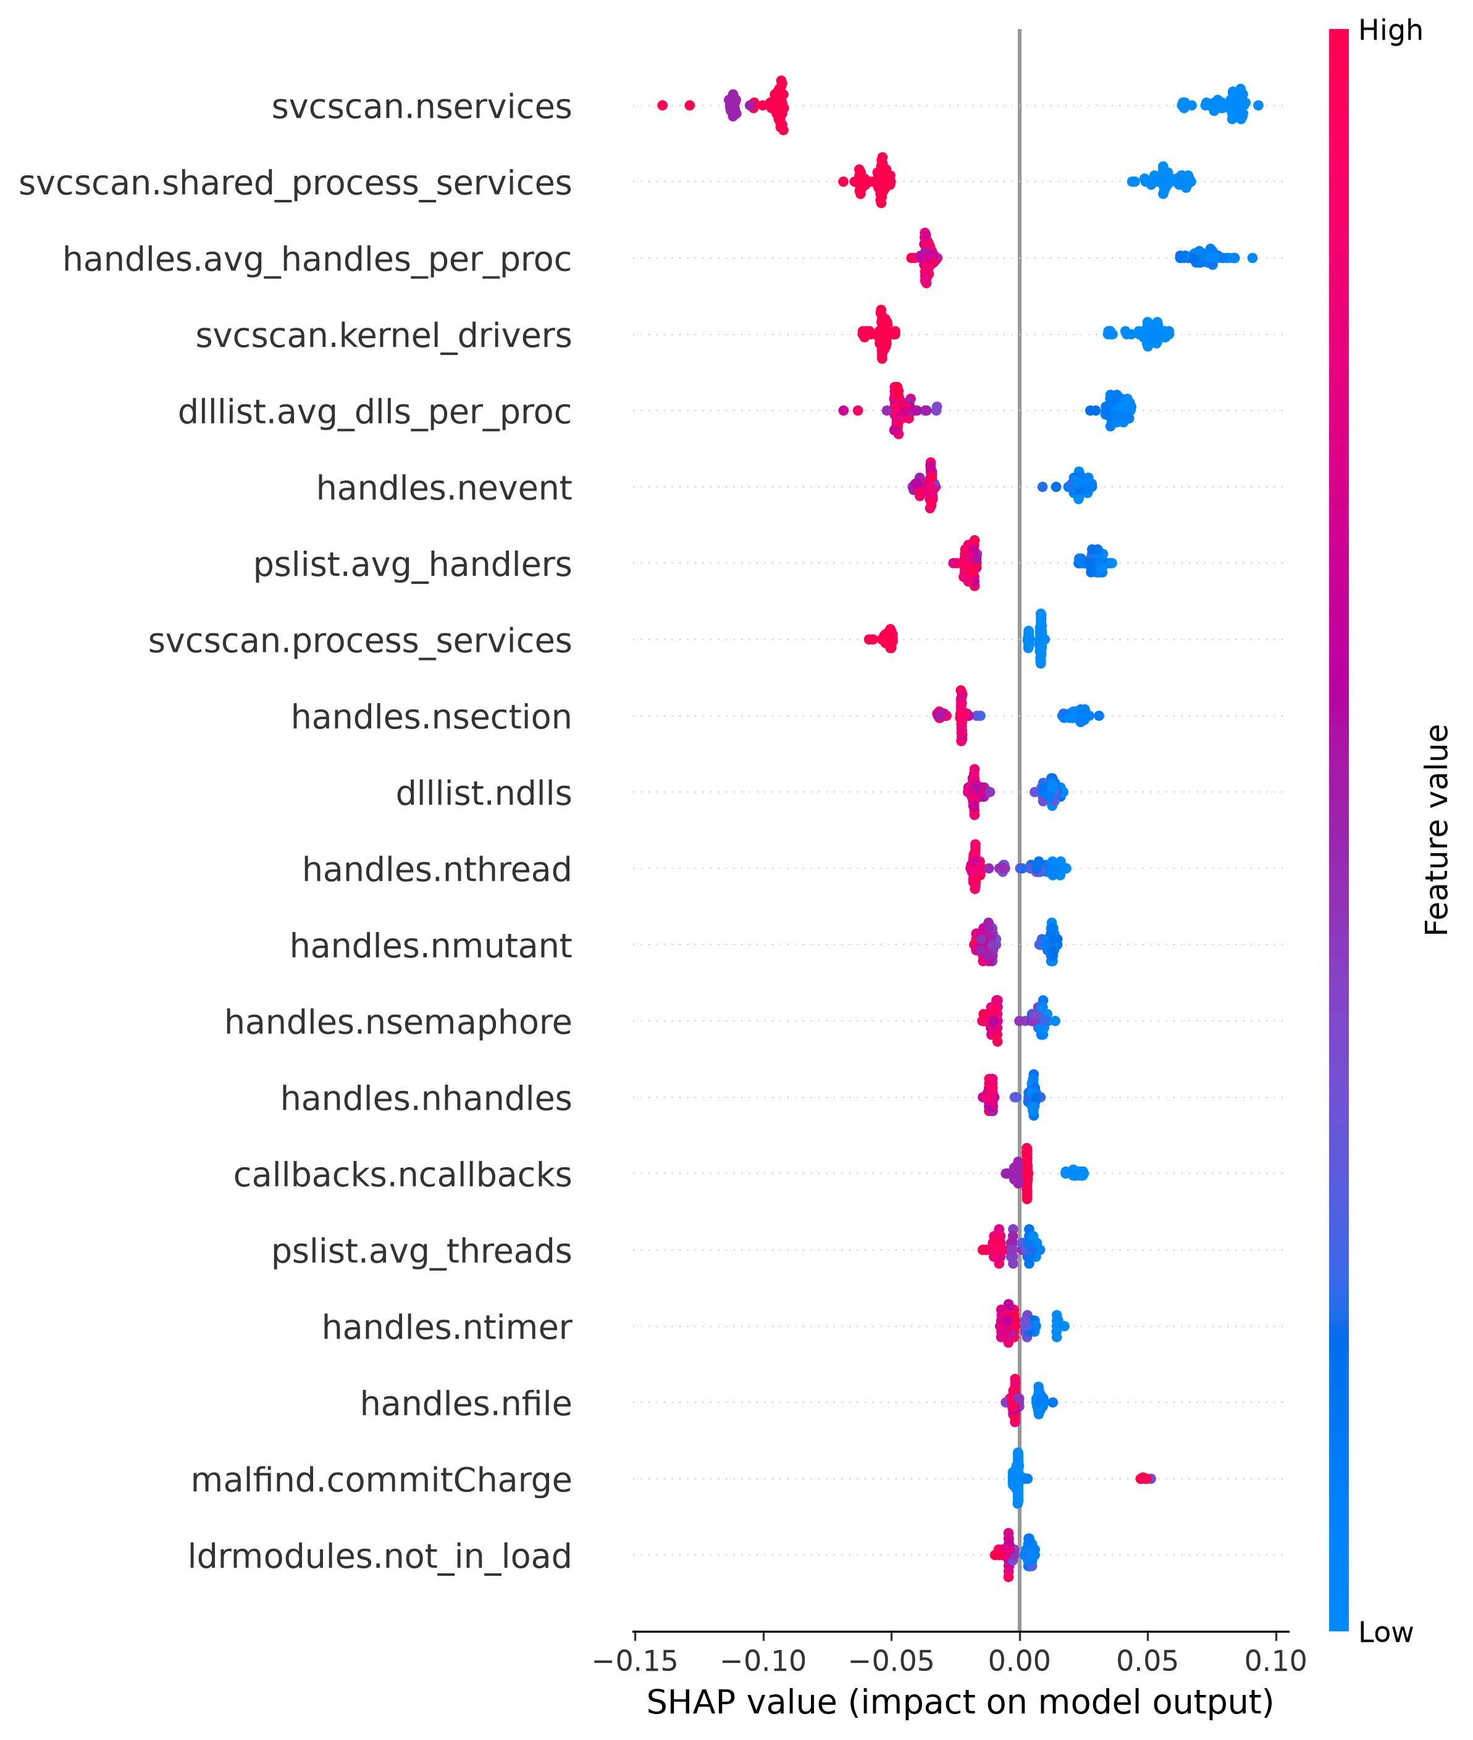


Phase 5 — Explaining every verdict
PHASE 5
SHAP
Game theory: each feature’s fair share of the score
Top 10 features, toward malware (+) or benign (−)
Global view: what the model relies on overall
LIME
Changes the sample slightly and fits a simple local model
Top 8 readable rules, e.g. “malfind.ninjections > 2”
Independent check on SHAP
Feature names are translated to plain English, e.g. malfind.ninjections → “direct memory code injections”.
Global SHAP summary (100 samples)
Notes:
In forensics a score alone is not enough, so every verdict is explained twice. SHAP gives each feature its fair share of the prediction; LIME builds a simple local model around the snapshot and returns readable rules. Using two different methods lets them cross-check each other. The chart on the right is the global SHAP summary: service counts, handles and drivers drive most decisions, which I discuss again in the limitations.

Slide 9
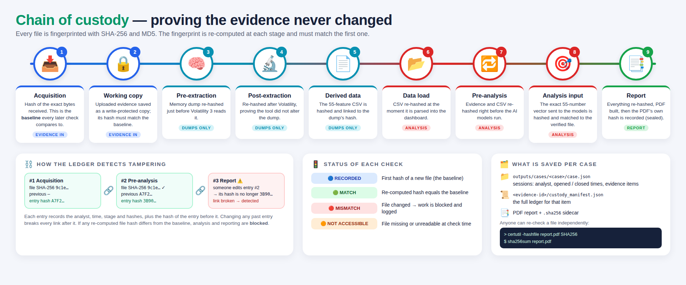



Phase 6 — Proving the evidence never changed
PHASE 6
SHA-256 + MD5 at 9 stages, from acquisition to the sealed PDF
Hash-linked ledger: each entry stores the previous entry’s hash
Any mismatch blocks analysis and reporting, and is logged
Notes:
A forensic tool must not change the evidence, and must be able to prove it. Every file is fingerprinted with SHA-256 and MD5 when it arrives, and re-checked at nine stages, including before and after Volatility and on the exact feature vector sent to the model. Each ledger entry stores the hash of the previous one, so editing history breaks the chain. If any hash does not match, the tool blocks the analysis.

Slide 10
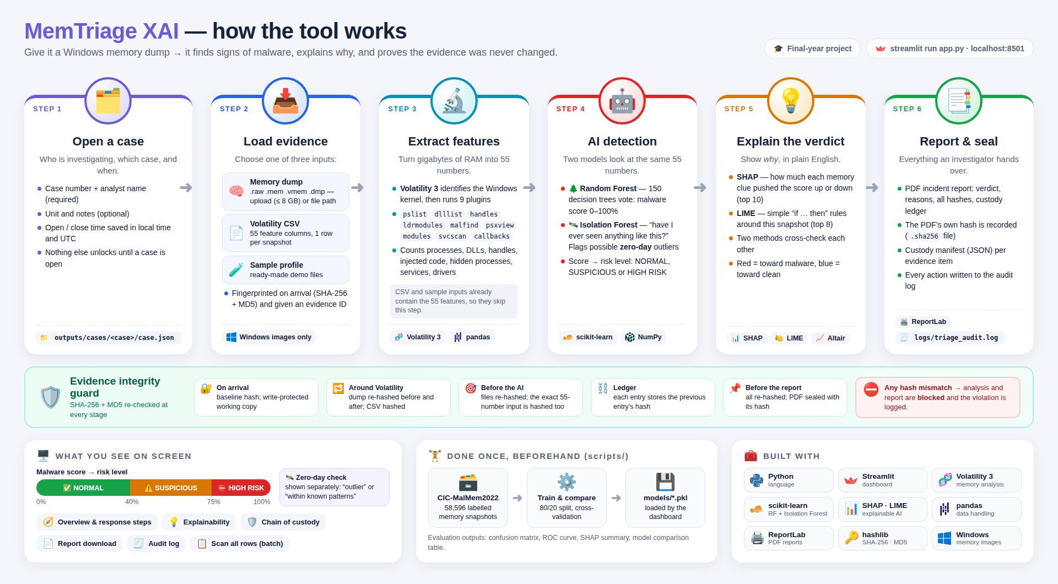
Phase 7 — The working tool, end to end
PHASE 7
Notes:
Here is the finished tool. The analyst opens a case with their name and case number, loads a memory dump or CSV, the tool extracts features, runs both models, explains the result and produces a sealed PDF report. The green band shows the integrity checks along the way. It is built in Python with Streamlit for the interface. I can demonstrate it live after the presentation.

Slide 11
Testing and validation
Test profile | Expected | Malware score | Risk level | Correct?
Benchmark malware (dataset) | Malware | 100% | HIGH RISK | Yes
Benchmark benign (dataset) | Benign | 0% | NORMAL | Yes
Simulated APT zero-day | Malware | 100% | HIGH RISK | Partly
Stealth rootkit (hand-built) | Malware | 75.7% | HIGH RISK | Yes
Fileless miner (hand-built) | Malware | 78.0% | HIGH RISK | Yes
Aggressive ransomware (hand-built) | Malware | 74.4% | SUSPICIOUS | Partly
Clean baseline (hand-built) | Benign | 79.6% | HIGH RISK | No
Real benign sample | Benign | 82.2% | HIGH RISK | No
Simulated Cobalt Strike | Malware | 2.4% | NORMAL | No
What the tests show
Real dataset rows are classified correctly
Profiles that differ from the training machines are often misjudged
So the model does not yet generalise to new environments
Also validated: input CSV checks, label-leakage check, hash re-verification at every stage.
Notes:
Beyond the test-set metrics I ran the tool on nine profiles. Real rows from the dataset are classified correctly. But hand-built profiles and a real benign sample from outside the training conditions are often wrong. I am reporting this honestly because it shows the main limitation: the model does not yet generalise to machines it has not seen.

Slide 12


Limitations and future work
Limitations
Future work
Accuracy is optimistic: near-identical snapshots of the same sample (and 534 duplicates) appear in both train and test
Benign data comes from essentially one machine, so the model partly learns “differs from that machine”
Explanations describe the model, not ground truth
Custody ledger is tamper-evident, not tamper-proof; no login yet
Remove duplicates and split by sample; add benign dumps from many machines and Windows versions
Build my own lab dataset: Windows VM, simulated fileless attacks, RAM capture
Show per-process evidence (PIDs, injected regions) beside the verdict
Sign custody manifests, add authentication, use the malware-family model
Notes:
These are the main limitations. The near-perfect accuracy comes from a random split where near-copies of the same malware sample end up in both training and test data, and most benign data comes from one machine. The fix is clear: de-duplicate, split by sample, and add benign dumps from many machines, ideally from my own lab with a Windows VM, simulated attacks and RAM capture. I would also add per-process evidence and stronger protection of the custody records.

Slide 13








Tools and technologies
Python
Streamlit
Volatility 3
scikit-learn
Programming language
Web dashboard
Memory analysis
Random Forest, Isolation Forest
SHAP · LIME
pandas · NumPy
ReportLab
hashlib
Explainable AI
Data handling
PDF incident reports
SHA-256 · MD5 hashing
Notes:
These are the tools I used: Python, Streamlit for the interface, Volatility 3 for memory analysis, scikit-learn for both models, SHAP and LIME for explainability, pandas and NumPy for data, ReportLab for the PDF, and Python's hashlib for the integrity checks.

Slide 14

Thank you — questions?
Detect · Explain · Preserve the evidence
Raw memory dump → 55 features → two models → SHAP + LIME → sealed report
Every step hash-verified; limitations measured and documented
Notes:
To summarise: the tool takes a raw memory dump, extracts 55 features, scores them with two models, explains the verdict two ways and produces a sealed report, with the evidence verified at every step. I have also measured and documented its limitations. Thank you, I am happy to take questions.

