Slide 1
Gradient-Free Methods in Neural Network Training
DSEEB
Abdullah Bilici
Eren Oluğ
Salim Beyden

Slide 2
Introduction
Compare the effectiveness of gradient-based and gradient-free methods.
Explore possibilities of combining these method to develop hybrid algorithms.
Through this analysis, we aim to enhance optimization performance and advance the field of optimization techniques.

Slide 3
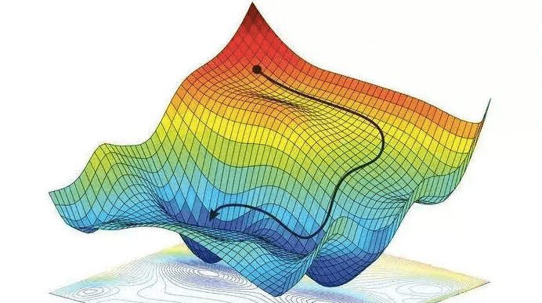
Gradient Descent
Optimization Algorithm
Parameter Update
Gradient Calculation

Slide 4
Challenges of Gradient-Based Methods
Non-differentiable or Discontinuous Functions
Global Optimization and Escaping Local Optima
Expensive or Black-Box Functions
High-Dimensional Search Spaces
Avoiding Manual Hyperparameter Tuning
Exploratory Search

Slide 5

Genetic Algorithm
What is Genetic Algorithm?
Class of optimization algorithms inspired by natural selection and genetics.
Used to solve complex optimization problems by mimicking the process of evolution.
Genetic algorithms provide an efficient and effective approach to finding approximate solutions in various domains.

Slide 6
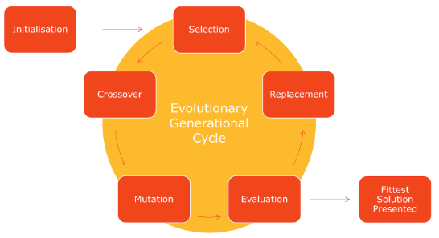
How does it work?

Slide 7
Can We Find Initial Weights with Genetic Algorithm?
Benefits
Drawbacks
Can even find the global
Time complexity doesn’t change
Can stuck at local minima
Evaluates neural network for fitness function lots of times

Slide 8
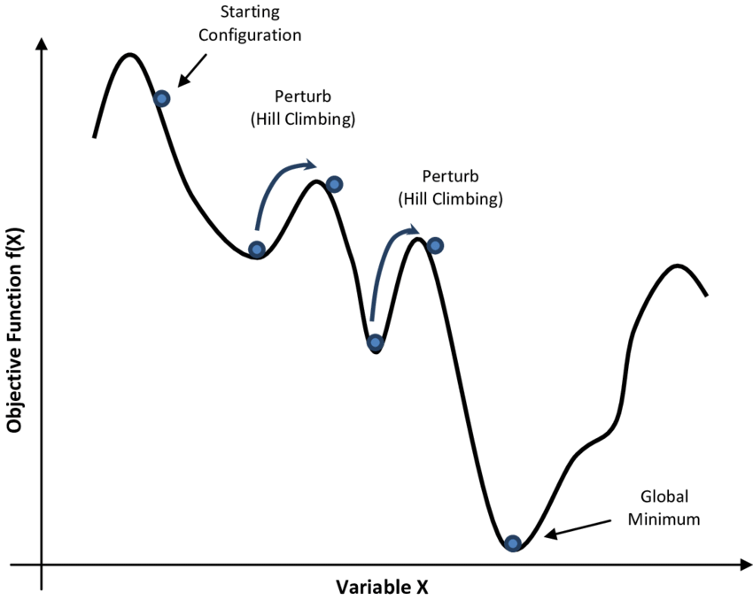
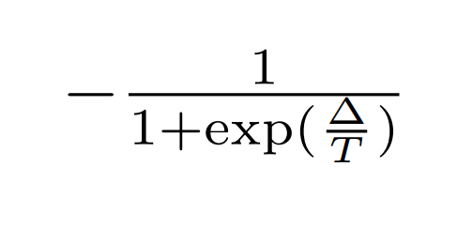
Simulated Annealing
Temperature: T
Cooling Rate: r (<1)
Acceptance probability:

Slide 9
Feature Selection with SA
Initialization of process
Randomly select some number of features
Initialize variable to keep the best subset so far
Repeat during iterations
Randomly add or remove a feature from subset
Evaluate new subset and calculate cost difference between current subset
Check acceptance probability
Update T value

Slide 10
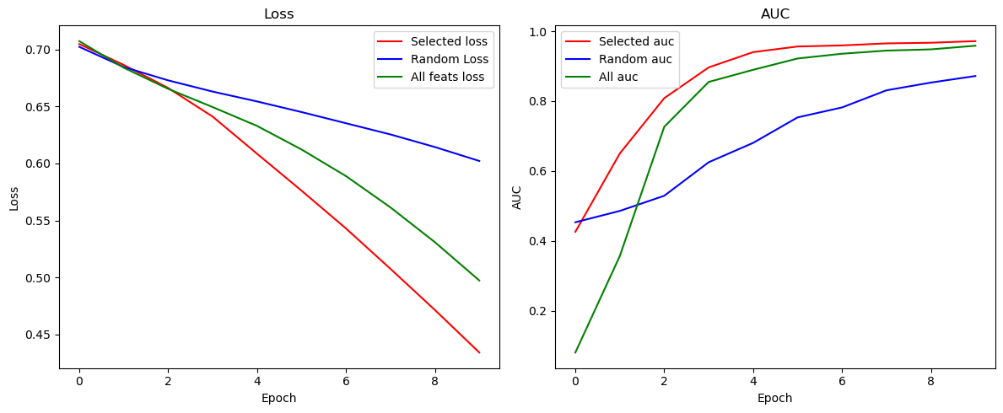
Performance Comparison

Slide 11
Comparison
Gradient-Based
Gradient-Free
More robust in neural network training
Effective if the search space is huge
No continuity requirement (Feature selection)
Time complexity

Slide 12
Conclusion and Recommendations
Training neural network using gradient-free methods doesn’t look promising because of huge search space.
Determining optimum initial weights using GA resulted with finding local minima. Training with gradient descent doesn’t increase accuracy.
Feature selection using simulated annealing has potential in real world datasets which aren’t already preprocessed. It was better than random feature selection.

Slide 13

Q&A Session

