Slide 1
Neural Network

Slide 2
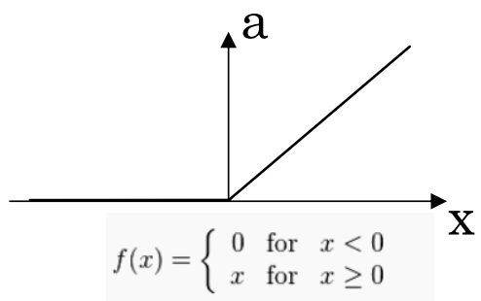
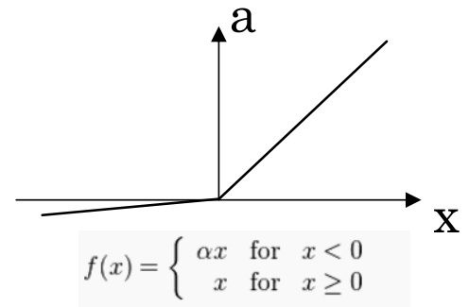
Activation Function
Rectified Linear Unit(ReLU)
Leaky ReLU

Slide 3
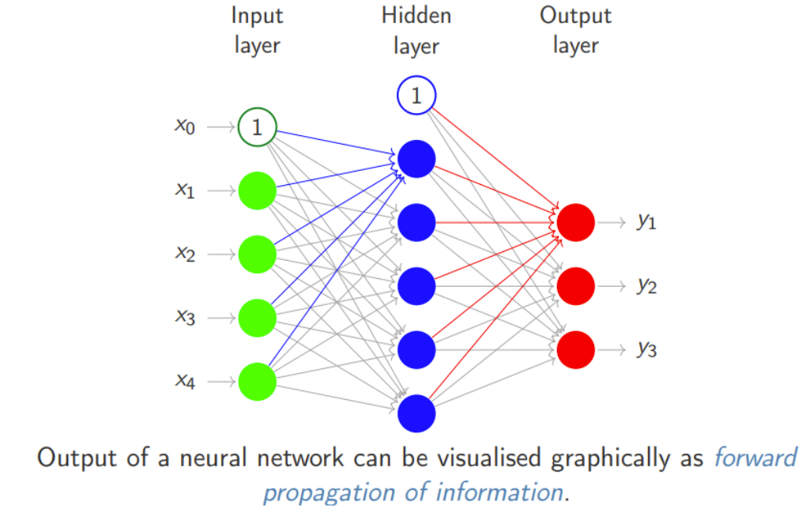
Neural Network

Slide 4
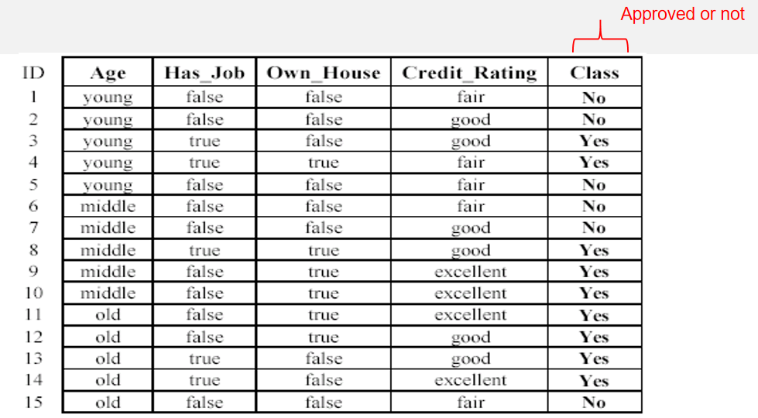
An example: data (loan application)

Slide 5
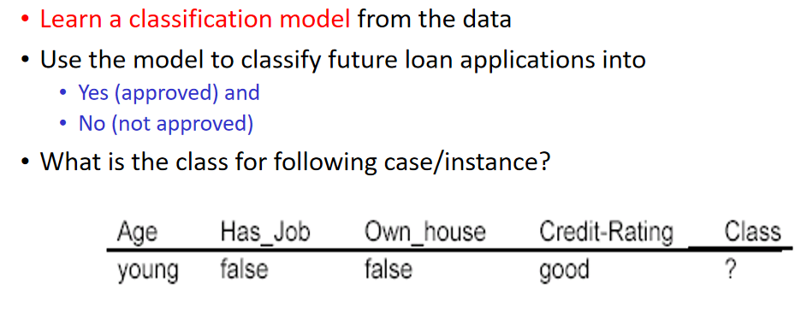
An example: the learning task

Slide 6
Example
Number of input neurons (Input Layer)=2
Number of hidden neurons (Hidden Layer)=3
Number of output neurons (output Layer)=1
Activation function for both hidden and output layer is sigmoid

Slide 7
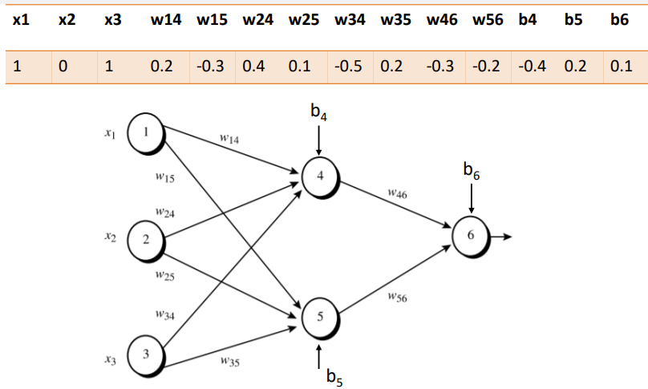
Example

Slide 8
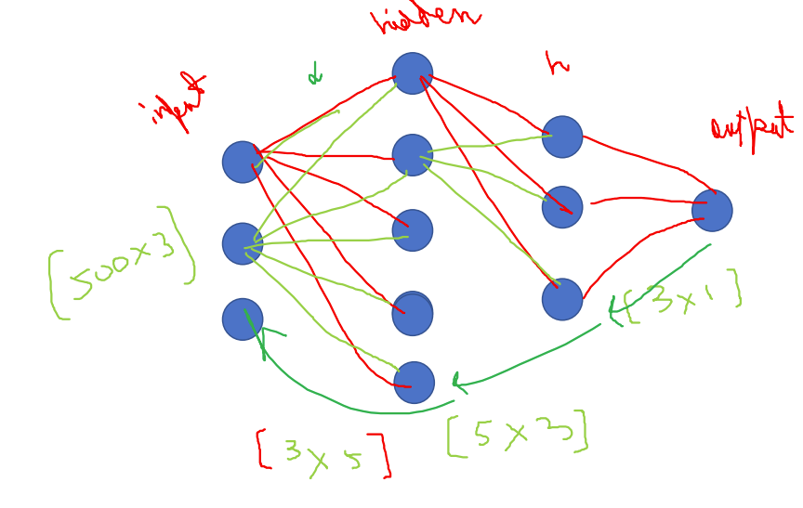
Neural Network: Weight Matrices

Slide 9
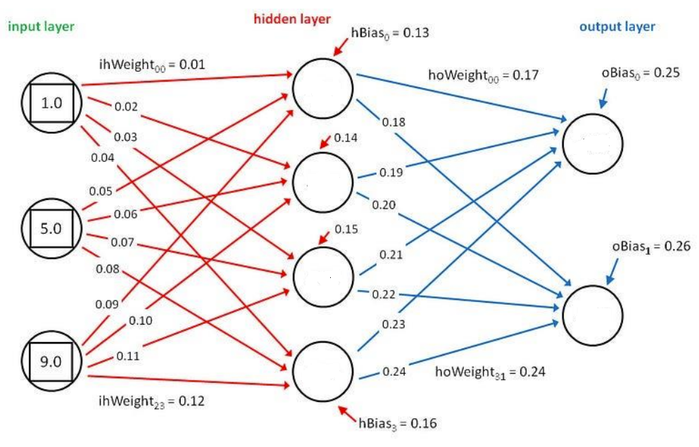
Example

Slide 10
Class Activity
Weight Update of output layer
Δw_{ij} = -c (∂Error/ ∂w_{ij}) = -c[-(d_{j} - O_{j}) . f’(act_{j}) . x_{i}]
Update the weights of output layer using delta rule
Desired output d=0, Activation function: sigmoid
Learning rate :0.1

Slide 11
Variants of Gradient Descent Algorithm
In a Neural Network, the Gradient Descent Algorithm is used during the backward propagation to update the parameters of the model.
Batch Gradient Descent
Stochastic Gradient Descent(SGD)
Mini-batch Gradient Descent
Notes:
https://www.analyticsvidhya.com/blog/2021/03/variants-of-gradient-descent-algorithm/

Slide 12
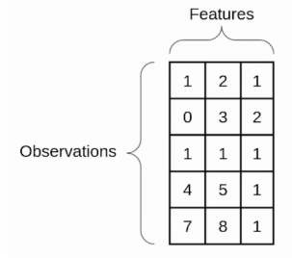
An epoch is when the entire training set is passed through the model, forward propagation and backward propagation are performed and the parameters are updated.
Each time the parameter is updated, it is known as an Iteration.

Slide 13
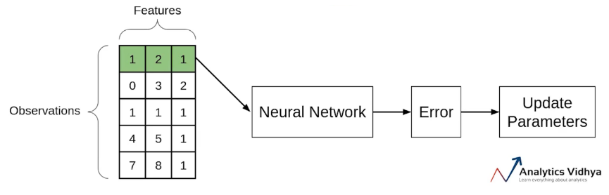
Stochastic Gradient Descent(SGD)
If you use a single observation to calculate the cost function it is known as Stochastic Gradient Descent, commonly abbreviated as SGD. We pass a single observation at a time, calculate the cost and update the para if we use the entire dataset to calculate the cost function, it is known as Batch Gradient Descent and if use a single observation to calculate the cost it is known as SGD.

Slide 14
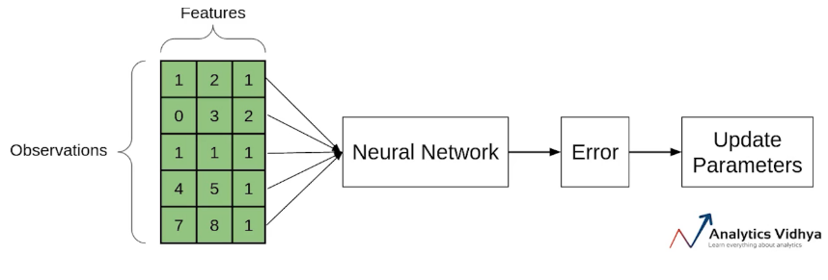
Batch Gradient Descent
In batch Gradient Descent since we are using the entire training set, the parameters will be updated only once per epoch.

Slide 15
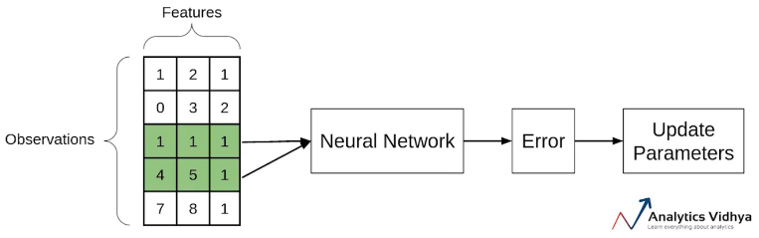
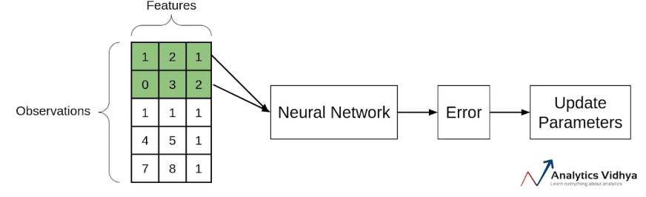
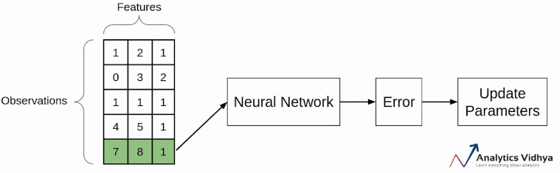
Mini-batch Gradient Descent
It takes a subset of the entire dataset to calculate the cost function.

Slide 16
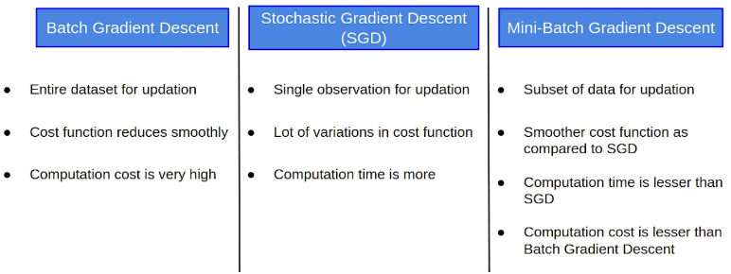
Comparison between Batch GD, SGD, and Mini-batch GD:

Slide 17
Batch size
Epochs
1000 Samples
Batch size=1000 Epochs=1 iteration=? | Batch size=100 Epochs=1 iteration=? | Batch size=1 Epochs=1 iteration=?
Notes:
Batch size=1000
Epochs=1, iteration=1
Batch size=100
Epochs=1, iteration=10
Batch size=1
Epochs=1, iteration=1000

Slide 18
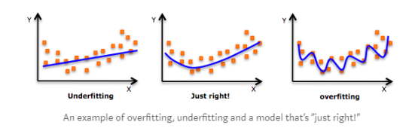
Issues of ANN
Overfitting
Overfitting is an undesirable machine learning behavior that occurs when the machine learning model gives accurate predictions for training data but not for new data.
Overfitting occurs when the model cannot generalize and fits too closely to the training dataset instead.
Overfitting happens due to several reasons, such as:
The training data size is too small and does not contain enough data samples to accurately represent all possible input data values.
The training data contains large amounts of irrelevant information, called noisy data.
The model complexity is high, so it learns the noise within the training data.
Notes:
https://aws.amazon.com/what-is/overfitting/
https://www.analyticsvidhya.com/blog/2021/06/complete-guide-to-prevent-overfitting-in-neural-networks-part-1/

Slide 19
Examples:
Consider a use case where a machine learning model has to analyze photos and identify the ones that contain dogs in them. If the machine learning model was trained on a data set that contained majority photos showing dogs outside in parks , it may learn to use grass as a feature for classification, and may not recognize a dog inside a room.
Another overfitting example is a machine learning algorithm that predicts a university student's academic performance and graduation outcome by analyzing several factors like family income, past academic performance, and academic qualifications of parents. However, the test data only includes candidates from a specific gender or ethnic group. In this case, overfitting causes the algorithm's prediction accuracy to drop for candidates with gender or ethnicity outside of the test dataset.

Slide 20
How can you prevent overfitting?
Early stopping
Regularization/Reduce The Complexity Of The Model
Data augmentation

Slide 21
Underfitting
Underfitting is another type of error that occurs when the model cannot determine a meaningful relationship between the input and output data.
Underfitting vs. overfitting
Underfit—they give inaccurate results for both the training data and test set.
Overfit models—they give accurate results for the training set but not for the test set

Slide 22
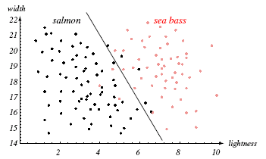
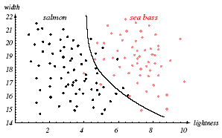
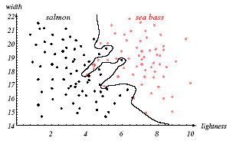
Generalization & Overfitting

Slide 23
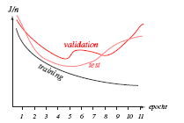
Generalization & Overfitting
An example: Training set error, validation set error and test set error

Slide 24
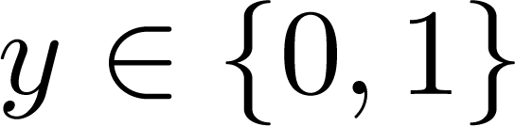
Binary Classification
Email: Spam / Not Spam?
Online Transactions: Fraudulent (Yes / No)?
Tumor: Malignant / Benign ?
0: “Negative Class” (e.g., benign tumor)
1: “Positive Class” (e.g., malignant tumor)

Slide 25
Multiclass classification
Email foldering/tagging: Work, Friends, Family, Hobby
Medical diagrams: Not ill, Cold, Flu
Weather: Sunny, Cloudy, Rain, Snow

Slide 26
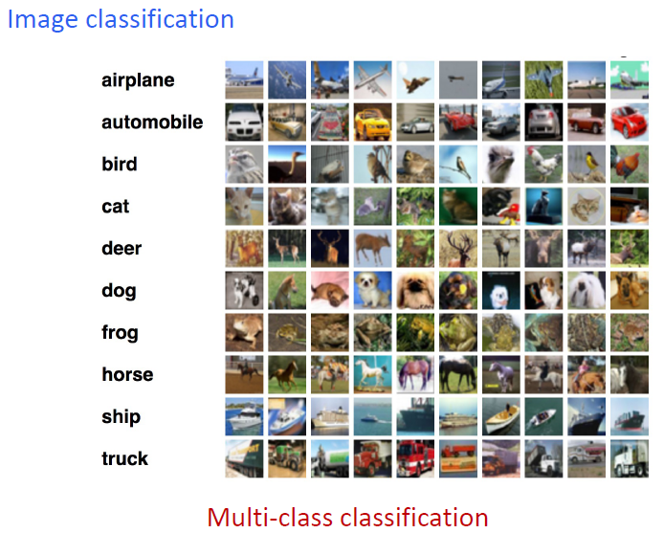
Multiclass classification:

Slide 27
Multiclass classification
One Hot Vector
Softmax function

Slide 28
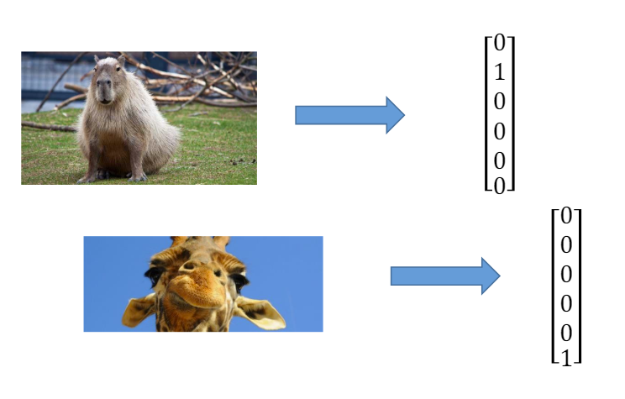
One HOT encoding
Create a binary variable for each class, all variables are set to zero except for the actual class, which is set to 1.

Slide 29
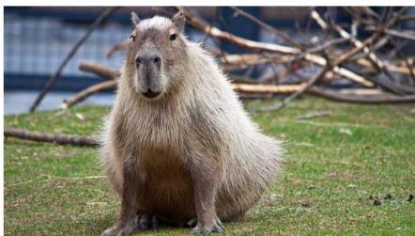
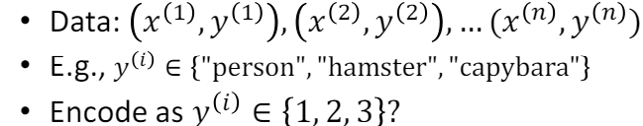
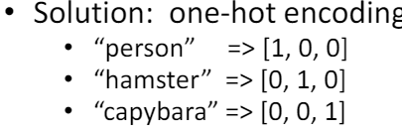
One-Hot Encoding

Slide 30
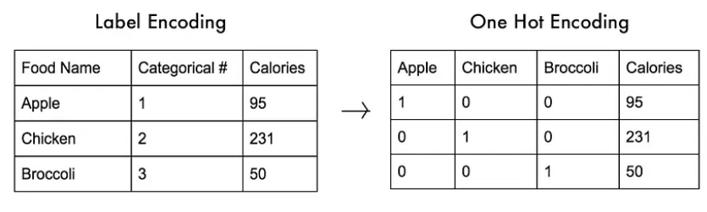
ONE HOT Encoding
Three labels/classes

Slide 31
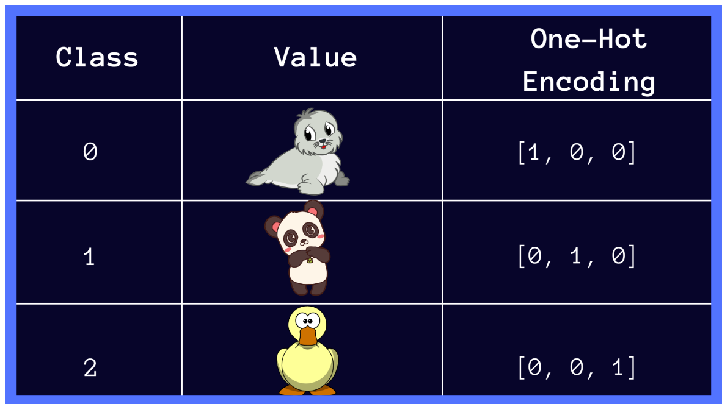
Multiclass Classification
{seal, panda, duck}

Slide 32
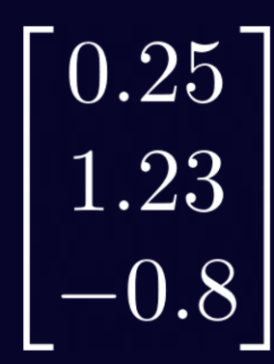
Multiclass Classification
z = [0.25, 1.23, -0.8]
= ?

Slide 33
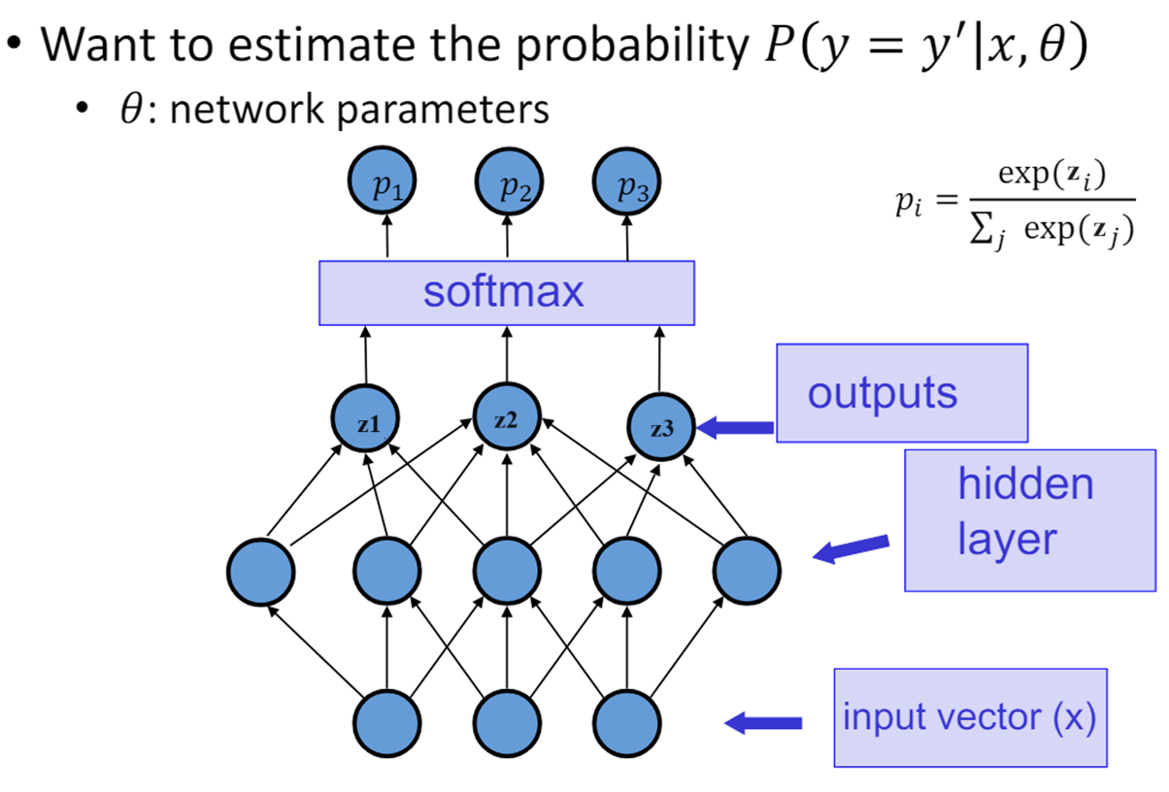
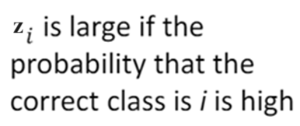
Multilayer Neural Network for Classification: Softmax

Slide 34
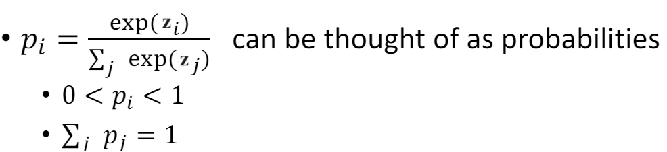
Softmax

Slide 35
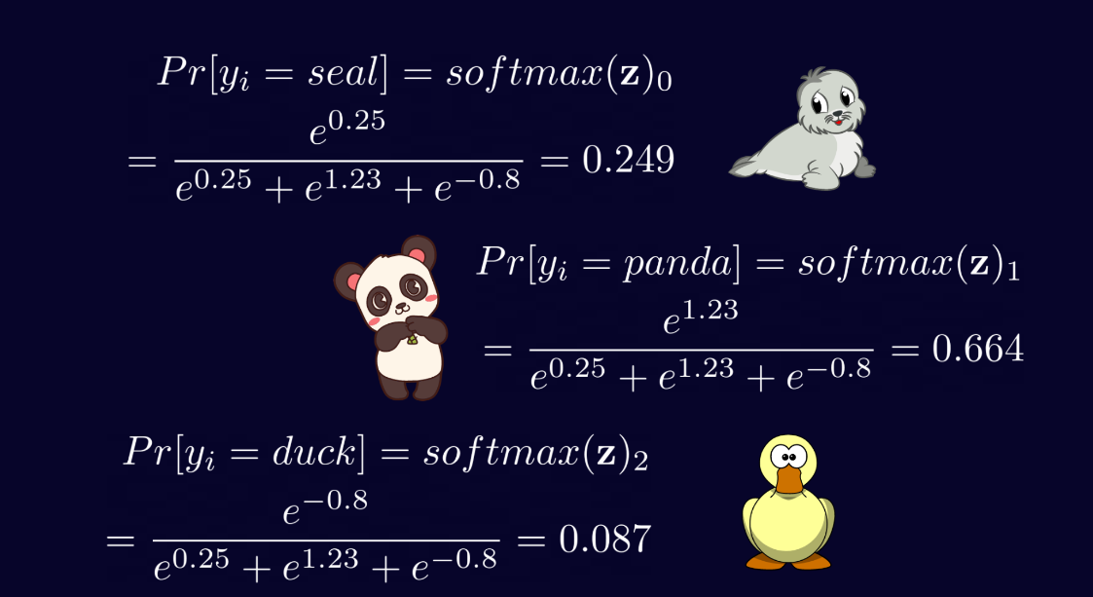
Softmax

Slide 36
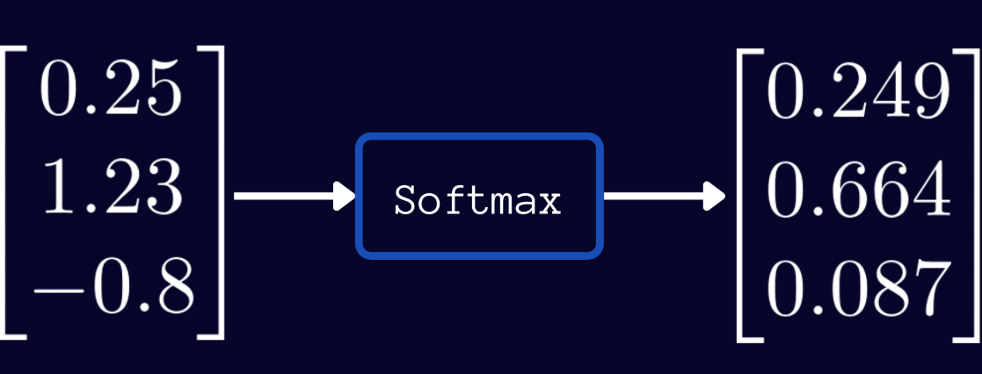
Softmax

Slide 37
From the softmax output above, we can make the following observations:
In the vector z of raw outputs, the maximum value is 1.23, which on applying softmax activation maps to 0.664: the largest entry in the softmax output vector. Likewise, 0.25 and -0.8 map to 0.249 and 0.087: the second and the third largest entries in the softmax output respectively. Thus, applying softmax preserves the relative ordering of scores.
All entries in the softmax output vector are between 0 and 1.
In a multiclass classification problem, where the classes are mutually exclusive, notice how the entries of the softmax output sum up to 1: 0.664 + 0.249 + 0.087 = 1.
softmax(z) = [0.294 ,0.664, 0.087]
Notes:
https://www.pinecone.io/learn/softmax-activation/
argmax(softmax(z))

