Slide 1

Exploratory Data Analysis
Virtual Internship
20-May-2022
Abdullah DOĞAN

Slide 2
Executive Summary
14 Features (5i nteger, 3 float, 6 object)
Timeframe of the data: 2016-01-31 to 2018-12-31
Total data points :359,392
Assumptions:
There is no missing value
Cab_Data.csv
Customer_ID.csv
Transaction_ID.csv
City.csv
Final cab data

Slide 3
Problem Statement
XYZ is a private firm in US. Due to remarkable growth in the Cab Industry in last few years and multiple key players in the market, it is planning for an investment in Cab industry and as per their Go-to-Market(G2M) strategy they want to understand the market before taking final decision.
Approach
To give the best guidance to the customer about which company to choose.

Slide 4
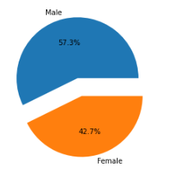
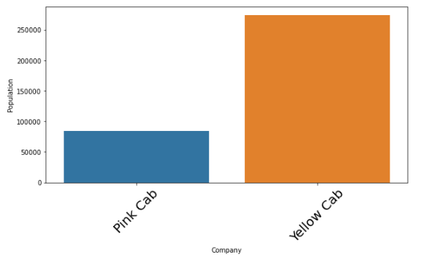
EDA
When we look at the data set, we see that the male population is more.
Customers using the Yellow cab use the Pink cab approximately 3 times as much.

Slide 5
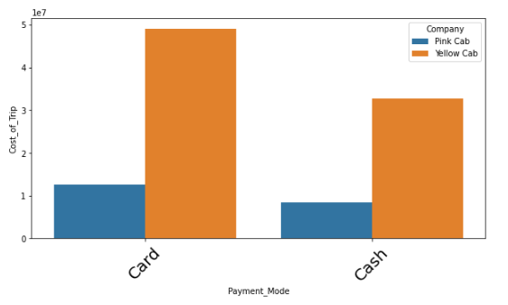
EDA
Most payments were made by card.

Slide 6
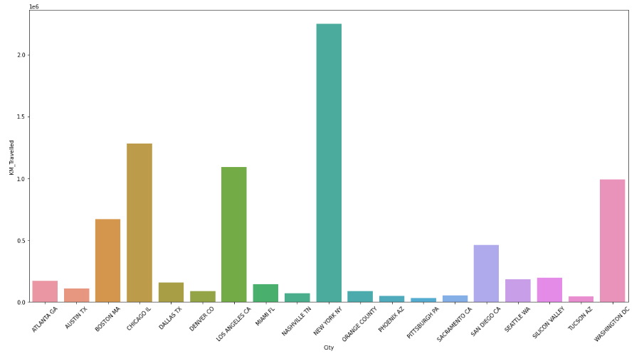
EDA
Taxis were mostly used in New York.

Slide 7
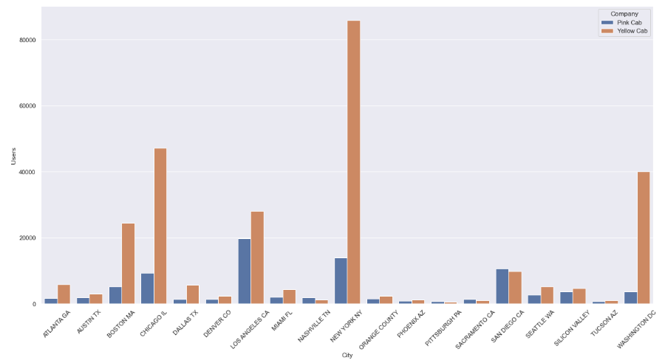
EDA
When the cities are examined one by one, Yellow Cab is used in the majority of the cities.

Slide 8
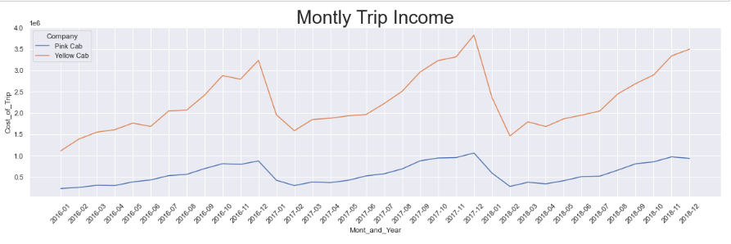
EDA
When we look at the monthly income, we see that the two companies earn the most income in the winter months.

Slide 9
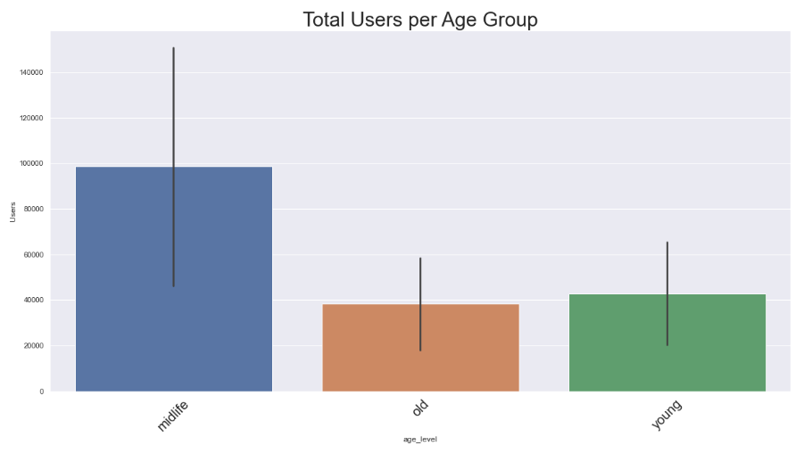
EDA
Middle-aged people used taxi services more than younger and older people.

Slide 10
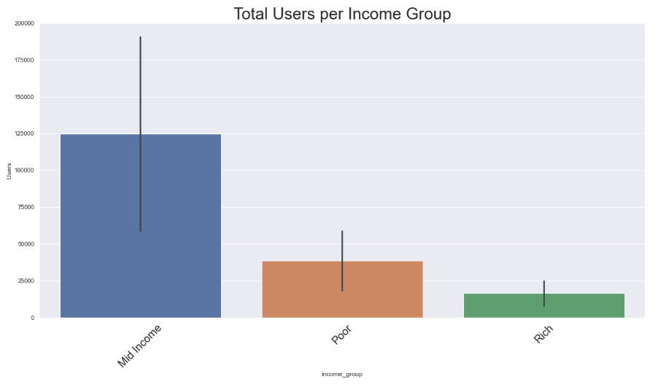
EDA
there is difference in using the taxi by age group. Middle-income people used more taxi services than poor and rich people combined.

Slide 11
Recommendations
We have evaluated both the cab companies on following points and found Yellow cab better than Pink cab:
Customer Reach : Yellow cab has higher customer reach in 14 cities while Pink cab has higher customer reach in 3 cities. We have also observed that Yellow cab is doing good in covering other cab users as compared to Pink cab.
Age wise Reach : Using cab has customer in all age group and it’s been observed that it’s even popular in 60+ age group as equally as its in 18-24 age group. Middle-aged people used taxi services more than younger and older people.
Income wise Reach :Both the cabs are very popular in mid income class.
On the basis of above point , we will recommend Yellow cab for investment.

Slide 12
Thank You

