Slide 1

Machine Learning
K-Means (Clustering Algorithm)
Dr. Muhammad Kamran Malik

Slide 2
Outline
What is K-Mean
K-Mean Algorithm
Applications of Clustering Algorithm
Example

Slide 3
K-Mean (Clustering Algorithm)

Slide 4
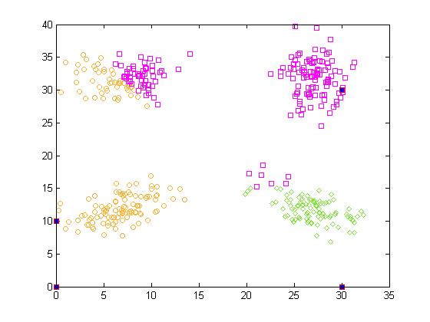
Initial centres
Ref: K. Javed et. al, “The behavior of K-Means: An empirical study”, International Conference on Electrical Engineering, 2008

Slide 5
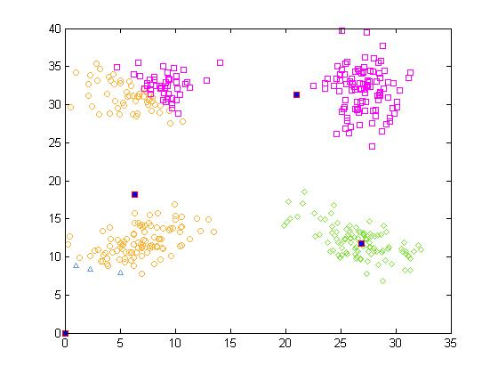
Ref: K. Javed et. al, “The behavior of K-Means: An empirical study”, International Conference on Electrical Engineering, 2008

Slide 6
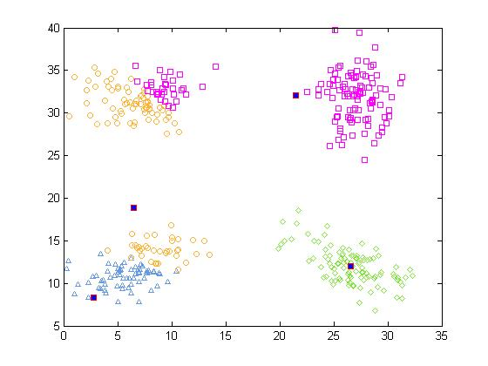
Ref: K. Javed et. al, “The behavior of K-Means: An empirical study”, International Conference on Electrical Engineering, 2008

Slide 7
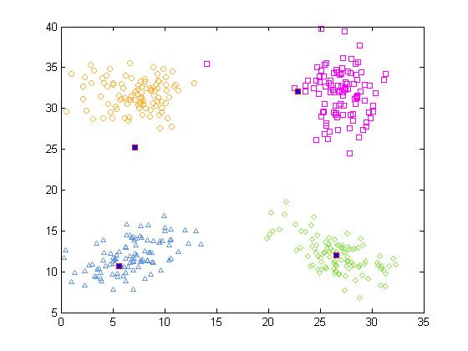
Ref: K. Javed et. al, “The behavior of K-Means: An empirical study”, International Conference on Electrical Engineering, 2008

Slide 8
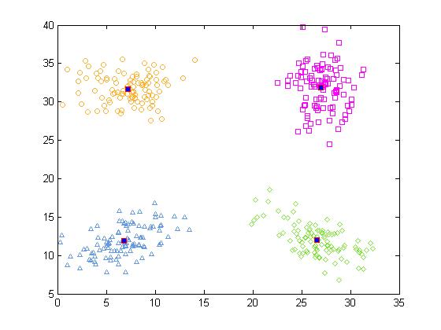
Ref: K. Javed et. al, “The behavior of K-Means: An empirical study”, International Conference on Electrical Engineering, 2008

Slide 9
K-Mean Algorithm

Slide 10
K-Means Algorithm
1.Initialize:
Choose K random data points from the data set to represent the initial centers of the K partitions
2.Calculate the group memberships:
3.Update the centroids:
4.Repeat steps 2 and 3
until converge to stable values

Slide 11
Q & A

Slide 12
Applications of Clustering Algorithm

Slide 13


Slide 14
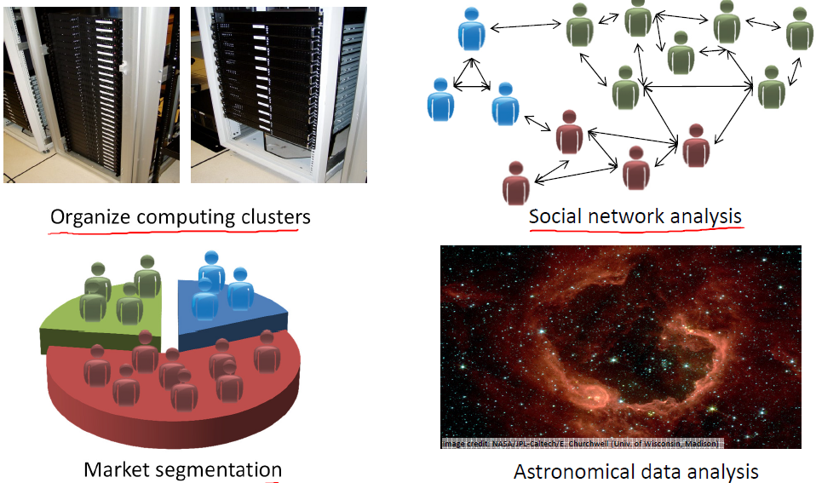

Slide 15
Q & A

Slide 16
Example of K-Mean Algorithm

Slide 17
Example
Problem: Cluster the following eight points (with (x1, x2) representing locations) into three clusters
A1(2, 10)
A2(2, 5)
A3(8, 4)
A4(5, 8)
A5(7, 5)
A6(6, 4)
A7(1, 2)
A8(4, 9).
Initial cluster centers are: A1(2, 10), A4(5, 8) and A7(1, 2).
The distance function between two points a=(x1, y1) and b=(x2, y2) is defined as: ρ(a, b) = |x2 – x1| + |y2 – y1| .

Slide 18
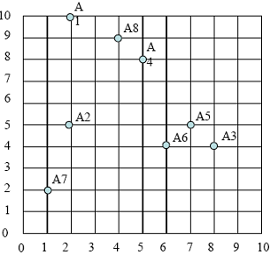
Plot
A1(2, 10)
A2(2, 5)
A3(8, 4)
A4(5, 8)
A5(7, 5)
A6(6, 4)
A7(1, 2)
A8(4, 9).

Slide 19
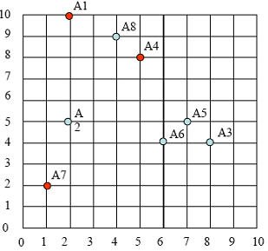
Plot
A1(2, 10)
A2(2, 5)
A3(8, 4)
A4(5, 8)
A5(7, 5)
A6(6, 4)
A7(1, 2)
A8(4, 9).

Slide 20
Solution (Iteration 1)
 |  | (2, 10) | (5, 8) | (1, 2)
 | Point | Dist Mean 1 | Dist Mean 2 | Dist Mean 3 | Cluster
A1 | (2, 10)
A2 | (2, 5)
A3 | (8, 4)
A4 | (5, 8)
A5 | (7, 5)
A6 | (6, 4)
A7 | (1, 2)
A8 | (4, 9)
|x2 – x1| + |y2 – y1|

Slide 21
Solution (Iteration 1)
 |  | (2, 10) | (5, 8) | (1, 2)
 | Point | Dist Mean 1 | Dist Mean 2 | Dist Mean 3 | Cluster
A1 | (2, 10) | 0 | 5 | 9 | 1
A2 | (2, 5)
A3 | (8, 4)
A4 | (5, 8)
A5 | (7, 5)
A6 | (6, 4)
A7 | (1, 2)
A8 | (4, 9)
|x2 – x1| + |y2 – y1|

Slide 22
Solution (Iteration 1)
 |  | (2, 10) | (5, 8) | (1, 2)
 | Point | Dist Mean 1 | Dist Mean 2 | Dist Mean 3 | Cluster
A1 | (2, 10) | 0 | 5 | 9 | 1
A2 | (2, 5) | 5 | 6 | 4 | 3
A3 | (8, 4)
A4 | (5, 8)
A5 | (7, 5)
A6 | (6, 4)
A7 | (1, 2)
A8 | (4, 9)
|x2 – x1| + |y2 – y1|

Slide 23
Solution (Iteration 1)
 |  | (2, 10) | (5, 8) | (1, 2)
 | Point | Dist Mean 1 | Dist Mean 2 | Dist Mean 3 | Cluster
A1 | (2, 10) | 0 | 5 | 9 | 1
A2 | (2, 5) | 5 | 6 | 4 | 3
A3 | (8, 4) | 12 | 7 | 9 | 2
A4 | (5, 8) | 5 | 0 | 10 | 2
A5 | (7, 5) | 10 | 5 | 9 | 2
A6 | (6, 4) | 10 | 5 | 7 | 2
A7 | (1, 2) | 9 | 10 | 0 | 3
A8 | (4, 9) | 3 | 2 | 10 | 2
|x2 – x1| + |y2 – y1|

Slide 24
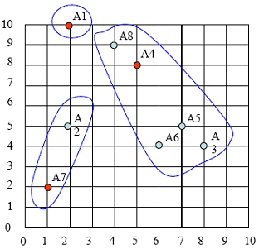
Membership
 | Point | Cluster
A1 | (2, 10) | 1
A2 | (2, 5) | 3
A3 | (8, 4) | 2
A4 | (5, 8) | 2
A5 | (7, 5) | 2
A6 | (6, 4) | 2
A7 | (1, 2) | 3
A8 | (4, 9) | 2

Slide 25
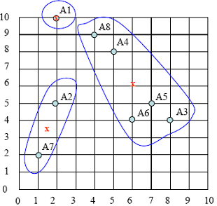
Centroid Update
 | Point | Cluster
A1 | (2, 10) | 1
A2 | (2, 5) | 3
A3 | (8, 4) | 2
A4 | (5, 8) | 2
A5 | (7, 5) | 2
A6 | (6, 4) | 2
A7 | (1, 2) | 3
A8 | (4, 9) | 2

Slide 26
Solution (Iteration 2)
 |  | (2, 10) | (6, 6) | (1.5, 3.5)
 | Point | Dist Mean 1 | Dist Mean 2 | Dist Mean 3 | Cluster
A1 | (2, 10)
A2 | (2, 5)
A3 | (8, 4)
A4 | (5, 8)
A5 | (7, 5)
A6 | (6, 4)
A7 | (1, 2)
A8 | (4, 9)
|x2 – x1| + |y2 – y1|

Slide 27
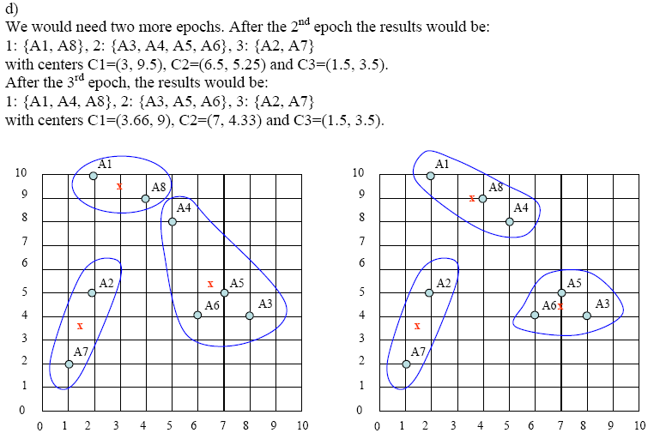

Slide 28
Q & A

Slide 29
Programming Assignment

Slide 30








k=2
k=3
k=10
Reference: Bishop 2006.

Slide 32
Questions

