Slide 1

Traveling Salesman Problem Genetic Algorithm
By
Abdullah Haidar

Slide 2
Outline
Genetic Operators
Topology of the network
Parallelization using MPI
Parallelization using OpenMP
Parameterizations
Test bench
2/21

Slide 3
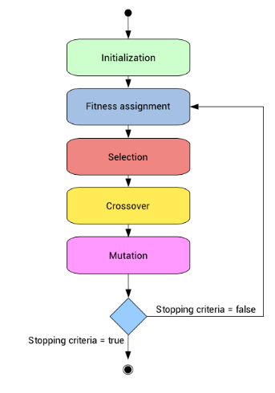
Genetic Operators
Fitness Evaluation
Selection Operators:
Roulette Selection
Stochastic Universal Selection
Crossover Operators:
Multipoint Crossover
Cycle Crossover
Mutation Operators:
Swap Mutation
Scramble Mutation
3/21

Slide 4
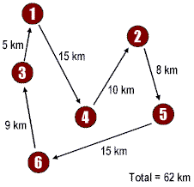
Fitness Evaluation
A chromosome is an array of contiguous cities.
The distance of the path is calculated pairwise between cities.
The fitness is obtained by :
Fitness=1/Distance
The lower the distance the highest the fitness is.
4/21

Slide 5
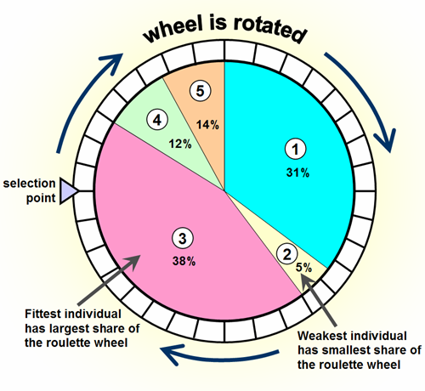

Roulette Selection
Fitness proportionate selection
This fitness level is used to associate a probability with each chromosome, probability of being selected is:
A random number is generated, and the cumulative probability distribution gives the individual.
The fittest chromosomes will have better chance but the weak ones might still be chosen.
A drawback of this technique is premature convergence of the GA to a local optimum, due to the possible presence of a dominant individual that is always selected as a parent.
5/21

Slide 6
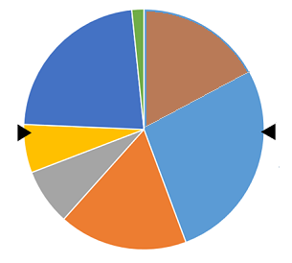
Stochastic Universal Selection
Stochastic Universal Sampling is similar to Roulette wheel selection.
Instead of having just one fixed point, we have multiple fixed points as shown in the following image.
All the parents are chosen in just one spin of the wheel.
Such a setup encourages the highly fit individuals to be p chosen at least once.
L : number of individuals to select
5/15

Slide 7
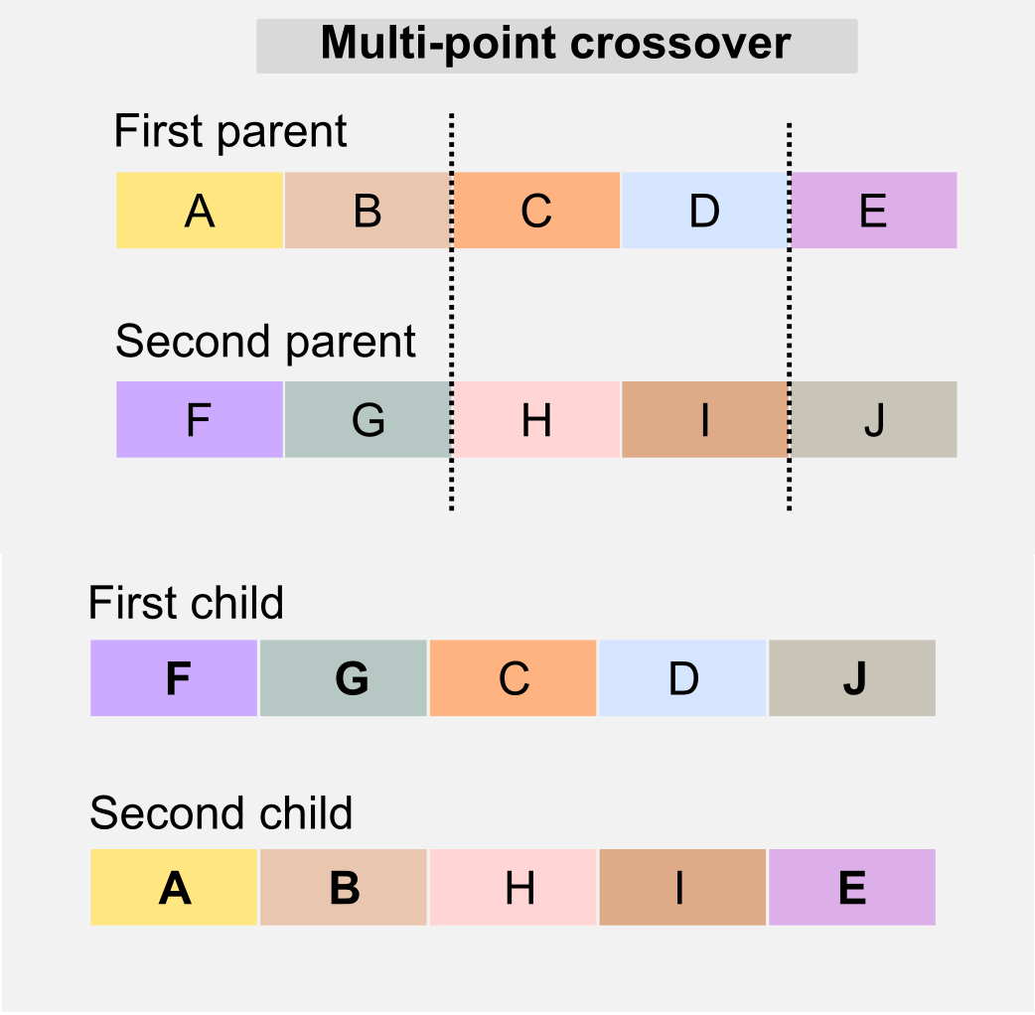
Multipoint Crossover
Multi point crossover is a generalization of the one-point crossover wherein alternating segments are swapped to get new off-springs.
Choose two cutoff indexes and then swap the genes before, between and after the genes.
Repair the genes at the end if there are holes created by duplicate genes.
7/21

Slide 8
Cycle Crossover
1
2
3
4
5
6
7
8
9
4
9
1
7
5
2
3
6
8
8/21

Slide 9
Cycle Crossover (continued)
Parent 1
1
2
3
4
5
6
7
8
9
Child 1
1
9
3
4
5
2
7
6
8
Child 2
4
2
1
7
5
6
3
8
9
Parent 2
4
9
1
7
5
2
3
6
8
9/21

Slide 10
Mutation Operators
Swap Mutation
before
1
2
3
4
5
6
7
8
9
after
1
2
7
4
5
6
3
8
9
Scramble Mutation
before
1
2
3
4
5
6
7
8
9
after
1
2
3
6
4
5
7
8
9
10/21

Slide 11
Topology Of The Network
Every node works on a separate population , the size of the sub-population is determined according to the speed and capacity of the node.
The details about the nodes and their speed and capacity is specified in tsp.config.
The user can specify as much nodes as he want as long he includes all their information in the configuration file.
Most fit chromosomes
11/21

Slide 12
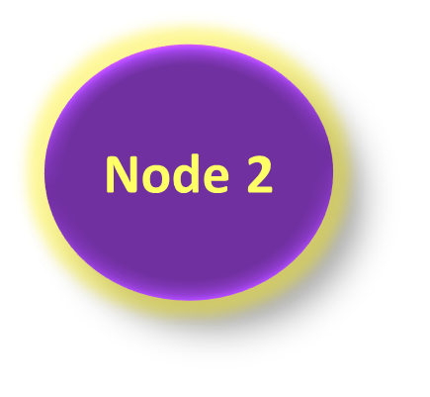



Parallelization Using MPI
Every EXCHANGE_PERIOD_SECONDS time the nodes exchange their most fit chromosomes. The number of chromosomes to exchange is specified by MIGRATION_PERCENTAGE.
Each node sends and receives best chromosomes using MPI_Isend and MPI_Irecv.
After EXECUTION_TIME_SECONDS the master uses MPI_Reduce to obtain the maximum fitness and then gathers the best chromosomes from all processes to display the chromosome(s) with the best fitness.
MASTER
Best chromosome
12/21

Slide 13
Parallelization Using OMP
OMP is used to calculate the distance matrix and is used locally on ecah machine in the following functions:
fromChromosomesToBuffer()
fromBufferToChromosomes()
Chromosome::
calculateDistance
shuffle()
compare()
Generation::
Generation()
getAverageDistance()
nextPopulation()
hasDuplicate()
cyclic_crossover()
In order to have the code running in parallel, we did the following :
Set the number of processors of the virtual machine to 4
Run “Export OMP_NUM_THREADS=4” from the command line
mostFit()
rouletteSelection()
13/21

Slide 14
Parameterization
The following parameters are specified in the tsp.config file
POPULATION_SIZE
MIGRATION_PERCENTAGE
SCRAMBLE_PERCENTAGE
EXECUTION_TIME_SECONDS
SIMILARITY_RATIO
CROSSOVER_PROBABILITY
MUTATION_PROBABILITY
EXCHANGE_PERIOD_SECONDS
The parameters change dynamically during the execution of the program.
If any process gets stuck( no improvements in the fitness ) the parameters and genetic operators will start to change in an attempt to keep the process generating more populations and hopefully better fitness.
14/21

Slide 15
Parameterization (continued)
A process can try to change the selection, crossover or mutation operators :
generation->useCrossoverOperation(multipoint_crossover);
generation->useCrossoverOperation(cyclic_crossover);
generation->useMutationOperation(swapping_mutation);
generation->useMutationOperation(scramble_mutate);
generation->useSelectionOperation(rouletteSelection);
A process can also change crossover probability, mutation probability or scramble percentage:
CROSSOVER_PROBABILITY+=0.01;
MUTATION_PROBABILITY+=0.05;
SCRAMBLE_PERCENTAGE+=0.05;
15/21

Slide 16
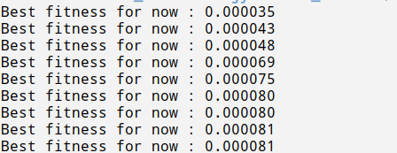
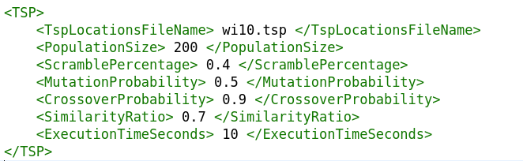
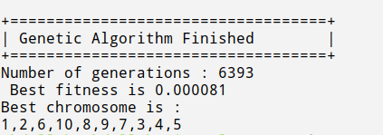
Benchmarking (serial version)
Test case 1
16/21

Slide 17
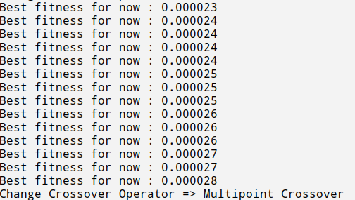
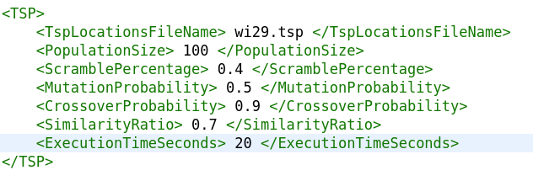

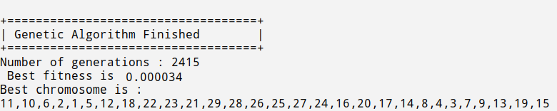
Benchmarking (serial version)
Test case 2
17/21

Slide 18

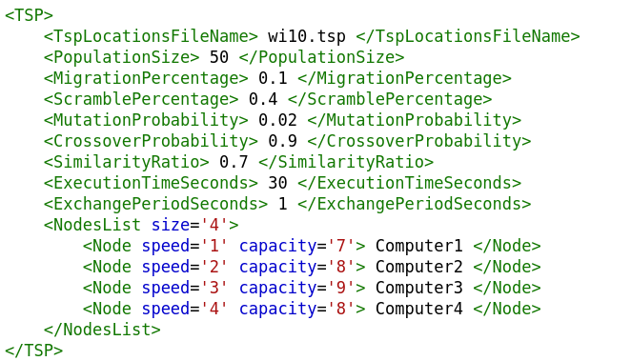
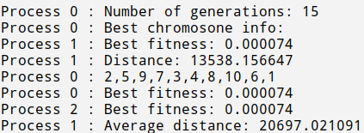
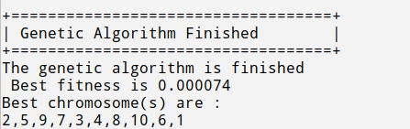
Benchmarking (parallel version)
Test case 1
18/21

Slide 19
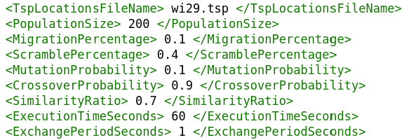
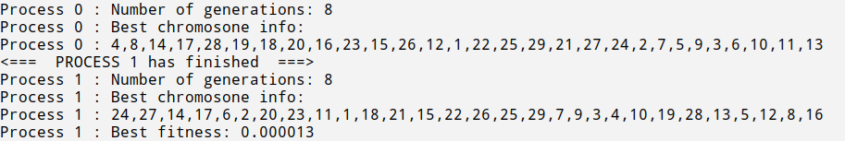
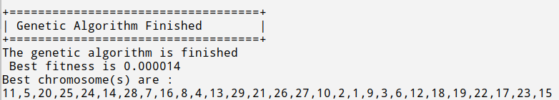
Benchmarking (parallel version)
Test case 2
19/21

Slide 20
Conclusion And Future Work
Concerning the genetic operators we have noticed that the cycle crossover with the scramble mutation have given better results. When we started the program with multipoint crossover the processes got stuck and soon switched to the cycle crossover. Also the increase in the mutation rate helped in keeping the generation diverse and preventing it from converging earlier.
Now about the parallel version of the code, we weren’t really surprised that the parallel version didn’t give better results ,due to the performance and constraints of the machine we are using to run the code. Although we increased the number of processors , which allowed for better results to appear sooner and to increase the number of generations, the code was still running on one a virtual machine with very low performance level . The number of generations generated by each process were much less then with the serial case.
For further work we would like to continue with some ideas that we started but weren’t able to finish:
MPI Datatype : we tried to create an MPI Datatype called mpi_chromosome but we weren’t able to fully integrate it with the code .
Allowing more of the parameters to change dynamically during the execution of the code such as the migration size, which might introduce more diversity to the generations populated
by the processes and better fit the need of the algorithm.
20/21

Slide 21
References
https://www.revolvy.com/page/Stochastic-universal-sampling
https://en.wikipedia.org/wiki/Stochastic_universal_sampling
https://www.codeproject.com/Tips/10417/Genetic-Algorithm-2
http://www.rubicite.com/Tutorials/GeneticAlgorithms/CrossoverOperators/CycleCrossoverOperator.aspx
https://www.tutorialspoint.com/genetic_algorithms/genetic_algorithms_parent_selection.htm
https://www.hindawi.com/journals/cin/2017/7430125
https://www.youtube.com/watch?v=DJ-yBmEEkgA
https://www.hindawi.com/journals/cin/2017/7430125/
http://eprints.iisc.ernet.in/6971/2/adaptive.pdf
21/21

