Slide 1

3’rd International Conference on
ADVANCE OF LIFE SCIENCE 2025
Mawlana Bhasani Science and Technology, Tangail
11-12 January 2025
K.A.JARIF*, T.MANDAL and MD. M. AHMED
AMERICAN INTERNATIONAL UNIVERSITY-BANGLADESH

Slide 2
‘’
VIOLENCE AGAINST WOMEN AND CHILDREN:
LEGAL FRAMEWORK, CHALLENGES AND BANGLADESH PERSPECTIVE

Slide 3

PRESENTATION OUTLINE
OBJECTIVES & BACKGROUND OF THE STUDY
RESULT & DISCUSSION
METHODS & METHODOLOGY
INTRODUCTION
CONCLUSION

Slide 4

INTRODUCTION
Legal Framework: Bangladesh has established laws like the Child Marriage Restriction Act of 2017 and the Domestic Violence (Prevention and Protection) Act of 2010 to address violence against women and children.
Challenges: The effectiveness of these laws is hindered by cultural norms, weak enforcement, and insufficient public awareness, which undermine their intended impact.
Bangladesh Perspective: Despite legislative efforts, violence against women and children remains widespread, with high rates of child marriage, sexual assault, and domestic abuse, particularly in both rural and urban areas.

Slide 5

To highlight the prevalence of violence against women and children in Bangladesh, including Child marriage, Domestic Violence and Sexual Assult.
OBJECTIVES

Slide 6

Background of the study
Examine the Effectiveness of Legal Frameworks.
Identify Enforcement Challenges.
Access the Prevalence of Violence
Provide Recommendation.

Slide 7
METHODOLOGY

Slide 8
Data Origin: Secondary Data
Report on Violence Against Woment Survey (VAW) 2015
UNFPA
Analytical Method
Graphical Representation: MS Excel
Stastical Analysis: Correlation Analysis
Mixed Methods Approach

Slide 9
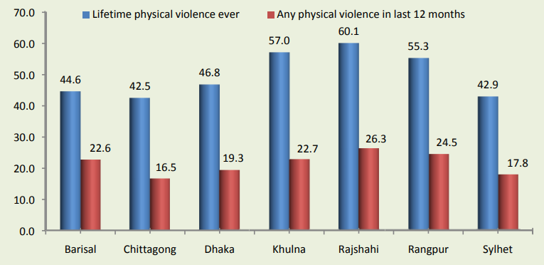
Report on Violence Against Women Survey 2015
RESULT &
Discussion
Prevalence of partner physical violence among ever-married women, by Division

Slide 10
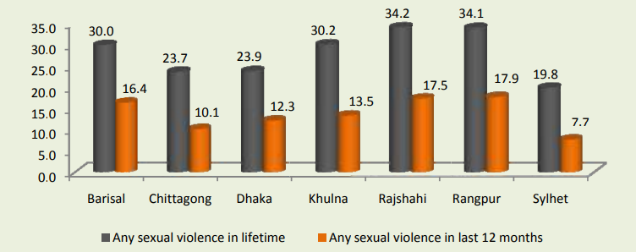
Report on Violence Against Women Survey 2015
RESULT &
Discussion
Prevalence of sexual violence by husband among ever-married women, by Division

Slide 11
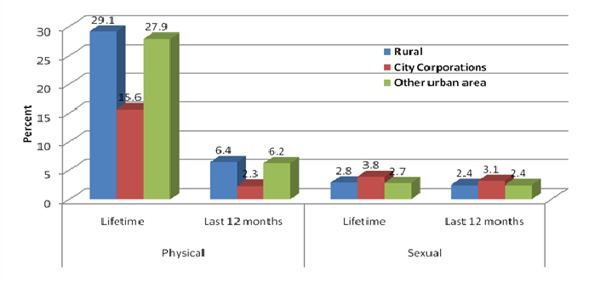
Report on Violence Against Women Survey 2015
RESULT &
Discussion
Lifetime and 12-month prevalence of non-partner physical and sexual violence among all women by rural / urban residence

Slide 12
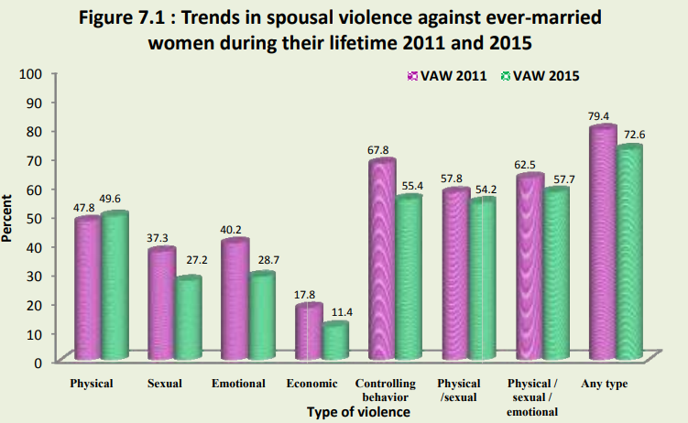
Report on Violence Against Women Survey 2015
RESULT &
Discussion

Slide 13

Discussion
Cultural and Socio-economic Influences
Awareness and Reporting
Policy Implications

Slide 14
Conclusion
Inadequate Legal Enforcement
Need for Public Awareness
Cultural Attitudes
Strengthening Support Services

Slide 15

Do You Have Any Question or Comments ?

Slide 16


