Slide 1


SMART INDIA HACKATHON 2026
TITLE PAGE
Problem Statement ID – SIH26032
Problem Statement Title - Smart Agricultural Procurement & Queue Management System
Theme- Smart Automation
PS Category- Software
Team ID-
Team Name (Registered on portal)

Slide 2
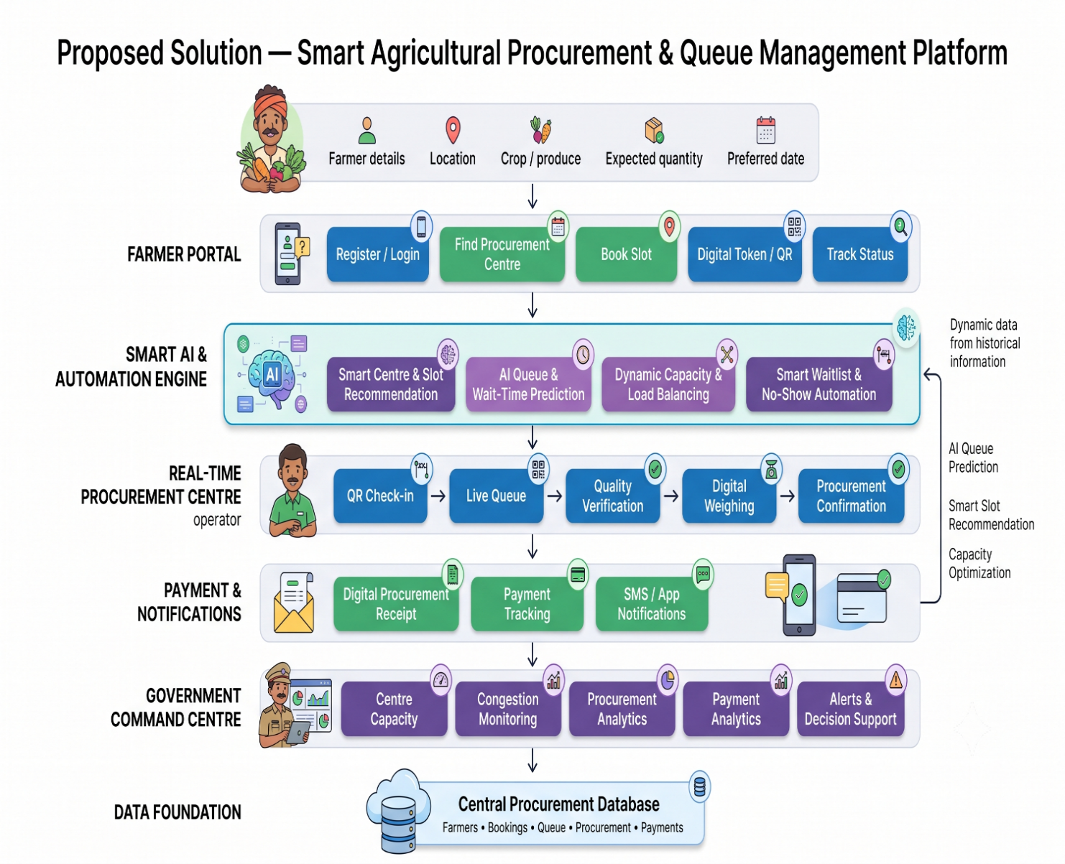
Smart Agricultural Procurement & Queue Management System
FarmOps
Proposed Solution
• AI-enabled procurement platform for slot booking, queue tracking, procurement and payment updates.
• Smart Slot Booking using farmer and centre data.
• Real-Time Queue Tracking with digital tokens and live status.
• AI Automation for queue prediction, recommendations and load optimization.
Additional Innovative Features :
AI Queue Prediction → Predicts queue length and estimated waiting time using real-time and historical centre data.
Smart Centre & Slot Recommendation → Recommends the least-congested centre and optimal time slot.
Dynamic Capacity & Load Balancing → Adjusts slot availability and distributes farmers across nearby centres.
Smart Waitlist & No-Show Management → Reallocates cancelled/no-show slots to farmers on the waitlist.
AI Anomaly Detection → Flags duplicate bookings, abnormal quantities, repeated cancellations, and suspicious procurement activity.

Slide 3
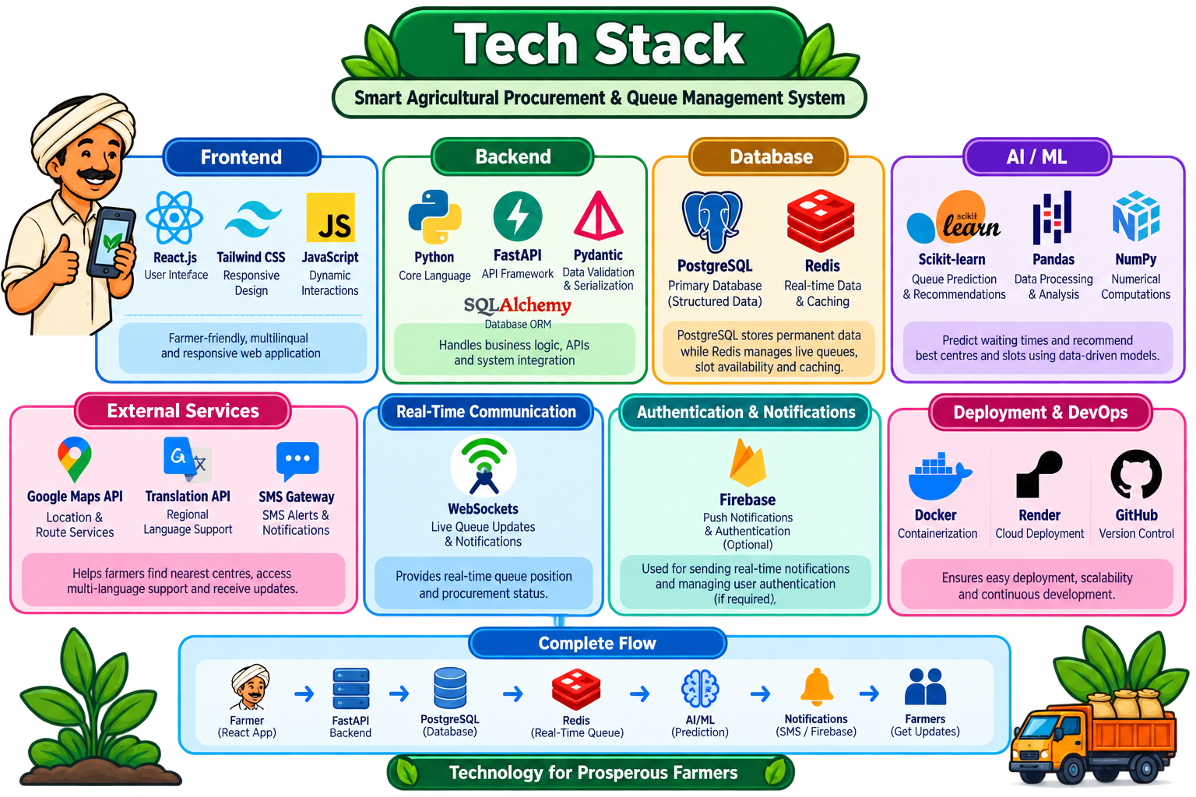
TECHNICAL APPROACH
FarmOps
• Technologies to be Used:
• Programming Languages:
• Frontend: JavaScript / TypeScript
• Backend & AI Engine: Python
• Frameworks & Libraries:
• Frontend Framework: React.js for a responsive, mobile-first user interface
• Backend Framework: FastAPI for high-performance RESTful APIs and real-time communication
• Machine Learning: Scikit-learn for lightweight queue prediction, smart slot recommendation, and centre-load optimization
• Database & Real-Time Services:
• Database: PostgreSQL for storing farmer profiles, bookings, procurement, and payment records
• Real-Time Data: Redis for queue management, caching, and real-time event handling
• WebSockets: For live queue position, waiting-time, and procurement status updates
• Supporting Tools & Services:
• Firebase: For push notifications and alerts
• Docker: For containerized deployment and consistent armer application environments
External Services:
Google Maps API
Translation API

Slide 4
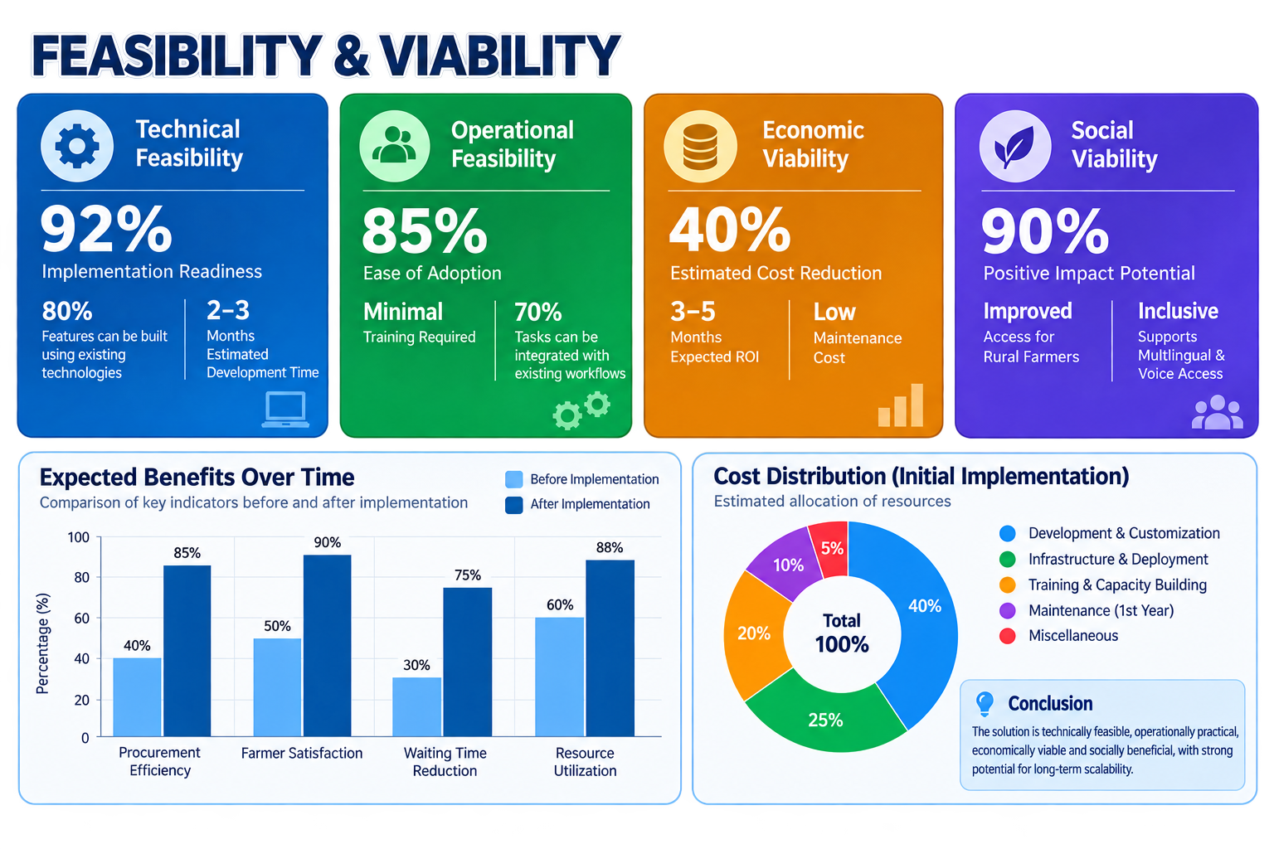


FEASIBILITY AND VIABILITY
FarmOps
Feasibility :
• AI-based queue prediction and slot recommendation can be implemented using rule-based logic and lightweight ML models.
• Mobile-friendly interface with multilingual support can be developed for easy farmer access.
• Procurement data can initially be entered manually and later integrated with government systems or APIs.
• Existing services such as SMS, maps, translation, and cloud hosting make development practical.
Viability :
• High demand: Farmers face long waiting times, uncertain schedules, and limited procurement status visibility.
• Scalable: The platform can expand across procurement centres, districts, crops, and states.
• AI-driven differentiation: Queue prediction, smart slot recommendation, and capacity optimization provide value beyond basic booking.
• Government value: Real-time dashboards help authorities monitor congestion and procurement operations.

Slide 5
IMPACT AND BENEFITS
FarmOps
Impact
• Reduced Farmer Waiting Time through smart slot booking and queue prediction. • Reduced Procurement Centre Congestion through dynamic capacity management. • Improved Transparency with real-time queue and procurement status. • Better Government Decision-Making through real-time analytics and reports.
Benefits
• Convenient Farmer Experience with digital tokens and notifications. • Efficient Resource Utilization across procurement centres. • Accessible to Rural Users through multilingual and offline support. • Scalable System that can expand across districts, states, and crops.

Slide 6
RESEARCH AND REFERENCES
FarmOps
• Department of Food & Public Distribution, Government of India – Information on food-grain procurement and procurement operations.
• Smart India Hackathon 2026, Problem Statement ID: 26032 – Problem statement regarding waiting times, procurement schedules, and procurement status for farmers.
• F. Ricci, L. Rokach, B. Shapira, Recommender Systems Handbook, Springer, 2022 – Reference for recommendation systems and intelligent decision-making.
• F. Pedregosa et al., Scikit-learn: Machine Learning in Python, Journal of Machine Learning Research, 2011 – Reference for implementing lightweight machine-learning models.
• FastAPI – Modern, High-Performance Web Framework for Building APIs with Python – Backend API development and integration.
• PostgreSQL – Open Source Object-Relational Database Management System – Storage and management of farmer, booking, procurement, and payment data.

