Slide 1

Data Strata 1.0 What is the best approach to become a Data Scientist ?? Abdullah Khilji, Banavath Shalini, Aniket Agarwalla abdullahkhilji.nits@gmail.com
NATIONAL INSTITUTE OF TECHNOLOGY SILCHAR

Slide 2
Why find a specific way to be a Data Scientist
‘Data Scientist’ is regarded as a broad job title and so it comes in many forms, with the specific demands dependent on the industry, the business, and the purpose/output of the role in question.
As a result, certain skillsets suit certain positions better than others, and this is why the path to data science is not uniform and can be via a diverse range of fields such as statistics, computer science and other scientific disciplines.

Slide 3
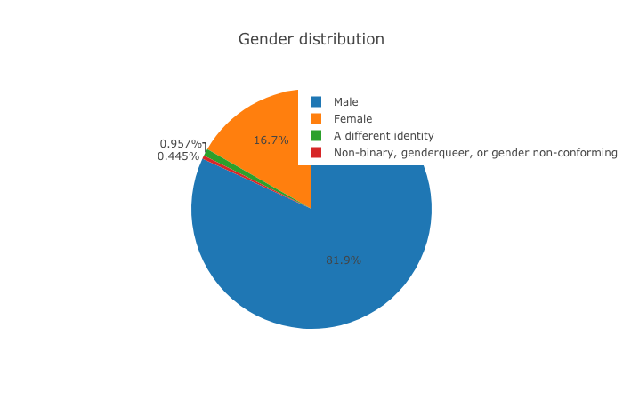
Gender Distribution

Slide 4
Analysis/Insights of the gender data.
Gender | Percentage of Candidates Surveyed
Male (Most Dominated) | 81.9 %
Female | 16.7 %
Others (Data NA/ Non Traditional) | 1.402 %
Thus it can be said with great confidence (as the data is largely consistent), that the field is male dominated.

Slide 5
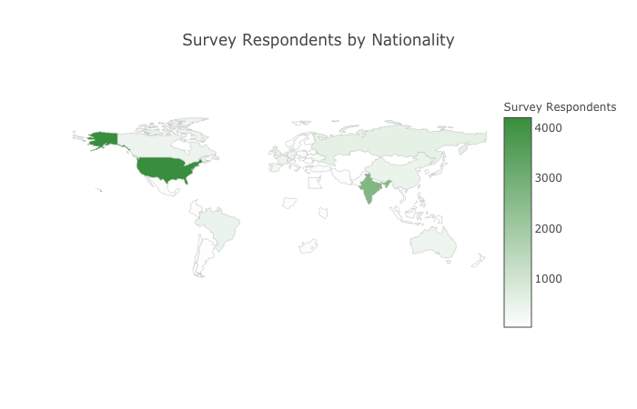
Nationality Distribution

Slide 6
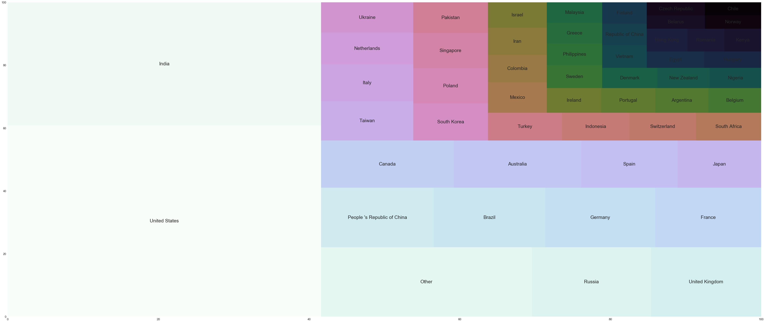
Analysis of Nationality from 52 Unique Countries

Slide 7
Analysis
It is clearly evident that India and The United States amount for nearly one – third of the total Data Scientist all over the world.
Thus, if you happen to be in one of these countries, you are simply lucky !

Slide 8
Analysis from the Graphical Representation.
Country | Percentage of Candidates Surveyed
United States | 24.98 %
India | 16.09 %
Others | 57.73 %
Data NA | 1.2 %

Slide 9
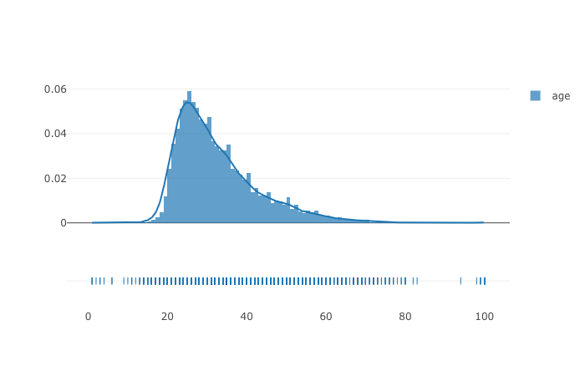
Age Distribution of all 52 Countries

Slide 10
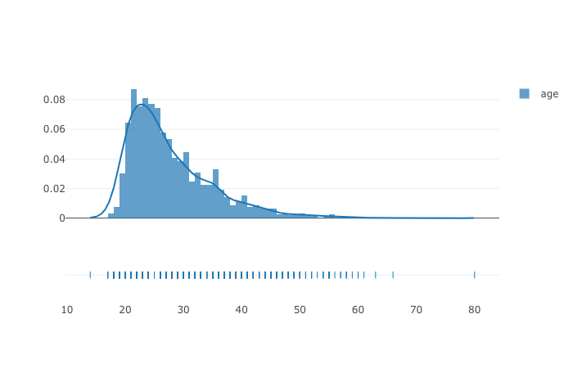
Age Distribution of India

Slide 11
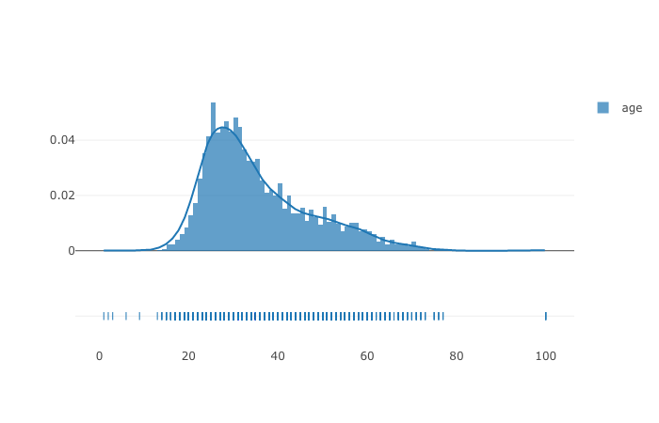
Age Distribution of The United States

Slide 12
Comparative study of United States and India
Compared to United States, more of younger Indian population have taken up this field.
In the United States, the population get into when they have a good knowledge of the field, compared to India where more of a younger population around the age of 20-25 have participated.
Whereas in US population around 30 are prevalent.
This can also be attributed to the higher gradient change at a earlier age on the Indian side.

Slide 13
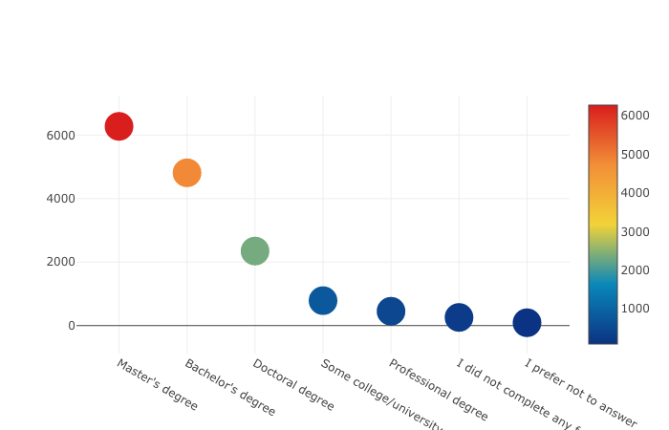
Graphical Distribution on Education

Slide 14
Analysis/ Insights on Educational Distribution
It is clearly evident that most of the surveyed candidates have a Master’s Degree.
Having a Bachelor’s degree is a must have.
Given the majority candidate’s having a Master’s degree, it is worth the effort.

Slide 15
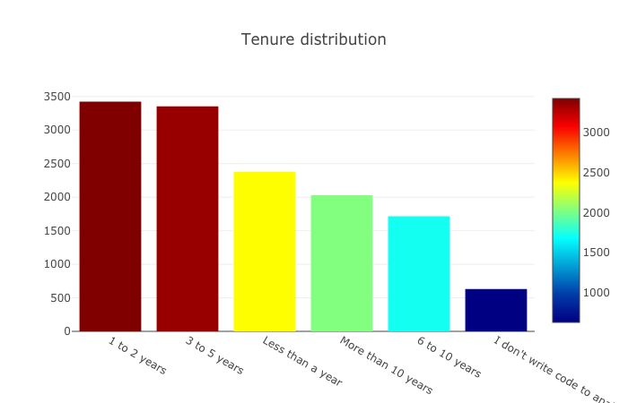
Duration in Office

Slide 16
Analysis from the Duration Data
It is clearly evident from the data that, since the field is relatively new it is difficult to find a very experienced Data Scientist.
And furthermore, most of the candidates are working with less experience.

Slide 17
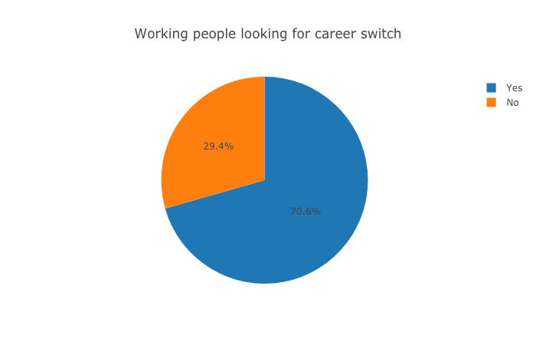
Is career switch a right option?

Slide 18
Yes sure, why not ?
According to the survey conducted, majority of the candidates, had opted for career change option.
Since Data Scientist is a very appealing field for all age trying to adapt to new technologies, so why not get the best ..?

Slide 19
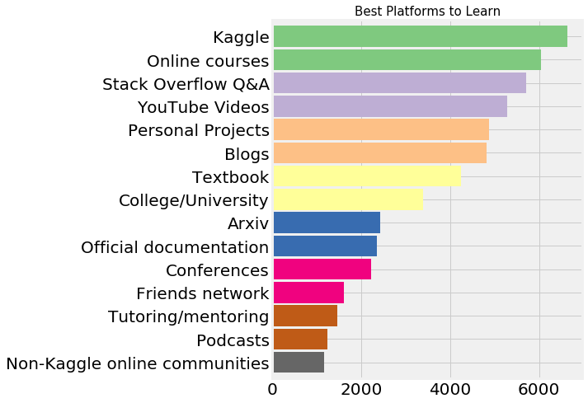
From where should we learn?

Slide 20
Analysis/Insights
Kaggle has been the most promising resource for Learners.
Online courses has been placed on the second position.
This is so because, large number of surveyed candidates at least had some knowledge of this field.
Now, let’s see for beginner’s what MOOC’s should they prefer …

Slide 21
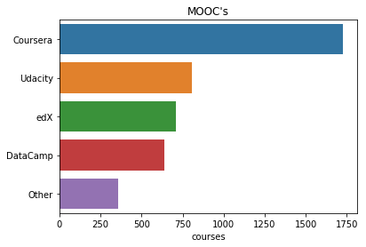
MOOC’s

Slide 22
A note on MOOC’s
It is seen that Coursera has clearly an edge among all online platforms, due to the greater flexibility offered by the platform.
Moreover, it is worth to note that it also offers an option for Financial Aid…

Slide 23
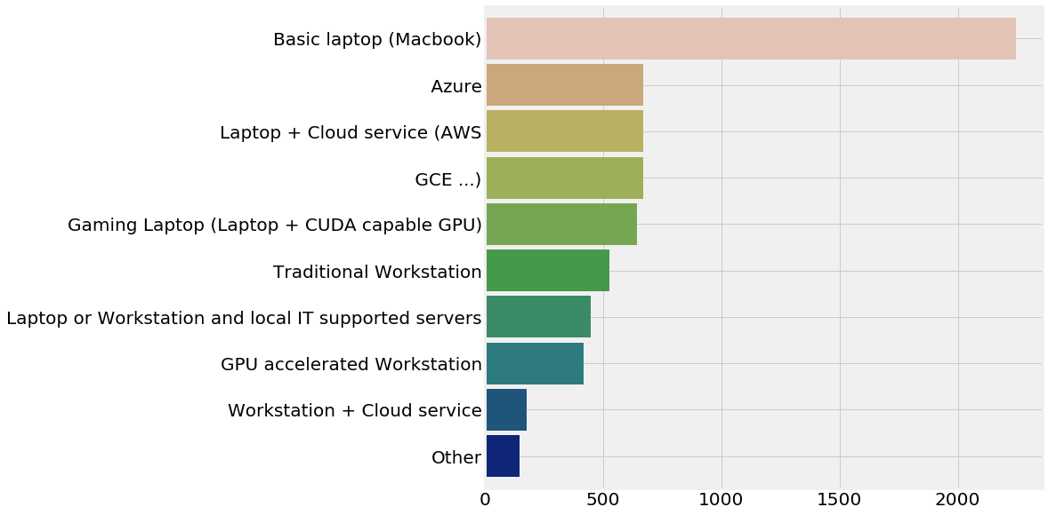
What hardware to start from ?

Slide 24
Will it cost you much, to begin with ?
No ! Definitely Not ..
Since majority of them had a basic notebook, any specific hardware is not required.
Though a GPU enabled machine is preferred.

Slide 25
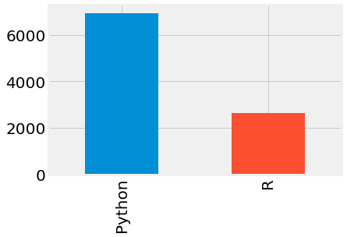
Which Language to use ?

Slide 26
Clearly Python is the winner here. Let’s see if having knowledge of R helps or not…

Slide 27
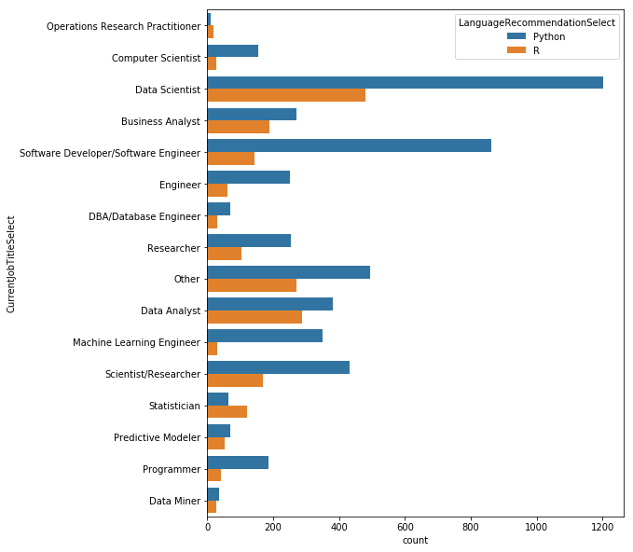
Profession using Python and R

Slide 28
Inference..
Almost all professions tend to prefer Python as their Language Recommendation of Choice. An important exception are the Statisticians who generally tend to prefer R. The only other profession that uses R more than Python is the Operations Research Practitioner.

Slide 29
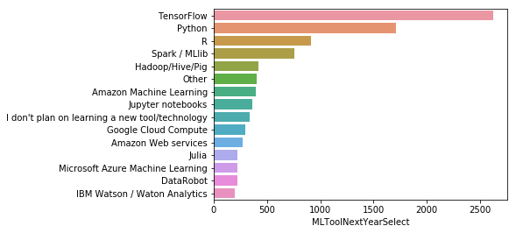
Which Technology should we prefer?

Slide 30
Who’s the winner here?
TensorFlow is the clear winner here. The Deep Learning framework from Google has gained a huge amount of popularity in the recent past due to its power and ease of use.

Slide 31
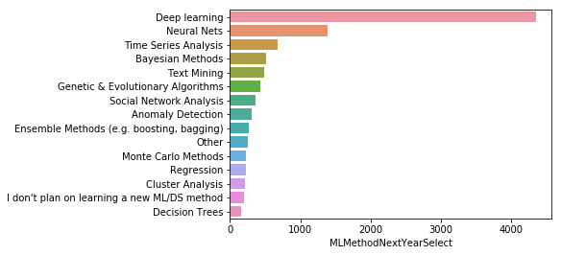
Which DS Method should I Master ?

Slide 32
The answer is Deep Learning …
An investment into learning these technologies (Neural Networks, Deep Learning and TensorFlow) can have huge benefits in the near future.

Slide 33
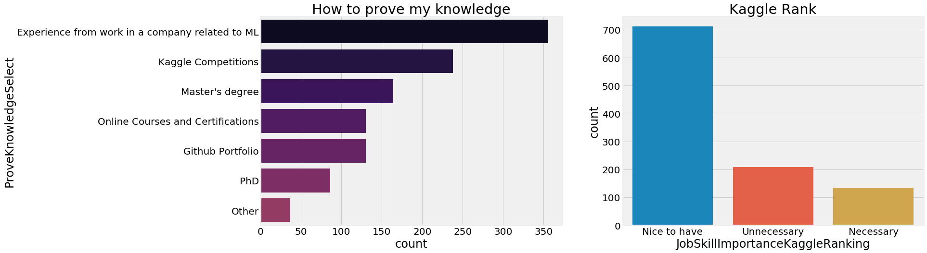
So once you have learned, how to prove ?

Slide 34
Analysis
The best way to prove your abilities is by working in companies.
Or it would also be great if you could participate in some good Kaggle competitions.

Slide 35
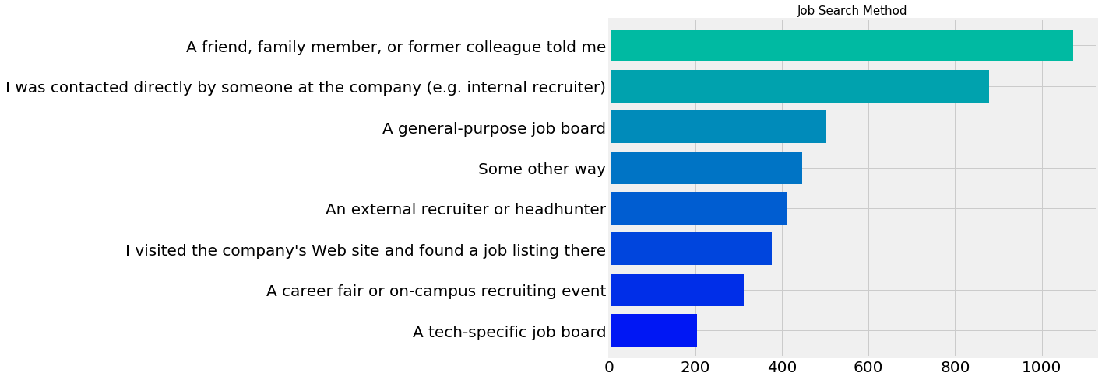
Where to look for a job ?

Slide 36
Inference
Most of them took opinion of their relatives or their friends, as it is the most easiest option amongst all.
You could also get recruited by a company HR.

Slide 37
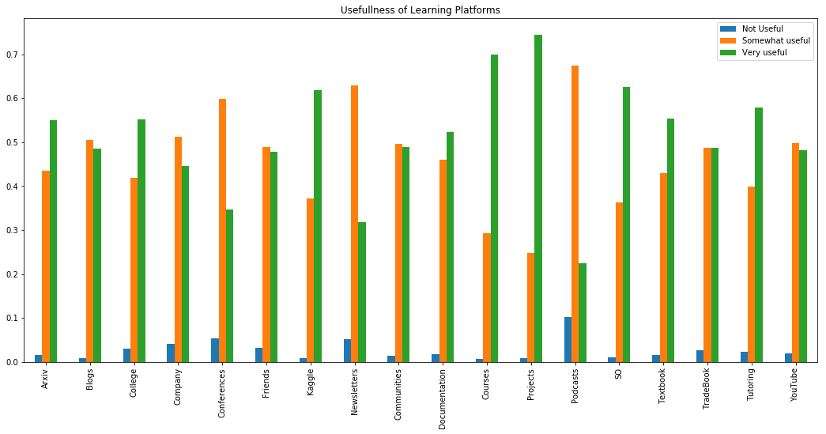
What to do to keep learning ?

Slide 38
Inference
The best way is by learning through online research papers and by completing good projects.
Though various blogs are also of great importance.

Slide 39
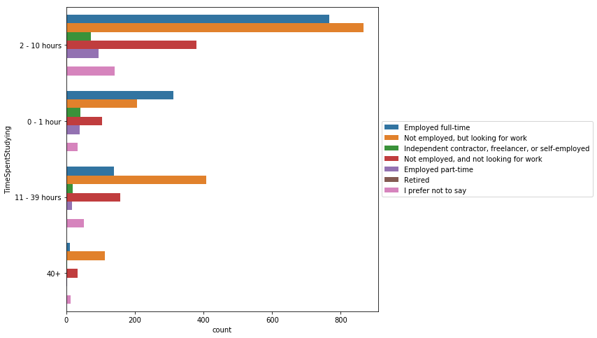
How much time should I spend ?

Slide 40
What does the data say ?
It would do if you are practice consistently and research on various techniques and algorithms for at-least 2 – 10 hours a day.

Slide 41
Now let’s see where the surveyed candidates good for our purpose?

Slide 42
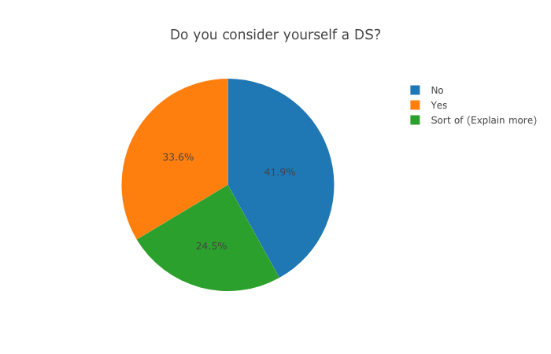
What proportion where actually Data Scientists ..

Slide 43
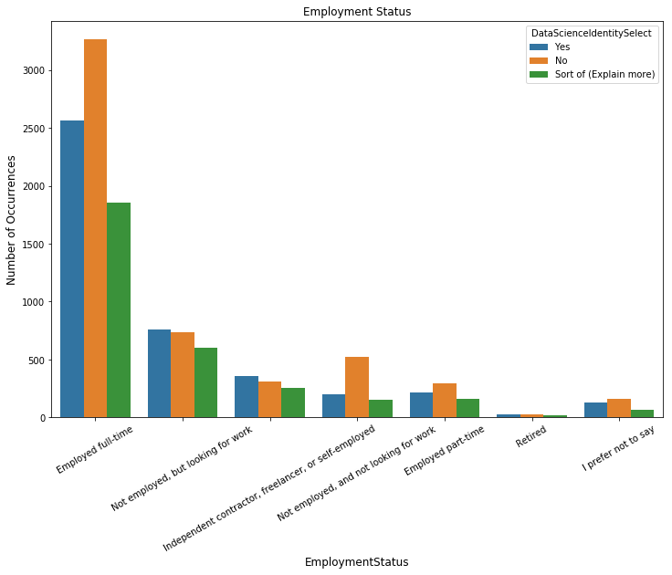
And, were they employed ?

Slide 44
Yes, the data was quite good !!
The data given had a good mixture of all the different levels of what it takes to be a data scientist.
Thus we had a good taste of our Data Analysis.

Slide 45
Final Insights and Conclusions
Overall if you are in either USA or India you would have greater opportunity given the large number professionals in these two countries.
Furthermore, if you are keenly interested in the field, it would be great if you could pursue MS after your graduation, as it is indicates by the greater professionalism shown at a later age in The United States.

Slide 46
Further Insights
If you are a beginner you should start with various online MOOC’s especially Coursera as a greater portion of them got a tacit agreement that it as quality content.
In this duration it would be great if you could have a mastery on Python.
And after pursuing the right courses you should move on various internships and job prospects.
And definitely you shouldn’t worry about your machine though a GPU enabled one would be great !

Slide 47
What if I get stuck somewhere ?
Stack Overflow will definitely come in handy.
And some great blogs are:
Data Science Central. Run By: Vincent Granville.
SmartData Collective. Run By: Social Media Today.
Simply Statistics. Run By: Jeff Leek, Roger Peng, and Rafa Irizarry.
And, do be updated by different Research Papers that your college has to offer.
And finally, make great colleagues and friends throughout your journey !

Slide 48
Thank You

