Slide 1

2026
Financial Feasibility
of Upstate House, LLC
An Affordable Housing Development Startup
HPD New Construction Finance (NCF) Programme · 329 Units · New York City
Presented by
Internal Supervisor
Abdullah Khizr
Dr M. A. F. Noor
Roll No. 24MFE002 | M.Sc. Banking & Financial Analytics | Dept. of Economics, Jamia Millia Islamia, New Delhi
External Supervisor
Mr. Haroon Khan | Jazaa Business Services

Slide 2




Literature Review
Theoretical & Empirical Foundations
Market Failure & the Case for Intervention
LIHTC, Tax-Exempt Bonds & the 4% Credit
HPD NCF, SONYMA MIF & Feasibility Frameworks
Glaeser & Gyourko (2008) establish that affordability challenges in high-cost cities stem from supply-side constraints — restrictive zoning, high land costs, and construction cost inflation — preventing the private market from serving low-income households. Schwartz (2014) traces how this failure led to the current ecosystem of tax credits and project-based subsidies, introducing complex multi-source financing requirements.
Cummings & DiPasquale (1999) document that LIHTC equity alone is insufficient in the highest-cost markets; additional subsidy layering is necessary. Rappaport (2014) notes that the 4% as-of-right credit triggered by 50%+ tax-exempt bond financing has become the dominant structure for large-scale affordable projects. In this project, bond financing produces a 0.50% permanent mortgage rate — the single most powerful lever in the capital structure.
Bratt (2009) identifies gap financing as a foundational prerequisite for subsidised housing viability. Orlebeke (2000) notes HPD's shift from grants to interest-accruing balloon loans, which has significant implications for long-term cash flow modelling. DiPasquale & Wheaton (1996) highlight SONYMA MIF's role in reducing lender risk, while its binding constraints — 80% LTV, 1.05x I/E, 1.5% replacement reserve — discipline developer assumptions. Peiser & Hamilton (2012) provide the feasibility framework applied in this study.
Glaeser & Gyourko (2008) · Schwartz (2014) · O'Regan & Quigley (2000)
Cummings & DiPasquale (1999) · Rappaport (2014) · McClure (2000)
Bratt (2009) · Orlebeke (2000) · DiPasquale & Wheaton (1996)
02

Slide 3
Research Objectives
What is this study trying to find out?
Core Question:
Once construction is complete and tenants move in, will rental income from 329 affordable units cover all operating costs and debt service obligations — and remain financially sustainable over a 30-year horizon?
i
ii
iii
iv
Assess Capital Structure
Evaluate Income Capacity
Test Debt Coverage
Sensitivity & Subsidy Dependence
Examine whether total permanent financing sources (LIHTC equity, HPD NCF subsidy, HFA mortgage, deferred developer fee) are sufficient to cover the Total Development Cost of USD 248.7 million with no residual funding gap.
Analyse the unit mix, AMI tier distribution (30%–80%), rent limits, and vacancy assumptions to determine whether projected Effective Gross Income is realistic and consistent with HUD rent schedules.
Determine whether Net Operating Income is sufficient to meet the HFA mortgage debt service and satisfy both the NCF minimum DSCR of 1.15x and the SONYMA MIF minimum I/E ratio of 1.05x across the 30-year period.
Assess the directional impact of changes in vacancy rates, operating expense levels, and debt service costs on project viability, and determine the degree to which financial sustainability is structurally dependent on public subsidy.
Obj. 1, 5 & 6
Obj. 2 & 4
Obj. 3
Obj. 7 & 8
03

Slide 4
Data Sources
How this study is built — and why market research is central to it
This study is based entirely on secondary data. No primary data collection — no surveys, interviews, or field observations — was undertaken. The analysis draws on two principal sources, with market research data underpinning the financial inputs throughout.
Regulatory Benchmark
Market Research — Central Input
Programme Frameworks
Market Data & HUD Schedules
HPD NCF Term Sheet · SONYMA MIF Regulations
HUD Income & Rent Limits · NYC Market Data · Academic Literature
The HPD NCF programme framework specifies eligibility criteria, per-unit subsidy limits, AMI tier requirements, rent limits, developer fee schedules, and the financial performance thresholds that every NCF-financed project must satisfy.
SONYMA MIF underwriting regulations govern the mortgage insurance constraints: 80% LTV cap, minimum 1.05× I/E ratio, and a 1.5% replacement reserve requirement — all of which function as binding structural inputs to the financial model.
HUD's FY 2025 Area Median Income and rent limit schedules for the NY–NJ–Jersey City MSA determine every rent figure in the model. NYC construction cost benchmarks, operating expense comparables, and capitalisation rates are drawn directly from market research.
This makes real-world market data the critical connective input — the bridge between the regulatory framework and the actual financial projections that underpin the feasibility assessment.
04
Confidential / Academic Use Only

Slide 5
Financial Model Structure
How the Excel model flows from inputs to Net Cash Flow
Key Performance Benchmarks
Min. DSCR
Min. I/E Ratio
LTV Cap
Replacement Reserve
DSCR Year 1
≥ 1.15×
≥ 1.05×
≤ 80%
≥ 1.5% of TDC
1.38× ✓
NCF Programme
SONYMA MIF
SONYMA MIF
Capitalised from sources
Model output (exceeds threshold)
Project
Assumptions
Unit Mix
& Rents
Sources
& Uses
Gross Income
(EGI)
Operating
Expenses
→
→
→
→
Timeline, AMI tiers,
vacancy, growth rates
329 units · HUD limits
30%–80% AMI tiers
TDC $248.7M · LIHTC
HFA Mortgage · NCF
Potential income less
5% vacancy deduction
Mgmt, utilities, R&M
1.5% replacement reserve
↓
Net Operating
Income (NOI)
Debt
Schedule
Debt Service
Coverage
Net Cash
Flow
→
→
→
EGI minus all operating
costs & reserves
HFA mortgage @ 0.50%
30-yr amortisation
Annual DS = $2.976M
NCF min DSCR ≥ 1.15×
NOI − Debt Service
Year 1: $1.13M
05
Confidential / Academic Use Only

Slide 6
Development Budget
Total Development Cost: USD 248,742,338
The Total Development Cost of Upstate House, LLC stands at USD 248.7 million, covering a 323,300 GSF development comprising 328 residential units and 18,000 SF of community facility space.
Construction hard costs form the largest component, reflecting the scale of new construction in New York City. The developer fee of USD 47.2 million represents 19% of TDC — a programme-standard figure under HPD NCF guidelines.
Acquisition at USD 10.6 million (4.3%) is modest relative to TDC, reflective of the site's affordable housing designation. Soft costs and carrying costs, while standard for a project of this scale and complexity, are partially offset by the tax-exempt bond structure.
The hard cost base of USD 242.2 million constitutes the LIHTC eligible basis for the 4% credit calculation.
07
Confidential / Academic Use Only

Slide 7
Sources & Uses — Capital Stack
The permanent capital stack totals USD 248.7 million, precisely matching Total Development Cost with no residual funding gap. Public financing instruments — LIHTC equity and the HPD NCF subsidy loan — account for 63.8% of permanent sources, confirming that financial viability is structurally dependent on simultaneous access to both. The construction phase is funded by an HFA tax-exempt bond construction loan of USD 134.6 million drawn progressively over 30 months, which converts to the permanent HFA first mortgage at stabilisation.
Construction Sources
Permanent Sources
USD 248.7M · 30-month draw period
Tax Credit: Elig. Basis $242.2M × 100% frac. × 4% = $9.69M/yr × $1.10 = $106.3M equity
08

Slide 8
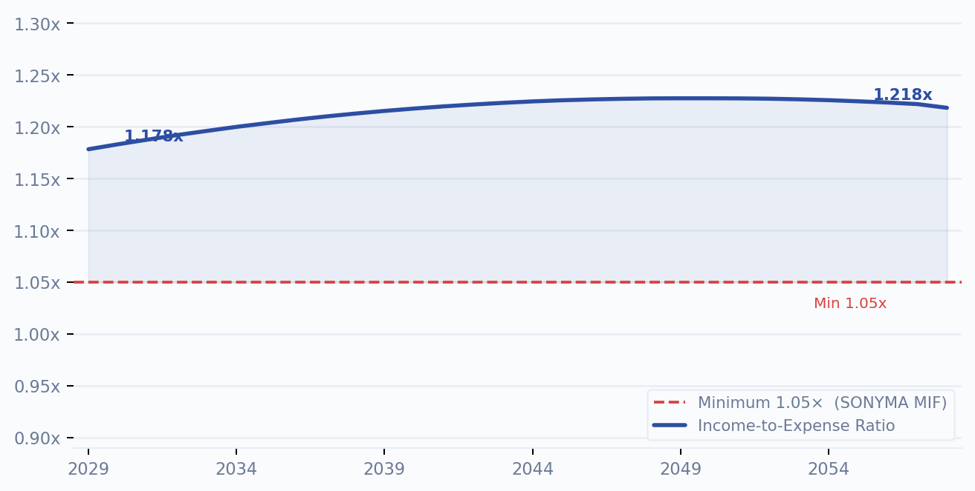
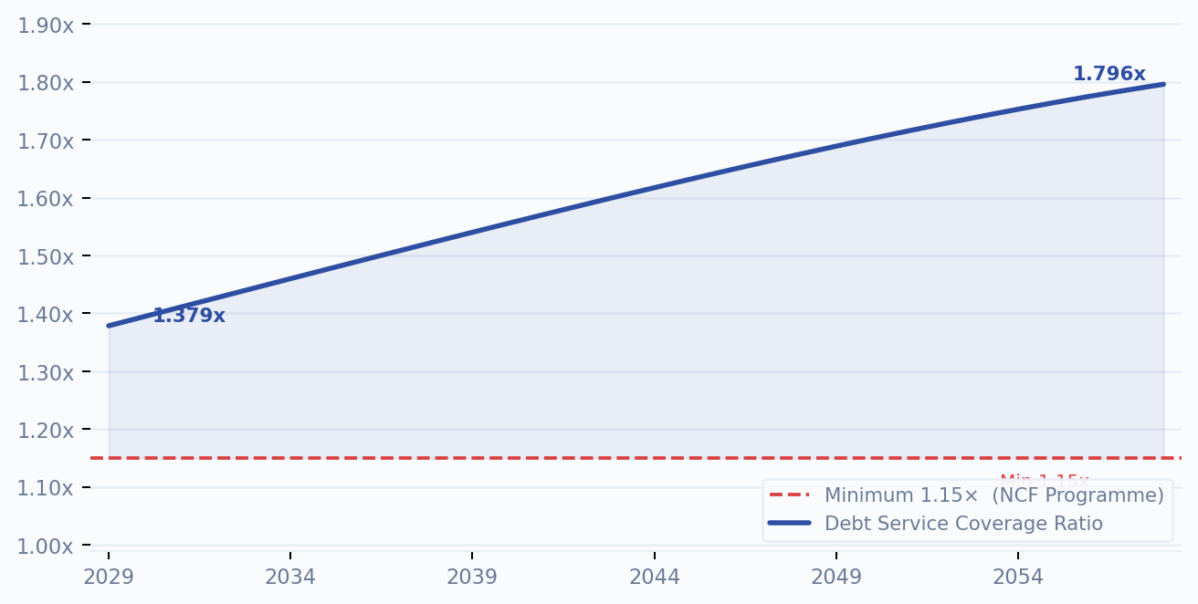
Financial Ratios
Income-to-Expense Ratio & Debt Service Coverage Ratio · 30-Year Projection (2029–2058)
I/E Ratio: Measures total effective gross income as a multiple of total expenses including debt service. SONYMA MIF requires a minimum of 1.05×. The project achieves 1.178× in Year 1, rising to 1.228× by Year 22 before stabilising — confirming sustained regulatory compliance across all 30 years.
DSCR: Measures Net Operating Income as a multiple of annual debt service ($2.976M fixed). NCF Programme requires a minimum of 1.15×. The project opens at 1.379× in Year 1 and improves steadily to 1.796× by Year 30 — driven by growing NOI against a fixed nominal debt obligation.
Income-to-Expense Ratio (I/E) · Min. 1.05× (SONYMA MIF)
Debt Service Coverage Ratio (DSCR) · Min. 1.15× (NCF Programme)
08
Confidential / Academic Use Only

Slide 9
Project Valuation
Capitalisation Rate Approach · 30-Year Property Value Projection (2029–2058)
Valuation Method
Property Value (USD Millions) · 2029–2058
Upstate House, LLC is valued using the Income Capitalisation (Cap Rate) method — the standard approach for income-producing affordable multi-family assets. Property value is derived by dividing stabilised Net Operating Income by the prevailing market cap rate for comparable regulated affordable assets in New York City.
Implied Cap Rate
≈ 7.0%
NOI (Year 1)
$4,101,794
Property Value (Year 1)
$58,597,050
Property Value (Year 30)
$76,343,138
Total Appreciation
+$17,746,088
Gross Rent Multiplier Yr 1
7.87×
Gross Rent Multiplier Yr 30
5.78×
The declining GRM (7.87× → 5.78×) reflects income growing faster than capital value over the 30-year horizon — a structural feature of AMI-regulated assets where rent growth is bounded by covenant constraints.
09
Confidential / Academic Use Only

Slide 10
Learning Outcomes
Key competencies developed through this dissertation and internship engagement
01
Financial Modelling
& Pro Forma Analysis
02
Market Research
& Data Application
03
Advanced Microsoft Excel
& Spreadsheet Engineering
Constructed a multi-sheet Excel financial model capturing a full development pro forma — sources & uses, income projections, operating expenses, debt sizing, and 30-year net cash flow analysis.
Applied HUD Area Median Income and rent limit schedules, NYC construction cost benchmarks, and market capitalisation rates to calibrate all financial assumptions to live market conditions.
Developed expertise in dynamic formula design, linked multi-sheet architecture, sensitivity tables, and structured data validation — enabling robust and auditable analytical output.
04
Affordable Housing Finance
& Public Subsidy Structuring
05
Development Budgeting
& Capital Stack Construction
06
Financial Feasibility
& Investment Viability Assessment
Gained applied understanding of the HPD NCF programme, 4% LIHTC equity mechanics, tax-exempt bond financing, SONYMA MIF credit enhancement, and AMI-tier rent regulation in the NYC context.
Structured a USD 248.7 million development budget across acquisition, hard costs, soft costs, and developer fee — and assembled a compliant permanent capital stack with no residual funding gap.
Evaluated long-run operational profitability through DSCR, I/E ratio, NOI trajectory, net cash flow analysis, and capitalisation rate valuation — benchmarked against applicable regulatory thresholds.
10
Confidential / Academic Use Only

Slide 11
Thank You
Financial Feasibility of Upstate House, LLC
HPD New Construction Finance (NCF) Programme · 329 Units · New York City
Presented by
Internal Supervisor
Abdullah Khizr
Dr M. A. F. Noor
Roll No. 24MFE002 | M.Sc. Banking & Financial Analytics | Dept. of Economics, Jamia Millia Islamia, New Delhi
External Supervisor
Mr. Haroon Khan | Jazaa Business Services

