Slide 1

Which Sector has Lowest revenue?
Real Estate Industry has lowest revenue.
It does not have stagnant growth in terms of revenue.

Slide 2
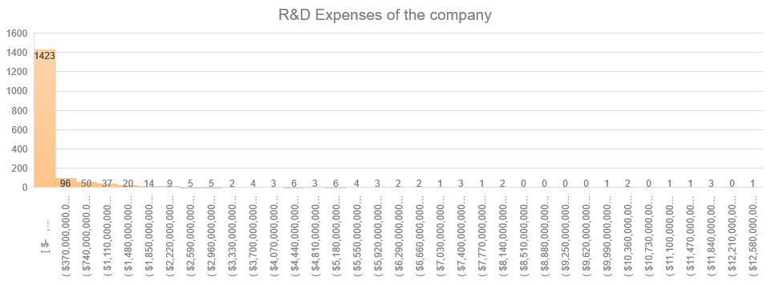

Expenses of the companies on Research & Development
Histogram of the total R&D expenses of the companies
The Histogram exhibits a right or positive skew, indicating that the mean surpasses the median, emphasizing a higher central tendency.

Slide 3
Growth in Real Estate Industry
Real Estate Industry Revenue has grown tremendously from 2012 to 2015. However, revenues decreased significantly after 2015.

Slide 4
Growth in Health Care Distributors market
Health Care Distributors market has great growth for the given 4 years.

Slide 5
Growth in Health Care Distributors market
ABC being the big players in the Health Care Distributors have large revenue

Slide 6
Which company has steeper growth in Health Care Distributors ?
From the graph we can easily say that not only ABC has higher total revenue but also steeper revenue growth.

