Slide 1


SMART INDIA HACKATHON 2025
TITLE PAGE
Problem Statement ID- SIH25092
Problem Statement Title-
Development of a Digital Mental Health and
Psychological Support System for Students in
Higher Education
Theme- MedTech / BioTech / HealthTech
PS Category- Software
Team ID- Not allotted yet
Team Name (Registered on portal)- CODEVATIVE

Slide 2
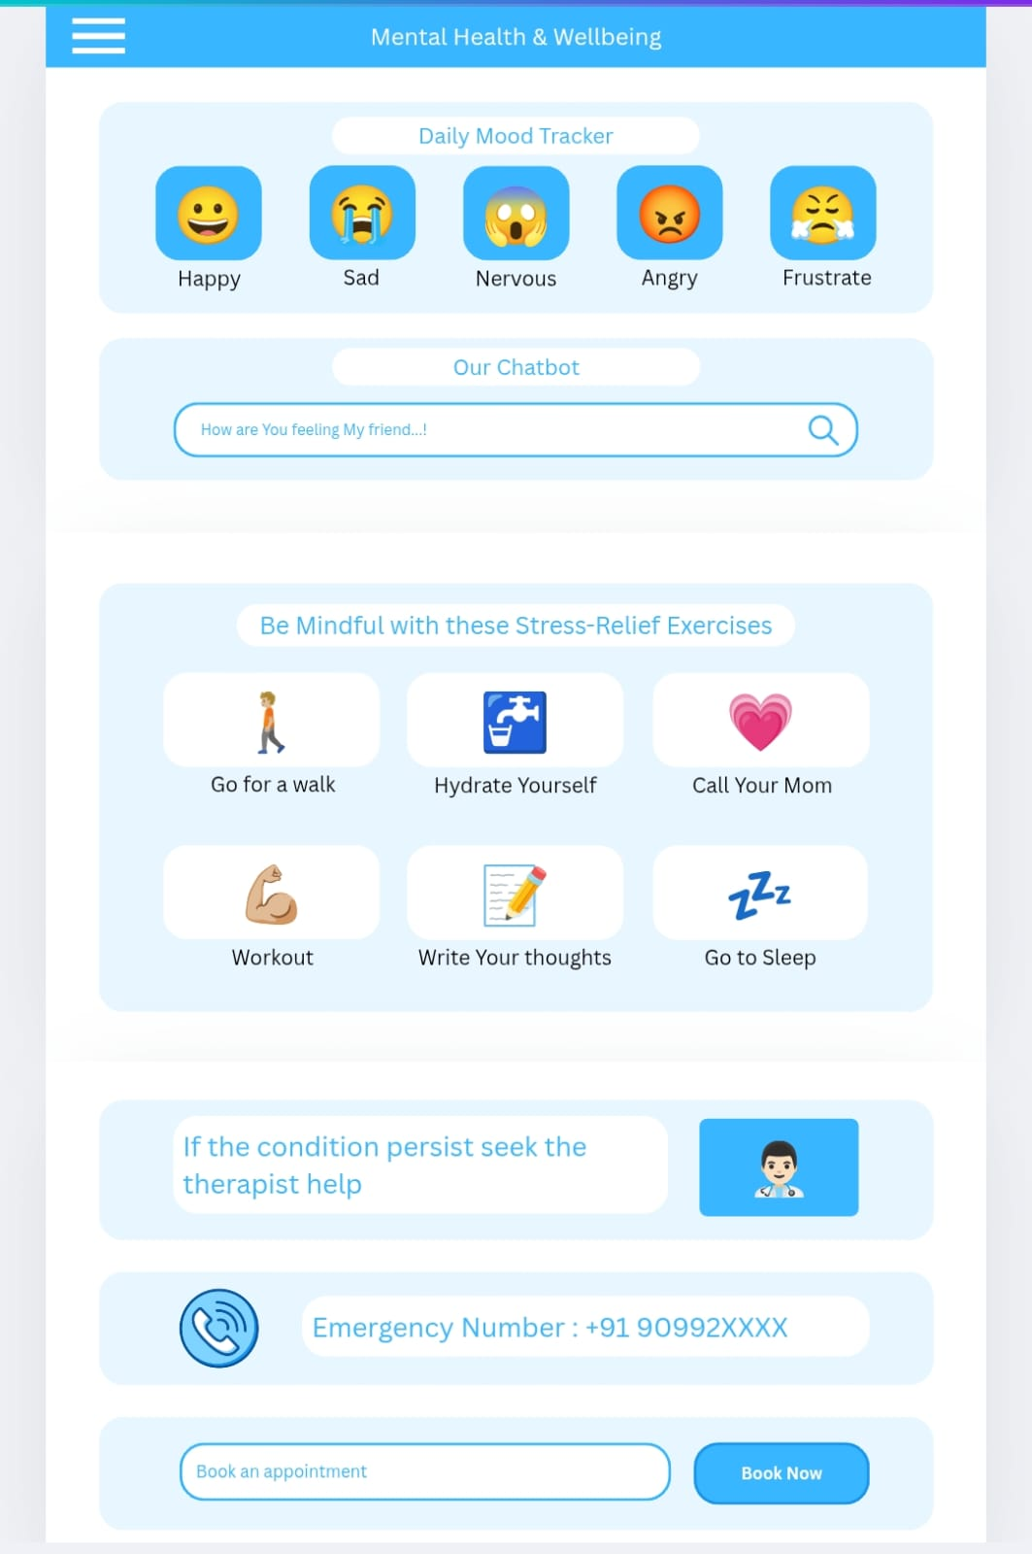
Ayushman
CODEVATIVE
Solution Overview: Our platform addresses the lack of accessible, stigma-free psychological support for students by providing AI-first aid, regional language resources, and direct links to institutional counsellors. It will be a platform for students offering mood tracking, AI support, mindfulness exercises, and access to professional counselling.
Problem Addressed: Helps students manage stress, anxiety, and emotional challenges confidentially and in real-time through our key features.
Key Features:
1. Personalized mood tracking, analytics and AI-driven emotional support chat
2. Confidential Booking System and Admin Dashboard
3. Guided mindfulness and stress-relief exercises
4. Access to professional counselling and peer support
Innovation & Uniqueness:
1. Interactive, AI-powered, student-centric, and multilingual resources
2. Proactive mental health support instead of reactive
3. Integrates emotional, educational, and professional resources in one platform

Slide 3
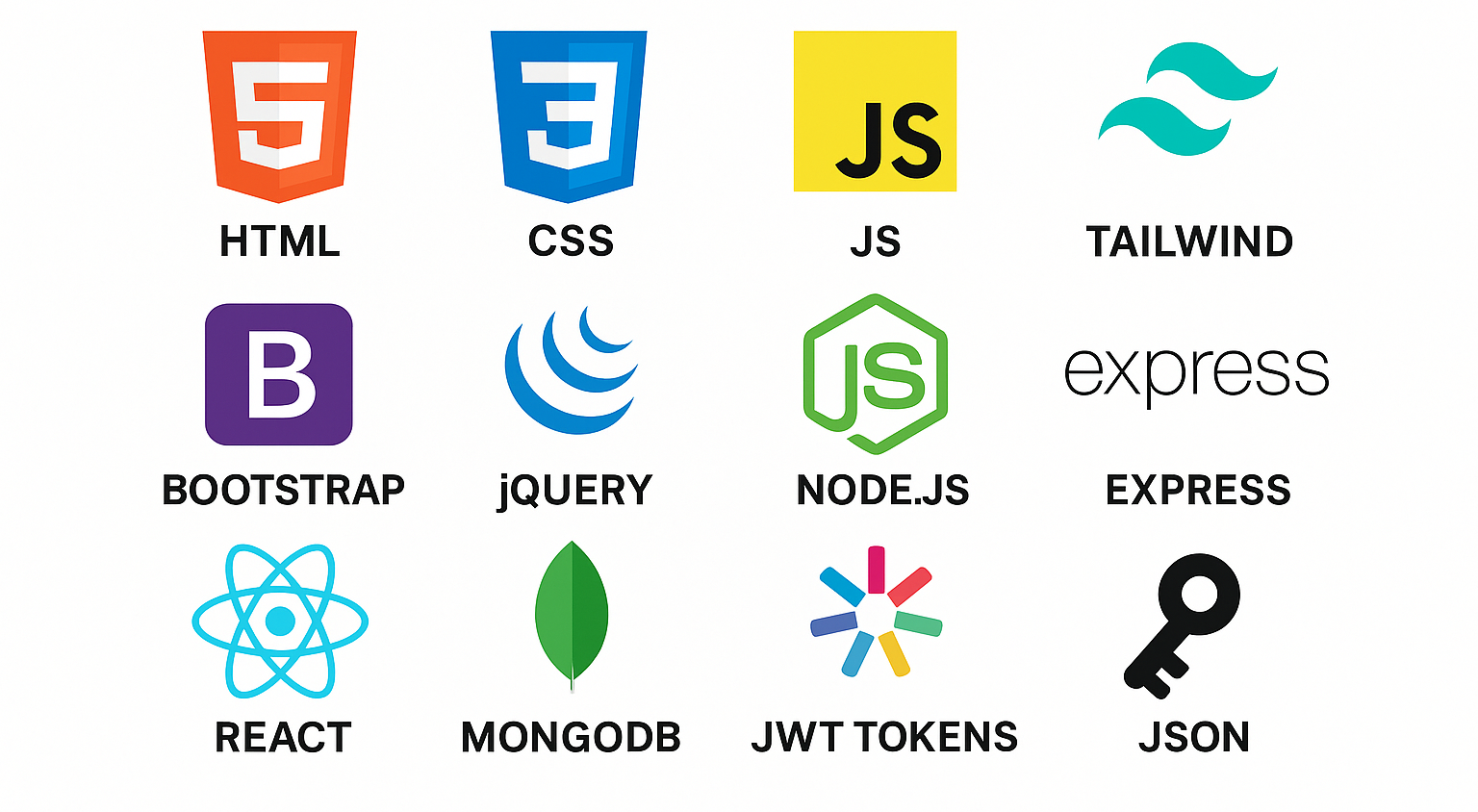
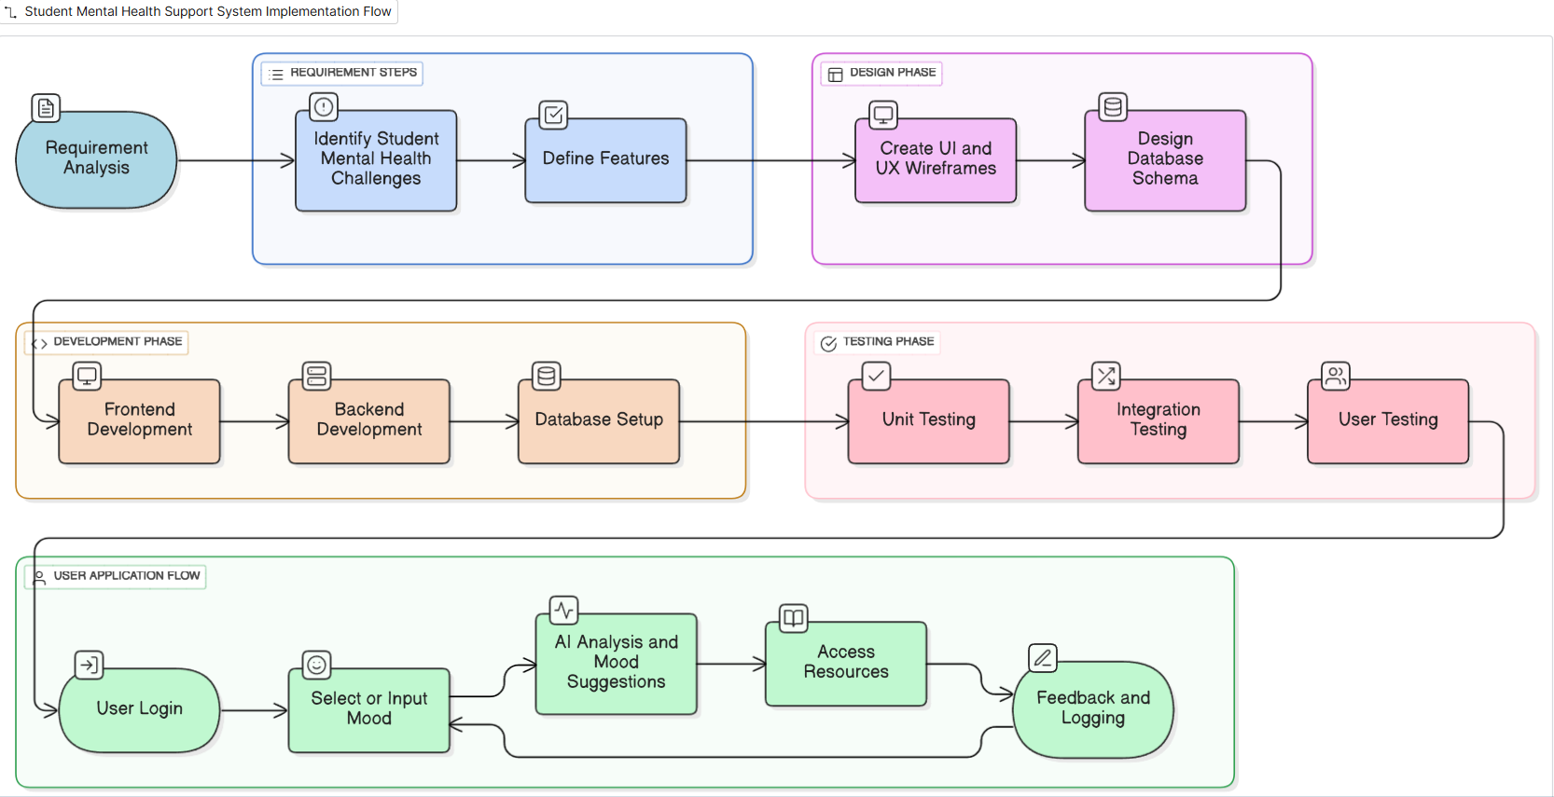
TECHNICAL APPROACH
CODEVATIVE
Technologies to be used: Methodology and Flow:

Slide 4
FEASIBILITY AND VIABILITY
CODEVATIVE
Feasibility Analysis:
1. Technical Feasibility: Can be implemented using HTML, CSS, JS, Tailwind, Node.js, and APIs.
2. Operational Feasibility: Students can easily use the platform
3. Schedule Feasibility: Can be built as a working prototype within hackathon timeline.
Potential challenges and strategies to overcome those challenges:
Potential Challenges | Strategies to Overcome
🔒 Data Security: Sensitive mental health data stored in database | ✅ Use HTTPS, JWT authentication, and database encryption; comply with privacy norms
🤖 AI Accuracy: Mood analysis may not always be precise | ✅ Validate AI outputs with simple rules; provide manual feedback option
📉 User Engagement: Students may not regularly interact | ✅ Intuitive UI via Tailwind, notifications, gamification, easy navigation
⚙️ Integration Bugs: Frontend-backend-AI interaction may fail | ✅ Modular development, extensive testing, error logging, staged deployment

Slide 5
IMPACT AND BENEFITS
CODEVATIVE
Potential Impact on Target Audience :
Enhanced Mental Well-being: Helps students manage stress, anxiety, and emotional challenges effectively.
Early Intervention: Mood tracking and AI suggestions allow timely support, reducing mental health crises.
Increased Awareness: Educates students about mental health resources and coping strategies.
Accessible & Inclusive: Platform is available anytime, anywhere, supporting all students including those hesitant to seek in-person help.
Benefits of the Solution :
Social: Promotes a healthier student community, reduces stigma, and encourages peer support.
Economic: Reduces long-term costs associated with untreated mental health issues; low-cost digital implementation.
Educational: Supports better focus, productivity, and academic performance by improving mental well-being.
Technological: Demonstrates innovative use of AI, web development, and interactive tools for social good.

Slide 6
RESEARCH AND REFERENCES
CODEVATIVE
Research & Articles on Student Mental Health:
1. World Health Organization (WHO) – Mental Health of Students
2. National Mental Health Survey India
3. Journal Articles: Digital Interventions for Student Mental Health, AI in Mental Health Support
Additional References:
1. Research papers and case studies on mood tracking apps and AI-driven mental health platforms.
2. Online blogs and articles for implementation best practices

