Slide 1

Innovwave - 2026
Manayush A Digital Mental Health Companion for College Students
Presented by:
Arshil Masood & Abdullah Ansari

Slide 2

Innovwave - 2026
The Problem
Academic pressure & future uncertainty
Social isolation & comparison culture
Rising mental health struggles
Students often suffer in silence

Slide 3

Innovwave - 2026
Why Existing Support Falls Short
Limited availability
Stigma around seeking help
Accessed too late

Slide 4

Innovwave - 2026
Introducing Manayush
Students often suffer in silence
AI-assisted mental health platform
Safe, stigma-free space for students
Encourages early emotional check-ins

Slide 5

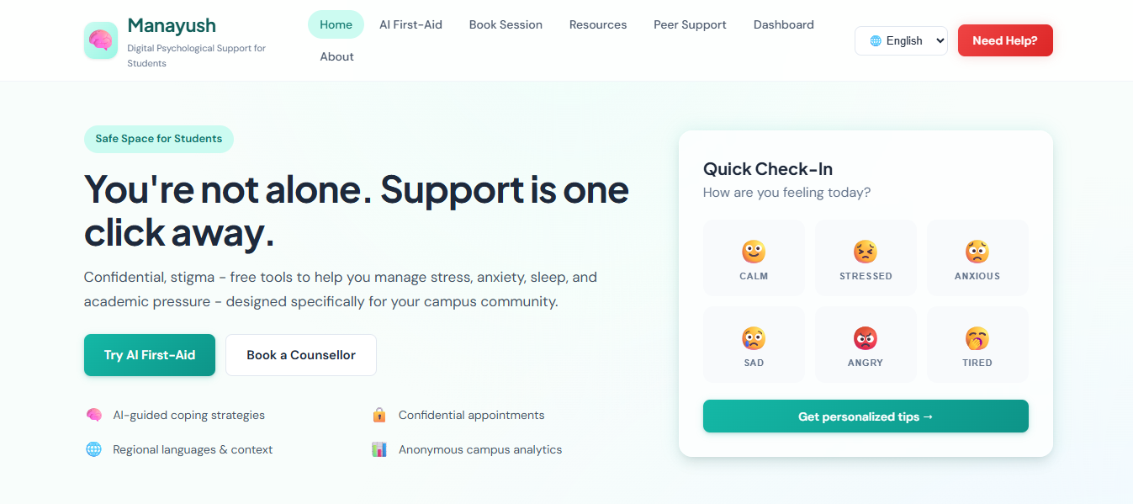
Innovwave - 2026
Core Features
• Mood tracking • AI emotional support chat • Mindfulness tools • Counsellor connect
Why It’s Different
• Preventive • Student-centric • Privacy-first

Slide 6
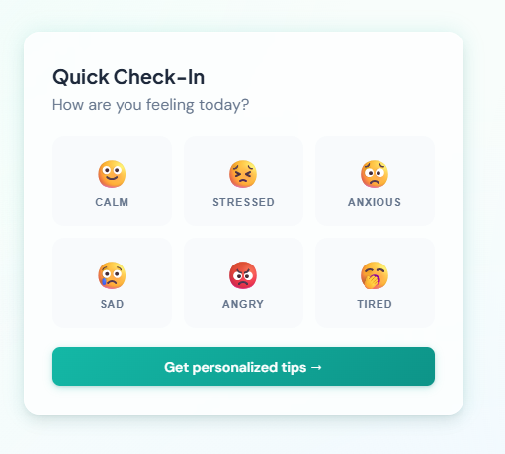
Innovwave - 2026
Solution Overview: Our platform addresses the lack of accessible, stigma-free psychological support for students by providing AI-first aid, regional language resources, and direct links to institutional counsellors. It will be a platform for students offering mood tracking, AI support, mindfulness exercises, and access to professional counselling.
Problem Addressed: Helps students manage stress, anxiety, and emotional challenges confidentially and in real-time through our key features.
Innovation & Uniqueness:
- Interactive, AI-powered, student-centric, and multilingual resources
- Proactive mental health support instead of reactive
- Integrates emotional, educational, and professional resources in one
platform

Slide 7
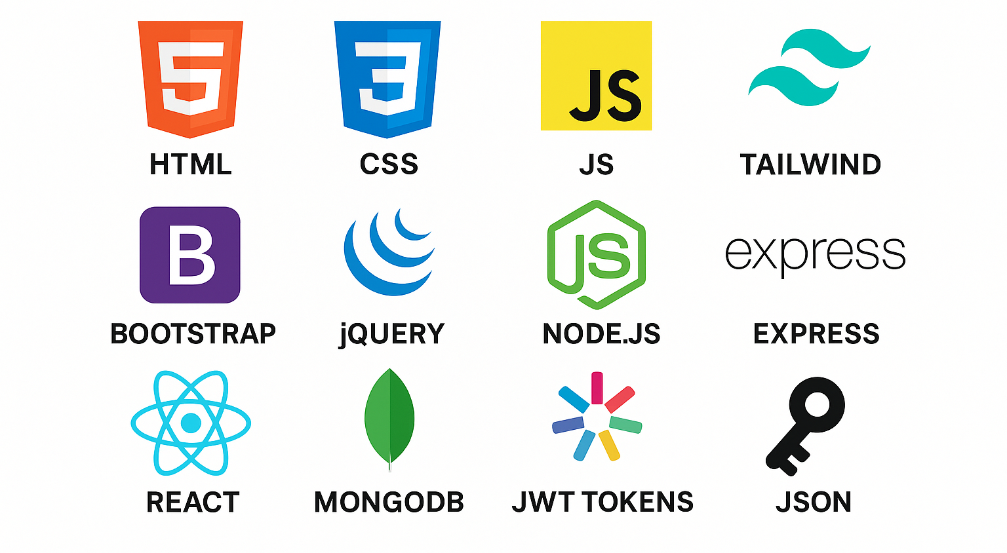
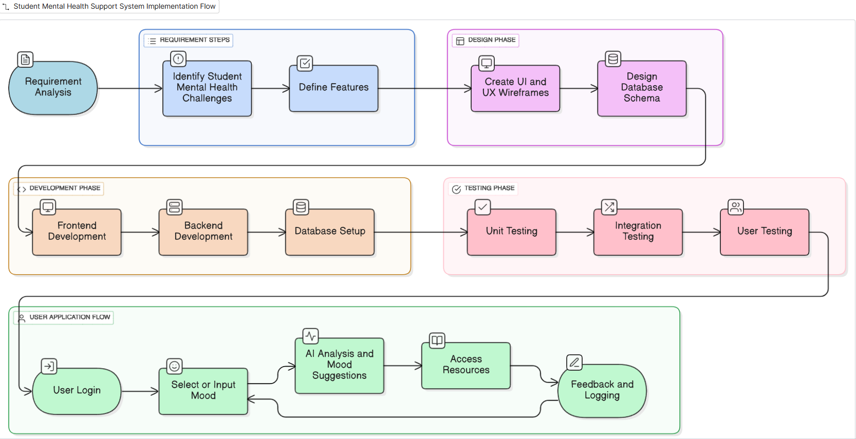
TECHNICAL APPROACH
Innvowave - 2026
Technologies :
Methodology and Flow:

Slide 8
FEASIBILITY AND VIABILITY
Innovwave - 2026
Feasibility Analysis:
1. Technical Feasibility: Can be implemented using HTML, CSS, JS, Tailwind, Node.js, and APIs.
2. Operational Feasibility: Students can easily use the platform
3. Ethical: Privacy-first, no forced data storage
Potential challenges and strategies to overcome those challenges:
Potential Challenges | Strategies to Overcome
🔒 Data Security: Sensitive mental health data stored in database | ✅ Use HTTPS, JWT authentication, and database encryption; comply with privacy norms
🤖 AI Accuracy: Mood analysis may not always be precise | ✅ Validate AI outputs with simple rules; provide manual feedback option
📉 User Engagement: Students may not regularly interact | ✅ Intuitive UI via Tailwind, notifications, gamification, easy navigation
⚙️ Integration Bugs: Frontend-backend-AI interaction may fail | ✅ Modular development, extensive testing, error logging, staged deployment

Slide 9
IMPACT AND BENEFITS
Innovwave - 2026
Scalability and Business Model:
Target Users: Colleges & Universities (B2B).
Model: Institution-level licensing
Future Scope: Premium analytics for institutions, Government & CSR partnerships, Integration with campus wellness programs
Benefits of the Solution :
Social: Promotes a healthier student community, reduces stigma, and encourages peer support.
Economic: Reduces long-term costs associated with untreated mental health issues; low-cost digital implementation.
Educational: Supports better focus, productivity, and academic performance by improving mental well-being.
Technological: Demonstrates innovative use of AI, web development, and interactive tools for social good.

Slide 10
RESEARCH AND REFERENCES
Innovwave - 2026
Research & Articles on Student Mental Health:
1. World Health Organization (WHO) – Mental Health of Students
2. National Mental Health Survey India
3. Journal Articles: Digital Interventions for Student Mental Health, AI in Mental Health Support
Additional References:
1. Research papers and case studies on mood tracking apps and AI-driven mental health platforms.
2. Online blogs and articles for implementation best practices

