Slide 1
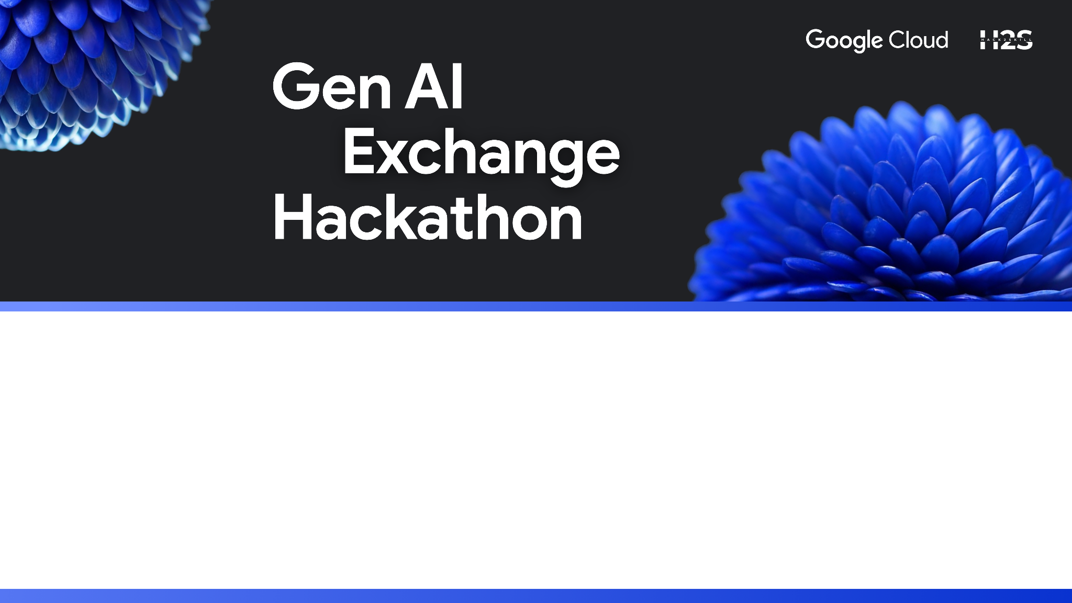
BYTE QUEST - HACKATHON
ORGANIZER: GFG CAMPUS BODY RBU
Date: 3 - 4 January 2026
Track: Fintech
Problem Statement - 13
Investing for Everyone - A Micro-Investment Platform
for First-Time Users
Team Name : CODEVATIVE

Slide 2
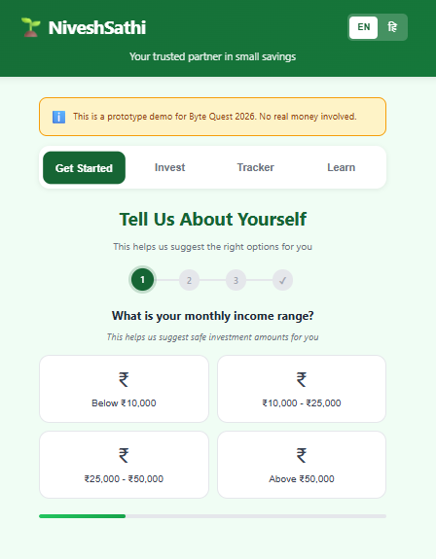
BYTE QUEST - HACKATHON
GFG CAMPUS BODY - RBU
OUR SOLUTION: NiveshSathi
NiveshSathi is a user-first micro-investment platform designed especially for first-time investors.
It allows users to:
Start investing with as low as ₹10
Choose safe and low-risk investment options
Learn investing in a simple and stress-free way
Use the platform easily on low-end smartphones
Access the platform in Hindi, making it inclusive for rural and semi-urban users

Slide 3
BYTE QUEST - HACKATHON
GFG CAMPUS BODY - RBU
How NiveshSathi is different from existing Investment solutions?
Limitation in Existing Platforms | NiveshSathi Approach
Apps assume users are experienced | Step-by-step guided onboarding using income, risk, and savings goal
High minimum investment | Start safely with as low as ₹10
Financial terms are confusing | Simple lessons and short videos teach investing basics
Complex dashboards | Simple tracker shows portfolio, returns, and goals clearly
Lack of personalization | Suggests investment amounts and plans based on user input
Not beginner-friendly user flow | Intuitive, guided interface designed for first-time investors

Slide 4
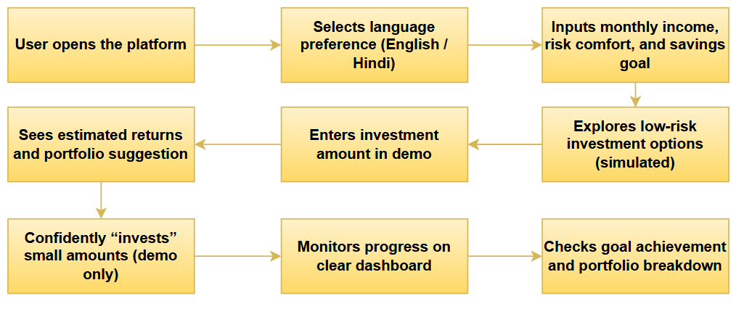
BYTE QUEST - HACKATHON
GFG CAMPUS BODY - RBU
NiveshSathi - User Interaction Flow Diagram

Slide 5

BYTE QUEST - HACKATHON
GFG CAMPUS BODY - RBU
Technology Stack
Frontend: HTML, CSS, JavaScript
UI/UX Design: Mobile-first & user-friendly design
Logic Implementation: Lightweight and efficient client-side logic
Our focus was on performance, simplicity, and accessibility rather than heavy frameworks.

Slide 6

BYTE QUEST - HACKATHON
GFG CAMPUS BODY - RBU
IMPACT & PRACTICALITY
Real-World Impact
Encourages financial inclusion
Helps users develop long-term saving habits
Reduces fear around investing
Practical and scalable for real-world adoption
Who benefits? Students, daily wage workers, rural citizens, and anyone new to investing.

Slide 7
BYTE QUEST - HACKATHON
GFG CAMPUS BODY - RBU
DEMO
Video Link: https://drive.google.com/file/d/1JpIud-eKHvGcUZSmiaDLJylouVNhkToR/view?usp=sharing
Deployed Link: https://niveshsathi-theta.vercel.app/

Slide 8

BYTE QUEST - HACKATHON
GFG CAMPUS BODY - RBU
CONCLUSION & FUTURE SCOPE
NiveshSathi successfully addresses the problem of investment fear and inaccessibility by offering a simple, low-risk, and beginner-friendly platform.
Future Enhancements
Integration with real financial services
Regional language support
Offline-friendly features
AI-based investment guidance
Gamified financial learning modules

Slide 9
BYTE QUEST - HACKATHON
GFG CAMPUS BODY - RBU
Thank You!

