Slide 1

C O U R S E R E C O M M E N D E R S Y S T E M
Uses machine learning techniques to recommend relevant courses based on user preferences and course similarities.

Slide 2
OUTLINE:
Executive Summary
Introduction
Methodology
Word Cloud of Course Titles
Course Genre & Enrollment Analysis
Most Popular Courses
Results
Content-Based Recommender — User Profile
Diagrammatic Workflow of System
Content-Based Recommender — Course Similarity
Comparative Insights
Clustering-Based Recommender
KNN Collaborative Filtering
NMF Collaborative Filtering
Neural Network Recommender
Model Performance Comparison
Live Demo Link
Dashboard Screenshots
Discussion
Overall Findings & Implications
Conclusion

Slide 3

EXECUTIVE SUMMARY
Explored and analyzed an online course enrollment dataset to understand user behavior and prepare the data for building recommendation models.
Extracted Bag of Words (BoW) features from course descriptions and measured course similarity using textual content.
Built content-based recommendation systems using both course similarities and user profile vectors based on course genres and user preferences.
Applied clustering techniques to group users with similar interests and improve personalized course recommendations.
Implemented collaborative filtering using K-Nearest Neighbors (KNN) and Non-negative Matrix Factorization (NMF) to recommend courses from user-item interactions.
Developed a neural network recommender to learn user and course embeddings for predicting course ratings.
Used the learned embedding features to build both regression and classification models for predicting user course ratings and rating categories.
Compared multiple recommendation approaches to understand how different machine learning techniques can be used to generate personalized course recommendations.

Slide 4

INTRODUCTION
Recommender systems help users discover relevant items by learning from course information and user interactions. In this project, different recommendation techniques were implemented and compared using an online course dataset. The work started with data exploration and feature engineering, followed by content-based filtering, clustering, collaborative filtering, and neural network-based recommendation models. Finally, the learned embeddings were used to build regression and classification models for predicting course ratings and recommendations.

Slide 5

METHODOLOGY
Explored the dataset to understand courses and user interactions.
Prepared the data for building recommendation models.
Created Bag of Words (BoW) features from course information.
Built content-based recommenders using course similarity and user profiles.
Grouped similar users using clustering techniques.
Developed collaborative filtering models using KNN and NMF.
Learned user and course embeddings with a neural collaborative filtering model.
Trained regression and classification models using the learned embeddings.
Compared different models to evaluate their recommendation performance.

Slide 6
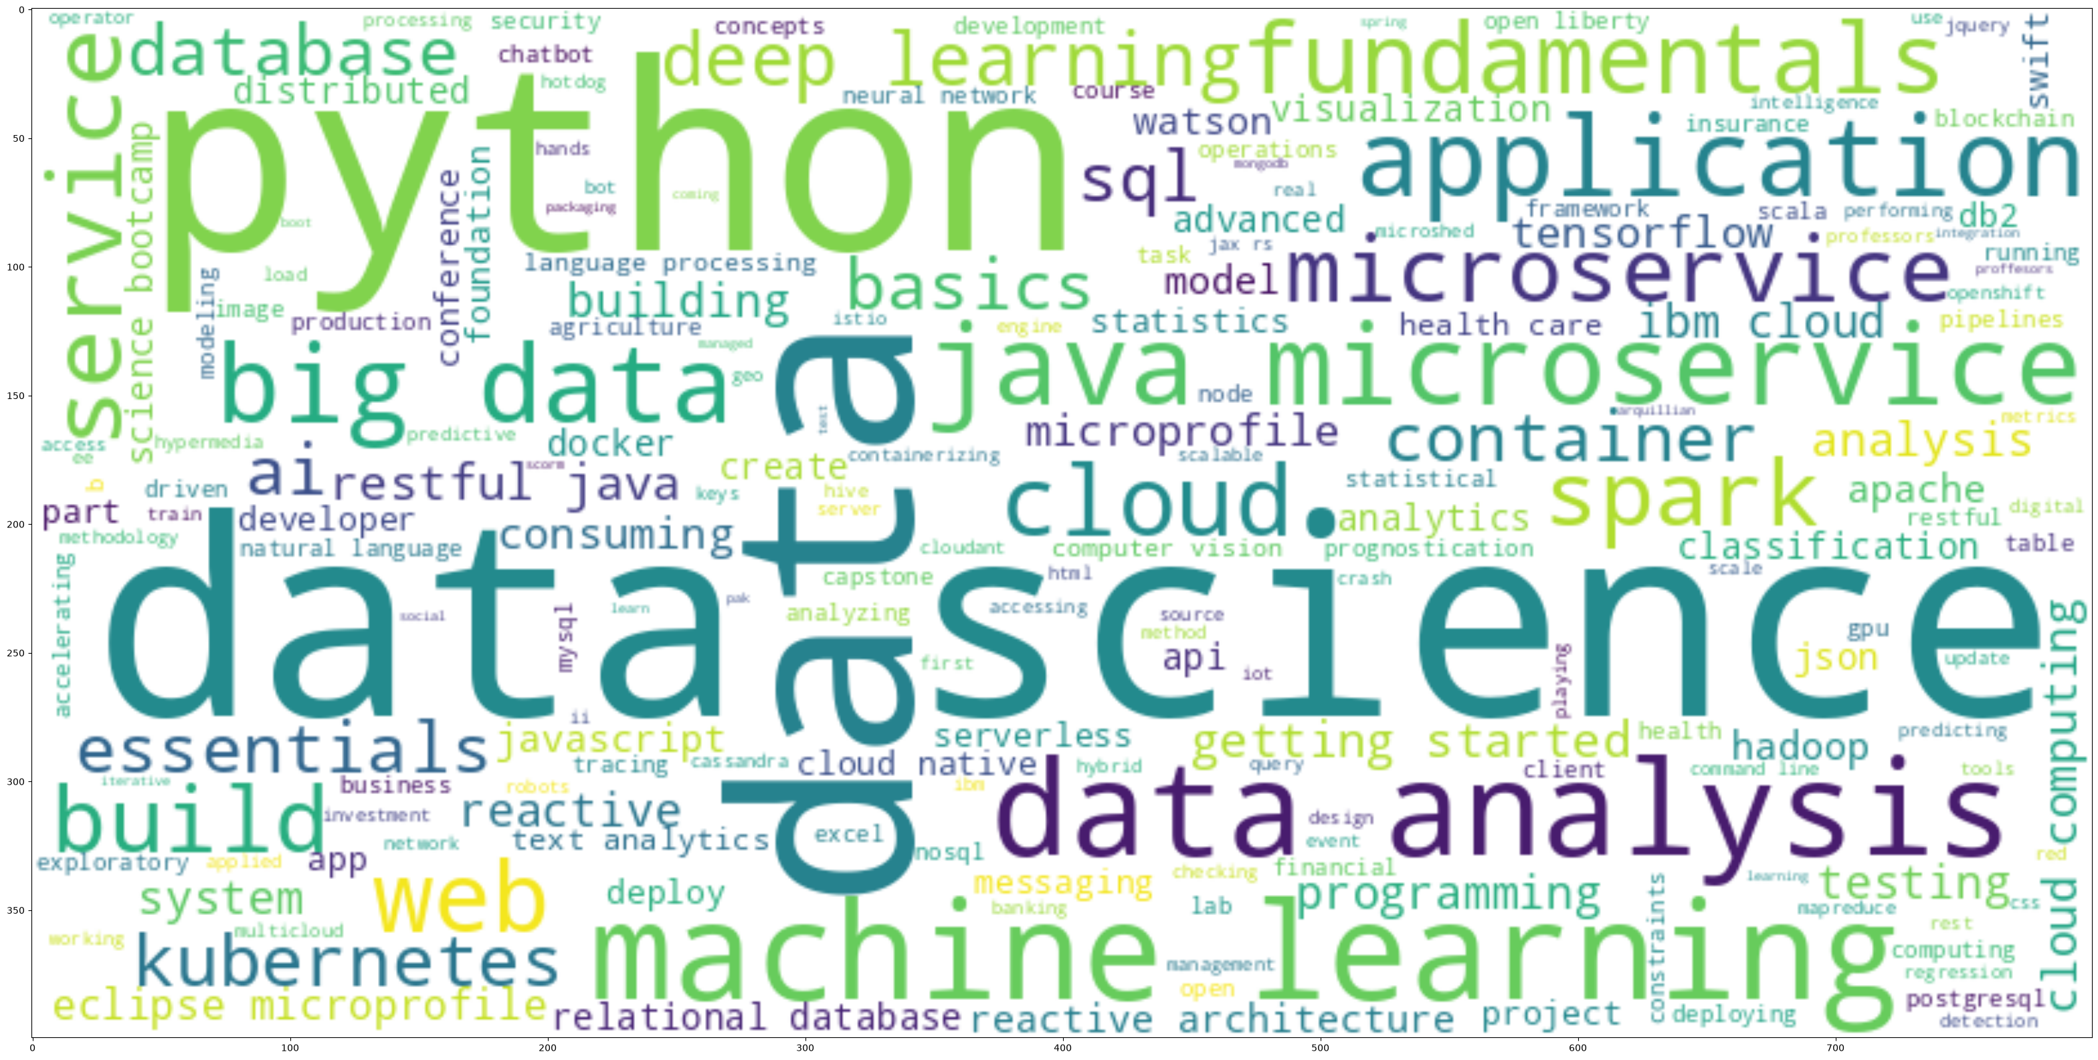
WORD CLOUD OF COURSE TITLES
How it was built
All course titles were combined into one text block, and common filler words ("getting started", "using", "enabling", "template", "university", "end", "introduction", "basic") were removed before generating the cloud.
What it shows
The catalog is dominated by IT and data skills — python, data science, machine learning, big data, ai, tensorflow, container, cloud — confirming the courses are focused on in-demand tech topics.

Slide 7
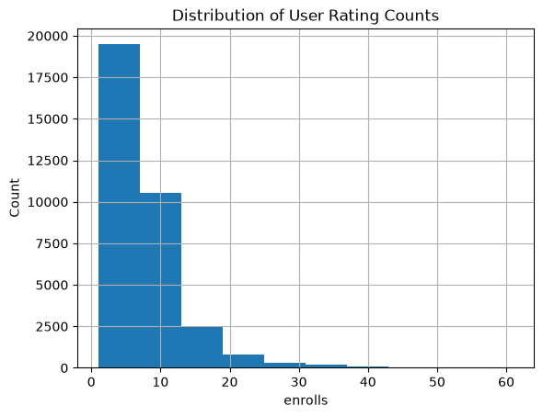
COURSE GENRE & ENROLLMENT ANALYSIS
Course counts per genre
Distribution of user enrollment counts
33,901 learners in the dataset
Average of 6.88 courses enrolled per learner (std 5.82)
Half of all learners enrolled in 6 or fewer courses; the most active learner enrolled in 61

Slide 8
20 MOST POPULAR COURSES
# | Course | Ratings
1 | python for data science | 14,936
2 | introduction to data science | 14,477
3 | big data 101 | 13,291
4 | hadoop 101 | 10,599
5 | data analysis with python | 8,303
6 | data science methodology | 7,719
7 | machine learning with python | 7,644
8 | spark fundamentals i | 7,551
9 | data science hands on with open source tools | 7,199
10 | blockchain essentials | 6,719
# | Course | Ratings
11 | data visualization with python | 6,709
12 | deep learning 101 | 6,323
13 | build your own chatbot | 5,512
14 | r for data science | 5,237
15 | statistics 101 | 5,015
16 | introduction to cloud | 4,983
17 | docker essentials — a developer introduction | 4,480
18 | sql and relational databases 101 | 3,697
19 | mapreduce and yarn | 3,670
20 | data privacy fundamentals | 3,624

Slide 9
RESULTS
Successfully explored and analyzed the online course dataset.
Generated course recommendations using content-based filtering, collaborative filtering, and neural network approaches.
Built course similarity and user profile models to recommend relevant courses.
Grouped users with similar interests using clustering techniques.
Learned user and course embeddings to capture interaction patterns.
Trained regression and classification models using the learned embeddings to predict course ratings and recommendation outcomes.
Compared different recommendation techniques to understand their strengths and how they generate personalized recommendations.

Slide 10
CONTENT-BASED RECOMMENDER — USER PROFILE WORKFLOW
1. Build user profile vector = dot product of the user's rating vector and the course genre matrix
2. For each test user, find their unseen / not-yet-enrolled courses
3. Get the genre vectors for those unseen courses
4. Recommendation score = dot product of user profile vector and course genre vector
5. Apply a recommendation score threshold (10.0)
6. Recommend the courses that score above the threshold

Slide 11
USER PROFILE-BASED RECOMMENDER — EVALUATION RESULTS
Average new courses recommended per user
Top-10 most frequently recommended courses
60.82
Course | Users recommended to
TA0106EN | 17,390
excourse21 | 15,656
excourse22 | 15,656
GPXX0IBEN | 15,644
ML0122EN | 15,603
excourse04 | 15,062
excourse06 | 15,062
GPXX0TY1EN | 14,689
excourse73 | 14,464
excourse72 | 14,464
Computed across all test users, using a recommendation score threshold of 10.0

Slide 12
DIAGRAMMATIC WORKFLOW OF SYSTEM
Course Dataset
Data Exploration
Feature Engineering (BoW)
Recommendation Models
(Content-Based · Clustering · Collaborative Filtering · Neural Collaborative Filtering)
Course Recommendations

Slide 13
CONTENT-BASED RECOMMENDER — COURSE SIMILARITY WORKFLOW
1. Turn each course's text (title + description) into Bag-of-Words features
2. Compute a course-to-course similarity matrix from those features (0 = unrelated, 1 = identical)
3. For a test user, split their courses into enrolled vs. unseen
4. Compare every unseen course against each enrolled course using the similarity matrix
5. Keep unseen courses whose similarity score is above the threshold (0.4)
6. Sort the matches by similarity score and return them as recommendations

Slide 14
COURSE SIMILARITY-BASED RECOMMENDER — EVALUATION RESULTS
Average new courses recommended per user
Top-10 most frequently recommended courses
49.68
Course | Times recommended
excourse32 | 27,188
excourse68 | 26,358
excourse67 | 25,932
excourse74 | 25,639
excourse23 | 25,556
excourse36 | 25,556
excourse38 | 24,510
excourse33 | 24,339
excourse04 | 24,277
DS0110EN | 23,909
Computed across all test users, using a similarity threshold of 0.4

Slide 15
COMPARATIVE INSIGHTS ACROSS CONTENT & COLLABORATIVE FILTERING
Content-Based Filtering | Collaborative Filtering
Recommends courses based on course features. | Recommends courses based on user interactions and ratings.
Good when course information is available. | Good for personalized recommendations.
Uses course similarity. | Uses similarities between users and their preferences.
Can recommend newly added courses. | Needs historical user interaction data.
Does not depend on other users' ratings. | Learns from patterns in user behavior.

Slide 16
CLUSTERING-BASED RECOMMENDER — WORKFLOW
1. Start with user profile vectors (33,901 users × 14 course-genre features)
2. Normalize features with StandardScaler (mean 0, std 1)
3. Reduce dimensions with PCA — 5 components capture ~90% of the variance
4. Find the optimal number of clusters with the elbow method → k = 6
5. Fit KMeans(k=6) and assign every user a cluster label
6. For a test user: match to a cluster, then recommend that cluster's popular unseen courses

Slide 17
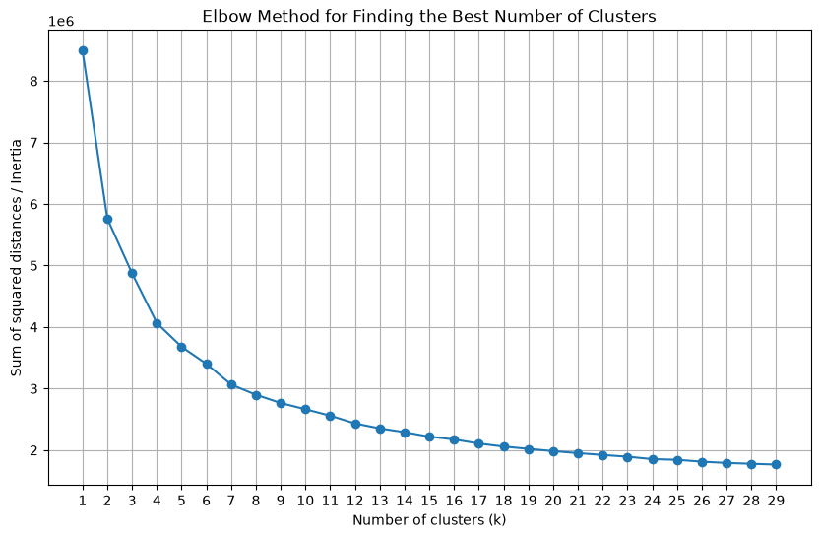
CLUSTERING-BASED RECOMMENDER — EVALUATION RESULTS
PCA components | Explained variance
1 | 52.1%
2 | 70.4%
3 | 81.7%
4 | 86.4%
5 (chosen) | 90.1%
Final result
33,901 users were grouped into 6 clusters (k = 6), using the top 5 PCA components that preserve ~90% of the original variance in user learning-interest profiles.
Elbow method used to pick the number of clusters (k)

Slide 18
KNN COLLABORATIVE FILTERING — WORKFLOW
1. Build the user-item rating matrix from all course enrollments
2. Split ratings into a train set and a test set
3. Fit KNNBasic() on the train set to find each user's nearest neighbors
4. For a target user-course pair, find the k most similar neighbors who rated that course
5. Predicted rating = similarity-weighted average of those neighbors' ratings
6. Evaluate on the test set → RMSE = 1.2900

Slide 19
NMF COLLABORATIVE FILTERING — WORKFLOW
1. Build the user-item rating matrix (31,311 users × 124 items in the training set)
2. Split ratings into a train set and a test set
3. Factorize the matrix into a User latent matrix U and an Item latent matrix I (non-negative)
4. Minimize squared error between actual and predicted ratings using SGD over 50 epochs
5. Predicted rating = dot product of user vector u_j and item vector i_k
6. Evaluate on the test set → RMSE = 1.3047

Slide 20
NEURAL NETWORK EMBEDDING-BASED RECOMMENDER — WORKFLOW
1. Encode each user as a one-hot vector (33,901 users)
2. Encode each course as a one-hot vector (126 items)
3. Pass both through Embedding layers (embedding size = 16) to get latent vectors
4. Combine the user and item embedding vectors with a dot product
5. Output: predicted rating
6. Trained for 10 epochs and evaluated on the test set → RMSE = 0.4492 (loss 0.2050)

Slide 21
MODEL PERFORMANCE COMPARISON
What the numbers say
KNN: RMSE 1.2900
NMF: RMSE 1.3047
Neural Network: RMSE 0.4492
The neural network's much lower RMSE partly reflects a different train/test split and rating scale than the Surprise-based KNN and NMF models, so the gap shouldn't be read as a like-for-like improvement — but among KNN and NMF specifically, KNN performed marginally better on this dataset.

Slide 22

LIVE DEMO LINK:
Steamkit: https://personalized-course-recommender-system-74bhfr6ufblqnrwrypn5nu.streamlit.app/

Slide 23
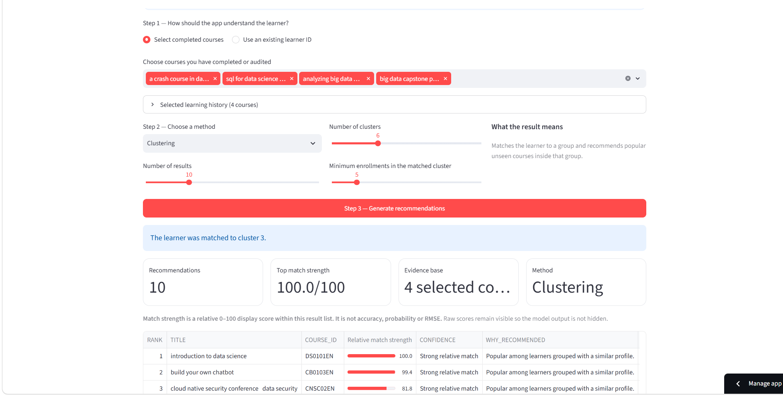
DASHBOARD TAB 1 - GET RECOMMENDATIONS

Slide 24
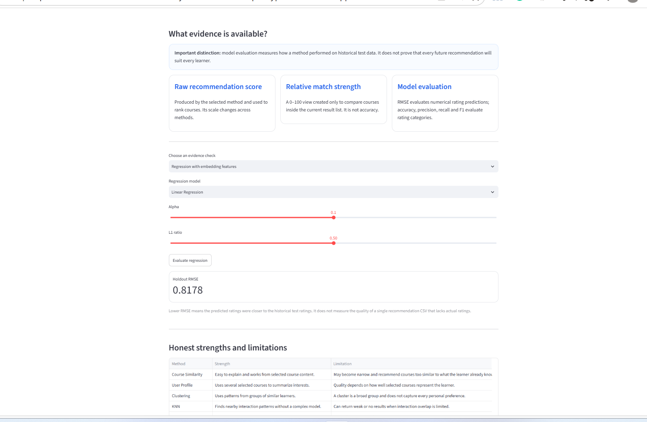
DASHBOARD TAB 2 – EVIDENCE & LIMITATIONS

Slide 25
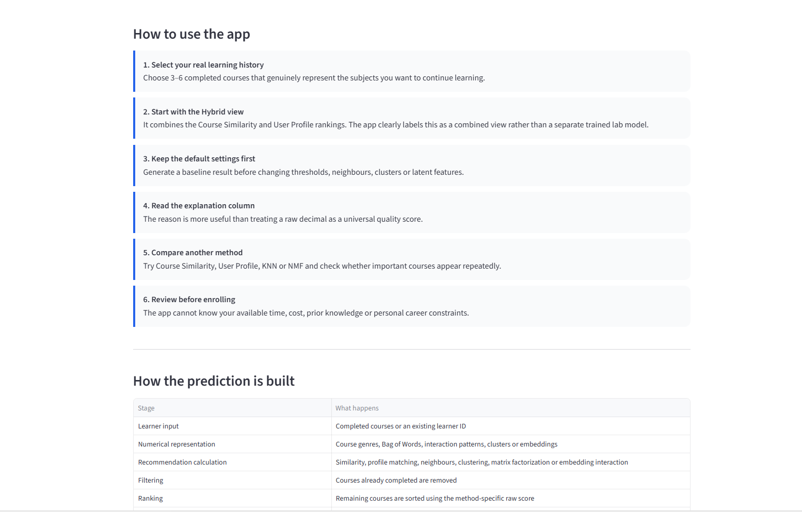
DASHBOARD TAB 3 – BEGINNER FRIENDLY GUIDE

Slide 26
DISCUSSION
The above screenshots shows the live demo of the course recommender system app that is deployed in streamlit by giving the system different type of courses and by using those courses user can get the personalized suggestions that which course he should do that matches his interest
First screenshot shows that the user can get personalized recommendation on which courses he should do in future based on his previously completed courses by selecting different models and tuning hyperparameters
The second screenshot shows the evidence behind the predictions which the model gives in the form metric like RMSE and the honest strengths and limitations of the system
The third screen screenshot shows the beginner friendly guide on how to use the app step by step and how the predictions are actually build.

Slide 27
OVERALL FINDINGS & IMPLICATIONS
Findings
Implications
Different recommendation methods produced different course rankings because each uses different learner information.
Content-based methods worked by recommending courses similar to the learner's completed courses.
Collaborative filtering methods used patterns from many learners instead of only course content.
Embedding-based models learned compact numerical representations of users and courses.
Model evaluation showed that prediction quality should be measured using appropriate metrics such as RMSE, Accuracy, Precision, Recall, and F1 Score.
There is no single method that is best for every learner or situation.
These methods are easy to understand and useful for learners with a clear learning history.
Recommendations can become more personalized when enough user interaction data is available.
Learned embeddings can capture relationships that are difficult to represent with manual features.
Evaluation metrics help compare models objectively, but final recommendations should still be reviewed by the learner.

Slide 28

CONCLUSION
Successfully developed and deployed a machine learning–based Course Recommender System.
Applied data preprocessing, recommendation algorithms, and model evaluation to generate personalized course recommendations.
Built an interactive application that makes the recommendation process simple and user-friendly.
Demonstrated the practical use of machine learning in solving a real-world recommendation problem.

Slide 29
APPENDIX
Executive summary
Introduction
Methodology
Word Cloud of Course Titles
Course Genre & Enrollment Analysis
Most Popular Courses
Results
Content-Based Recommender — User Profile
Diagrammatic Workflow of System
Content-Based Recommender — Course Similarity
Comparative Insights
Clustering-Based Recommender
KNN Collaborative Filtering
NMF Collaborative Filtering
Neural Network Recommender
Model Performance Comparison
Live Demo Link
Dashboard Screenshots
Discussion
Overall Findings & Implications
Conclusion

