Slide 1
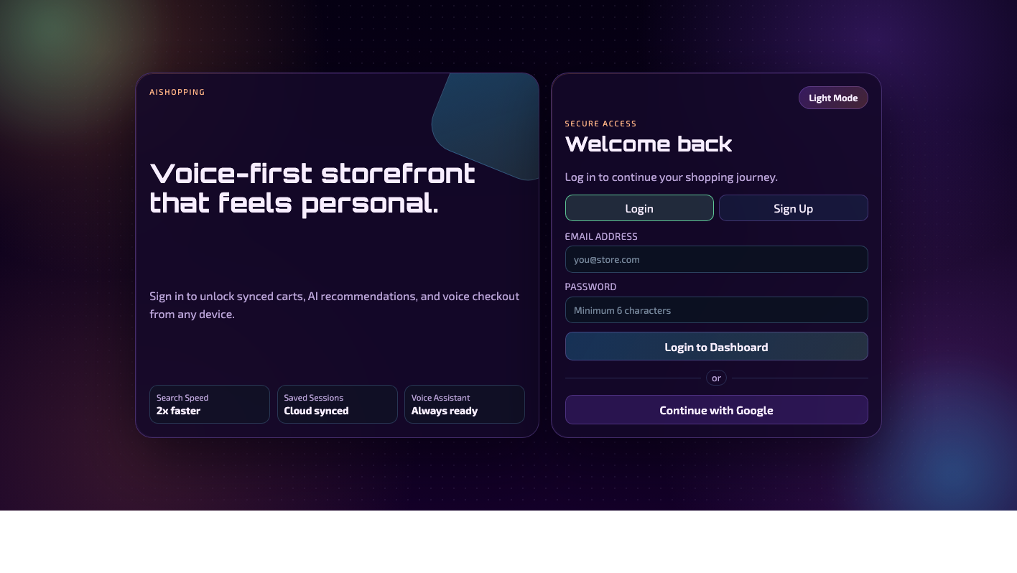
INT428 PROJECT DECK
Powered Shopping
Voice-powered AI shopping concierge
A redesigned presentation built from the live codebase,
with format cues borrowed from the INT428 manual and patent template.
React + Vite
Express + Firebase
OpenAI + Voice UX
Live application snapshot used as presentation evidence

Slide 2
Problem, Objective, Novelty, Advantage
PROBLEM
OBJECTIVE
Online shopping is crowded, manual, and not voice-native.
Let users search, recommend, add, and checkout through natural commands.
NOVELTY
ADVANTAGE
AI tool-calling is paired with deterministic fallbacks and voice recovery.
The system still works when APIs, speech services, or Firestore fail.
02 | Powered Shopping | INT428 format

Slide 3
Scope and project fit
MANDATORY FIT
OPTIONAL WINS
Clear domain: e-commerce voice shopping assistant
Session memory through history and last-category recall
Uses Generative AI API for assistant chat and transcription
Voice fallback recording when browser speech fails
Domain-constrained tools: products, cart, checkout, recommendations
Firebase authentication and optional Firestore cart persistence
Working prototype with frontend and backend
Responsive UI already visible on desktop and mobile
03 | Powered Shopping | INT428 format

Slide 4
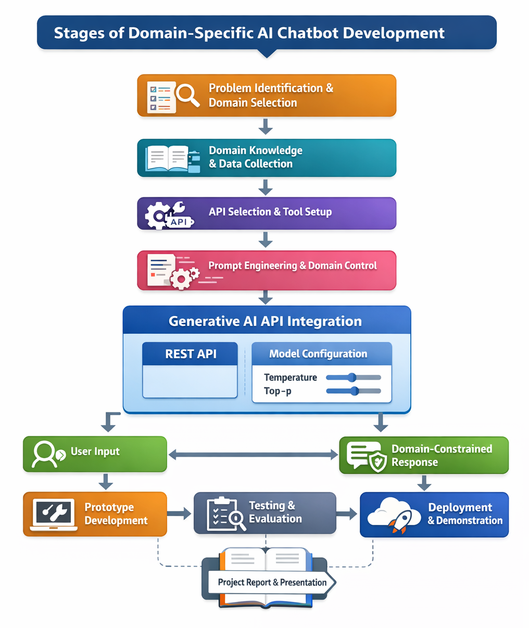
Development stages
01 Problem identification
02 Domain knowledge and shopping intents
03 API selection: OpenAI, Firebase, FakeStore
04 Prompt control plus tool-calling workflow
05 Prototype, testing, and demo-ready evidence
Visual structure adapted from the uploaded INT428 manual.
04 | Powered Shopping | INT428 format

Slide 5
System architecture
CLIENT
BACKEND
AI LAYER
DATA
React + Vite UI
Express routes
Tool-calling assistant
FakeStore + mock JSON
Voice + text command entry
Controllers + services
Whisper transcription
Firestore or memory cart
Firebase auth gate
Standardized API responses
Deterministic parser fallback
Browser storage preferences
05 | Powered Shopping | INT428 format

Slide 6
Core feature set
Voice control
Typed fallback
Smart catalog
Live speech, continuous mode, and spoken replies.
Manual commands and quick prompts for reliable demos.
Search by text, category, brand, price, and rating.
Recommendations
Cart + checkout
Resilience
Trending and similar suggestions from the backend.
Add, remove, summarize, and simulate payment flow.
Mock data, in-memory cart, and local parser fallback.
06 | Powered Shopping | INT428 format

Slide 7
API, model, and runtime configuration
LLM and assistant layer
System controls and fallbacks
OpenAI chat endpoint with tool-calling
Catalog timeout: 1200 ms before fallback
Default chat model: gpt-4o-mini
Product cache TTL: 5 minutes
Transcription model: whisper-1
Firestore cart if configured, memory cart otherwise
Temperature explicitly set to 0.2
Browser speech first, recorder fallback second
Server-side tool loop limit: 6
Auth handled by Firebase email/password + Google
07 | Powered Shopping | INT428 format

Slide 8
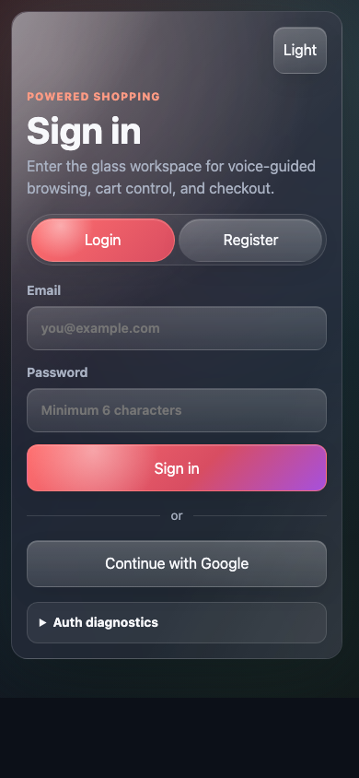
Interface evidence
Auth-first flow
Clean glass-style UI
Responsive mobile layout
08 | Powered Shopping | INT428 format

Slide 9
Stack and project scale
46
source files analyzed
10,211
approximate lines analyzed
3
major external integrations
Frontend
React 18, Vite 5, Firebase 11
Backend
Node.js, Express 4, firebase-admin
AI
Chat completions, Whisper, tool-calling
Ops
npm dev flow, local env files, mock fallbacks
09 | Powered Shopping | INT428 format

Slide 10
Evaluation readiness and next actions
WHAT SCORES WELL
FIX NEXT
Problem clarity: voice-first e-commerce assistant
Sanitize env example files before submission
Technical depth: frontend, backend, AI, auth, persistence
Align port docs with actual runtime defaults
Demo value: visible UI plus search-cart-checkout workflow
Add baseline automated tests for parser, cart, and APIs
Academic alignment: domain, API use, model awareness, presentation evidence
Prepare one clean end-to-end demo account path
10 | Powered Shopping | INT428 format

Slide 11
DEMO MESSAGE
One storefront,
multiple graceful fallbacks.
Q&A
Project walkthrough
Architecture decisions
Fallback strategy
The strongest story for presentation is simple:
auth, search, recommendations, cart action, and checkout by voice or text.
Future improvements
Powered Shopping | Styled deck generated from project analysis

