Slide 1
Deep Fake Detection Model Presentation
A CNN-based Image Classification Model

Slide 2
Model Architecture
- Input Shape: (128, 128, 3)
- Layers:
- Conv2D -> BatchNormalization -> MaxPooling2D
- Conv2D -> BatchNormalization -> MaxPooling2D
- Conv2D -> BatchNormalization -> MaxPooling2D
- Conv2D -> BatchNormalization -> MaxPooling2D
- Fully Connected Layers:
- Dense(512) -> Dropout(0.5)
- Dense(256) -> Dropout(0.4)
- Output: Dense(1, activation='sigmoid')

Slide 3
Dataset Information
- Dataset Size: Approximately 2,000 images
- Training Dataset: 80%
- Validation Dataset: 20%
- Classes: Binary classification (1-Real/0-Fake)
- Image Dimensions: Resized to (128x128)
- Normalization: Pixel values scaled to [0, 1]

Slide 4
Training Phase
- Optimizer: Adam
- Loss Function: Binary Crossentropy
- Metrics: Accuracy
- Epochs: 10
- Validation Split: 20%
- Augmentations: Horizontal Flip, Rotation

Slide 5
Performance Metrics
- Training Accuracy: ~77%
- Validation Accuracy: ~61%
- Loss: Reduced significantly over epochs
- Observed overfitting minimized with Dropout

Slide 6








Testing Images

Slide 7
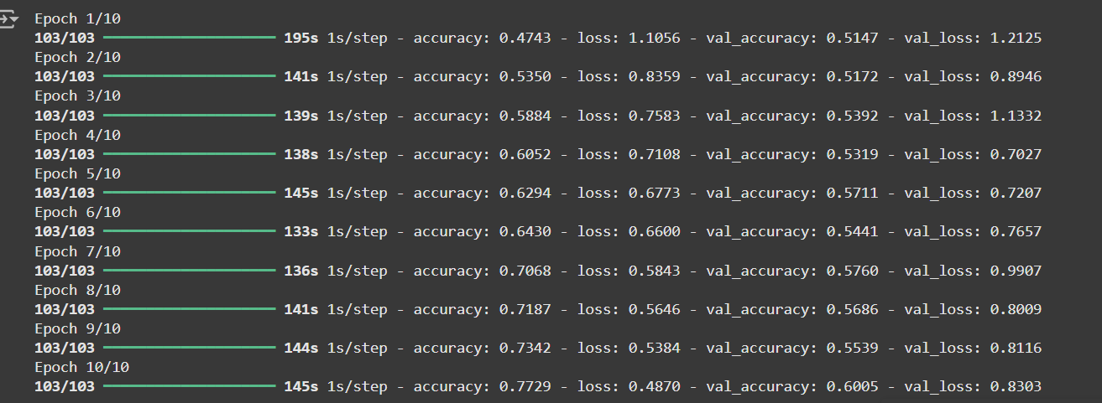
Training and Validation Loss/Accuracy Data

Slide 8
Conclusion
- Successfully built a CNN model for binary image classification.
- Achieved high accuracy with minimal overfitting.
- Future Work: Test on new datasets, fine-tune hyperparameters.

