Slide 1

INTRODUCTION
Universal Bank
Growing its customer base rapidly
480( 9.6%) of people previous campaign
The goal : customers who are most likely to accept the loan offer in future emailings.
My focus :
  gain experience in banking loan campaign
  develop a model which identifies potential customers

Slide 2
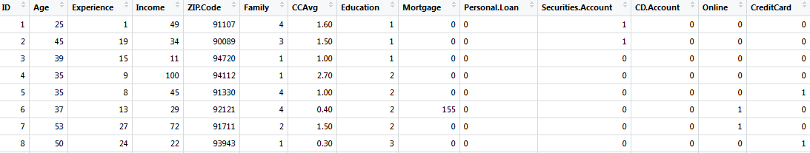
DATASET
‘Universal Bank’ data
13 variables / 5000 records
  Age
  Experience
  Income
  ZIP Code
  Family
  CCAvg(Cash Credit)
  Education
  Mortgage
  Securities Account
  CD Account(Certficiate of deposit)
  Online
  Credit Card

Slide 3

IMPLEMENTATION
Binary classification problem
Class attribute: Personal Loan (0 or 1)
  Number of class 0 : 4520
  Number of class 1 : 480
  Importing data into R
  Check whether dataset includes ‘NA’
  Apply set.seed()
  Try 50 different seed numbers
  Train data: 70% of dataset
  Test data: 30% of dataset
  Tree package in R consider Gini Index

Slide 4
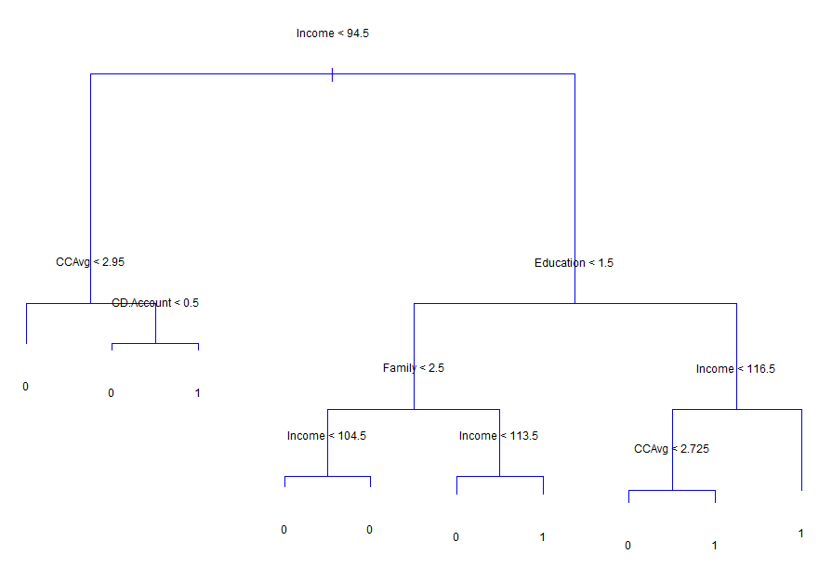
DECISION TREE
Attributes in decision tree
Income
CCAvg
Family
Education
CD account

Slide 5
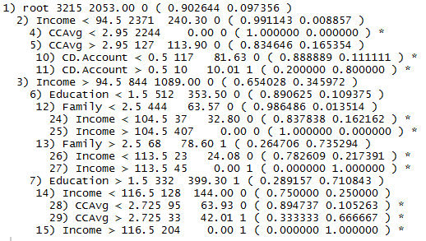
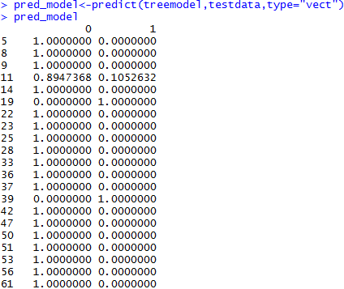
IMPLEMENTATION
Check how this decision tree model performs using the test data
Summary of decision tree
  branch of attributes
  number of instances in the node
  deviance
  probability of being 1 or 0.

Slide 6

EVALUATION
Performance measures: Accuracy, Precision, Recall
Recall rate is vital for my objective
Run 50 times(different seed numbers)
Confusion matrix
SEED | ACCURACY | RECALL | PRECISION
48 | 98.768% | 91.128% | 99.070%
4 | 98.711% | 92.215% | 99.198%
29 | 98.711% | 91.820% | 99.201%
Average performance measures on this dataset:
  Average accuracy of 50 replications: 98.376 %
  Average recall of 50 replications: 87.809 %
  Average precision of 50 replications: 98.694 %

Slide 7
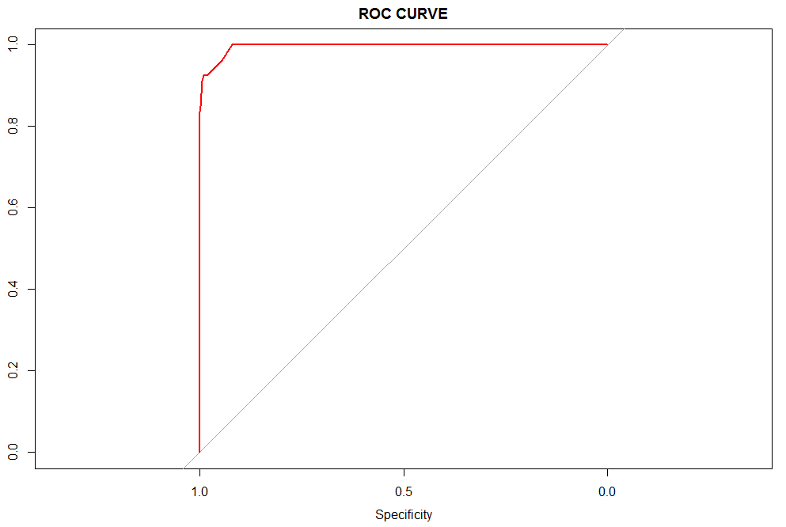
EVALUATION
ROC curve
Area under ROC curve model’s accuracy
AUC: 99.6 %

