Slide 1
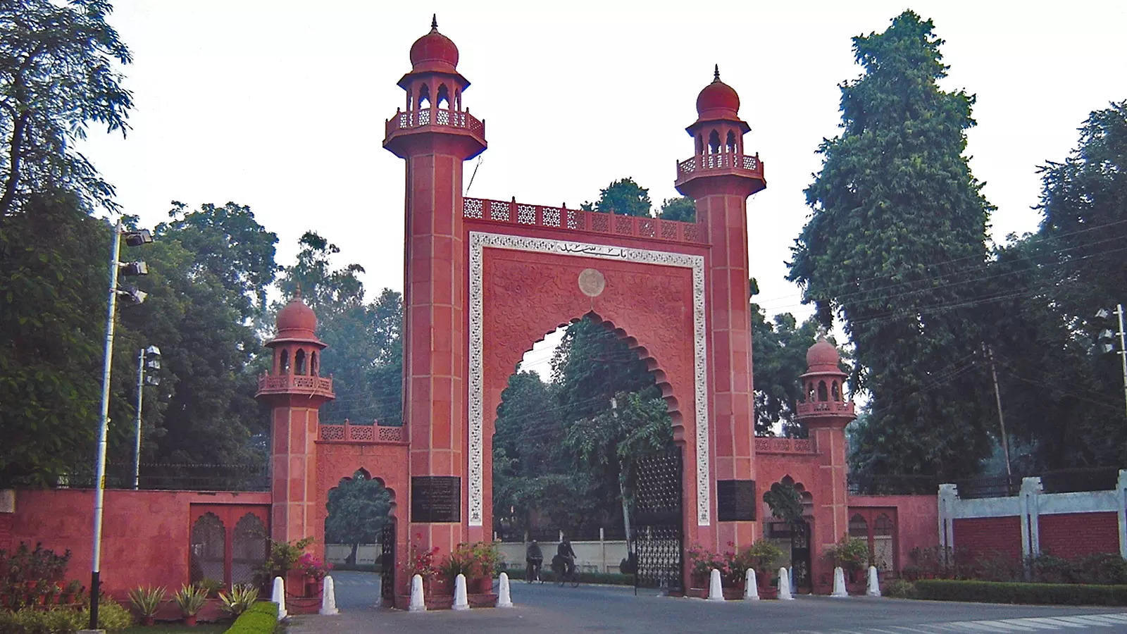

Aligarh Muslim University
ANNUAL MAGAZINE
2026-27

