Slide 1
Artificial Intelligence in Everyday Life
How AI is changing the way we live, work and learn

Slide 2
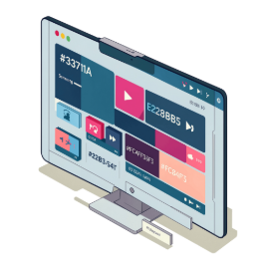
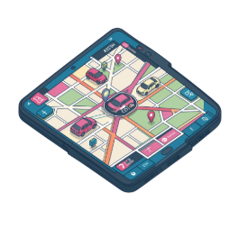
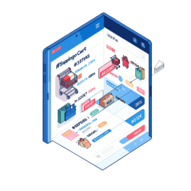
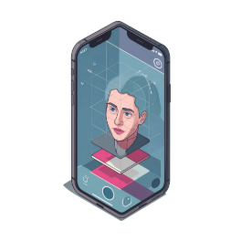
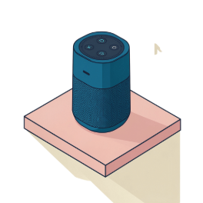
AI Around Us
🎬 Entertainment
🚗 Transportation
🛒 Shopping
Product recommendations and customer-service chatbots
Personalized movies, music and video recommendations
Navigation, traffic prediction and driver-assistance systems
📱 Smartphones
🏠 Smart Homes
Voice assistants, face recognition and predictive text
Smart speakers, cameras and automated appliances

Slide 3
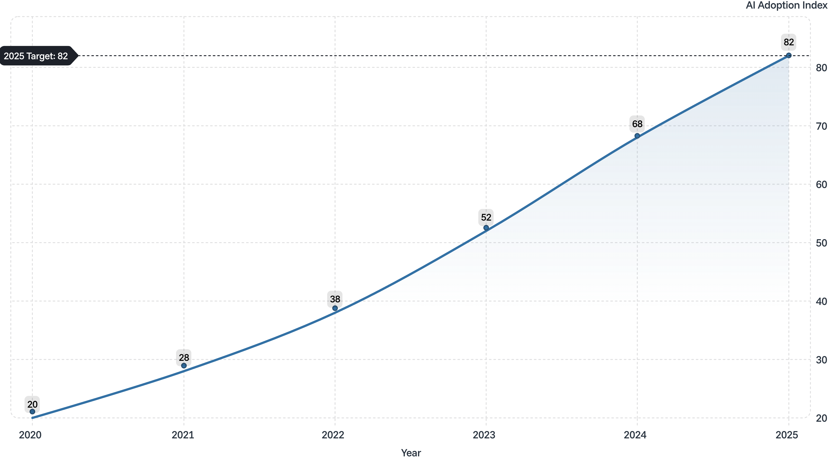
The Growth of Artificial Intelligence
The illustrative AI Adoption Index climbs steadily from 20 in 2020 to 82 in 2025,
reflecting how rapidly AI technologies are being integrated into daily life across
industries and households worldwide.

Slide 4
AI: Benefits vs. Challenges
Benefits
Challenges
✅ Saves time
⚠️ Privacy concerns
✅ Automates repetitive work
⚠️ Job displacement
✅ Personalized services
⚠️ Bias and unfair decisions
✅ Helps analyze large amount data
⚠️ Incorrect information
✅ Supports learning and creativity
⚠️ Cybersecurity risks

Slide 5

What Does the Future Hold?
More Integration
AI will become more integrated into everyday devices.
Human–AI Collaboration
Human–AI collaboration will become increasingly important.
Responsible Use
Responsible use of AI will require privacy, security and ethical standards.
Future-Ready Skills
Learning AI skills can help students prepare for future careers.

Slide 6
THANK YOU

