Slide 1








Mental Health and Sleep Patterns - Health

Slide 2
Table of contents
01
02
03
Introduction
Identification
Cause & Results

Slide 3
Team of Project
Asghar Ali (22K-4415) | Web Development
Abdullah Shafique (22K-4489)
Muhammad Bilal (22K-4242)
Muhammad Bilal (22K-4242) | Report Writting
Ali Kahful Wara (19K1066) | PPT Desgining
Asad Irfan (22k-4276)
Zain Baig (22k-4593 | Population Survey

Slide 4


01
Introduction

Slide 5
Learning about Mental Health, Sleeping Patterns and their Relation
Interconnected Nature: Mental health and sleep are integral components of our overall well-being. A disruption in one can adversely affect the other, forming a bidirectional relationship.
Epidemic of Mental Health Issues: In contemporary society, there is a growing prevalence of mental health issues, ranging from stress and anxiety to more severe conditions like depression and PTSD.
Rising Sleep Disorders: Concurrently, sleep disorders are on the rise, with a significant portion of the population experiencing disruptions in their sleep patterns, contributing to a cycle of mental health challenges.
Public Health Concern: Recognizing the coexistence of mental health issues and sleep disorders is crucial in addressing a public health concern, demanding comprehensive approaches to develop effective strategies for overall well-being.

Slide 6
Relationship Between Students, stress and sleep.
Balancing academic pressures often leads to irregular sleep patterns and potential sleep deprivation.
Elevated stress levels can disrupt sleep, creating a cyclical relationship that challenges a student's mental and physical health.
Inadequate sleep contributes to heightened stress levels, impacting academic performance and overall well-being.
1

Slide 7

Pittsburg Sleep Quality index and its results

Slide 8
PSQI (Pittsburgh Sleep Quality Index)
The Pittsburgh Sleep Quality Index (PSQI) is a self-report questionnaire that assesses sleep quality over a one-month period, encompassing seven components, including sleep duration, latency, disturbances, efficiency, and overall satisfaction, providing a comprehensive evaluation of an individual's sleep quality.
Sleep Quality
Sleep Duration
Sleep Latency
Overall Sleep Quality

Slide 9
1. Subjective Sleep Quality: This category evaluates overall sleep satisfaction, with higher scores indicating poorer sleep quality. 2. Sleep Latency: It assesses how long it takes for an individual to fall asleep after going to bed. Longer sleep latency contributes to a higher score. 3. Sleep Duration: This category considers the total time spent asleep. Shorter sleep duration contributes to a higher score. 4. Sleep Efficiency: It calculates the percentage of time spent asleep while in bed. Lower efficiency, indicating more time awake in bed, leads to a higher score.
Categories of PSQI

Slide 10

PSQI analysis and results of students of FAST-NUCES

Slide 11
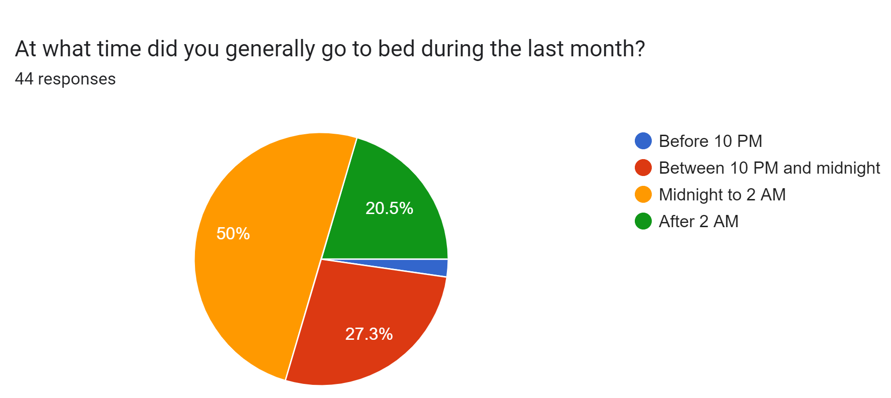
1

Slide 12
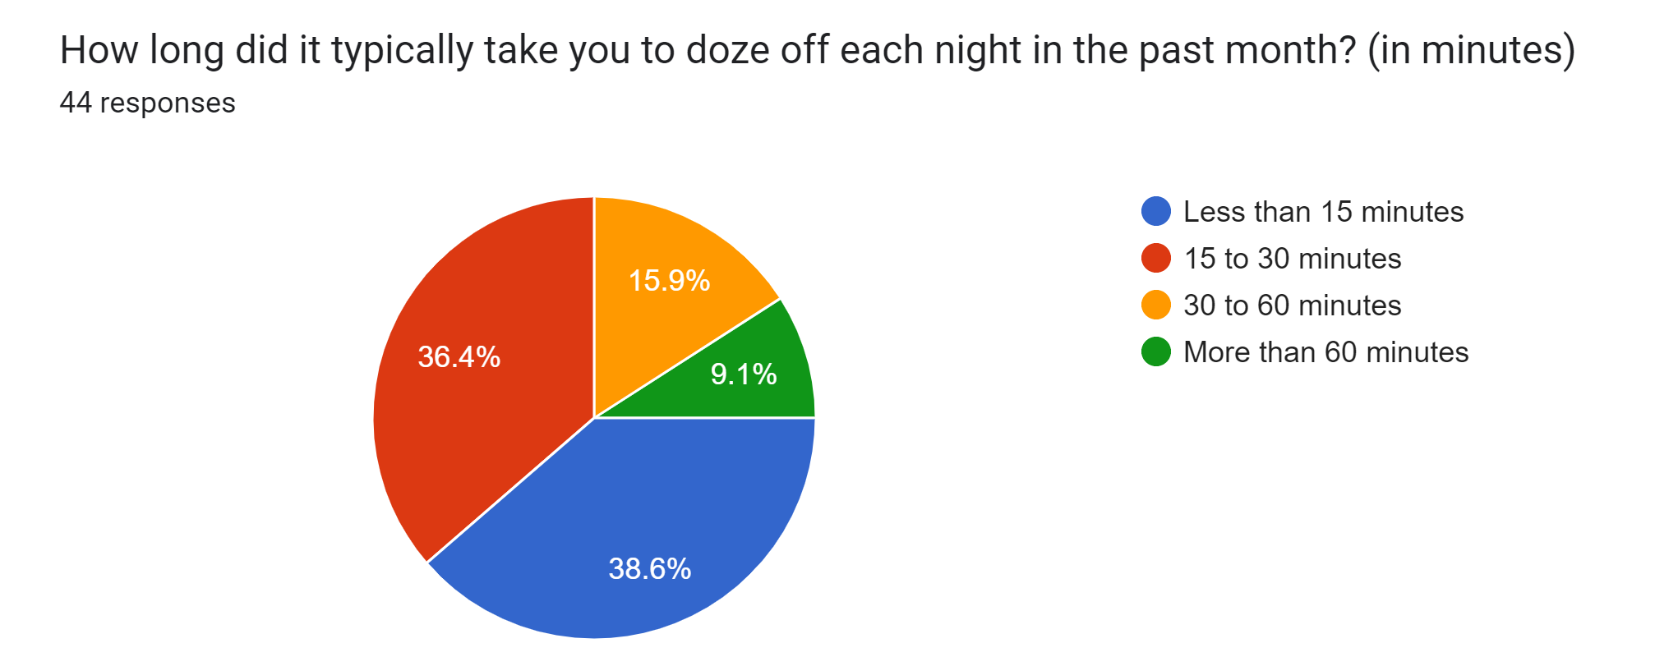
2

Slide 13
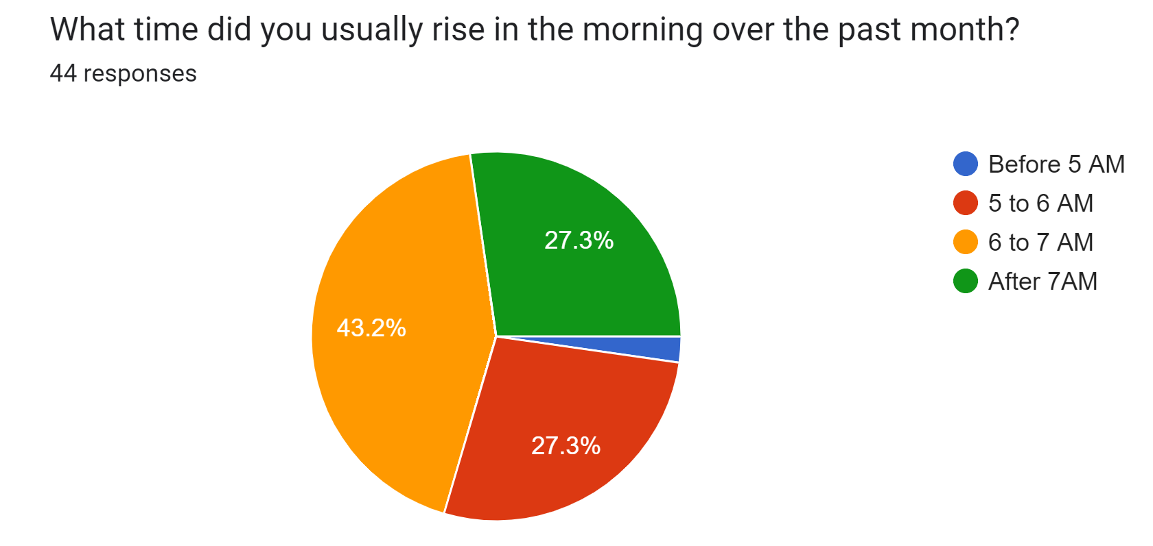
3

Slide 14
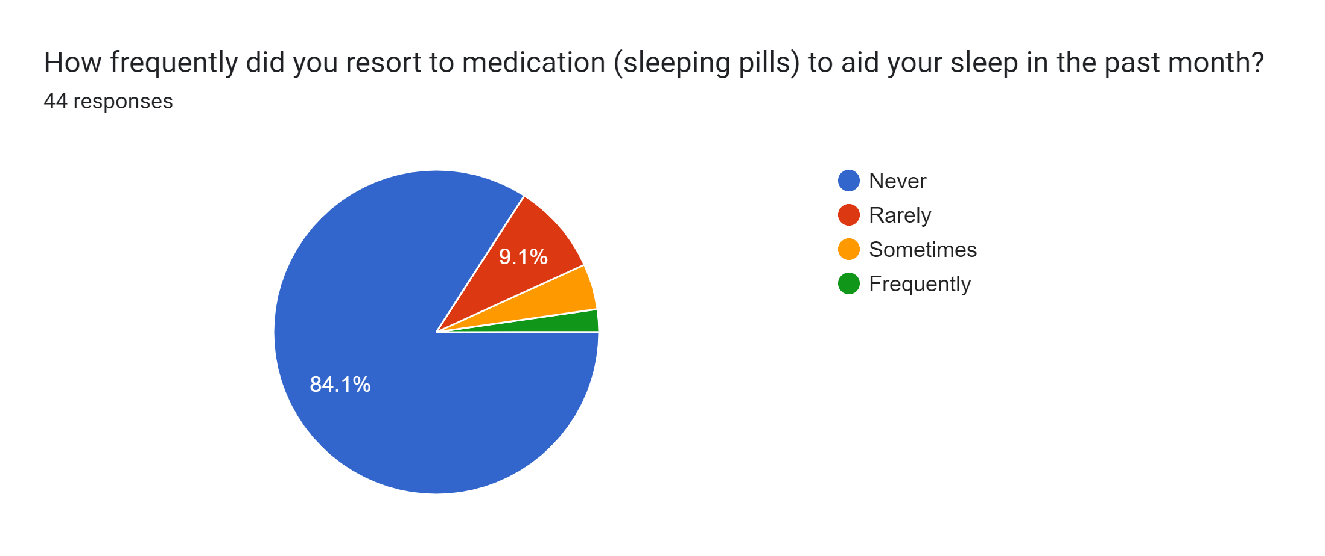
4

Slide 15
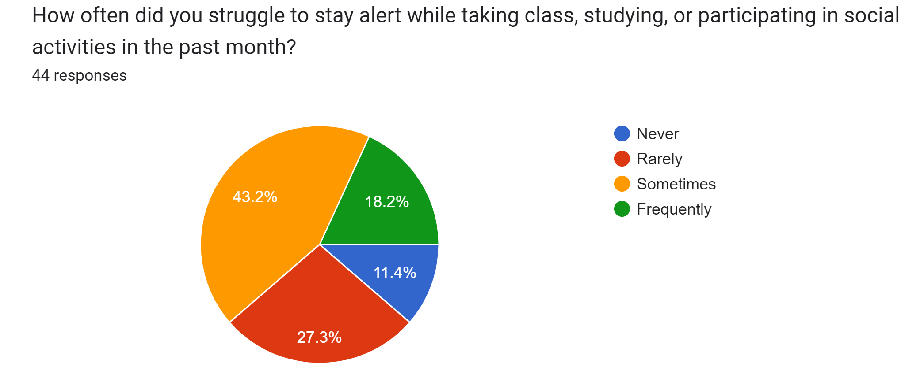
5

Slide 16
Amount of Total Bedtime of Each Participant

Slide 17
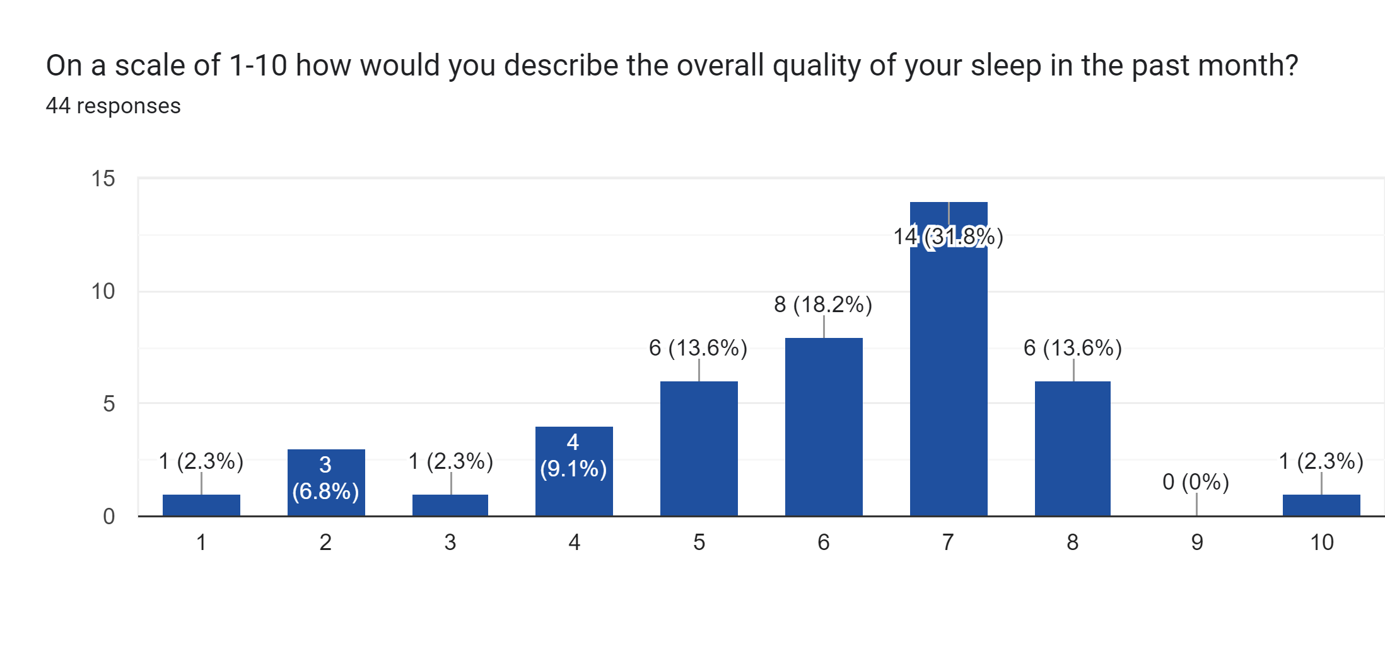

Slide 18
Results and Solutions

Slide 19
Interconnected Sleep: Factors such as stress, lifestyle choices, and overall health can also play significant roles in influencing both sleep patterns and academic/physical performance. Extended Sleep Onset (more than 60 minutes): 1. Likely experiencing sleep onset insomnia, leading to increased stress and anxiety. 2. Impact on concentration and physical performance. Healthy Sleep Onset (15 to 30 minutes): 1. Indicates a more consistent and healthier sleep pattern. 2. Positive impact on cognitive function and physical well-being, resulting in fewer struggles.

Slide 20
Sporadic Sleep Onset (rarely struggling): 1. Suggests an erratic sleep pattern with varying influencing factors. 2. Occasional challenges in concentration and engagement during studies and physical activities.

Slide 21

Results
Stress
Poor Physical Health
Abnormal Sleeping

Slide 22
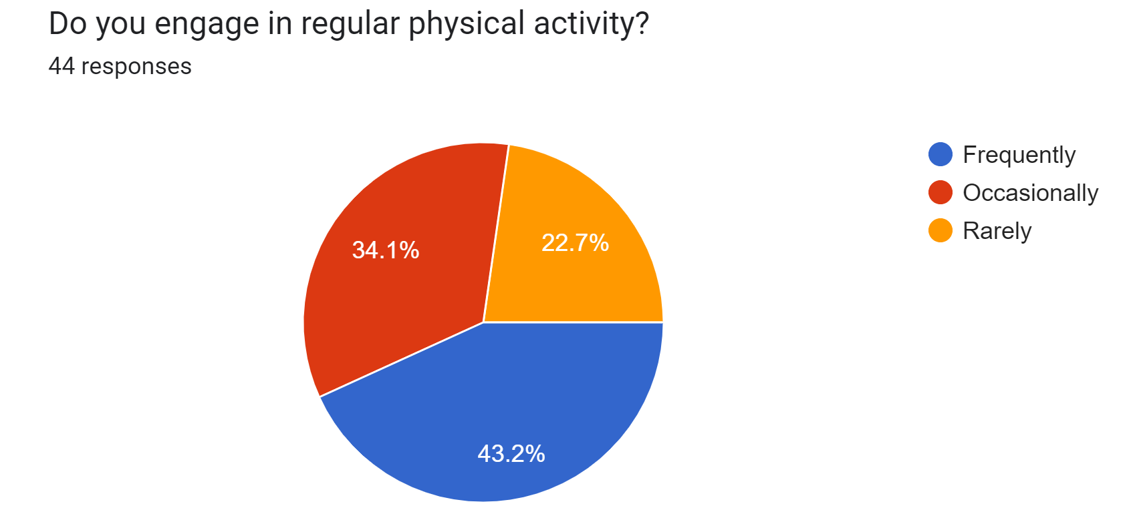
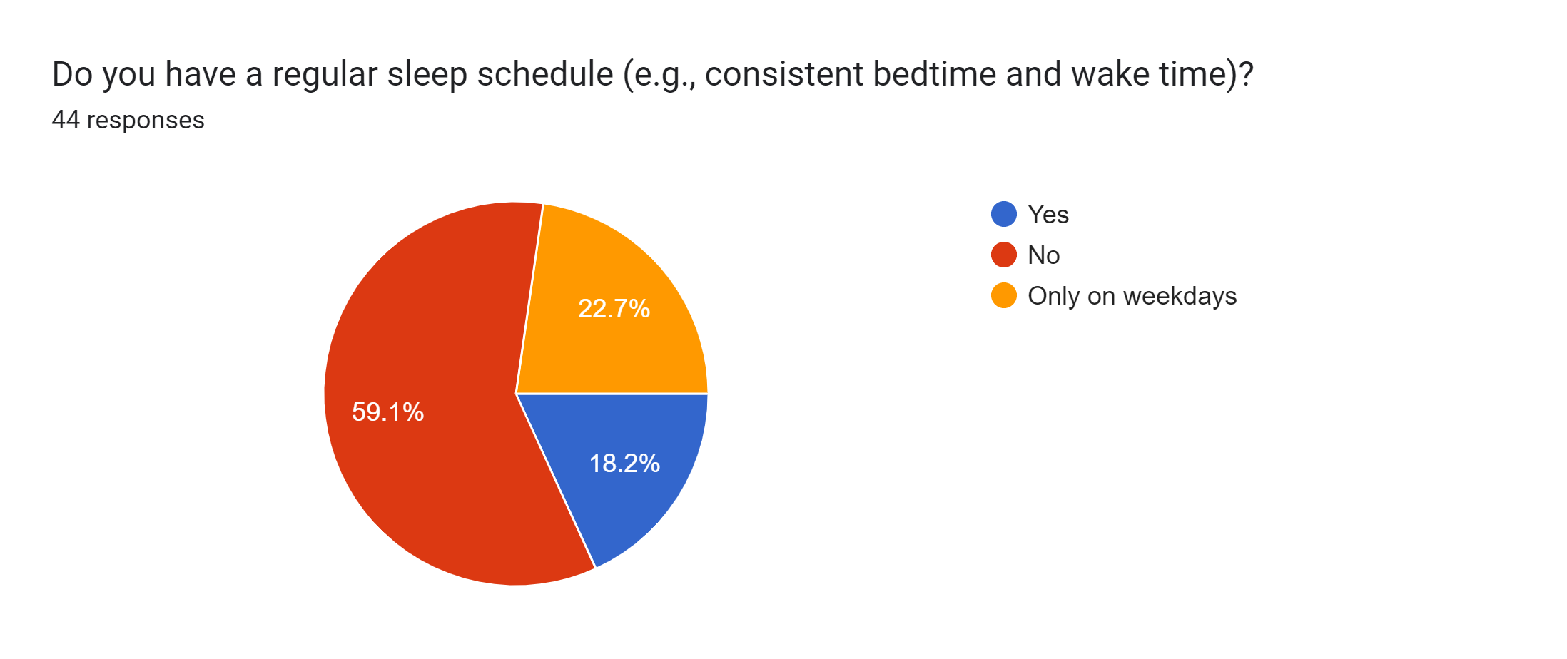
Stress, Physical Health, Abnormal Sleeping Effects to Students

Slide 23
1. Sleep Onset and Regular Sleep Schedule: The majority experiencing longer sleep onset times (Students take doze off sleep each night) results in not having regular sleep (Students Planning Sleeping Schedule). This creates hindrance in falling asleep and causes irregular sleep pattern. 2. Morning Routine and Sleep Quality: Those rising after 7 am (Students rise early in the morning) may be correlated with a lack of a sleep schedule (Students Planning Sleeping Schedule). Late waking times impact the consistency of sleep schedules. 3. Sleep Aid Usage and Sleep Quality: The majority (Students take sleeping pills) not resorting to sleeping pills aligns with those who report longer sleep onset times (Students take doze off sleep each night) , indicating a preference for natural sleep. 4. Struggles and Sleep Quality: Those who struggle with studying and (Students struggle with studying and participating in physical activities ) might be related to longer sleep onset times (Students take doze off sleep each night) , suggesting a potential impact on daily functioning.
Conclusion

Slide 24
The lecturer
Aqsa Fayyaz
Psychologist

Slide 25
Thanks!

