Slide 1
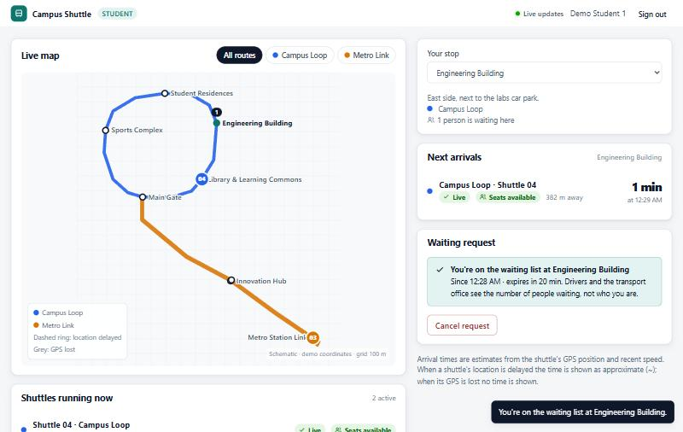
Campus Shuttle Tracking & Demand Prediction
Timely, honest shuttle information — and the demand data to plan with
Abdullah · Zuhair Halawa
BCS 305 Software Architecture · Dr. Khaled Ammar · Fall 2026
Notes:
Introduce the team and the one-sentence problem. The screenshot is the real student view of our prototype, running on a laptop.

Slide 2
Students wait blind; the office plans without data
1
Students
2
Drivers
3
Transport office
Cannot see where the shuttle is, so they wait outdoors — often in the heat — or miss it.
We give: live map, arrival times with a confidence level, "I'm waiting here".
Interrupted by calls asking where they are; blamed when GPS or mobile data fails.
We give: one-tap trips, offline-tolerant location sharing, a GPS simulator.
Sees neither the fleet nor where and when students actually wait.
We give: live operations, routes, trip tracks, demand trends and explainable forecasts.
Also affected University IT, who must run it securely and cheaply · the data-protection officer, because driver locations and student identities are personal data · university management, who fund the fleet.
Notes:
Three distinct user groups (the brief requires at least three). Also affected: university IT and the data-protection officer — location and identity data. All data in the prototype is demonstration data, not a real university.

Slide 3
The hard quality: information that is timely and honest
When GPS and mobile data are good, every viewer must see a new position within about a second.
When they fail, the system must say so — "location delayed", "GPS lost" — instead of showing a confident but wrong arrival time, and recover — delivering positions buffered during a network outage, within stated limits.
Second hard concern: privacy of location and identity data.
35 ms
20 / 60 s
p95 to 1,000 simulated viewers (local benchmark, one PC)
no position → "delayed" → "GPS lost", no ETA
10 min
9
network outage with no validated position lost (page open; tested)
measurable quality-attribute scenarios (report §2.3)
Notes:
This is the quality attribute named in our proposal. Every number here comes from a test or a local benchmark, not an estimate. The 35 ms is a local benchmark: simulated viewers in the same process over loopback, no browsers, not a field measurement. The network-outage guarantee is bounded: newest 500 positions kept, at most 10 minutes old on arrival, lost if the driver closes the page. The thresholds are configurable and must be validated with real phones.

Slide 4
Four architectures compared — the modular monolith wins
Weighted against freshness, robustness, security & privacy, modifiability, team-of-two simplicity, growth
A: best measured freshness, one trust boundary, one command to run
B: independent scaling one campus does not need; ≥ 5 deployables
C: data 2.5 s old on average; 200 req/s for 1,000 idle viewers
D: location data held by a third party; paid tiers; hard offline demo
Notes:
Scores are our judgement, justified in report section 6.3, but the freshness column is backed by the load test. Say what would change our mind: several campuses or more than one server instance — then put a broker behind the existing EventPublisher interface.

Slide 5
One process, eight components, enforced boundaries
Student UI
Driver UI + GPS simulator
Office UI
REST (JSON) + Server-Sent Events over HTTP
Campus Shuttle server — one Node.js process (src/)
Web API — auth, role checks, CSRF, CSP (web/)
Real-time Gateway — SSE, coalescing (realtime/)
Identity & Access
(identity/)
Network & routes
(network/)
Tracking, ETA, GPS states
(tracking/)
Demand & forecasting
(demand/)
Event Bus — domain events, Observer (shared/)
Persistence — SQLite repositories (persistence/)
test/architecture.test.ts fails if an import breaks these rules: tracking and demand never import each other · business code sees routes only through interfaces · only the composition root knows SQLite. (It checks imports, not every UML detail.)
Notes:
Each box is a folder you can open. Components talk through port interfaces and domain events. Point at the component diagram in the UML appendix for the UML notation (lollipops, required interfaces).

Slide 6
One GPS upload reaches every viewer in milliseconds
Driver app
queue + batch
(sentAt)
Web API
session, role,
trip owner
TrackingService
validate · snap
to route · ETA
SQLite
store first,
then memory
Event Bus
trip.location
SSE Hub
one message per
trip, serialised once
Local benchmark (1 PC, Node 24) | p50 | p95 | max | skipped
1,000 viewers × 60 updates | 23–25 ms | 35–37 ms | 55–56 ms | 0
3,000 viewers × 30 updates | 70–72 ms | 90–98 ms | 108–113 ms | 0
Server-Sent Events: browsers reconnect by themselves and get a full snapshot
A slow phone skips updates and is resynchronised — it cannot grow server memory
Positions are stored before memory changes: a restart loses nothing
npm run load-test · viewers share the server process over loopback, one session, no browsers: a fan-out benchmark with simulated viewers, not a field test (31 Oct and 1 Nov runs)
Notes:
Walk through the design sequence diagram (UML appendix A.5). The load test is npm run load-test. Be precise about what it shows: the fan-out of the server with simulated viewers in the same process over loopback, sharing one session, with no browser rendering and no real network. It does not prove that 3,000 real students on campus Wi-Fi get the same latency; a deployment test from separate machines is still needed.

Slide 7
When GPS fails, the system says so instead of guessing
Awaiting fix
Live
Delayed
GPS lost
trip started, no position yet
newest position ≤ 20 s old
20–60 s without a position
more than 60 s
Students see
"waiting for first GPS position"
Students see
ETA: "4 min · at 08:14"
Students see
ETA marked "~4 min", then "Due"
Students see
no ETA — "last seen 2 min ago"
Any accepted position → Live again · no position for 30 min → trip closed automatically
Network loss on the driver's phone
Positions are queued in the open driver page (newest 500 kept) and retried with backoff (1 → 15 s). On reconnection the server corrects the phone's clock using sentAt, sorts them, rejects duplicates, positions over 10 min old and impossible jumps, and the shuttle jumps to its true position. Closing the page loses the queue.
Notes:
This is the State pattern: four classes, one per state, each deciding how to react and how much ETA information it is honest to show. The UML state machine (appendix A.6) maps one-to-one onto those classes.

Slide 8
Five design patterns, each solving a concrete problem
1
Strategy
2
Observer
3
State
ETA and forecasting algorithms change without touching the services; models compared side by side.
One update reaches hundreds of browsers and the waiting module; tracking knows none of them.
What passengers may be told depends on GPS freshness; no status switch statements.
EtaStrategy · DemandPredictor
EventBus · callback subscribers
SignalState: Live / Stale / Lost
4
Repository
5
Adapter
6
Composition root
Business rules independent of SQL; unit tests run without a database.
Demo without vehicles, but through exactly the same upload path as a real phone.
One place knows concrete classes; tests swap the clock, database and strategies.
TripRepository → SQLite / in-memory
DeviceGps · SimulatedGps (duck-typed)
src/container.ts
Notes:
The brief asks for at least three patterns with class diagrams; we have five (appendix A.13–A.17), plus the composition root. For each, say the problem first, then where it is in the code.

Slide 9
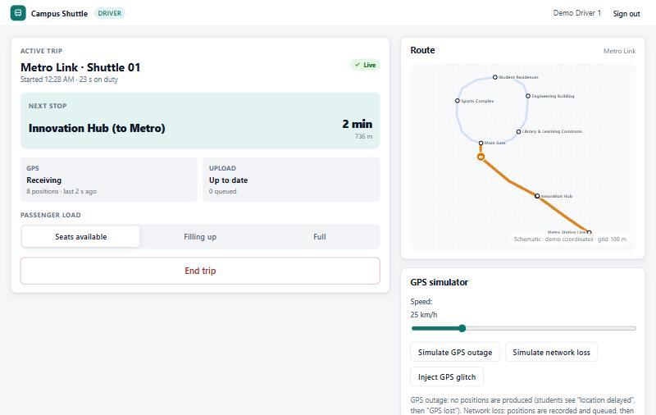
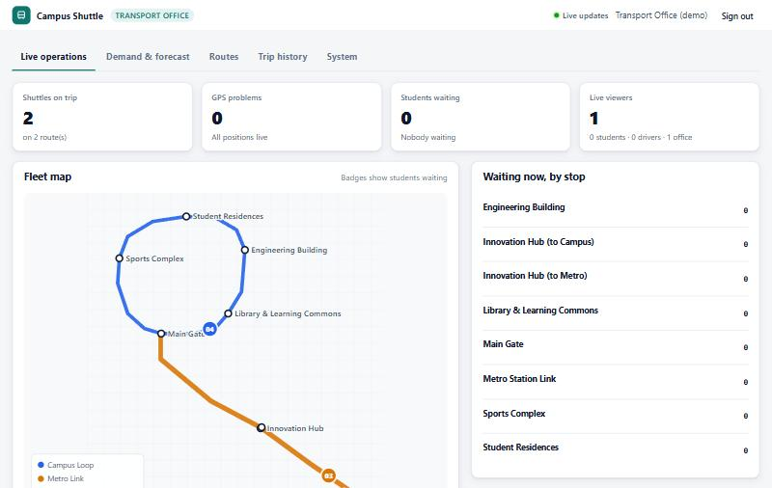
Three roles, one live system
Student
Driver
Transport office
Live map, arrivals with confidence, "I'm waiting here"
Trip status, what passengers see, GPS simulator
Fleet, waiting demand, trips, routes, forecasts
Two primary use cases run end to end: run a trip → track it live, and waiting request → office demand view → forecast.
Notes:
These are real screenshots of the running prototype. Everything on them works: no mock screens. Next we demonstrate it live.

Slide 10
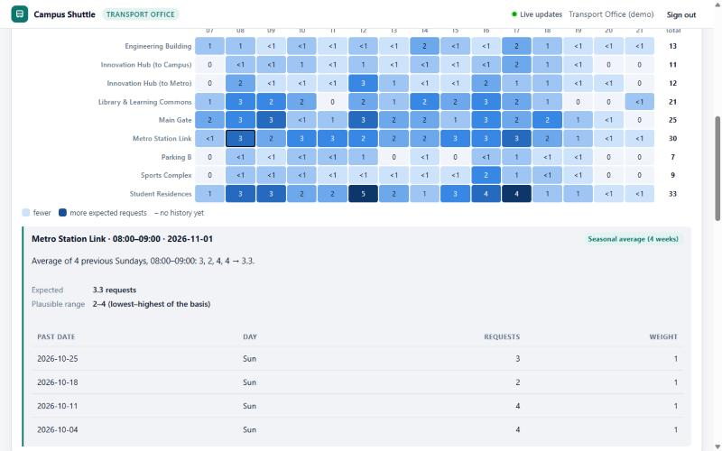
Demand forecasts the office can explain
ML lifecycle (RBC Borealis field guide)
1
Discovery Question: requests per stop and hour
2
Feasibility No real data → no trained model yet
3
Design Explanations and ranges for staff
4
Development Naive → seasonal → weighted baselines
5
Production Live requests become history automatically
Each forecast shows the exact past values, weights and range it came from — and "no forecast" instead of a guessed zero.
6
Maintenance Backtest = monitoring; retrain only if it wins
Notes:
Feasibility is the key stage: without real data a trained model would only learn our own assumptions. We built the pipeline, the explanations and the evaluation so a model can be added later as one more strategy.

Slide 11
Synthetic backtest: the method works, accuracy unproven
SYNTHETIC DATA
History generated from our own written assumptions (weekday peaks, quiet weekends) — not from any university
Weekday-aware models beat the naive one because the data was built that way: this checks the pipeline, nothing more
With one semester of real requests, the same backtest decides whether a trained model is worth adding
Notes:
Be explicit: we do not report this as accuracy. 1,890 stop-hours, rolling origin, no look-ahead (tested). Reproduce with npm run evaluate.

Slide 12
Live demonstration
1
Run a trip and track it
2
Waiting request → demand → forecast
Driver starts a trip with simulated GPS
Student sees the shuttle move and the ETA update
Network loss → trip cannot end offline → queue delivered
Injected GPS glitch is rejected
GPS outage button → "delayed" (~20 s) → "GPS lost" (~60 s) → Live
Student taps "I'm waiting here"
Office map badge and KPI update live
Shuttle reaches the stop → request closed
Forecast cell → explanation of its basis
Office ends a trip with a reason → audit log
Set-up before the session
npm start · npm run simulate -- --outage --outage-at 30 · three private browser windows: student1, driver1, office1
Backup if anything fails live: docs/evidence/ (test run, load tests, evaluation)
Notes:
Follow docs/demo-script.md. Start npm start and npm run simulate -- --outage --outage-at 30 before the session; use separate private windows for student, driver and office. The GPS-loss step is triggered with the Simulate GPS outage button in the driver window, so its timing is under your control.

Slide 13
Tested, measured — and honest about the gaps
103
26 × 4
113 ms
6
automated tests, all passing (unit, integration, architecture)
endpoints × caller types checked for role access
worst of 3,000 simulated viewers (local benchmark)
code defects found by tests and review, all fixed
Found by tests and independent review
Not done yet
Shuttle snapped a few metres behind at route corners (load test)
Real-time hub ran work after shutdown (integration test)
Driver app gave up a trip the server had not ended; live streams outlived their session (review)
Field test with a real phone on a real shuttle
HTTPS, single sign-on, Arabic, screen-reader audit
Real demand data — forecasts shown on synthetic data only
UML diagrams rendered and checked visually; deployment load test
Notes:
Numbers from docs/evidence. Mention the V-model pairing: unit ↔ module design, architecture test ↔ architectural design, integration ↔ system design, demo ↔ requirements.

Slide 14
What we would do next
Field test
Production basics
Real data, then ML
Real phones on a real route; tune the 20 s / 60 s thresholds and the speed blend
HTTPS behind a reverse proxy, university sign-on, backups
One semester of requests → rerun the backtest → add a model only if it wins
Questions?
The prototype baseline was built with AI assistance (Claude Code); what we reviewed, changed and added is stated in our AI-use statement.
Notes:
Keep this slide up during questions. The AI-use line must match the final AI-use statement in the report.

