Slide 1
WELCOME
TO OUR PRESENTATION

Slide 2

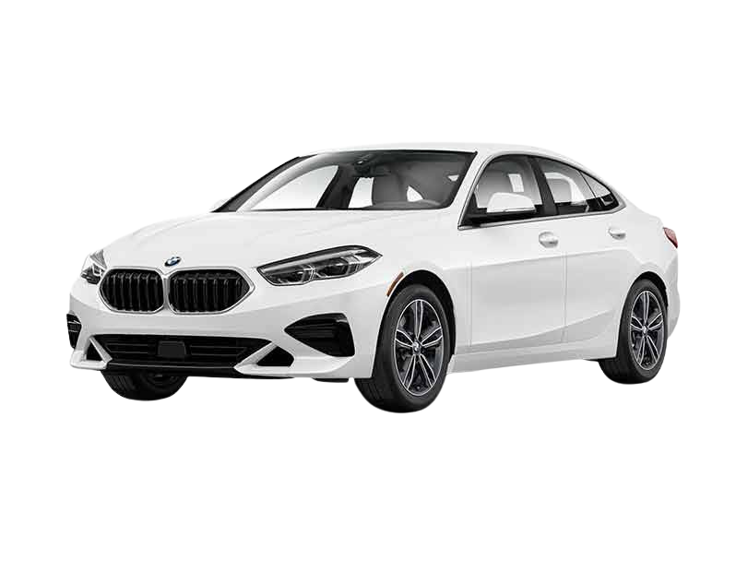
DREAM CAR RENTAL
Supervised By:
Mam Ramsha Khalid
Submitted by: Muhammad Abdullah (2025-GA-118) Muhammad Abdullah Hafeez (2025-GA-63) Muhammad Hassan Azam (2025-GA-70) Abdullah Bin Tahir (2025-GA-96) Ezza Fatima (2025-GA-82)
Jan-5/2026
Department of Computer Science
University of Engineering and Technology, Lahore

Slide 3







Demo Graphics

Slide 4
OBJECTIVES:
Develop a professional car rental website using HTML & CSS
Organize and analyze vehicle rental data using Excel
Track vehicle availability, rental prices, and income
Present data visually using charts for decision support
Practice version control and live deployment using GitHub

Slide 5
Website Overview
User-friendly car rental service website
Pages included:
Home
Brand-wise product pages
Booking
Contact
Focus on luxury and normal vehicle categories
Designed for clarity, navigation, and professionalism

Slide 6
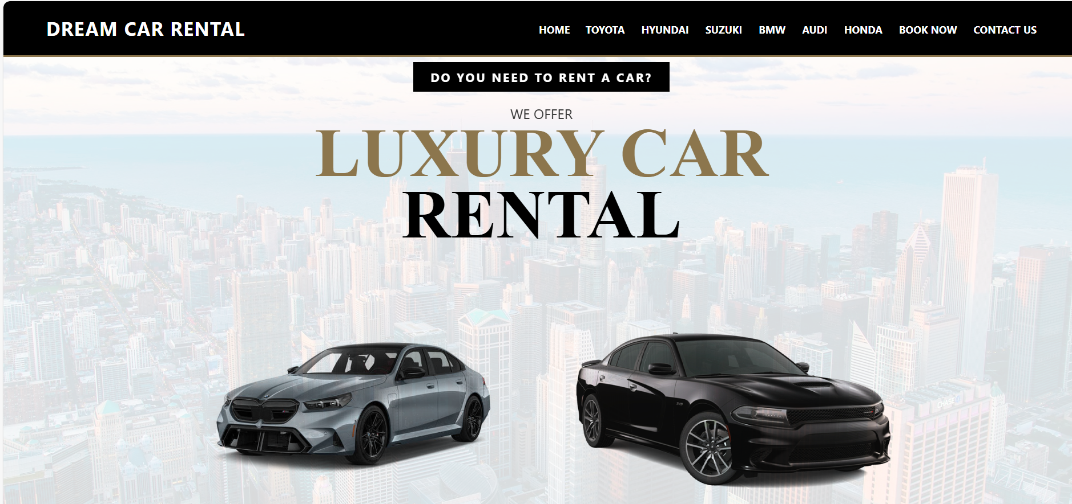
Home Page
Hero section with Book Now call-to-action
Brand highlights (Toyota, BMW, Audi, etc.)
Clean layout for first-time users
Sticky navigation bar for easy access

Slide 7
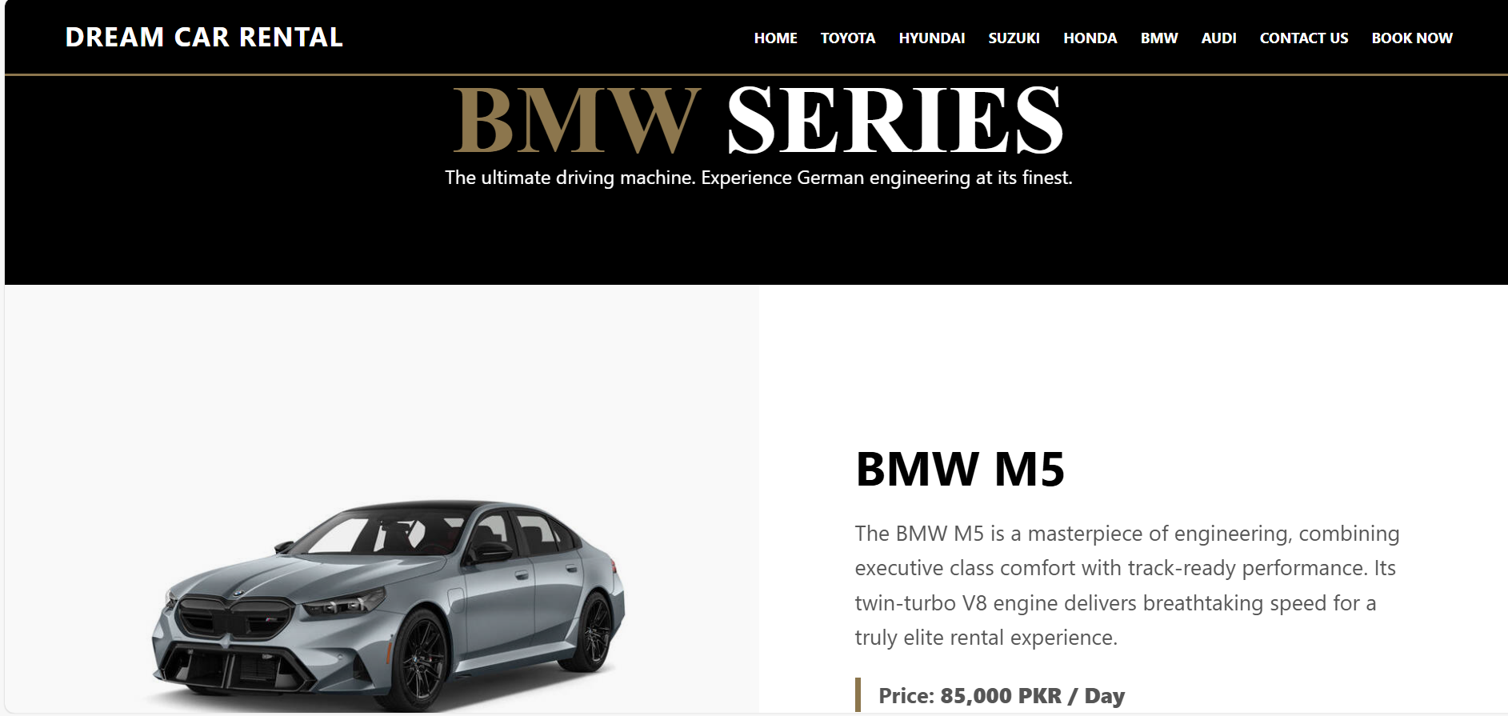
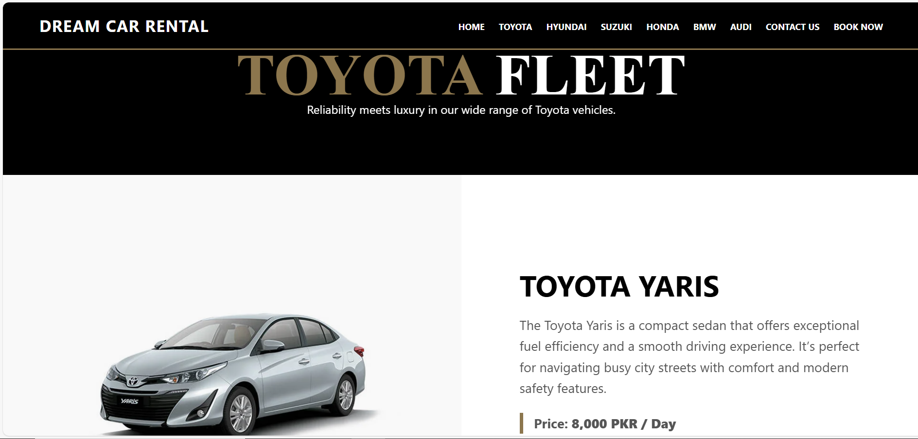
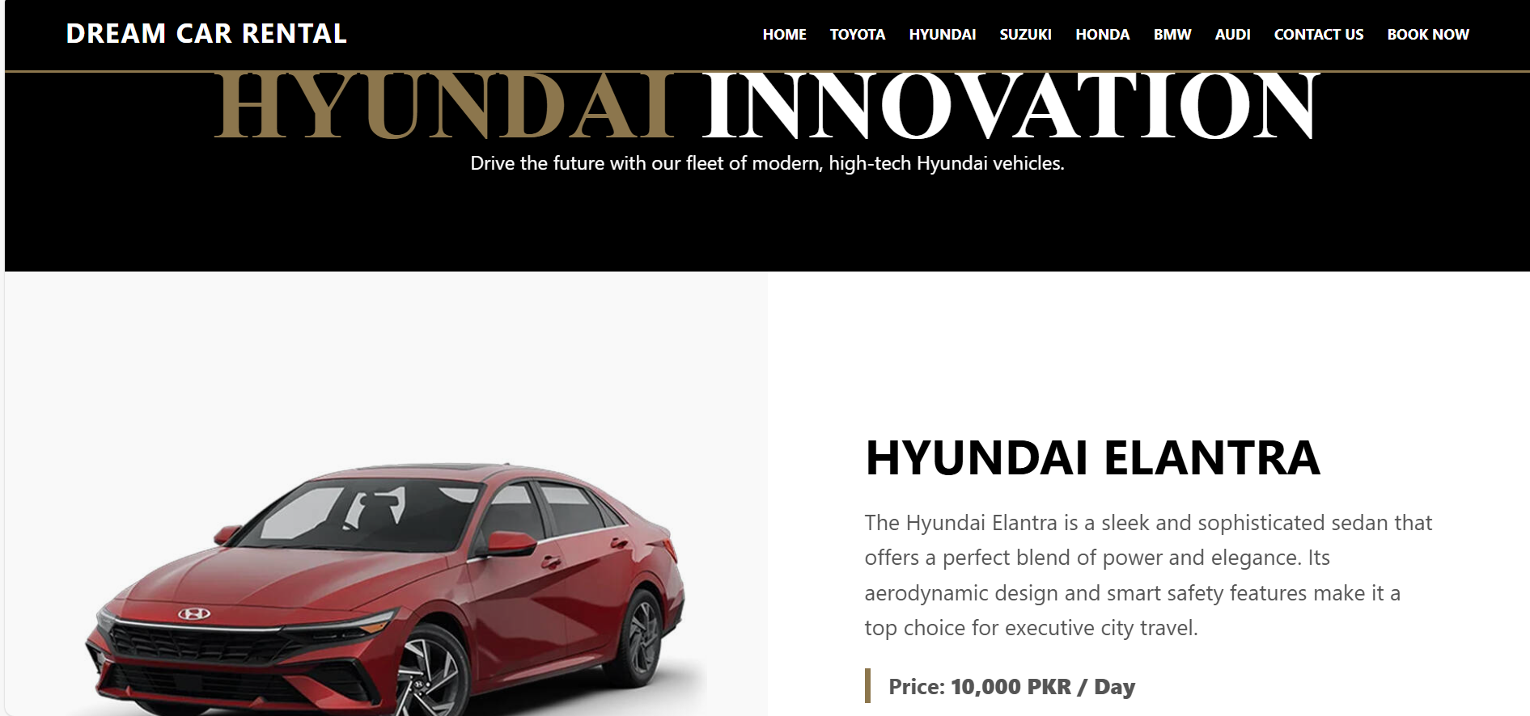
Product / Brand Page
Brand-wise vehicle listings
Displays car models and rental focus
Separate pages for Toyota, BMW, Audi, Honda, etc.
Helps users quickly compare options

Slide 8
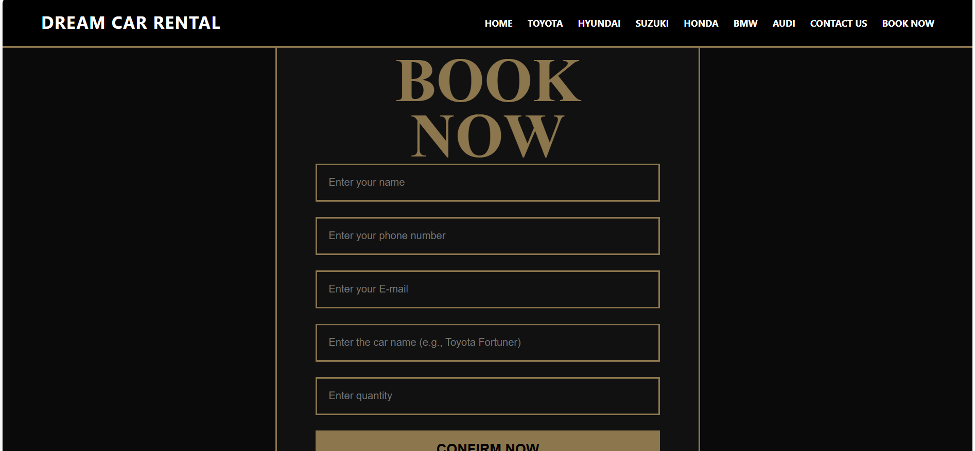
Contact / Booking Page
Customer inquiry and booking request interface
Designed for user communication
Supports rental service interaction
Simple and accessible layout

Slide 9
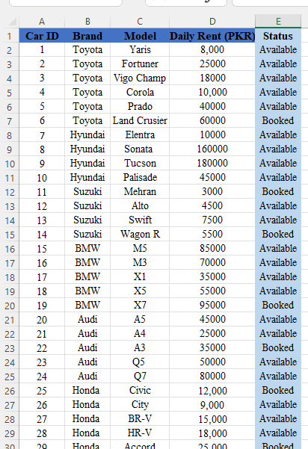
Excel Data Overview
Excel used as data backbone of the project
Tracks:
Vehicle brand & model
Daily rent
Vehicle category (Luxury / Normal)
Availability status
Enables income calculation and analysis

Slide 10



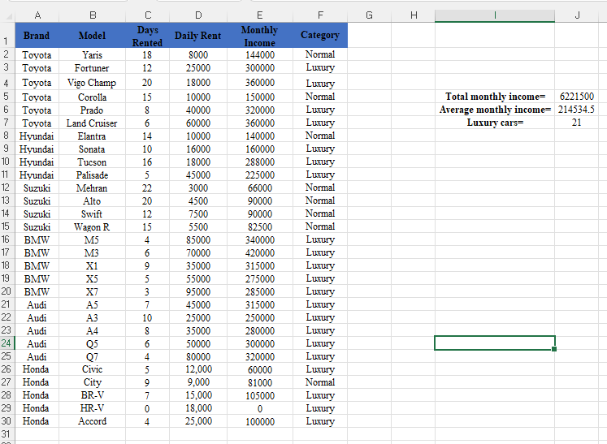



Key Data from Excel
Total vehicles: 29
Luxury cars: 21
Normal cars: 8
Brands covered: Toyota, BMW, Audi, Honda, Hyundai, Suzuki
Average monthly income per vehicle: 214,534 PKR

Slide 11
Chart from Excel (Required)
Easy communication across languages
More access for people with disabilities
Saves time and effort
Better quality of messages
Helps learning and teamwork

Slide 12
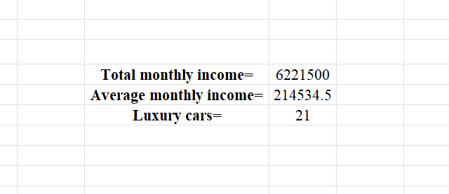
Financial Insights
Total monthly income: 6,221,500 PKR
Luxury vehicles contribute major revenue share
High-end cars like Land Cruiser generate higher daily rent
Data helps in pricing and inventory decisions

Slide 13

Design Decisions
Luxury-focused typography for premium branding
Alternating brand sections for visual balance
Sticky navigation bar improves usability
Consistent color theme for professional look

Slide 14

Tools & Technologies Used
HTML & CSS → Website development
Microsoft Excel → Data analysis & charts
Microsoft Word → Documentation
GitHub → Version control & live hosting.

Slide 15
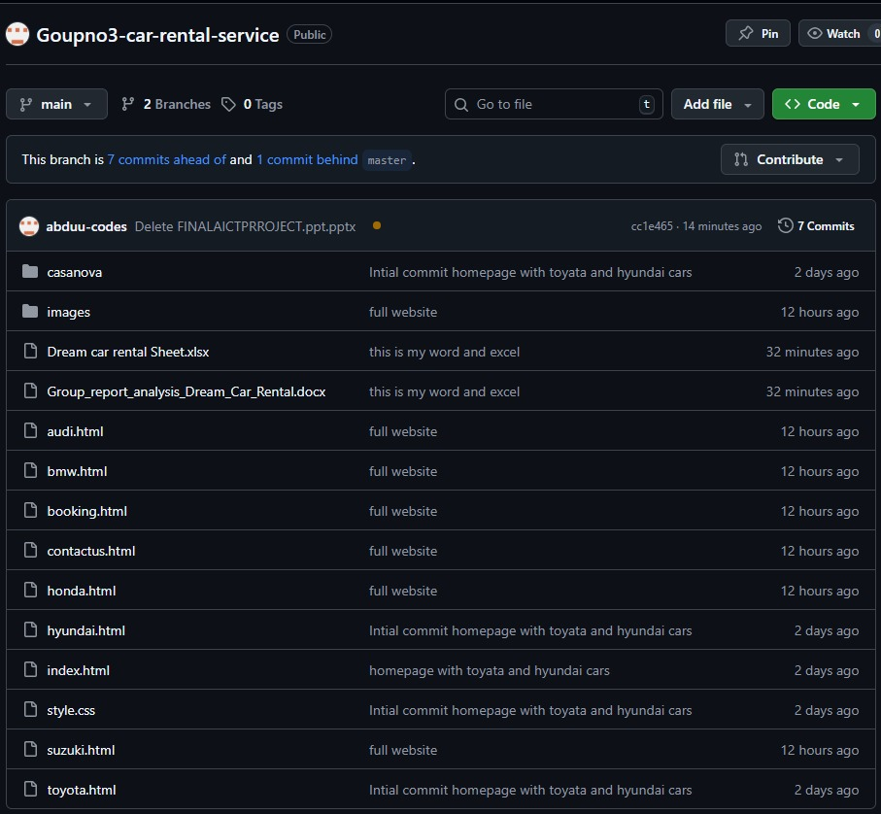
Demo Link & GitHub
Live Website (GitHub Pages): 👉 https://abduu-codes.github.io/Goupno3-car-rental-service/
GitHub Repository: 👉 https://github.com/abduu-codes/Goupno3-car-rental-service.git
Code hosted publicly
Live deployment for real-time access

Slide 16



Reflection
Learned how front-end design depends on accurate data
Understood importance of Excel in business logic
Improved skills in:
Website structuring
Data-driven decision making
Team collaboration

Slide 17

Conclusion
Successfully developed a static car rental website using HTML and CSS
Organized and analyzed rental data using Microsoft Excel
Visualized key metrics through charts for better understanding
Maintained consistency across website, Excel, and documentation
Met all technical and academic requirements of the AICT Lab project

Slide 18
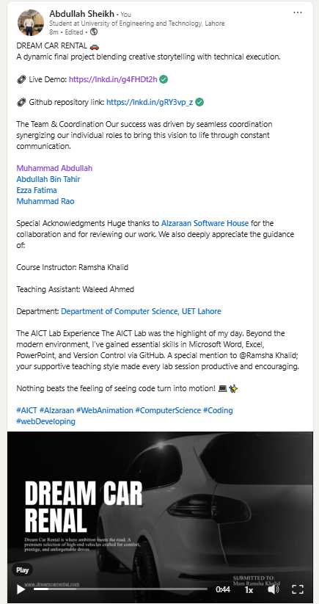
Social Media Presence

Slide 19
THANK YOU!
DO YOU HAVE ANY QUESTION?

