Slide 1
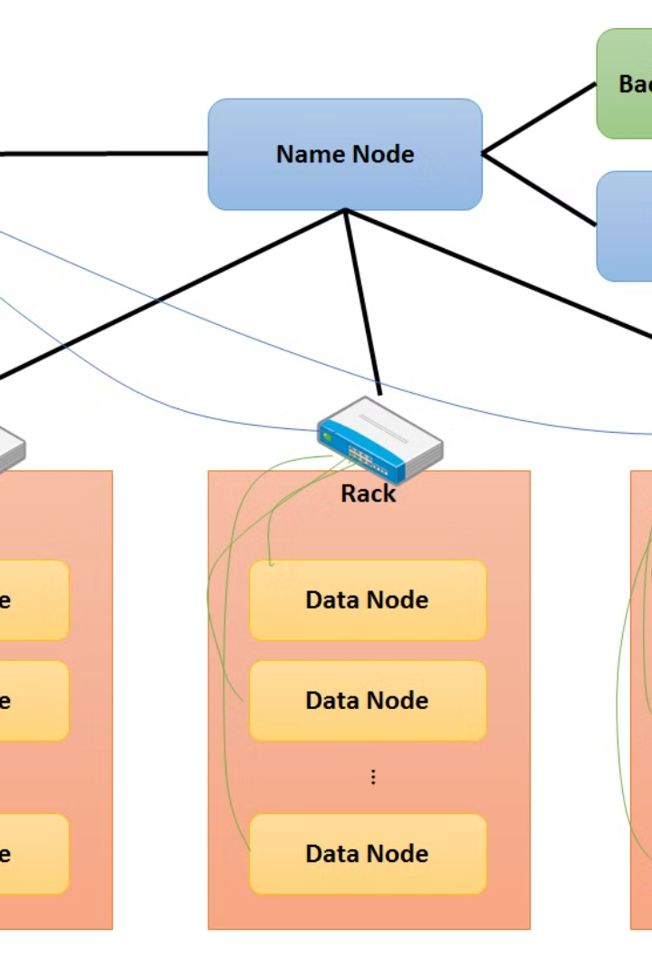


Overview of the HDFS File System
The Hadoop Distributed File System (HDFS) is a distributed file system designed to store and manage large volumes of data across clusters of computers.
by Abdullah Siraj

Slide 2
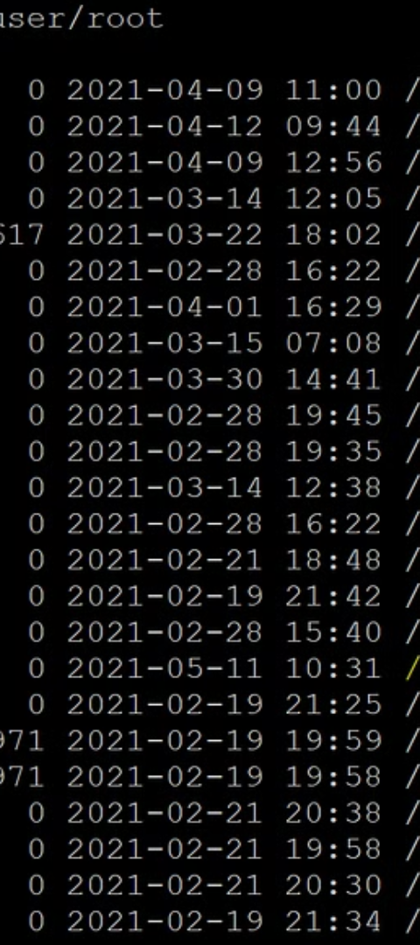
Importance of Transferring Files from HDFS to Local Disk
1
Data Accessibility
2
Data Backup
Transferring files allows easy access to data for local processing.
Local disk storage provides an extra layer of data redundancy and backup.

Slide 3
HDFS Command for Copying Files to Local File System
Command
Usage
The command "hdfs dfs -copyToLocal" is used to copy files from HDFS to the local file system.
It is used with the syntax "hdfs dfs -copyToLocal ".

Slide 4
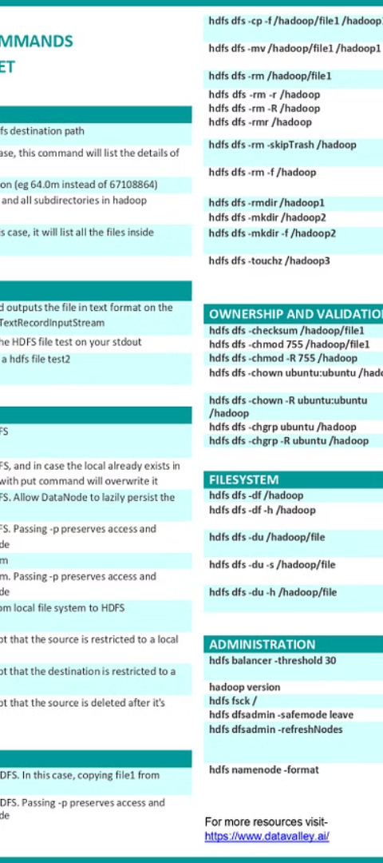
Syntax and Usage of the HDFS Command
1
Syntax
2
Usage
The syntax follows the pattern: "hdfs dfs -copyToLocal ".
It can be used to copy files or entire directories from HDFS to the local file system.

Slide 5
Examples of Using the HDFS Command to Copy Files
1
2
Example 1
Example 2
Copying a single file: "hdfs dfs -copyToLocal /path/to/HDFS/file /path/to/local/destination".
Copying entire directory: "hdfs dfs -copyToLocal /path/to/HDFS/directory /path/to/local/destination".

Slide 6
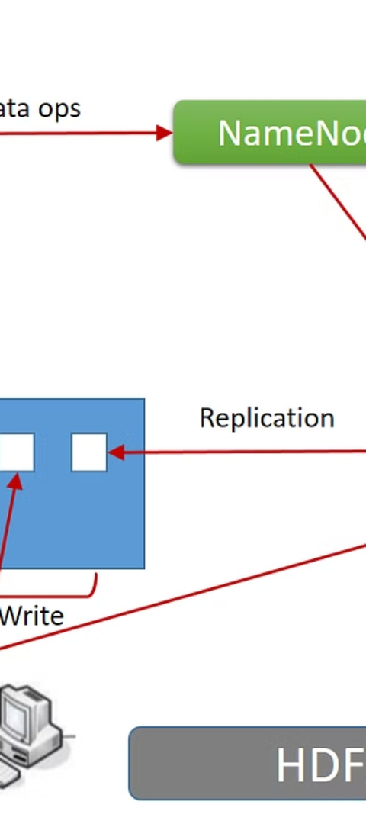
Benefits of Transferring Files from HDFS to Local Disk
Data Processing
Data Security
Enables efficient local processing of HDFS data.
Provides an isolated and secure environment for data analysis.

Slide 7




Conclusion and Key Takeaways
Enhanced Accessibility
Transferring files enhances data accessibility and utilization.
Data Redundancy
Local storage ensures additional redundancy and data backup.
Security & Flexibility
Allows for secure and flexible data processing and analysis.

