Slide 1


Early detection of lung cancer using machine learning
Supervised by: Dr. Ahmed Farouq
By: Abdullah Tarek
Sponsored by:

Slide 2
LUNG CANCER
Introduction to
There are about 2.5 million people get diagnosed with lung cancer a year.
In Egypt it is predicted that by 2030 20% of Egyptians will develop lung cancer in their life times

Slide 3
LUNG CANCER
Introduction to

Slide 4

LUNG CANCER
Introduction to
Prostate Cancer
307,000 Deaths
Colorectal Cancer
694,000 Deaths
2/3
That get diagnosed early survive
Breast Cancer
522,000 Deaths
Lung Cancer
1,590,000 Deaths

Slide 5
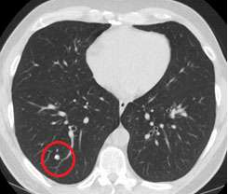
LUNG CANCER DIAGNOSIS
The current process of
Patient is given a low dose CT-scan.
Classifying and Drawing the line between a small nodule and a big one
classifying whether this nodule will grow or not.

Slide 6
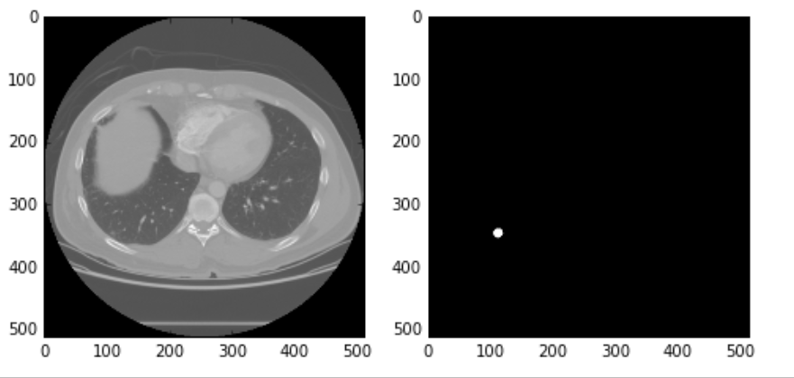
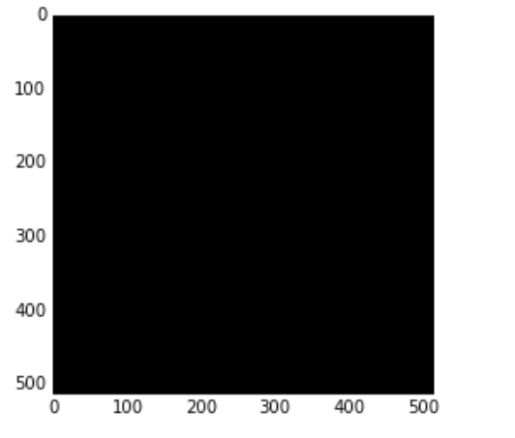
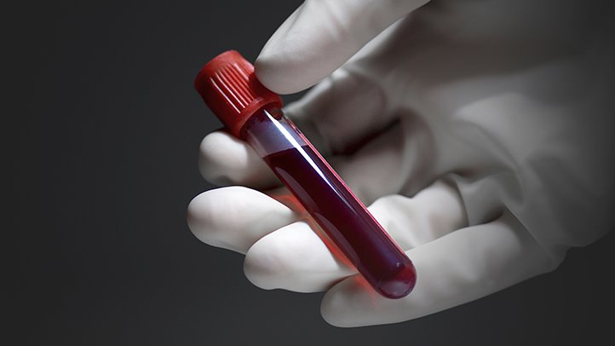
DEEP LEARNING
The power of
Needle in haystack problem
Classifying the whole CT-scan
Segmenting nodules
CT scan slice
Desired Mask
Generated Mask

Slide 7


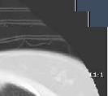
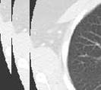
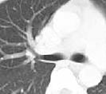
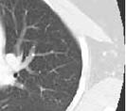

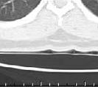
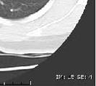
THE PIPELINE
Deeper look into

Slide 8
THE PIPELINE
Deeper look into

Slide 9
THE PIPELINE
Deeper look into
1. Reading annotations
2. Loading and preprocessing CT-scans
3. Generating CT-scans crops
4. Nodule classification model
5. Malignancy classification model

Slide 10
THE PIPELINE
Deeper look into
Pre-processing CT-scans
Reading Annotations
Generating Crops
Nodule Classification
malignancy Classification

Slide 11
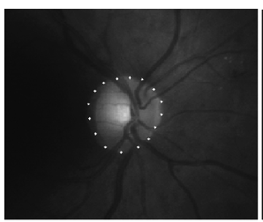



THE PIPELINE
Deeper look into
Reading Annotations
$$\left(\sum{X}i)/n\right.$$
One hot array
1 nodule
[0,1]
0 non-nodule
[1,0]
$$\left(\sum{y}i)/n\right.$$
Pre-processing CT-scans
Nodule voxel position and diameter
Generating Crops
Nodule Classification
malignancy Classification
$$\left(\sum{z}i)/n\right.$$
CSV
XML

Slide 12
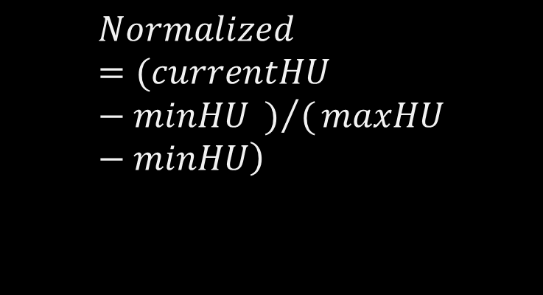
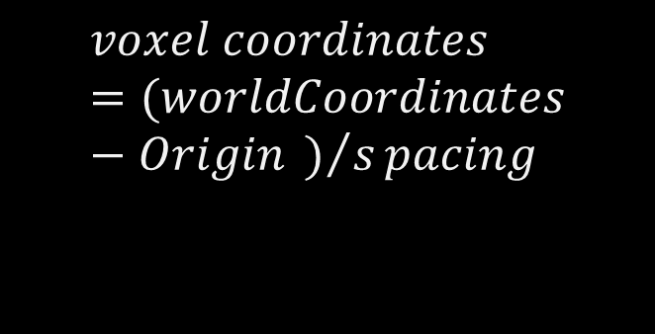
THE PIPELINE
Deeper look into
$$\left.Normalized =(currentHU−minHU )/(maxHU−minHU\right)$$
$$voxel coordinates=(worldCoordinates−Origin )/spacing$$
Pre-processing CT-scans
Reading Annotations
Generating Crops
Nodule Classification
malignancy Classification
Voxel coordinates
Normalizing scans

Slide 13
THE PIPELINE
Deeper look into
Generating Crops
Reading Annotations
Pre-processing CT-scans
Nodule Classification
malignancy Classification

Slide 14
THE PIPELINE
Deeper look into
Generating Crops
3D CROPS 64 X64X64
2D CROPS 64 X64
Reading Annotations
Pre-processing CT-scans
Nodule Classification
malignancy Classification

Slide 15
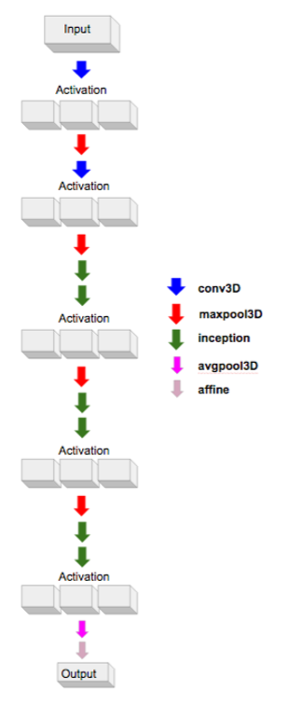
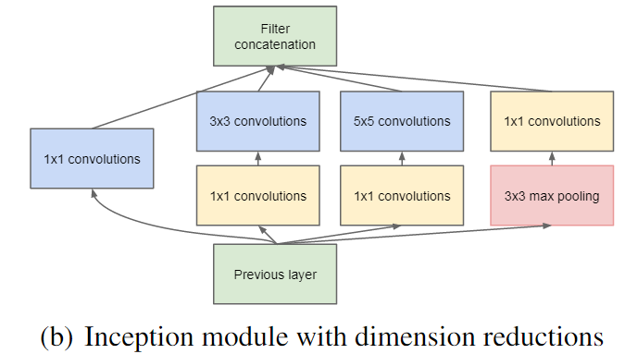
THE PIPELINE
Deeper look into
Nodule Classification
Reading Annotations
Pre-processing CT-scans
Generating Crops
Googlenet
16 layers
Inception layer
malignancy Classification
Dealing with skewed data
By incremental Training
+
-
500
4500

Slide 16
THE PIPELINE
Deeper look into
Lnet model
malignancy Classification
I
Input
Reading Annotations
Conv
Pre-processing CT-scans
Generating Crops
Nodule Classification
0 → not malignant
1 → malignancy level 1
2 → malignancy level 2
3 → malignancy level 3
4 → malignancy level 4
Max Pooling
Dense

Slide 17
THE RESULTS
Deeper look into

Slide 18
THE RESULTS
Deeper look into

Slide 19
Thank you

