Slide 1

Abdullah Tarek, Ahmed Tag, Amr Moushtaha, Hassan Khalil, and Nader Hosny

Slide 2

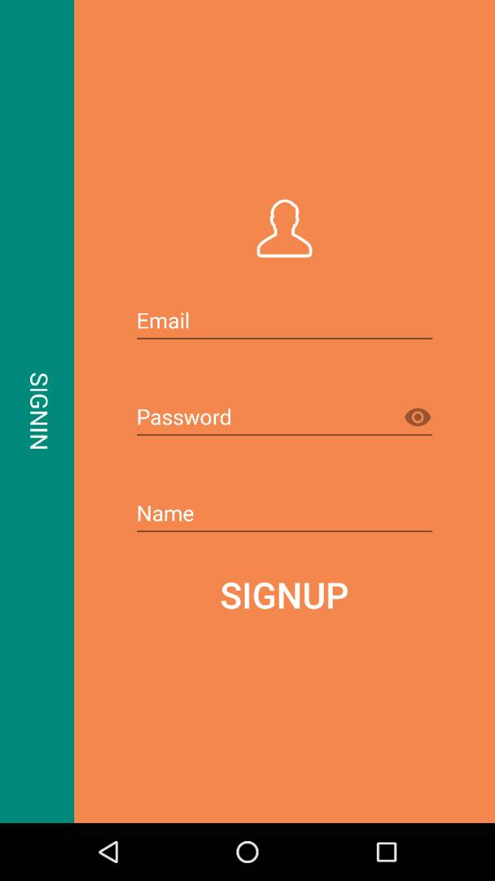
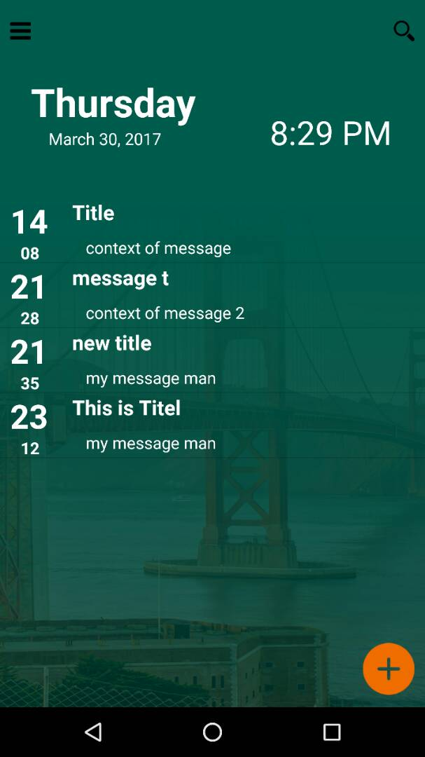
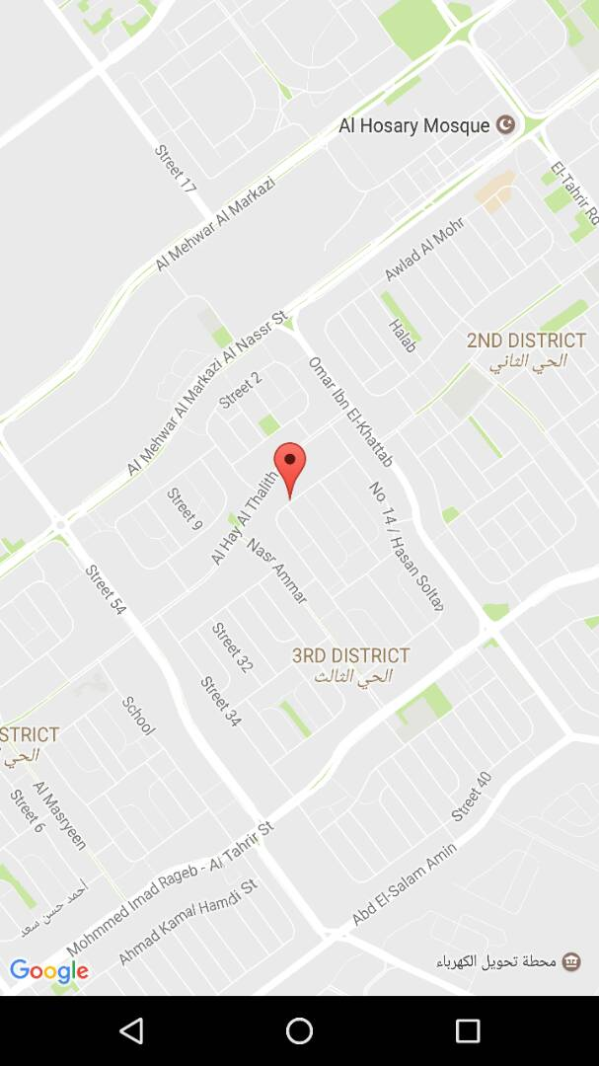
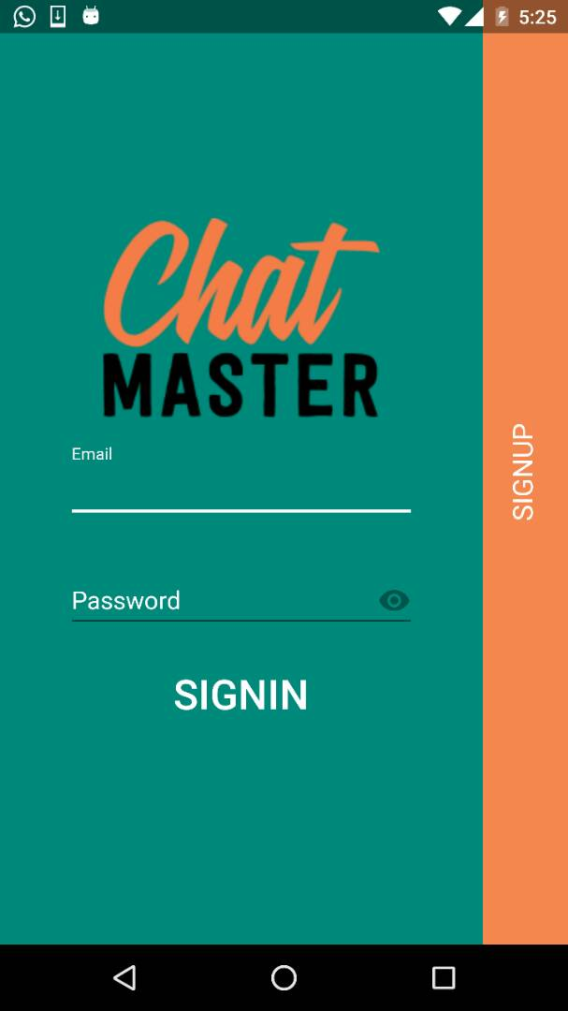
OVERVIEW
Application process
Sign in and sign up
Events page
Map and event page
The sign in and sign up are in the same activity with some animations to make the application attractive
All user events are displayed in an attractive custom made list view, with and add button in the bottom
The map is showed and after you choose a location you go to the event activity and fill in the rest of the information. And this is also the activity where you edit an event

Slide 3



Application
Dynamics
Encrypt using server public key
Client
RSA
Every client has his own private and public key generated on signup.
Server has his own public and private key.
encrypt Using client public
Decrypt Using client
Private key
Save In Database
Server
Decrypt Using server private key
Retrieve Data
Database

Slide 4
SECUIRITY SERVICES
Our
Non-
repudiation
Confidentiality
Integrity
Authentication
By encrypting messages with RSA over the Network
By using MD5 hash to compare the encrypted message with the hash
By using the login screen
By using a trusted party in between (server)
By using digital signature

Slide 5
Thank You

