Slide 1
Market Outlook — Fourth Quarter 2025
Vectera Advisors — House View

Slide 2
Key Themes
• Core real-estate values are stabilizing after the 2023–2024 repricing; U.S. private funds have turned positive over the past year (see exhibits).
• We favor industrial / logistics and multifamily, remain underweight office, and are selective in retail.
• Leverage discipline and patient deployment into the recovery.

Slide 3
Macro & Capital Markets
• Global macro is stabilizing; core values are recovering following the significant 2023–2024 repricing.
• U.S. private real estate fund returns have moved back into positive territory over the trailing year (exhibit).
• Cap rates have largely stabilized while the spread over Treasuries has widened, restoring the real-estate risk premium (exhibit).
• Transaction activity is rebounding from cyclical lows as rate volatility eases and bid-ask spreads narrow.
• We maintain leverage discipline and prefer moderate loan-to-value as financing normalizes.

Slide 4
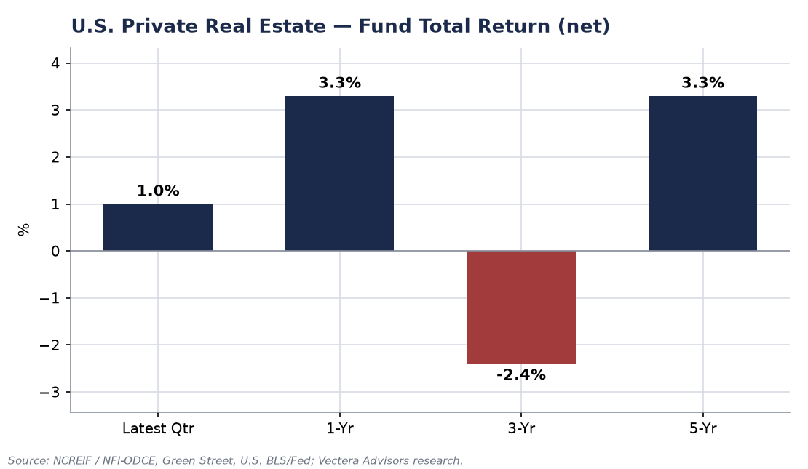
Return Backdrop — U.S. Private Real Estate
Trailing 3-year returns still carry the drawdown, but the latest quarter and one-year figures have turned positive.

Slide 5
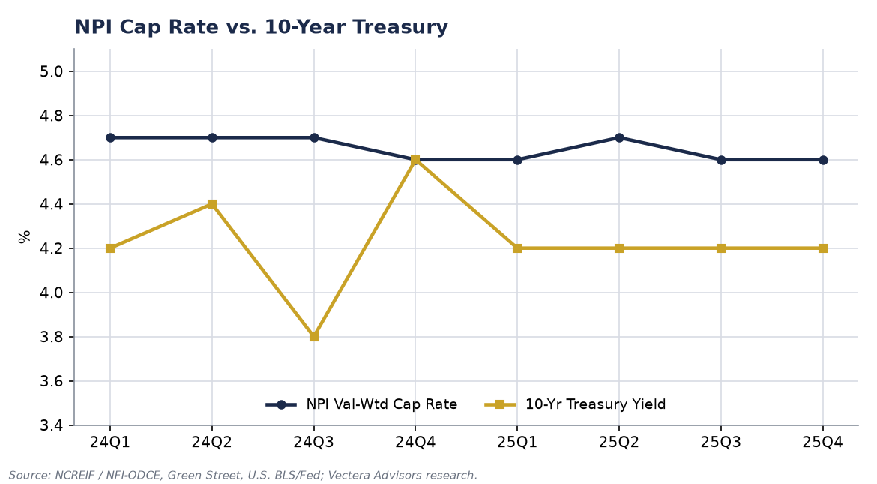
Capital Markets — Cap Rates and Rates
Cap rates have held broadly stable as Treasury yields settled; the spread has re-widened versus the 2024 trough.

Slide 6
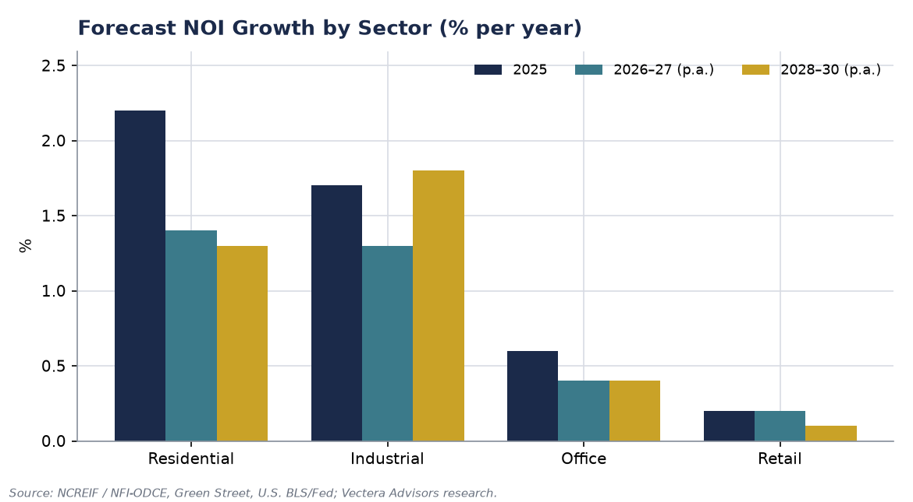
Sector Outlook — Forecast NOI Growth
Residential and industrial lead forecast income growth; office and retail lag across the horizon.

Slide 7
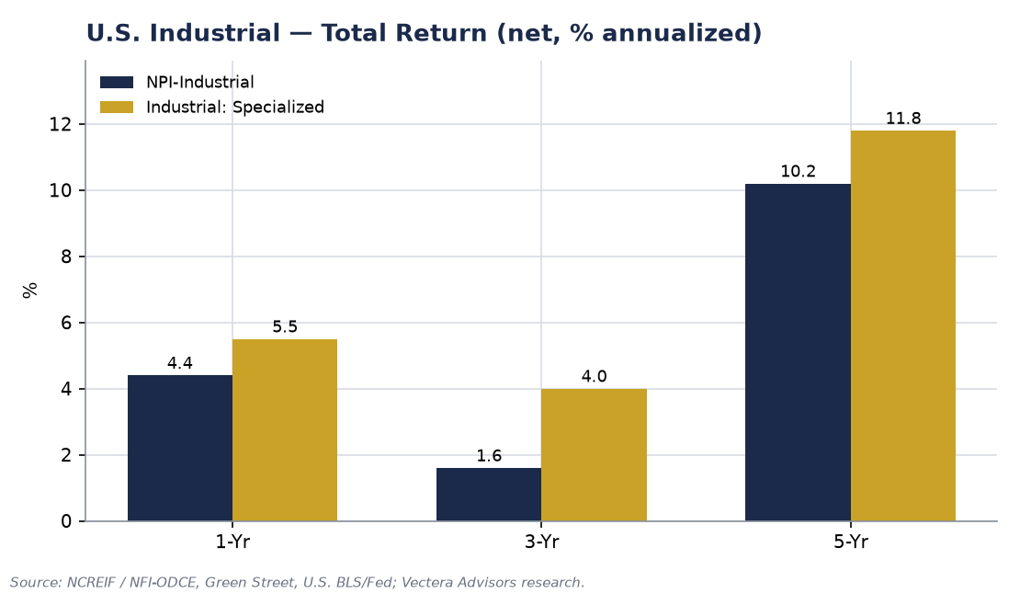
Industrial & Logistics — Overweight
• Our top overweight: fundamentals remain tight and rent growth is normalizing from double-digit peaks.
• Vacancy sits well below its long-run average; new supply is moderating after a record delivery wave.
• Focus on infill locations and outdoor / industrial storage.

Slide 8
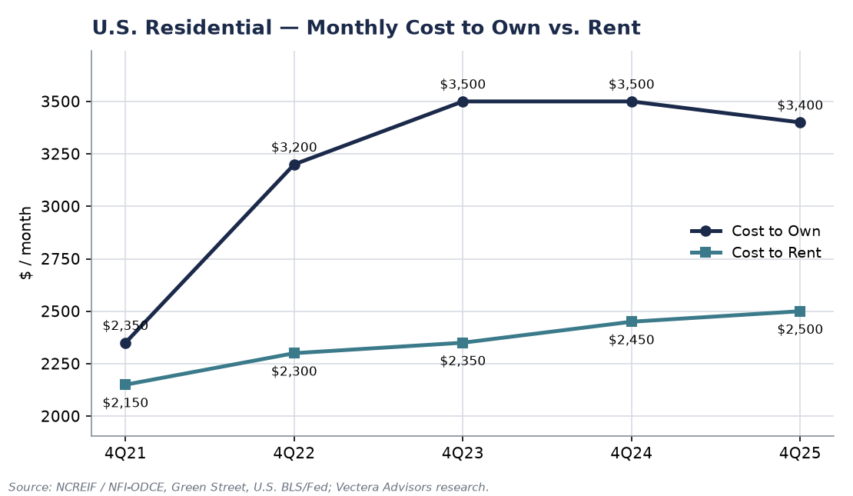
Residential / Multifamily — Favored
• A widening own-versus-rent affordability gap supports durable rental demand (exhibit).
• Record new deliveries are peaking and set to taper, easing rent pressure.
• A key area of interest for new capital deployment.

Slide 9
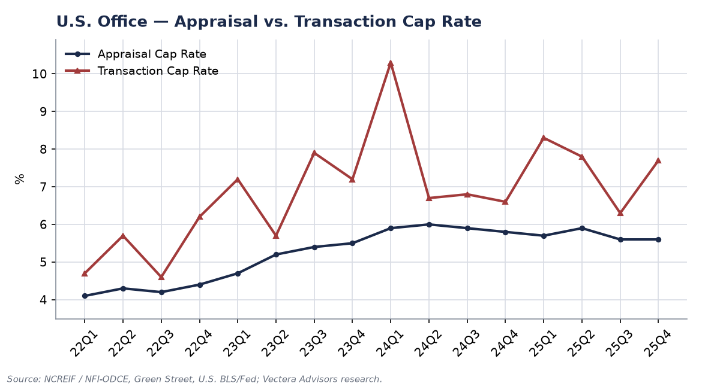
Office — Underweight
• Transaction cap rates have repriced sharply higher — well above appraisal marks (exhibit).
• A pronounced bifurcation persists; only best-in-class, well-located assets are favored.
• Leasing is improving off a low base, but the recovery is uneven.

Slide 10
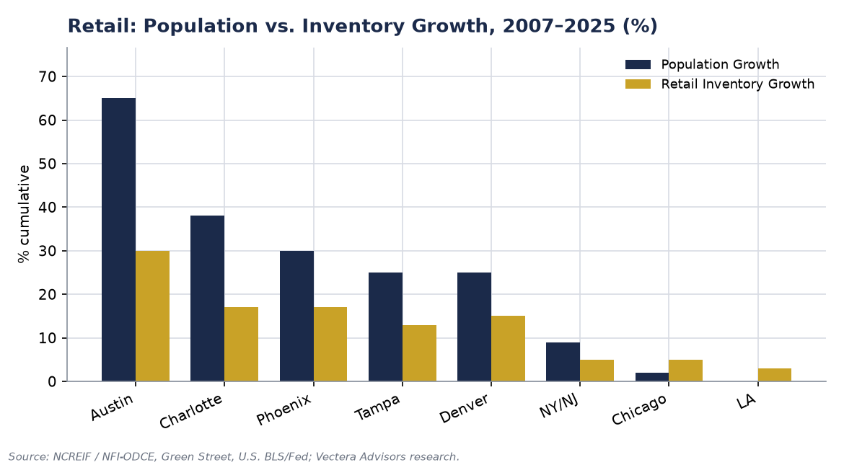
Retail — Selective
• Years of minimal new supply against steady population growth have tightened availability, especially in the Sun Belt (exhibit).
• Grocery-anchored and necessity-based formats are favored for resilient cash flows.
• Discretionary and enclosed-mall formats remain out of favor.

Slide 11
Private Real Estate Debt — Opportunistic
• Reduced bank lending has widened spreads, creating selective opportunities in senior and mezzanine credit.
• Relevant for dedicated debt mandates; not a focus of core / value-add equity portfolios.

Slide 12
Risks We Are Monitoring
• A resurgence in rate volatility could re-widen bid-ask spreads and stall the transaction recovery.
• Refinancing of 2020–2021 vintage debt at higher rates remains a sector-wide overhang, most acute in office.
• Slower-than-expected supply absorption in select multifamily submarkets.

Slide 13
Positioning Summary
• Maintain leverage discipline; prefer moderate loan-to-value.
• Tilt toward industrial / logistics and multifamily; underweight office; be selective in retail.
• Deploy patiently into the recovery as pricing stabilizes.

