Slide 1

DIP PRESENATATION
REPRESENTATORS:
ABDULLAH
MUHAMMAD AWAIS
USAMA SHAHID

Slide 2

Project : “ PHOTO LAB ”
Implement All Techniques Learn in this Course.
Implement a Variety of Image Retouching Operations (Image Enhancement Tools) etc…

Slide 3
What we have already done:
Load Image
Gray Scale
Export Image
Resize
Reset
DEHAZE
Salt & Pepper Noise
Speckle Noise
Gaussian Noise
Poisson Noise
Median Filter
Gaussian Filter
Averaging Filter
Motion Blur
Laplacian Filter
Composite Filter
Auto Contrast
Histogram
Invert Color
STEGNOGRAPHY
Encoding
Decoding
Bit Plane Slicing

Slide 4
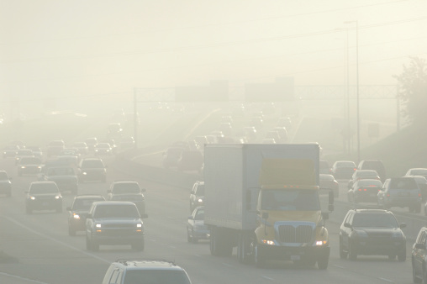
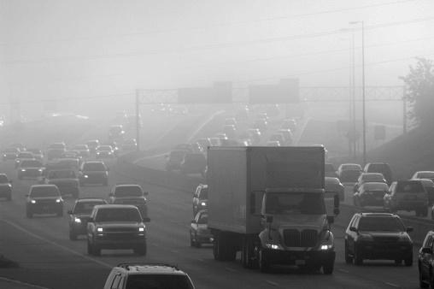
Image Enhancement (Problem)
Original Image
Auto-Contrast

Slide 5

What does it mean to dehaze an Image?
Purpose : Remove atmospheric haze from a photo
Applications :
1. City View Images
2. Under Water Images
3. License Plate Recognition
CODE : imreducehaze(‘myImg’);

Slide 6
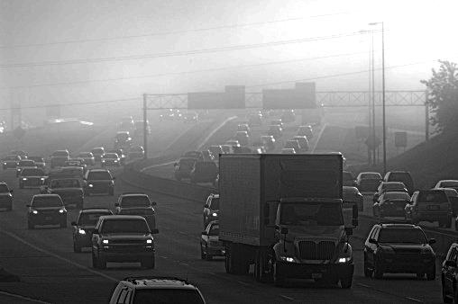
Image Enhancement (Dehaze)
Auto-Contrast
Dehaze Image

Slide 7


Any Suggestions …
“You are welcome to give us any suggestions.”

