Slide 1
CMPE493: Introduction to IR Term Project: Named Entity Normalization for the Bacteria Biotopes Domain
Mansur YeşİLBursa
Abdullah Yıldız
Can Devecİ

Slide 2
Overview
Part 1: Pre-processing and Baseline, Mansur Yeşilbursa
Part 2: Performance Evaluations, Abdullah Yıldız
Part 3: Future Work, Can Deveci

Slide 3
Preprocessing
Dataset class
Processes .a1 and .a2 files in the given set (train, dev or test)
Stores Term number-Term name tuples and Term number-OBT tuples
Stores position of terms in the txt files
Creates a vocabulary if training set is given
Has access to Ontology
No case-folding

Slide 4
Baseline System
Exact Match
On Training Set
Searches training set to find exact entity match
If finds, retrieves OBT of the matched entity
Performance: 22% correct normalization on dev set
On Ontology
Searches Ontology file to find exact entity match
If finds, retrieves OBT of the matched entity
Improved performance by 11%
Performance: 33% correct normalization on dev set

Slide 5
Baseline System
Exact Match
Lemmazation
For given test entities, lemmazation is applied
If lemmatized entity is different than original entity
Searches for both terms in Training set and Ontology
Improved performance by 4%
Performance: 37% correct normalization in dev set
Abbreviation Resolution
Requires a comprehensive Biomedical Abbreviation Database
One that is used was messy and not comprehensive enough [1]
Didn’t improved performance for now

Slide 6
Baseline System
Cosine Similarity
Used if exact match fails
Measures cosine similarity of given entity with all entities in the Training set
Binary vectors of Training set vocabulary size
Improves performance by 10%
Performance: 47% correct normalization on dev set.

Slide 7
Performance Problems
Input Term | Normalized Term | True Normalized Term
CD20-positive cells | phagocyte | lymphocyte
lymphocytic | nutrient broth | lymphocyte
B cells | phagocyte | lymphocyte
T cells | phagocyte | lymphocyte
lymphocytic | nutrient broth | lymphocyte
Predicts phagocyte instead of lymphocyte although input containts lymphocytic.
nltk.wordnet.WordNetLemmatizer()
e.g. lymphocytic -> lymphocytic
Lemmatization could not lemmatize scientific terms.
Cells -> phagocyte
..cytic -> nutrient broth

Slide 8
Performance Problems
Input Term | Normalized Term | True Normalized Term
patients with atypical lymphoid infiltrates | elderly person | patient
patients with low-grade MALT lymphoma | elderly person | patient
patients with Helicobacter pylori-chronic active gastritis | elderly person | patient with infectious disease
patients with high-grade primary gastric lymphoma | elderly person | patient
patients with chronic active gastritis | elderly person | patient
Predicts elderly person instead of patient
Associates certain words to certain entities

Slide 9
Performance Problems
Input Term | Normalized Term | True Normalized Term
placenta of a 38-year-old secondary recurrent aborter | experimental medium | placenta
38-year-old secondary recurrent aborter | experimental medium | pregnant woman
Part of speech tagging can be applied to first sentence for morphological analysis.
Sentence is split into phrases.

Slide 10
Performance Problems
Input Term | Normalized Term | True Normalized Term
placenta of a 38-year-old secondary recurrent aborter | experimental medium | placenta
38-year-old secondary recurrent aborter | experimental medium | pregnant woman
Part of speech tagging can be applied to first sentence for morphological analysis
Sentence is split into phrases

Slide 11
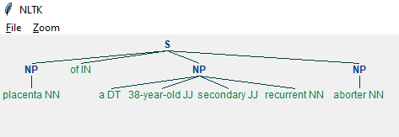
Performance Problems
Part-of-speech tagging can be applied to first sentence
Test = ‘placenta of a 38-year-old secondary recurrent aborter ‘
(S (NP placenta/NN) of/IN (NP a/DT 38-year-old/JJ secondary/JJ recurrent/NN) (NP aborter/NN))
JJ : adjective
NP: noun phrase
S: sentence
DT: determiner

Slide 12
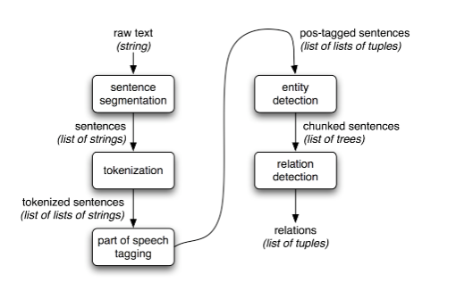
Performance Problems
Architecture for a simple information extraction system
Ref : https://www.nltk.org/book/ch07.html

Slide 13
Ontology
There is an Ontology implementation in Python written by Martin Larralde.
Reference : github.com/althonos
Given an .obo document.
Creates the graph representation of Ontology Terms by implementing the specifications of the Open Biomedical Ontologies 1.4

Slide 14
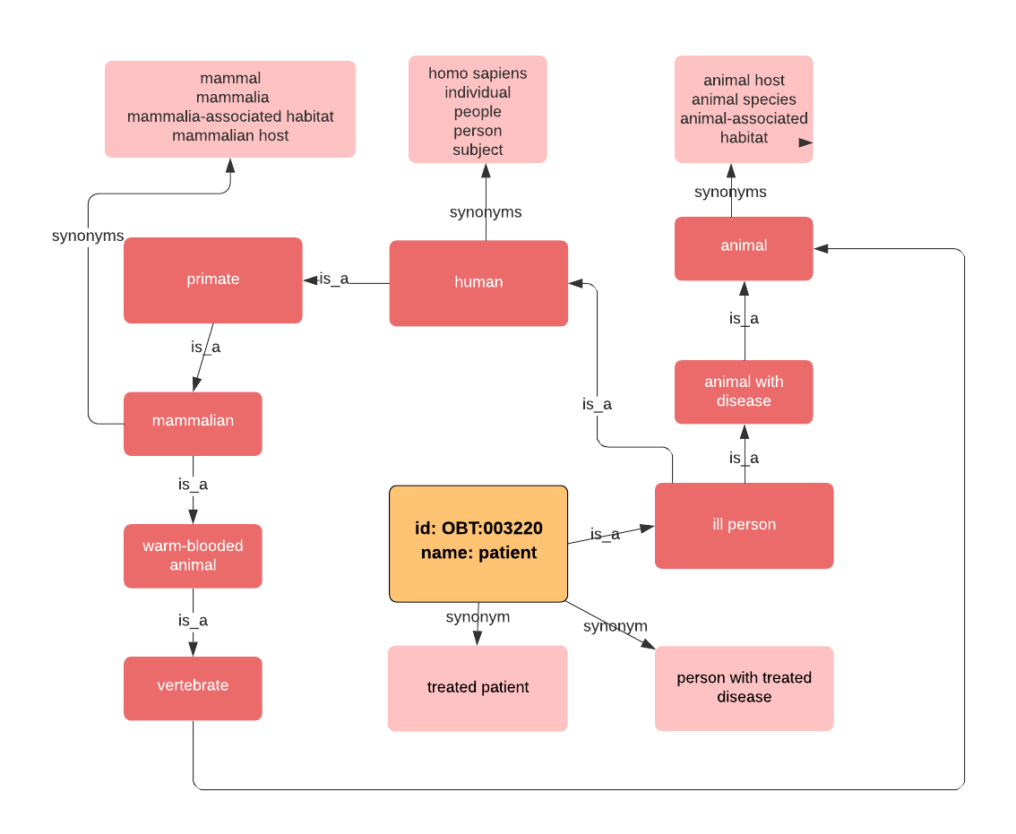
Ontology Library - Pronto
Starts from the Patient (OBT:003220 ) term.
Whole graph can be induced by following is_a and synonym relationships.
Pronto library has superclasses and subclasses functions to return relevant Ontology terms.

Slide 15
Ontology Library - Pronto
Superclasses of ‘Patient’
'root for extraction’
'microbial habitat’
'living organism’
'eukaryote host’
'animal’
'animal with disease’
'vertebrate’
'warm-blooded animal’
'mammalian’
'primate’
'human’
'ill person'

Slide 16
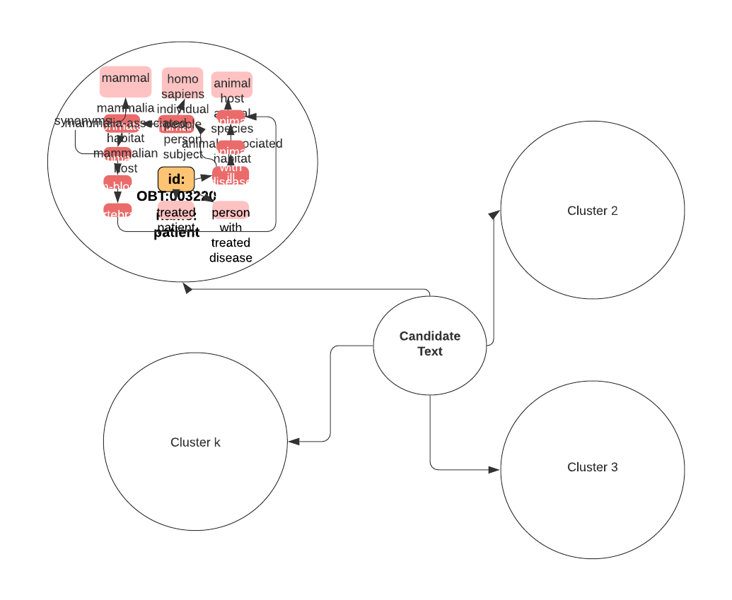
Ontology Library - Pronto
K-Means Clustering
Nearest cluster can be selected for candidate text.

Slide 17
Future Work
Researched Habitats Domain NER Papers List
Researched Biomedical Domain NER Papers List
Fused List
Ease in Implementation
Computational/Hardware Concerns
Relatedness to our goals

Slide 18
Paper 1 [1]
A smarter utilization of existing dictionaries
Brenda Tissue Ontology, 121321 habitat synonyms
E.g. the term “central nervous system” (OBT:000831) was expanded to include “hippocampus” and 2748 other terms
Problem with dictionary-based NER:
Prone to poor precision, especially after automatic dictionary expansion
Solution
Stopword lists are used to remove matches that contribute the most to the drop in precision
Criteria: removing those terms that were likely to not decrease true positive matches
E.g. unclassified, scales, root
Again, found existing dictionaries

Slide 19
Paper 2 [4]
Preprocessing
Acronym expansion: already done
Abbreviation expansion: already observed defect
Stemming: Porter stemmer [17] (we do not expect a better result [4])
Improving TDIDF, weighted sparse vector space representation
Each concept name in the ontology is considered a document and the IDF weights are based on these names
each concept name and each entity mention is represented with a TFIDF weighted vector and the concept with the highest cosine similarity is assigned for a given entity
Whereas these representations are commonly formed in a bag-of-words fashion
Using character-level n-grams (n=1,2,3 ) will probably result in better outcome [4]

Slide 20
Paper 3 [2]
Conditional Random Field (CRF) based classifier [2]
a type of discriminative and undirected probabilities graphical models often used for tagging sequential data and in named entity recognition in natural language processing and biology domains
Features for the CRF model
Lexical features such as current word, its root, its POS tag etc. GeniaTagger [16] may be used.
Orthographic features: substring and word form features
Substring features: first two & four characters and the last two & four characters of the original word and the word form are chosen as features
this was already mentioned in the lectures, using first k chars may work better than hard lemmatization
Word form features: case-folding and/or normalizing all numbers to ‘0’
Dictionary features: binary features to indicate
the presence of the word in the dictionary
the position of the word within any dictionary entries

Slide 21
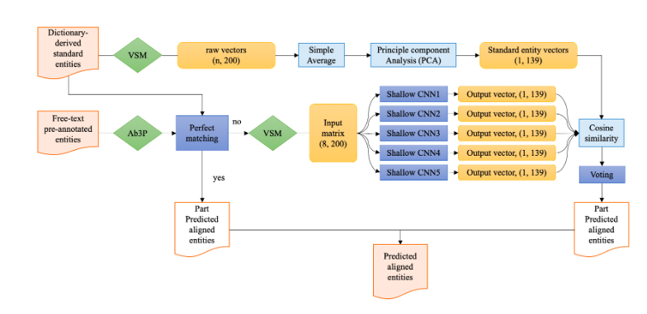
Idea 3
Authors originally used Mallet (a Java implementation)
We may change toolkit or implementation
For Python implementation (https://github.com/TurkuNLP/BHE) [3]
Or, Employing a hybrid (rule-based & ML based) structure such as
Figure 1: Model Architecture Overview [10]

Slide 22
Habitats Domain NE Normalization Papers
[1] A dictionary- and rule-based system for identification of bacteria and habitats in text
[2] Automatic extraction of microorganisms and their habitats from free text using text mining workflows
[3] Detection and categorization of bacteria habitats using shallow linguistic analysis
[4] End-to-End System for Bacteria Habitat Extraction
[5] Linking entities through an ontology using word embeddings and syntactic re-ranking

Slide 23
Biomedical Domain NE Normalization Papers
[6] A Survey on Recent Advances in Named Entity Recognition from Deep Learning models
[7] Normalizing biomedical terms by minimizing ambiguity and variability
[8] NERBio: using selected word conjunctions, term normalization, and global patterns to improve biomedical named entity recognition
[9] A method for named entity normalization in biomedical articles application to diseases and plants
[10] An ensemble CNN method for biomedical entity normalization
[11] CNN-based ranking for biomedical entity normalization
[12] DNorm disease name normalization with pairwise learning to rank
[13] OrganismTagger detection, normalization and grounding of organism entities in biomedical documents
[14] Unsupervised geneprotein named entity normalization using automatically extracted dictionaries
[15] A. K. McCallum. MALLET: A Machine Learning for Language Toolkit. http://mallet.cs.umass.edu, last accessed 08 July 2011.
[16] Tsuruoka, and J. Tsujii. Bidirectional Inference with the Easiest-First Strategy for Tagging Sequence Data. In Proceedings of HLT/EMNLP, 2005.
[17] Martin F Porter. 1980. An algorithm for suffix strip-ping.Program14(3):130–137.

Slide 24
Thanks

