Slide 1
Term Project Progress Presentation
Mansur YeşİLBursa
Abdullah Yıldız
Can Devecİ

Slide 2
Overview
Part 1: Pre-processing and Baseline, Mansur Yeşilbursa
Part 2: Performance Evaluations, Abdullah Yıldız
Part 3: Future Work, Can Deveci

Slide 3
Preprocessing
Dataset class
Processes .a1 and .a2 files in the given set (train, dev or test)
Stores Term number-Term name tuples and Term number-OBT tuples
Stores position of terms in the txt files
Creates a vocabulary if training set is given
Has access to Ontology
No case-folding

Slide 4
Baseline System
Exact Match
On Training Set
Searches training set to find exact entity match
If finds, retrieves OBT of the matched entity
Performance: 22% correct normalization on dev set
On Ontology
Searches Ontology file to find exact entity match
If finds, retrieves OBT of the matched entity
Improved performance by 11%
Performance: 33% correct normalization on dev set

Slide 5
Baseline System
Exact Match
Lemmatization
For given test entities, lemmatization is applied
If lemmatized entity is different than original entity
Searches for both terms in Training set and Ontology
Improved performance by 4%
Performance: 37% correct normalization in dev set
Abbreviation Resolution
Requires a comprehensive Biomedical Abbreviation Database
One that is used was messy and not comprehensive enough [1]
Didn’t improved performance for now

Slide 6
Baseline System
Cosine Similarity
Used if exact match fails
Measures cosine similarity of given entity with all entities in the Training set
Binary vectors of Training set vocabulary size
Improves performance by 10%
Performance: 47% correct normalization on dev set

Slide 7
Performance Problems
Input Term | Normalized Term | True Normalized Term
CD20-positive cells | phagocyte | lymphocyte
lymphocytic | nutrient broth | lymphocyte
B cells | phagocyte | lymphocyte
T cells | phagocyte | lymphocyte
lymphocytic | nutrient broth | lymphocyte
Predicts phagocyte instead of lymphocyte although input containts lymphocytic.
e.g. lymphocytic -> lymphocytic
Lemmatization could not lemmatize scientific terms
Cells -> phagocyte
..cytic -> nutrient broth

Slide 8
Performance Problems
Input Term | Normalized Term | True Normalized Term
patients with atypical lymphoid infiltrates | elderly person | patient
patients with low-grade MALT lymphoma | elderly person | patient
patients with Helicobacter pylori-chronic active gastritis | elderly person | patient with infectious disease
patients with high-grade primary gastric lymphoma | elderly person | patient
patients with chronic active gastritis | elderly person | patient
Predicts elderly person instead of patient
Associates certain words to certain entities

Slide 9
Performance Problems
Input Term | Normalized Term | True Normalized Term
placenta of a 38-year-old secondary recurrent aborter | experimental medium | placenta
38-year-old secondary recurrent aborter | experimental medium | pregnant woman
Lack of Part of Speech tagging
Lack of phrases

Slide 10
Ontology
There is an Ontology implementation in Python written by Martin Larralde
github.com/althonos
Given an .obo document
Creates the graph representation of Ontology Terms by implementing the specifications of the Open Biomedical Ontologies 1.4

Slide 11
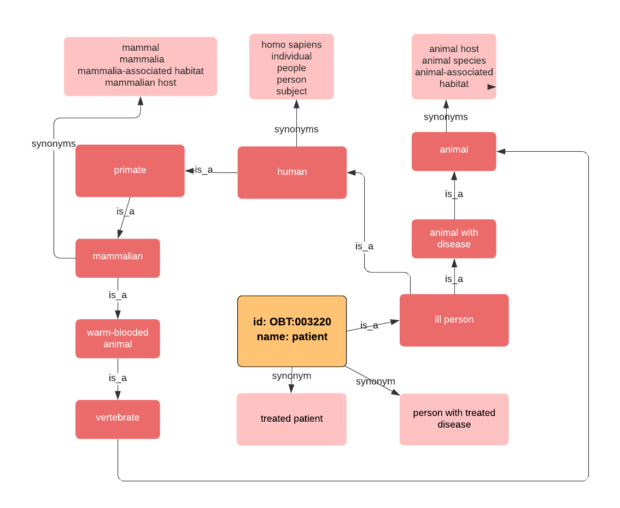
Ontology Library - Pronto
Starts from the Patient (OBT:003220 ) term
Whole graph can be induced by following is_a and synonym relationships
Pronto library has superclasses and subclasses functions to return relevant Ontology terms

Slide 12
Ontology Library - Pronto
Superclasses of ‘Patient’
'root for extraction’
'microbial habitat’
'living organism’
'eukaryote host’
'animal’
'animal with disease’
'vertebrate’
'warm-blooded animal’
'mammalian’
'primate’
'human’
'ill person'

Slide 13
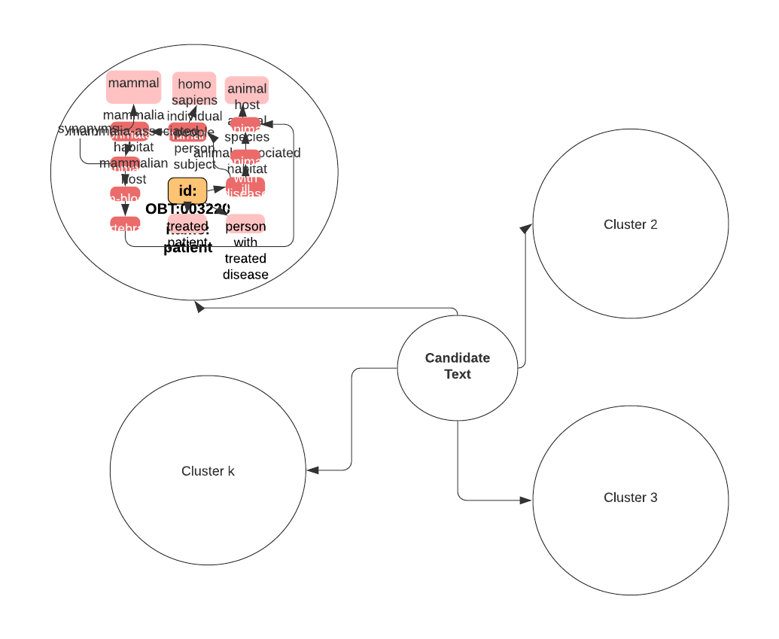
Ontology Library - Pronto
K-Means Clustering
Nearest cluster can be selected for candidate text.

Slide 14
Future Work
Bacteria Habitats Normalization Papers
Biomedical Named Entity Normalization Papers
4 implementable ideas

Slide 15
Expanding Dictionaries
Brenda Tissue Ontology (BTO)
121,321 habitat synonyms [1]
Prone to poor precision
Stop-word lists
2381 stop-words for bacteria
E.g. unclassified, scales, root

Slide 16
TF-IDF
Baseline TF-IDF
Habitat names -> a document
Represented habitat names a TF-IDF weighted vector
Select habitat name -> highest cosine similarity
Improving TF-IDF
BOW model -> character-level, n-grams [2]

Slide 17
CRF
Conditional Random Field
used for tagging sequential data especially in Named Entity Recognition in NLP [3]
3 types of features
Lexical features
current word, its root, its POS tag etc.
Orthographic features
Substring features
first n-characters & the last-n characters
already mentioned in classes
Word form features
case-folding
normalizing numbers to ‘0’
Dictionary features
presence & position of the word in the dictionary

Slide 18
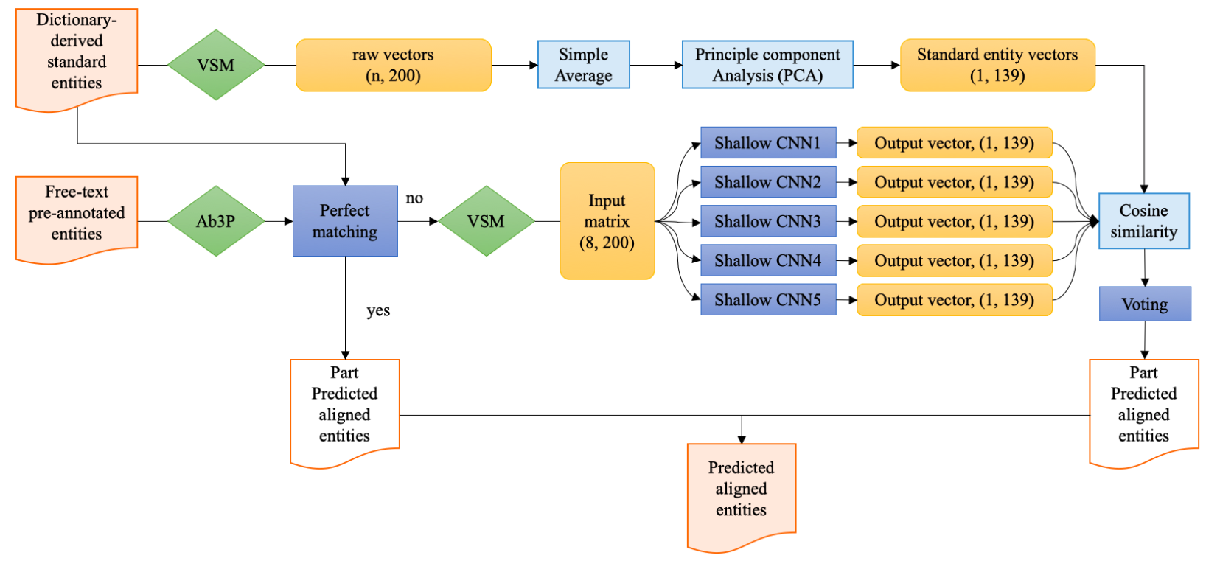
Hybrid Architecture
Hybrid (rule-based & ML) structure
Figure 1: Model Architecture Overview [4]

Slide 19
Our References
[1] A dictionary- and rule-based system for identification of bacteria and habitats in text
[2] End-to-End System for Bacteria Habitat Extraction
[3] Automatic extraction of microorganisms and their habitats from free text using text mining workflows
[4] An ensemble CNN method for biomedical entity normalization

Slide 20
Thanks

