Slide 1

AI BOOTCAMP CAPSTONE PROJECT
Group 2 Members Supervisor
Abdul Samad (EE) Dr. Awais Adnan
Abdullah Zunorain (EE)
Akif Fazal (EE)

Slide 2
TITLE
LLAMA 2-Based Automatic Blog Generation

Slide 3
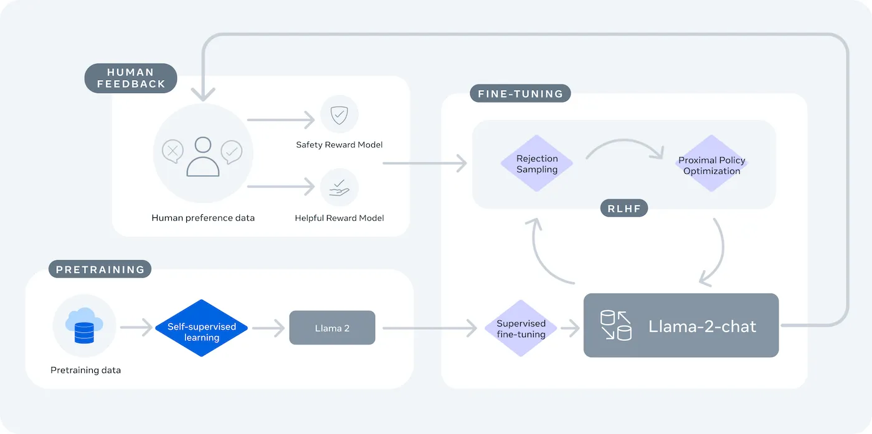
Introduction
Meta LLaMA2 is a state-of-the-art language model developed by Meta, designed to understand and generate human-like text.
Llama 2 models are trained on 2 trillion tokens and have double the context length of Llama1.

Slide 4
Problem Statement
Challenges in Content Creation
Writing blogs manually is time-consuming and requires creativity and knowledge.
Consistency in tone, style, and quality can be difficult to maintain over time.
Need for Automation
Automating blog generation can help content creators, marketers, and businesses scale their content production efficiently.

Slide 5
Objectives
Automate blog generation using the LLaMA2 model to save time.
Ensure consistent tone, style, and quality in generated content.
Help businesses and creators scale content production efficiently.
Enable high-quality blogs on diverse topics with minimal effort.

Slide 6
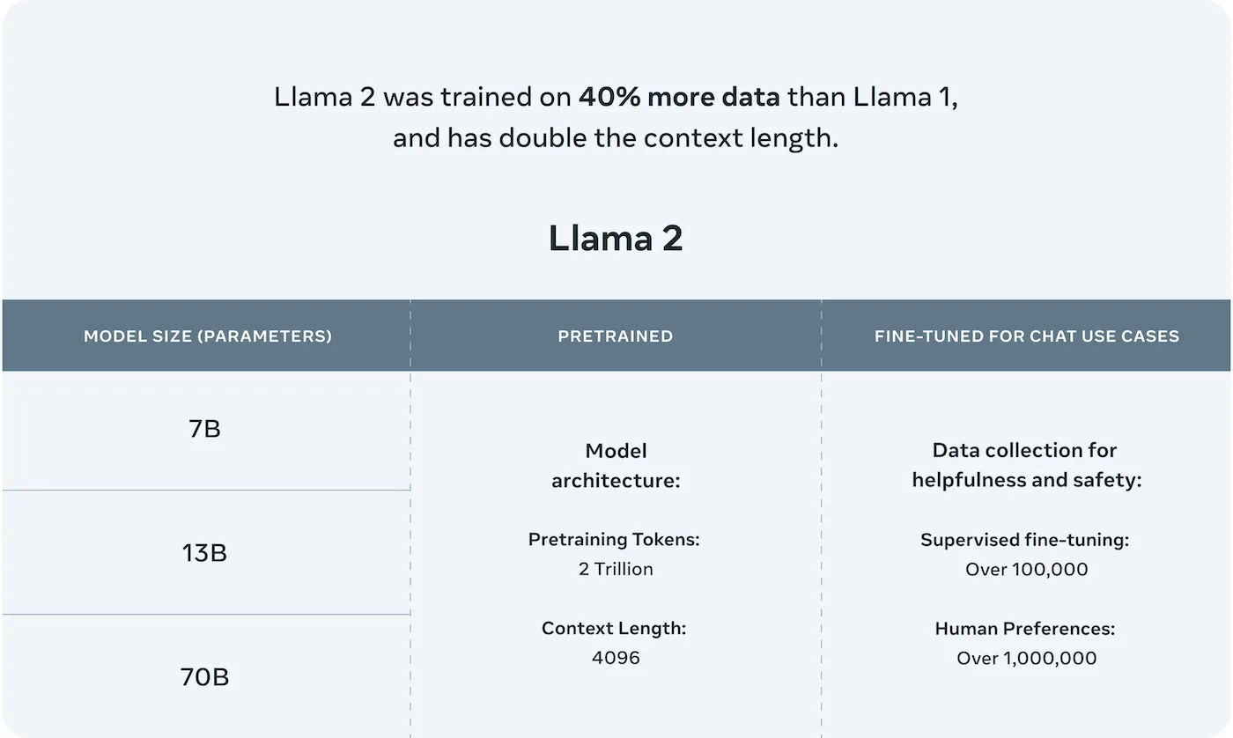
Literature Review
We did an Extensive literature review including the llama2 main paper.

Slide 7
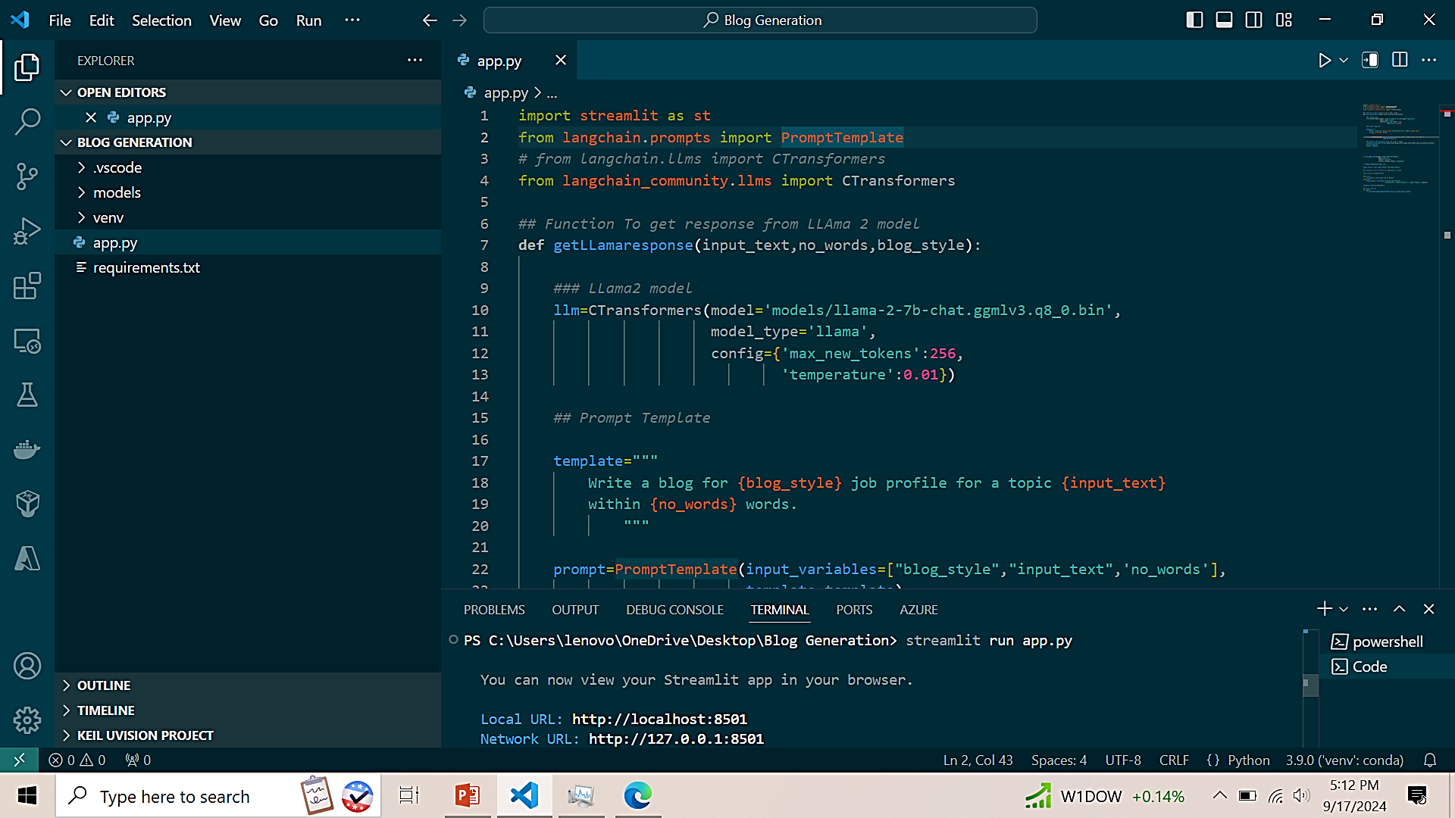
Methodology
Model Setup:
Downloaded and configured the LLaMA2 model locally using CTransformers with specific settings for token generation and temperature.
Code Implementation:
Developed a Python script using Streamlit, transformers, LangChain and other necessary libraries to create a web application for blog generation. The script includes:
A function getLLamaresponse that generates blog content based on input parameters (topic, word count, and blog style) using the LLaMA2 model.
A prompt template that structures the input for the model to produce coherent and relevant blog posts.

Slide 8
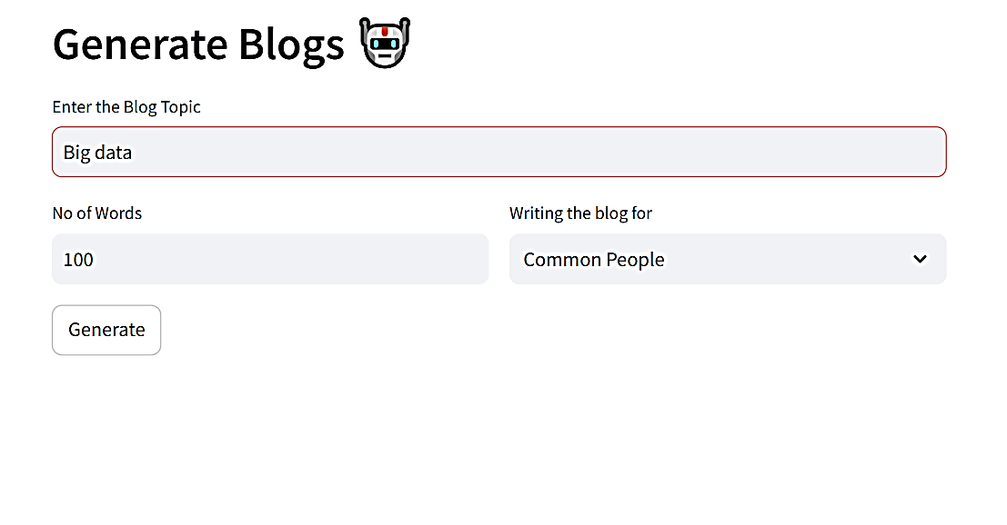
Methodology
Web Interface:
Set up a Streamlit application with:
Input fields for blog topic, word count, and blog style.
A button to trigger the blog generation and display the output.
Execution:
The model generates blog content in response to user inputs, which is then displayed in the Streamlit app as shown below.

Slide 9
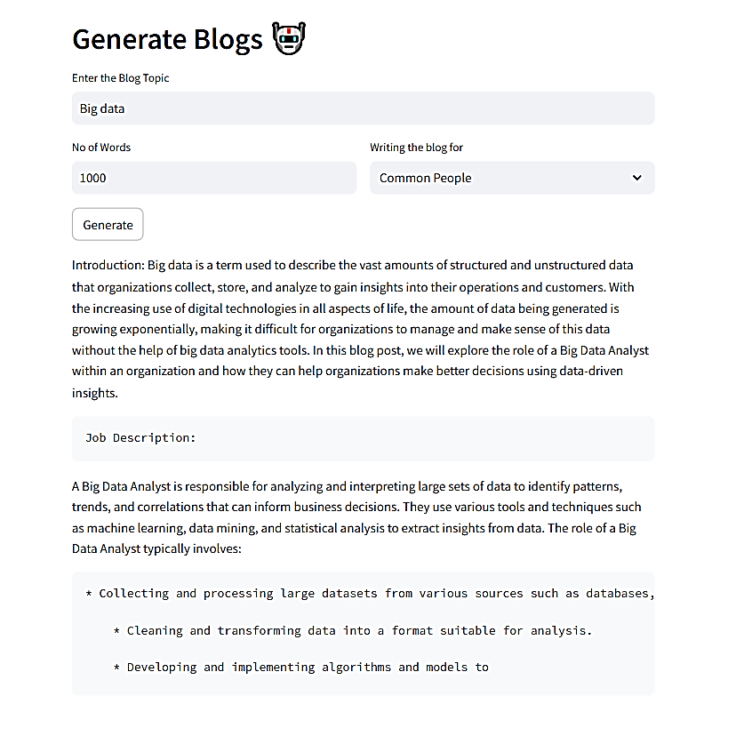
Results

Slide 10
Limitations
We are running the model locally without GPU support, resulting in longer response times.
The performance is limited by the local hardware, affecting the efficiency of blog generation.
Utilizing a GPU would enhance processing speed and reduce the time required for generating responses.
10
10

Slide 11
THANK YOU
LOOKING FORWARD FOR YOUR ADVICE AND SUGGESTION

